Slide 1
Introduction
International Finance:
Fundamentals of Multinational Finance

Slide 2
各位同学请注意：
受疫情影响，我们教学方式有较大改变，为了保证完成教学大纲，自修的任务很重，请大家振奋精神每天完成老师布置的任务。
Copyright © 2009 Pearson Prentice Hall. All rights reserved.
1-*

Slide 3
Outline
International Finance国际金融
Modern financial system现代金融系统
Textbook课本
Examing考试
Group studying and grade小组学习和分数
About bilingual teaching and studying关于双语教学
Survey and Questions 调查和问题
Copyright © 2009 Pearson Prentice Hall. All rights reserved.
1-*

Slide 4
International Finance
International finance is the branch of economics.
International Finance studies the money, capital, financing, and credit crossing the national boundaries, can be called multinational finance.
Multinational Finance is about international financial management with special emphasis on the multinational enterprise(MNE).
International financial management is among international financial environment.
Copyright © 2009 Pearson Prentice Hall. All rights reserved.
1-*

Slide 5
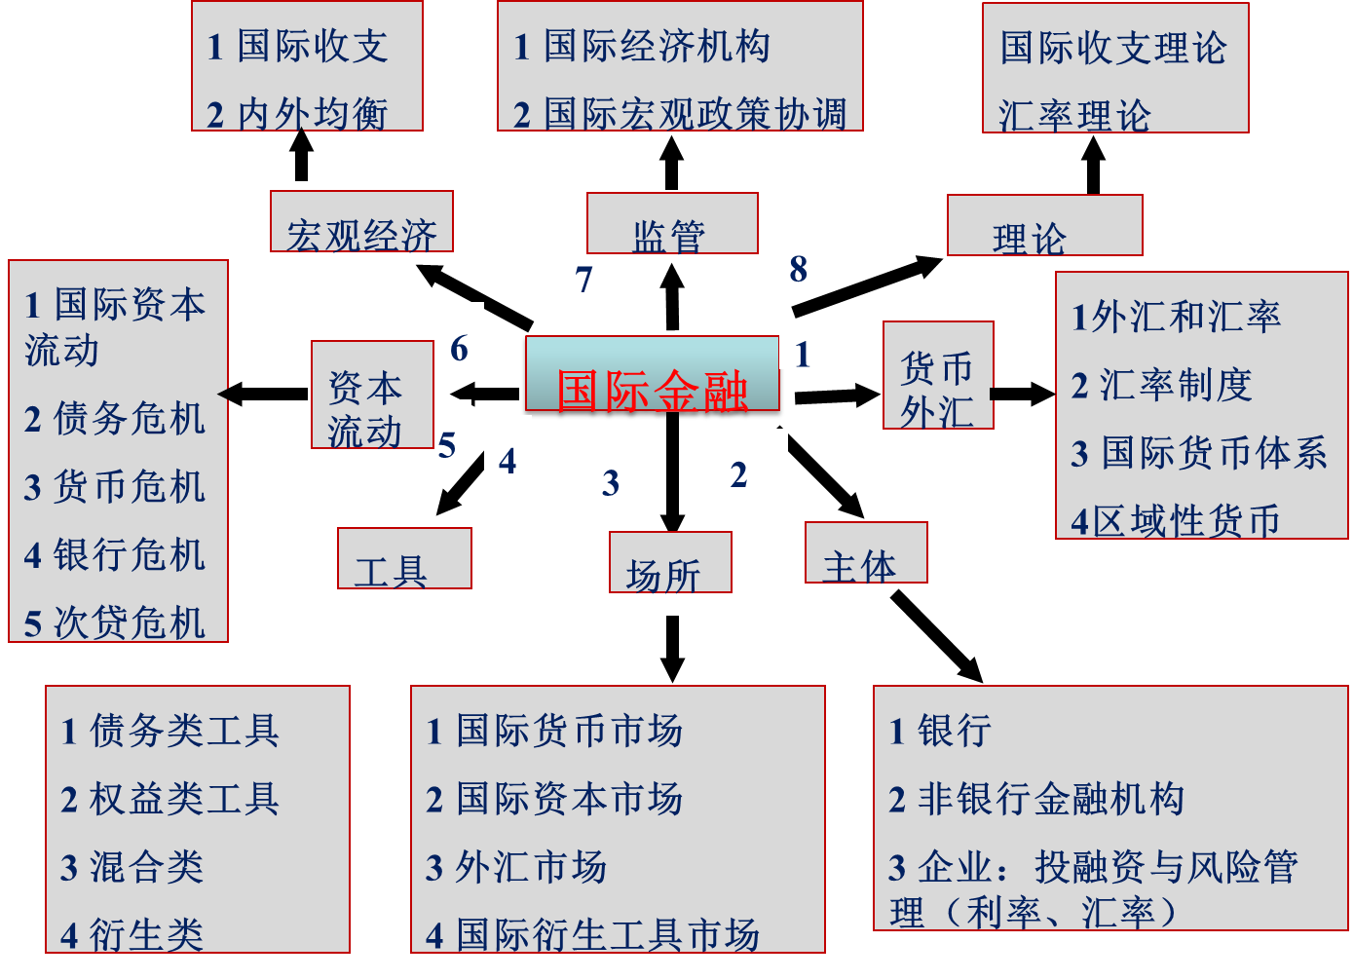
国际金融课程内容
Copyright © 2009 Pearson Prentice Hall. All rights reserved.
1-*

Slide 6
Modern financial system
Components:
  Circulation of money；
  Financial institutions
  Financial markets
  Financial instruments
  System and control mechanism
Copyright © 2009 Pearson Prentice Hall. All rights reserved.
1-*

Slide 7
Modern financial system
Financial institutions
  Bank
  Non-bank
Financial markets
  Capital market、money market、foreign exchange market、insurance market、derivative instrument markets.
  place
Copyright © 2009 Pearson Prentice Hall. All rights reserved.
1-*

Slide 8
国际金融课程内容
1 国际收支
2 内外均衡
1 国际经济机构
2 国际宏观政策协调
国际收支理论
汇率理论
监管
8
宏观经济
1 国际资本流动
2 债务危机
3 货币危机
4银行危机
5 次贷危机
7
1外汇和汇率
2 汇率制度
3 国际货币体系
4区域性货币
6
1
国际金融
货币
外汇
资本流动
5
4
3
2
工具
场所
主体
1 债务类工具
2 权益类工具
3 混合类
4 衍生类
1 国际货币市场
2 国际资本市场
3 外汇市场
4 国际衍生工具市场
1 银行
2 非银行金融机构
3 企业：融资决策、投资决策、风险管理（利率、汇率）
Copyright © 2009 Pearson Prentice Hall. All rights reserved.
1-*

Slide 9
Contents of the text
Part1: Global Financial Environment
Part2: Foreign Exchange Theory
Part3: Foreign Exchange Exposure
Part4: Financing The Global Firm
Part5: International Investment Decisions
Part6: Managing Multinational Operations
Copyright © 2009 Pearson Prentice Hall. All rights reserved.
1-*

Slide 10
Part1: Global Financial Environment
Chapter 1 Globalization and the Multinational Enterprise
Chapter 2 Financial Goals and Corporate Governance
Chapter 3 The International Monetary System
Chapter 4 The Balance of Payments
Chapter 5 The Foreign Exchange Market
Copyright © 2009 Pearson Prentice Hall. All rights reserved.
1-*

Slide 11
Part2: Foreign Exchange Theory
Chapter 6 International Parity Conditions
Chapter 7 Foreign Exchange Rate Determination and Forecasting
Chapter 8 Foreign Currency Derivatives
Copyright © 2009 Pearson Prentice Hall. All rights reserved.
1-*

Slide 12
Part3: Foreign Exchange Exposure
Chapter 9 Transaction Exposure
（Chapter 10 Operating Exposure ）
（Chapter 11 Translation Exposure ）
Chapter 15 Interest Rate and Currency Swaps
Copyright © 2009 Pearson Prentice Hall. All rights reserved.
1-*

Slide 13
Key items learning this semester
Basic principles of international finance
  Basic laws of movement of money and capital
  Meaning of a lot of financial terminology
  Understand the international monetary system and international financial institutions.
Copyright © 2009 Pearson Prentice Hall. All rights reserved.
1-*

Slide 14
Explain various financial and economic phenomena using the basic principles and methods.
Know how to manage various risks a MNE in international operation.
Copyright © 2009 Pearson Prentice Hall. All rights reserved.
1-*

Slide 15
Examining
Normal Scores:
Homework, discussion and questions, attendance 30%
several class tests 40%
Final exam 30%
All questions and problems are in English
  Answers can be in Chinese and English
Copyright © 2009 Pearson Prentice Hall. All rights reserved.
1-*

Slide 16
Requirement on studying
Attitude to the course learning:
grade A and B
30 marks in normal scores, comment on:
attention on class (5)
Questions and discussion，etc (10)
Doing homework (15)
Copyright © 2009 Pearson Prentice Hall. All rights reserved.
1-*

Slide 17
Textbook
Fundamentals of Multinational Finance(3e)
- Michael H. Moffett
- Arthur I. Stonehill
- David K. Eiteman
China Machine Press
Copyright © 2009 Pearson Prentice Hall. All rights reserved.
1-*

Slide 18
Reference books
International Financial Management (6e)
  (U.S) Cheol S. Eun,
  (U.S) Bruce G. Resnick
  China Machine Press
Copyright © 2009 Pearson Prentice Hall. All rights reserved.
1-*

Slide 19
Reference books
International Finance (2 edition)
  Ephraim Clark
  Peking University Press
International Finance
  James C. Baker
  Higher Education Press
International Financial Management (7e)
  Jeff Madura
  Peking University Press
Copyright © 2009 Pearson Prentice Hall. All rights reserved.
1-*

Slide 20
Reference books
《国际金融新编》 （第三版）
  姜波克 著 复旦大学出版社
《国际经济学》
  克鲁格曼、奥伯斯法尔德著 中国人民大学出版社
《国际金融》
  易纲、海闻 上海人民出版社；
《金融工程》，
  [美]约翰.马歇尔，清华大学出版社
《国际货币与金融》
  [美]迈克尔.梅尔文，中译本，上海三联书店
Copyright © 2009 Pearson Prentice Hall. All rights reserved.
1-*

Slide 21
Journals
Wall street journal
The Financial Times
Journal of International Money and Finance
Journal of Multinational Financial Management
《经济研究》
《金融研究》
《国际金融研究》
《世界经济》
Copyright © 2009 Pearson Prentice Hall. All rights reserved.
1-*

Slide 22
Web Pages
1.Institutes and companies:
IMF，International Monetary Fund
The world Bank
OECD，Organization for Economic Cooperation and Development
PBC, The people’s bank of China http://www.pbc.gov.cn/publish/english/963/index.html
China International Capital Corporation Limited (中国国际金融有限公司，中金公司，CICC) http://www.cicc.com.cn/index_cn.xhtml?locale=zh_CN
2. Marketplaces:
CME, Chicago Mercantile Exchange
ICE, InterContinentalExchange http://ir.theice.com/investors-and-media/press/press-releases/press-release-details/2014/IntercontinentalExchange-Completes-Acquisition-of-Singapore-Mercantile-Exchange/default.aspx
Copyright © 2009 Pearson Prentice Hall. All rights reserved.
1-*

Slide 23
Survey about students’ thinking about your life
Greg Smith, “Why I Am Leaving Goldman Sachs,” New York Times, March 14, 2012 (Chinese, English edition)
A simple introduction about yourself and what’s your characteristics or aspects you like best? Hometown, high school, age etc.
Can you comment on your current situation in a word?
What’s your dream in your life?
Is there something happened in your life you are proud of yourself for it?
If you like you can write down your name and student’s number on upper left corner. : )
1-*
Copyright © 2009 Pearson Prentice Hall. All rights reserved.

Slide 24
Any Questions?
Copyright © 2009 Pearson Prentice Hall. All rights reserved.
1-*

