Slide 1
Lecture 10
All-Pairs Shortest Paths
Continued
Johnson’s algorithm

Slide 2

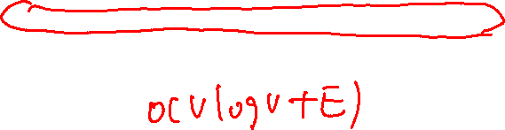
Johnson’s algorithm
(idea)
If { all edge weights are non-negative }
Invoke Dijkstra’s algorithm V times,
else if { there are negative weight edges but no negative weight cycles }
Reweight graph so that
      all edge weights are non-negative, and that
      shortest path does not change after reweighting
Invoke Dijkstra’s algorithm for each vertex as
source.
* Time Complexity: O(V²logV+VE) //using Fibonacci heap
* If G is sparse, better than Floyd-Warshall

Slide 3

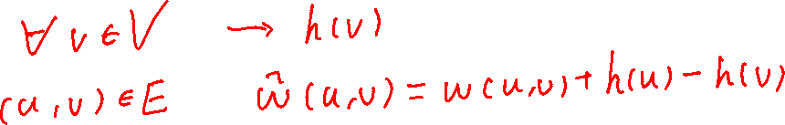
Reweighting Technique (I)
  Lemma 25.1 (reweighting does not change shortest paths):
  Given a weighted, directed graph G=(V,E) with weight function w. Let h:V→R be any function. For each edge (u,v)∈E, define
  ŵ(u,v) = w(u,v) + h(u) - h(v)
  Let p=<v₀,…,v_{k}> be any path from v₀ to v_{k}. Then p is a shortest path using weight function w if and only if it is a shortest path using weight function ŵ. That is w(p)=δ(v₀,v_{k}) if and only of ŵ(p)= (v₀,v_{k}) . Also, G has a negative-weight cycle with w if and only if G has a negative-weight cycle with ŵ.

Slide 4
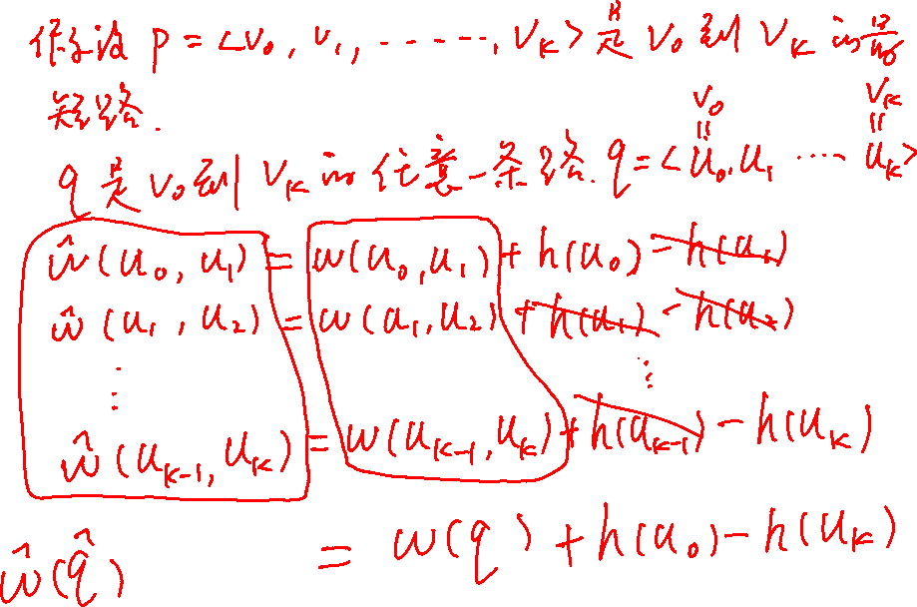

Slide 5
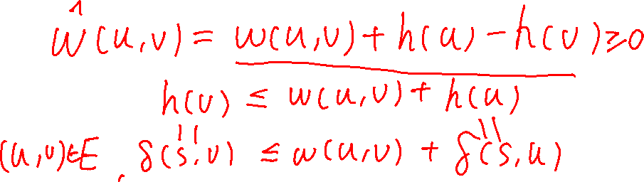
Proof
Proof: 1. For any path p from v₀ to v_{k}, we have
ŵ(p)=w(p)+h(v₀)-h(v_{k}),
so, p* is shortest with w if and only if it is shortest with ŵ.
2. Consider any cycle C=<v₀,…,v_{k}>, we have
ŵ(C) = w(C)+h(v₀)-h(v₀) = w(C),
G has a negative cycle with w if and only if it has a negative cycle with ŵ.

Slide 6
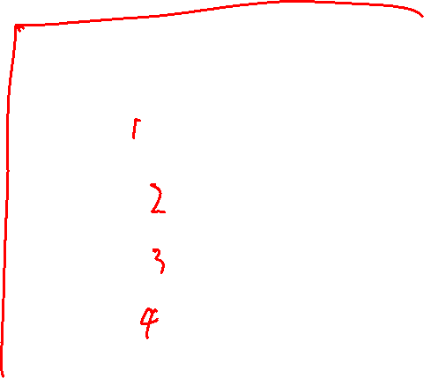
Reweighting Technique (II)
Producing nonnegative weights by reweighting
Given a weighted, directed graph G = (V, E) with w, we make a new graph G’ = (V’,E’), where V’ = V∪{s}, s is not in V, and E’ = E∪{(s,v) : v is in V}. w(s,v) is set to 0, for all v in V.
0
10
-5
10
-5
4
4
8
0
8
-6
-6
s
0
7
9
7
9
0
2
2
0

Slide 7
Reweighting Technique (III)
Producing nonnegative weights by reweighting
Suppose that G and G’ have no negative weight cycle. Define h(v) = δ(s,v) for all v in V’. By the triangle inequality (Lemma 24.10), we have h(v) <= h(u) + w(u,v) for all edges (u,v) in E’. Thus, we have
ŵ(u,v) = w(u,v) + h(u) – h(v) >= 0

Slide 8


Critical Steps
How to compute δ(s,v)?
  Bellman-Ford algorithm.
  Do you remember?
How to compute all (u,v)?
  Run Dijkstra algorithm |V| times.
  δ(u,v)= (u,v)+h(v)-h(u)

Slide 9
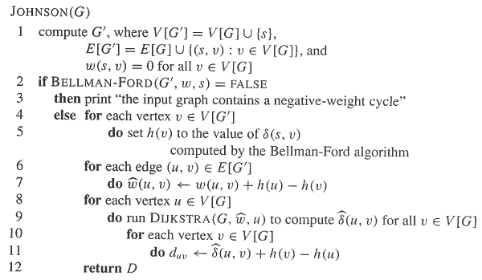
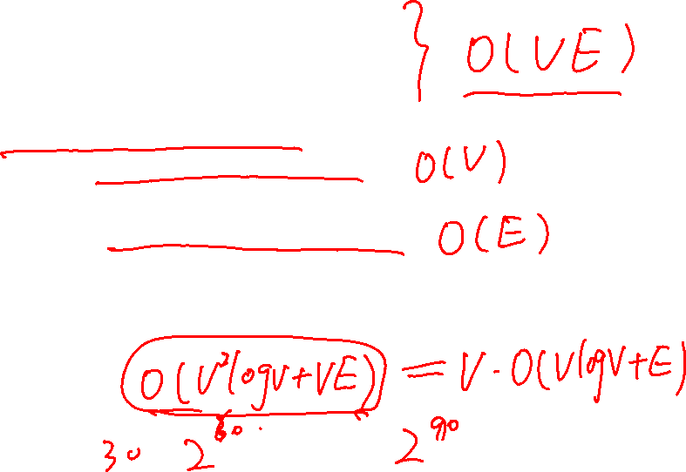
Johnson’s algorithm

Slide 10
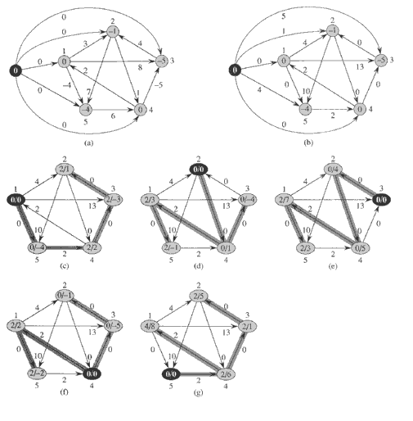
Johnson’s (example)

Slide 11
Johnson’s algorithm
Time complexity:
Compute G’: O(V)
Bellman-Ford: O(VE)
Re-weighting: O(E)
Dijkastra’s: O(VlgV+E)
Total: O(V²logV+VE)
If G is sparse, e.g., E=O(V), then better than Floyd-Warshall.

Slide 12
All-pairs shortest paths problem algorithm comparison
algorithm | running time
Dijkstra‘s | O(n2 log n+nm)
Bellman-Ford | O(n2 m)
matrix multiplication | O(n4)
improved matrix mult. | O(n3 log n)
Floyd-Warshall Transitive closure | O(n3)
Johnson‘s | O(n2 log n+nm)

Slide 13
Homework
25.3-4

