Slide 1
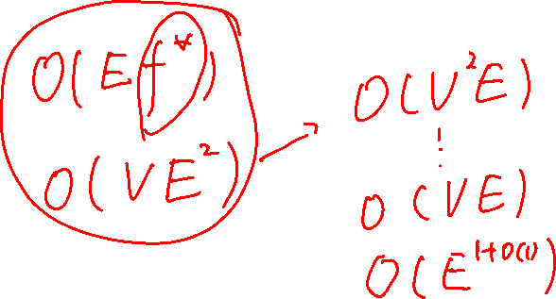
Lecture 11
Maximum Flow Problem
The Ford-Fulkerson method

Slide 2

Maximum flow
Liquids flow through pipes
Current through electrical networks
Information through communication networks
… …

Slide 3

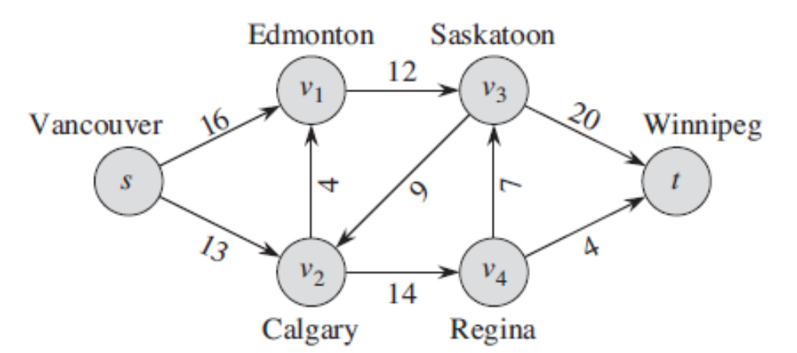
Flow Networks
A flow network G=(V,E) is a directed graph, where each edge (u,v)∈E has a nonnegative capacity c(u,v)>=0.
If (u,v)∉E, we assume that c(u,v)=0.
Requirement： if (u,v)∈E, then (v,u)∉E
two distinct vertices : source s and sink t.

Slide 4
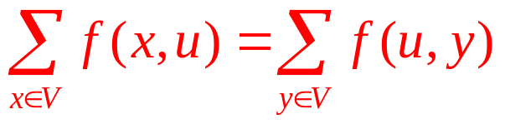
Flow
Given a flow network G=(V,E) with capacity function c. Let s be the source and t the sink.
A flow in G is a real-valued function f: V×V → R satisfying the following three properties:
Capacity constraint: For all u,v ∈V, 0≤ f(u,v) ≤ c( u,v).
If (u,v)∉E, f(u,v)=0
Flow conservation: For all u ∈V-{s,t},
^{u}

Slide 5
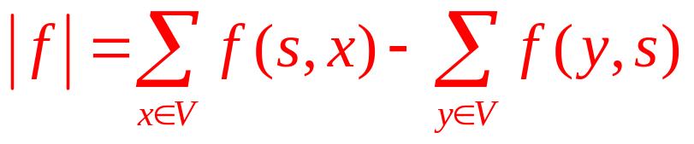
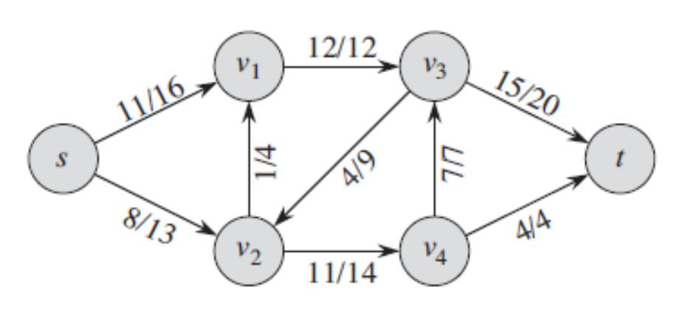
Value of a Flow
The value of a flow is defined as
The total flow out of the source minus the flow into the source.

Slide 6

Maximum-flow Problem
Input: a flow network G with capacity function c, source s and sink t
Output: a flow of maximum value
How to solve it efficiently?

Slide 7
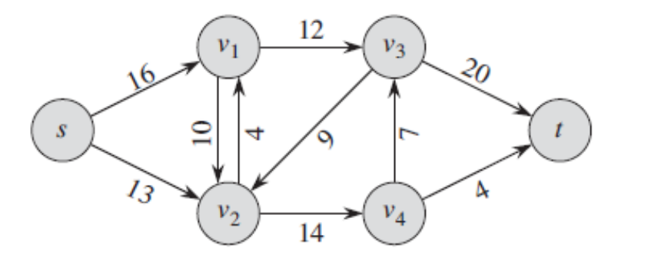
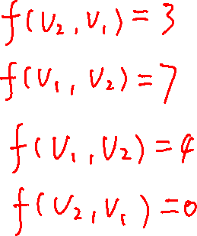
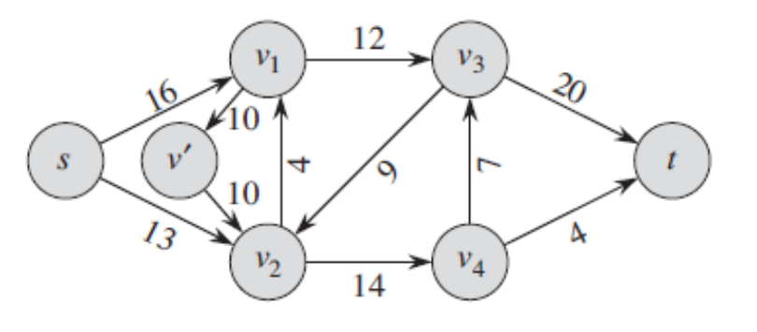
An example
We can assume that there is no pair of mutually reverse edges in the flow network.

Slide 8
Explore the Properties
Capacity constraint: Flow must not exceed capacity.
Flow-conservation: total flow out of ( or into) a vertex is 0.
  For all v∈V-{s,t}, “flow in equals flow out”
(u,v)∉E and (v,u) ∉E, f(u,v)=f(v,u)=0.

Slide 9
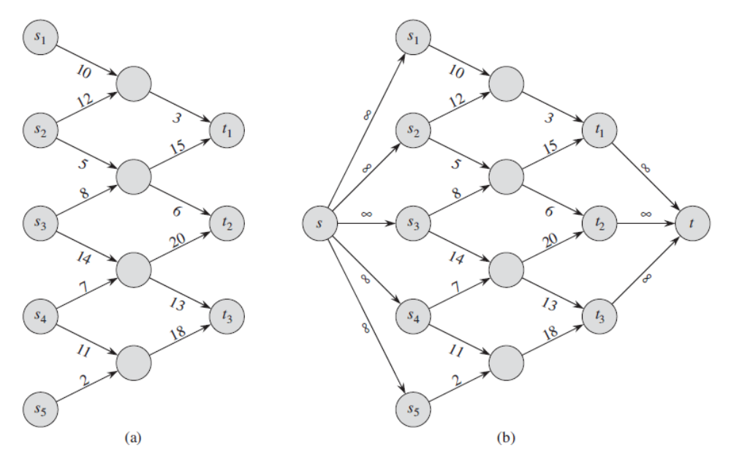
Networks with multiple sources and sinks

Slide 10
The Ford-Fulkerson Method
Why call it a “method” rather than an “algorithm”?
Because it encompasses several implementations with different running times.
The Ford-Fulkerson method depends on three important ideas:
residual networks, augmenting paths, and cuts.
These ideas are essential to the important max-flow min-cut theorem, which characterizes the value of maximum flow in terms of cuts of the flow network.

Slide 11
The Ford-Fulkerson Method
FORD-FULKERSON-METHOD(G,s,t)
  initialize flow f to 0
  while there exists an augmenting path p
  do augment flow f along p
  return f

Slide 13
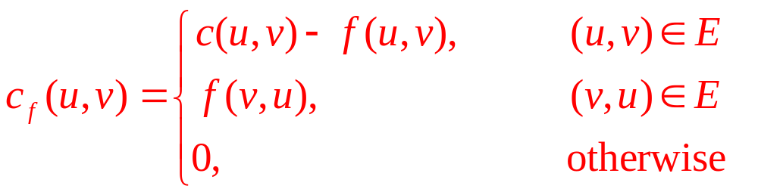
Residual Networks
Given a flow network and a flow, the residual network consists of edges that can admit more flow.
More formally, given:
G=(V,E) --a flow network with source s and sink t
f: a flow in G.
The amount of additional flow can be pushed form u to v before exceeding the capacity c(u,v) is the residual capacity of (u,v), given by:
Residual network: G_{f} = (V,E_{f}), where
E_{f} ={(u,v) ∈V×V: c_{f}(u,v) > 0}: residual edge.

Slide 14
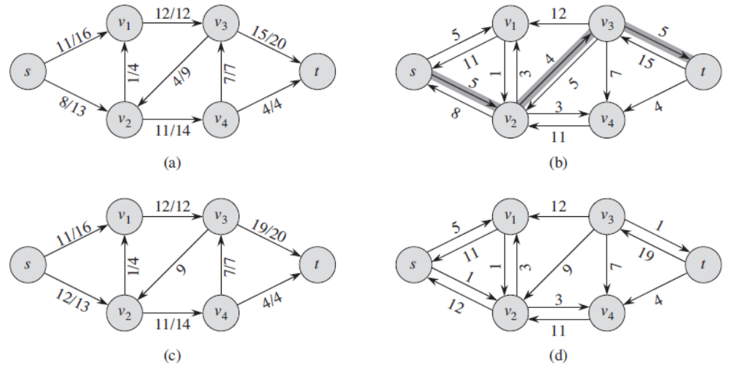
Residual Networks (example)

Slide 15
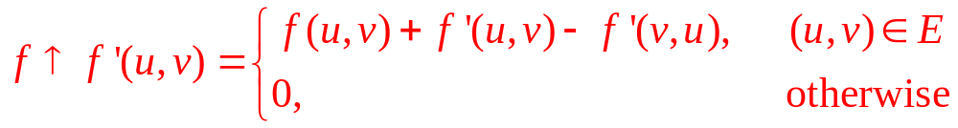
Augmentation and Cancellation
Given a flow network G=(V,E), if f is a flow in G and f’ is a flow in the corresponding residual network G_{f} ,
f ↑f’, the augmentation of flow f by f’ , is a function from V×V to R, defined by

Slide 16
The relationship between a flow in a residual network and one in the original network
Lemma 26.1
Let G=(V,E) be a flow network with source s and sink t ,and let f be a flow in G. Let G_{f} be the residual network of G induced by f, and let f’ be a flow in G_{f} .Then the function f ↑f’ is a flow in G with value ⎜f ↑f’⎟=⎜f⎟+⎜f’⎟.

Slide 17
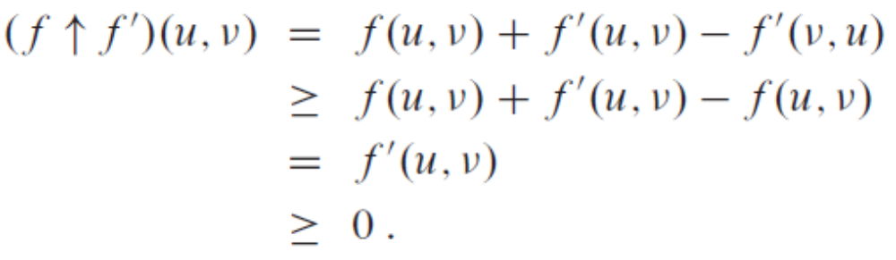
Proof of Lemma 26.1
Verify that f ↑f’ obeys the capacity constraint for each edge in E and flow conservation at each vertex in V-{s, t}.
Nonnegative.
For the capacity constraint, first observe that if (u, v) ∈E, then c_{f}(v,u)=f(u,v)
Therefore, f’(v,u)≤c_{f}(v,u)= f(u,v)
Hence,

Slide 18
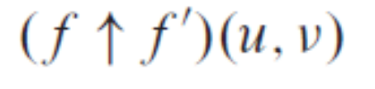
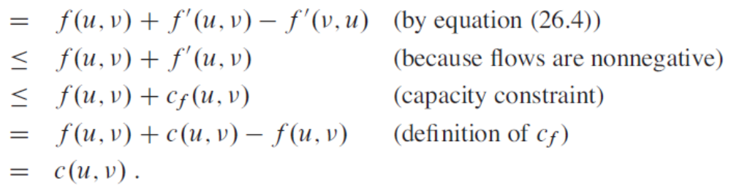
Proof continued
capacity constraint

Slide 19
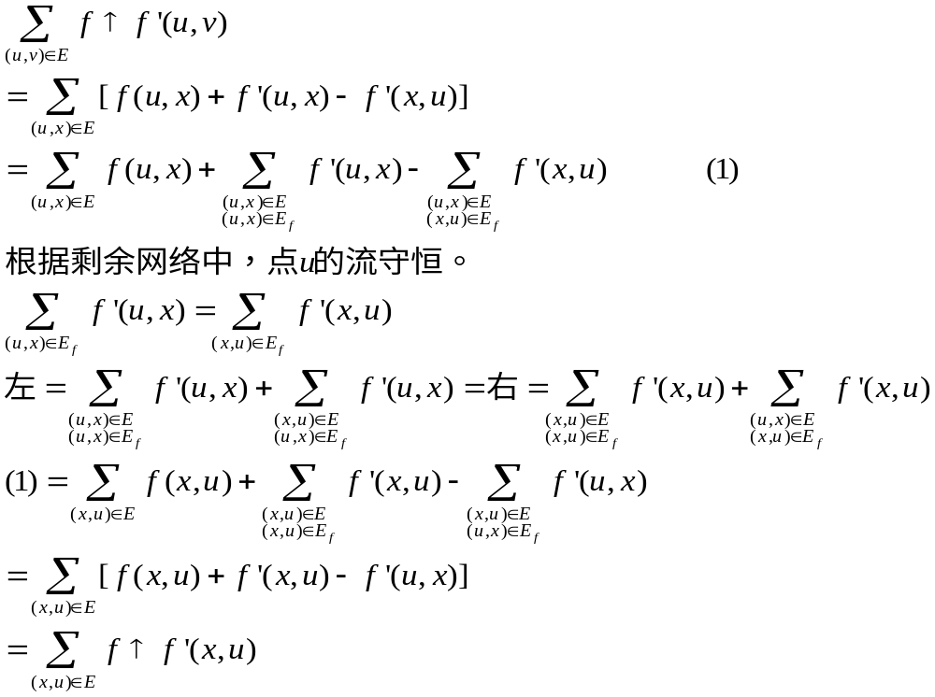
Proof continued
flow conservation, for all u∈V-{s, t}

Slide 20
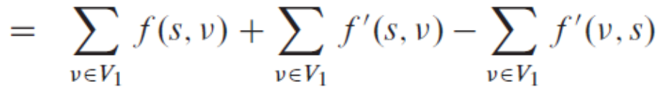
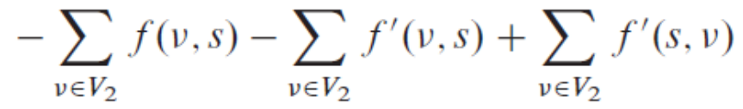
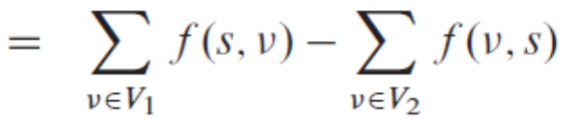
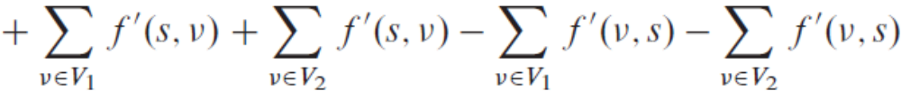
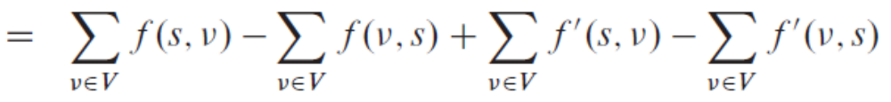

Proof continued
⎜f ↑f’⎟=⎜f⎟+⎜f’⎟ V₁: each of these vertices has an edge to s.
V₂: s has an edge to each of these vertices.
⎜f ↑f’⎟

Slide 21
Augmenting paths
Given a flow network G=(V,E) and a flow f, an augmenting path is a simple path from s to t in the residual network G_{f}
Residual capacity of p : the maximum amount of flow that we can ship along the edges of an augmenting path p, i.e.,
c_{f}(p) = min { c_{f}(u,v): (u,v) is on p}.
2
3
1
The residual capacity is 1.

Slide 22
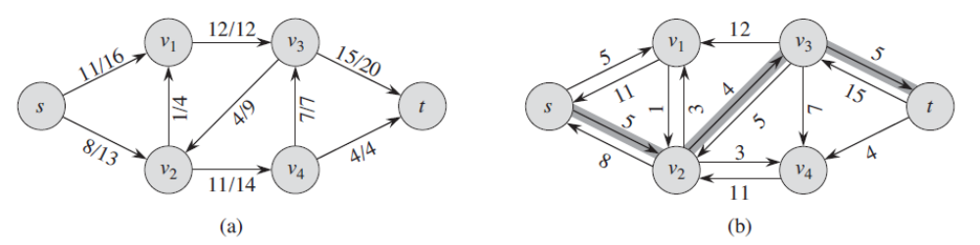
Augmenting Path (example)

Slide 23
Augmenting Path
Lemma 26.2
Let G=(V,E) be a flow network, Let f be a flow in G, and
let p be an augmenting path in G_{f} .Let f_{p} :V×V→R by
c_{f}(p) if (u,v) is on p
f_{p} (u,v) =
0 otherwose.
Then f_{p} is a flow in G_{f} with value |f_{p}|=c_{f}(p)>0.

Slide 24
Augmenting Path
Corollary 26.3
Let G=(V,E) be a flow network, Let f be a flow G, and let p be an augmenting path in G_{f} .Let f_{p} be defined as in equation (26.8). Define a function f’=f↑f_{p} .Then f’ is a flow in G with value |f’|=|f|+|f_{p}|>|f|.

Slide 25
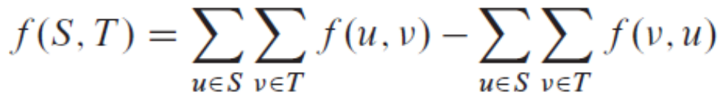
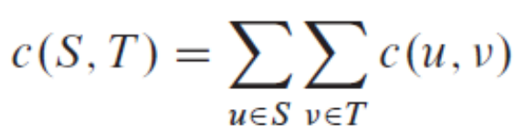
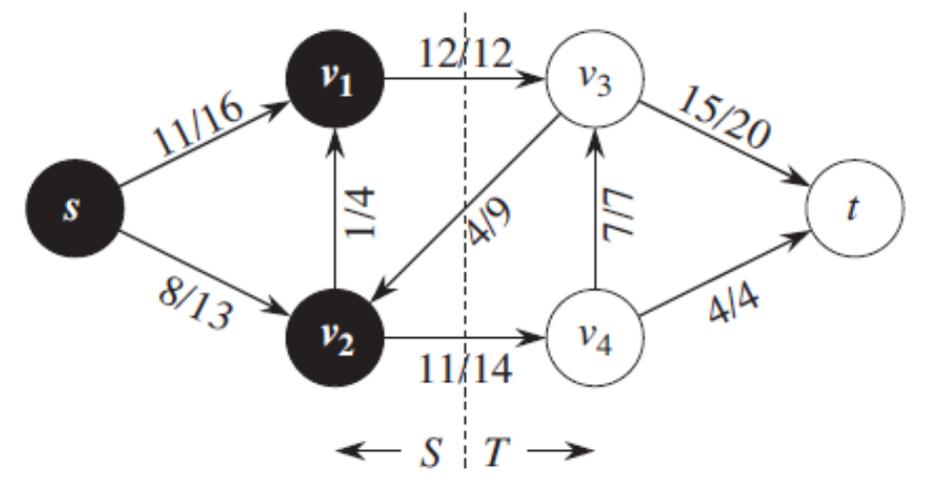
Cut
Cut (S, T): S is a subset of V, T =V-S, s∈S and t∈T.
Net flow across the cut (S,T): f(S,T)
Capacity of the cut (S,T): c(S,T)
Minimum cut of a network: a cut with minimum capacity.

Slide 26
Cut
Lemma 26.4
Let f be a flow in a flow network G with source s and sink t , and let (S,T) be a cut of G. Then the net flow across (S,T) is f(S,T)= |f|.

Slide 27
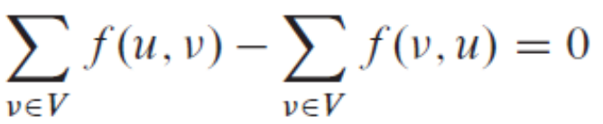
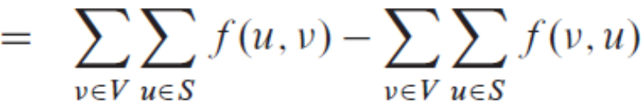
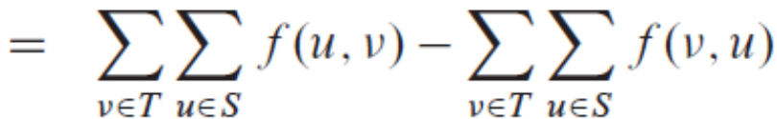
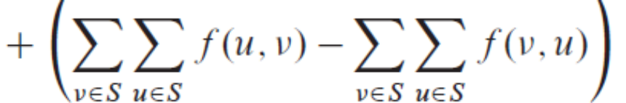

Proof of lemma 26.4
For all u∈V-{s, t},

Slide 28
Cut
Corollary 26.5
The value of any flow f in a flow network G is bounded from above by the capacity of any cut of G.
Proof
  Let (S,T) be any cut of G and let f be any flow. By Lemma 26.4 and capacity constraints,

Slide 29
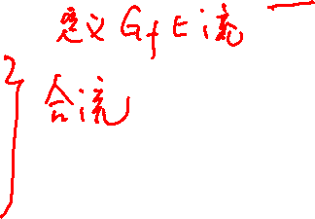
The Basic Ford-Fulkerson Algorithm
Ford-Fulkerson(G,s,t)
  For each edge (u, v)∈E
  do f[u,v]←0
  While there exists a path p from s to t in the residual network G_{f}
  c_{f}(p) ← min{c_{f}(u,v): (u,v) is in p}
  for each edge (u,v) in p
  if (u,v)∈E
  f[u,v]← f[u,v]+ c_{f}(p)
  else
  f[v,u]← f[v,u]- c_{f}(p)

Slide 30
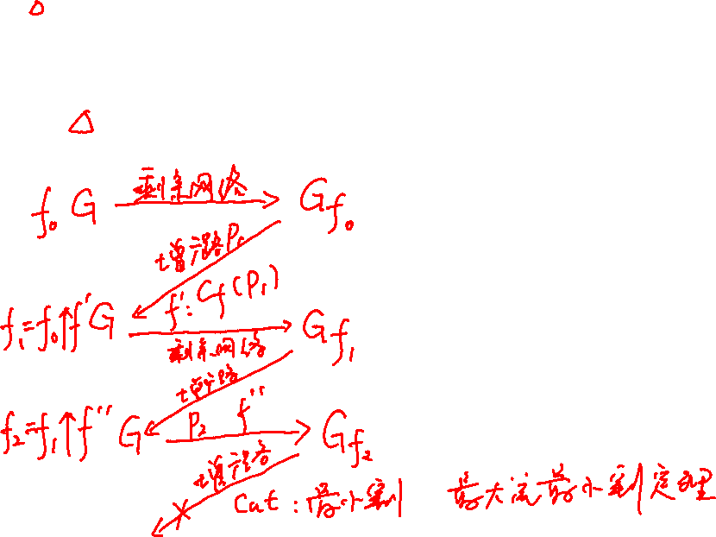
c_{f}(p) if (u,v) is on p
f_{p} (u,v) =
0 otherwise.

Slide 31
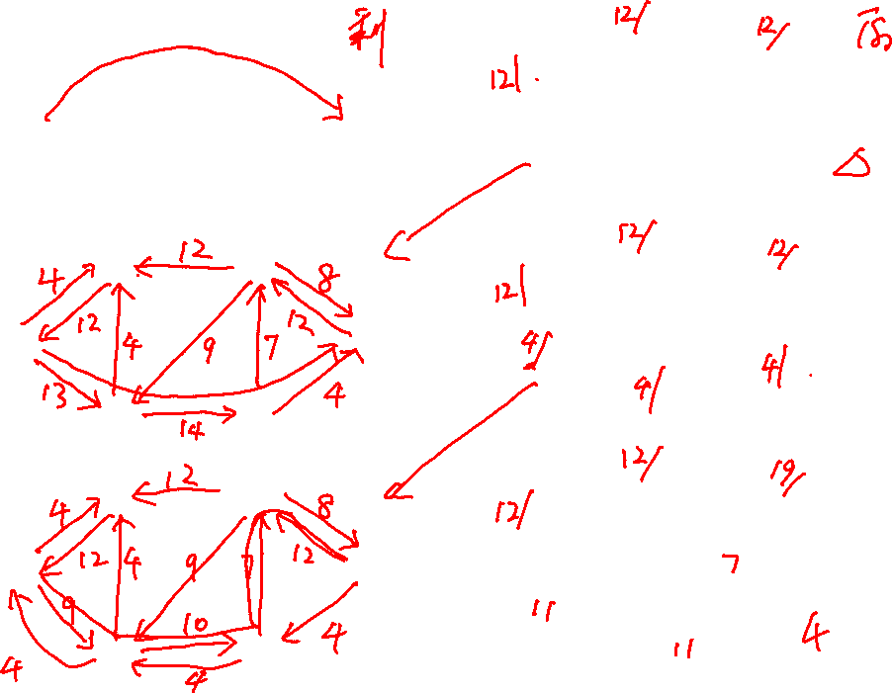
¹²
¹²
^{v1}
^{v3}
^{v1}
^{v3}
²⁰
²⁰
¹⁶
¹⁶
⁴
^{t}
⁴
⁷
^{t}
^{s}
⁹
⁷
^{s}
⁹
¹³
⁴
¹³
⁴
¹⁴
^{v2}
¹⁴
^{v4}
^{v2}
^{v4}
¹²
^{v1}
^{v3}
^{v1}
^{v3}
²⁰
¹⁶
^{t}
⁴
⁷
^{t}
^{s}
^{s}
⁹
¹³
⁴
^{v2}
¹⁴
^{v4}
^{v2}
^{v4}
¹²
^{v1}
^{v3}
^{v1}
^{v3}
²⁰
¹⁶
⁴
⁷
^{t}
^{s}
^{t}
^{s}
⁹
¹³
⁴
^{v2}
¹⁴
^{v4}
^{v2}
^{v4}

Slide 32
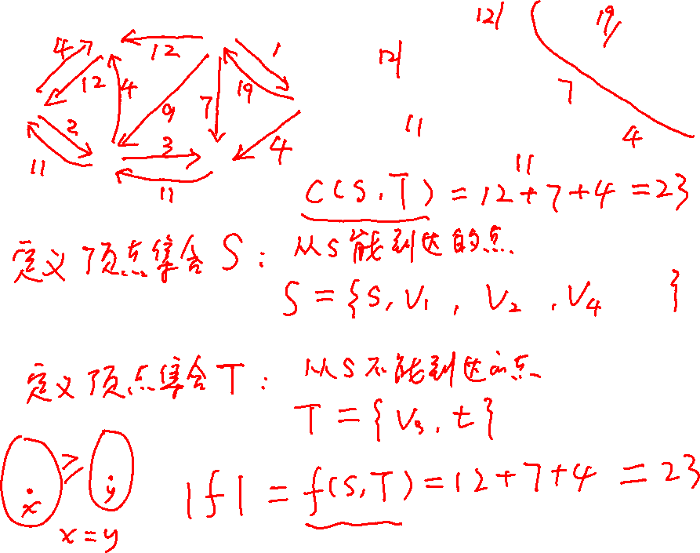
¹²
^{v1}
^{v3}
^{v1}
^{v3}
²⁰
¹⁶
⁴
⁷
^{t}
^{s}
^{t}
^{s}
⁹
¹³
⁴
^{v2}
¹⁴
^{v4}
^{v2}
^{v4}

Slide 33
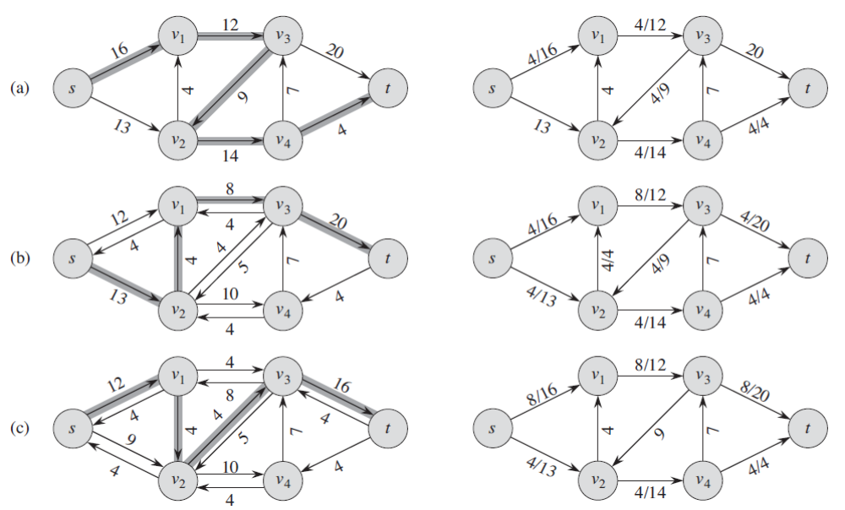
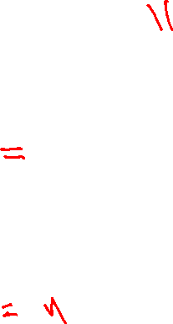
The Basic Ford-Fulkerson Algorithm

Slide 34
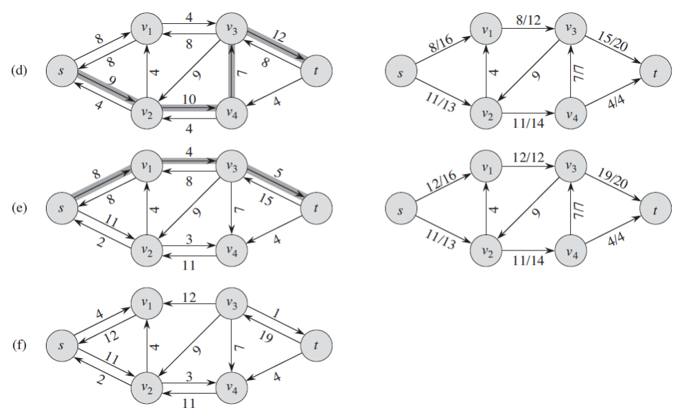

The Basic Ford-Fulkerson Algorithm

Slide 35
Cut
Cut (S, T): S is a subset of V, T =V-S, s∈S and t∈T.
Net flow across the cut (S,T): f(S,T)
Capacity of the cut (S,T): c(S,T)
Minimum cut of a network: a cut with minimum capacity.

Slide 36
Cut
Lemma 26.4
Let f be a flow in a flow network G with source s and sink t , and let (S,T) be a cut of G. Then the net flow across (S,T) is f(S,T)= |f|.
Corollary 26.5
The value of any flow f in a flow network G is bounded from above by the capacity of any cut of G.

Slide 37
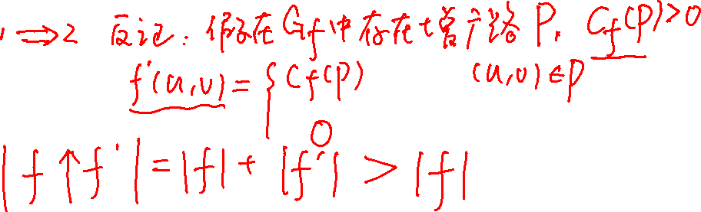
Cut
Theorem 26.7(Max-flow Min-cut Theorem)
If f is a flow in a flow network G=(V,E) with source s and sink t then the following conditions are equivalent:
  f is a maximum flow in G.
  The residual network G_{f} contains no augmenting paths.
  |f|=c(S,T) for some cut (S,T) of G

Slide 38
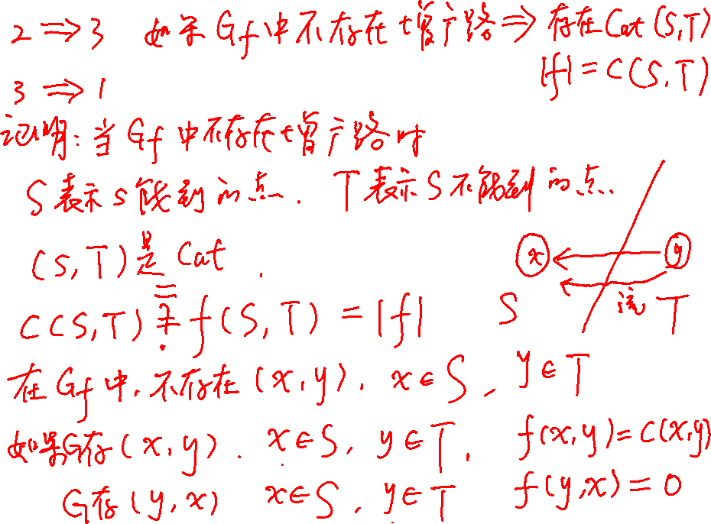

Slide 39
Proof
  (1)⇒(2): Suppose for the sake of contradiction that f is a maximum flow in G but G_{f} has an augment path p. Then, by Corollary 26.3, the flow sum f↑f_{p}, where f_{p} is given by equation (26.8), is a flow in G with value strictly greater than |f|, contradicting the assumption that f is a maximum flow.
  (2)⇒(3): Suppose that G_{f} has no augmenting path, that is, that G_{f} contains no path from s to t. Define
  S={ v ∈ V : there exists a path from s to v in G_{f} }
  and T=V-S. The partition (S,T) is a cut, s∈S and t∉S. For each pair of vertices u and v such that u∈S and v∈T, if (u,v)∈E, we have f(u,v)=c(u,v), since otherwise (u,v)∈E_{f} , which would place v in the set S. If (v,u)∈E, we have f(v,u)=0 for the same reason. By lemma 26.4, therefore, |f|=f(S,T)=c(S,T).
  (3)⇒(1): By Corollary 26.5, |f| ≤ c(S,T) for all cuts (S,T).
  Then |f| =c(S,T) implies that f is a maximum flow.

Slide 40
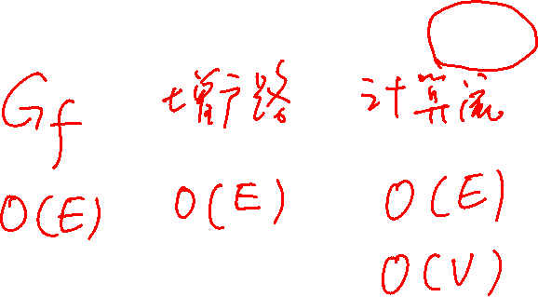
Analysis of Ford-Fulkerson Method
The selection of the augmenting path in this method is arbitrary.
If the capacities are irrational, the method may not terminate. If the flow does converge, however, it may converge to a value that is not necessarily maximum.
If the capacities are integers, the While loop is executed at most |f*| times, since the flow value increases by at least 1 in each iteration.
If we use either DFS or BFS, the time to find an augmenting path takes O(E) time, i.e. each iteration of While loop the takes O(E) time.
Thus, the total running time of the method is O(E |f*| ) .

Slide 41
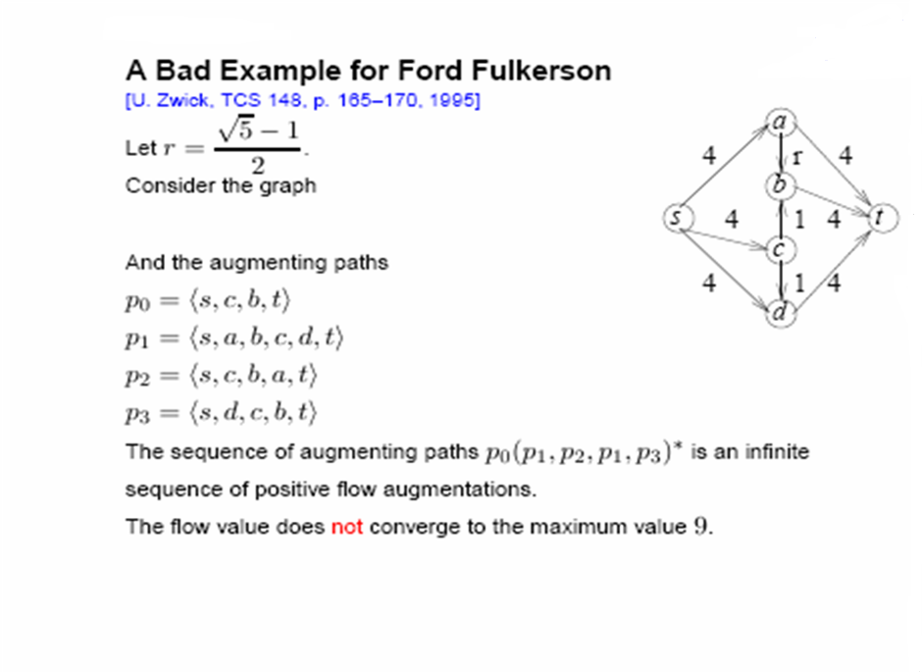
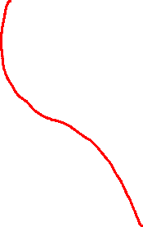
Analysis of Ford-Fulkerson Method

Slide 42
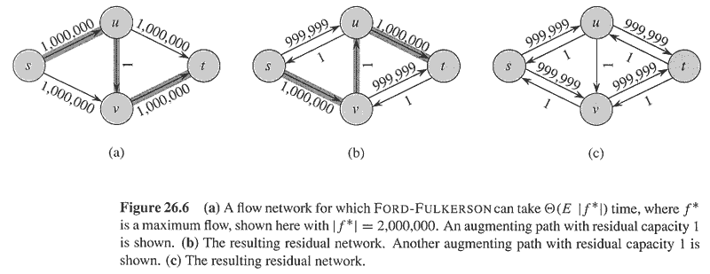
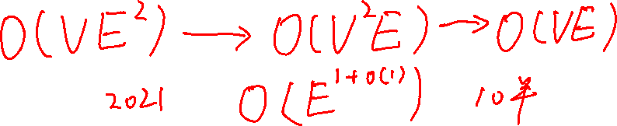
Analysis of Ford-Fulkerson Method

Slide 43
Edmonds-Karp Algorithm
The augmenting path is a shortest path from s to t in the residual network, where each edge has unit weight.
Time complexity: O(VE²)

Slide 44
Critical Lemma
Lemma 26.8
If the Edmonds-Karp is run on a flow network G= (V, E) with source s and sink t, then for all vertices v∈V-{s,t}, the shortest-path distance δ_{f} (s,v) in the residual network G_{f} increases monotonically with each flow augmentation.

Slide 46
Proof
  f : the flow before the first augmentation that decreases some δ_{f}(s,v).
  f’: the flow after the augmentation.
  Let v∈V-{s,t} be the vertex with the minimum δ_{f’}(s,v) whose distance was decreased by the augmentation, so that δ_{f’}(s,v) < δ_{f}(s,v).
  p=s~→u→v be a shortest path from s to v in G_{f’}, so that (u,v)∈ E_{f’}and
  δ_{f’}(s,u) = δ_{f’}(s,v)-1.
  We have δ_{f’}(s,u) ≥δ_{f}(s,u)
  Now we prove that (u,v)∉ E_{f} since otherwise,
  δ_{f}(s,v) ≤ δ_{f}(s,u)+1 ≤ δ_{f’}(s,u)+1 = δ_{f’}(s,v), contradicts δ_{f’}(s,v) < δ_{f}(s,v).
  Since (u,v)∉ E_{f} and (u,v)∈ E_{f’}, the augmentation must have increased the flow from v to u. As only flows on the shortest path can be increased, then (v,u) is on the shortest path in G_{f} , thus we have
  δ_{f}(s,v) = δ_{f}(s,u)-1 ≤ δ_{f’}(s,u)-1 = δ_{f’}(s,v)-2, contradicts δ_{f’}(s,v) < δ_{f}(s,v).
  Such vertex v can not exist.

Slide 47

Analyze its time complexity
Theorem 26.9
The total number of flow augmentations performed by the Edmonds-Karp algorithm is O(VE).
critical edge: an edge (u,v) on an augmenting path p with
c_{f}(p)= c_{f}(u,v)
There must be at least one critical edge on an augmenting path. After augment the flow, the critical edge disappears from the residual network.
To prove the theorem, we will show that each edge can become critical at most |V|/2-1 times.

Slide 48
Proof of the Theorem
  (u,v)∈E, when (u,v) is critical on an augmenting path for the first time, we have, δ_{f}(s,v) =δ_{f}(s,u)+1.
  Then (u,v) disappears from the residual network. It can not reappear until the flow from u to v is decreased, which occurs only if (v,u) appears on an augmenting path. If f’is the flow in G when this event occurs, then we have δ_{f’}(s,u) = δ_{f’}(s,v)+1.
  Since δ_{f}(s,v) ≤ δ_{f’}(s,v), then δ_{f’}(s,u) = δ_{f’}(s,v)+1≥ δ_{f}(s,v)+1= δ_{f}(s,u)+2.
  Consequently, from the time (u,v) becomes critical to the time it next becomes critical, the distance of u increases by at least 2. the distance of u is at most |V|-2. Thus, (u,v) can become critical at most (|V|-2)/2= |V|/2-1 times.
  There are at most O(E) edges and each augmenting path has at least one critical edge.

