Slide 1

Lecture 2
Breadth-First Search

Slide 2
Breadth-first search
(outline)
The single source shortest-paths problem for unweighted graph
The Breadth-first search algorithm
The correctness proof
The running time of BFS algorithm
Note: We only introduce BFS for undirected graphs. But it also works for directed graphs.

Slide 3

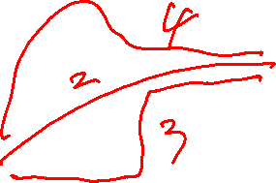
Shortest paths
d
e
b
c
s
a
Example: There are three simple paths (distinct vertices) from source s to b: <s, b>, <s, a, b>, <s, e, d, b> of length 1, 2, 3, respectively.
So the shortest path ( a path containing the smallest number of edges) from s to b is <s, b>.
The shortest paths from s to other vertices a, e, d, c are:
<s, a>, <s, e>, <s, e, d>, <s, b, c>.
There are two shortest paths from s to d.

Slide 4
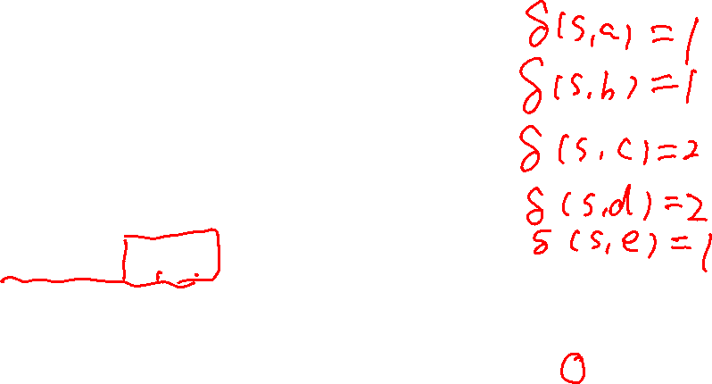
The shortest-paths problem
d
e
b
c
s
a
Distance δ(s, v) : The length of the shortest path from s to v. For example δ(s, c)=2.
The problem:
  Input: A graph G = (V, E) and a source vertex s∈V
  Question: A shortest path from s to each vertex v ∈V and the distance δ(s, v) .

Slide 5

The Breadth-First Search
The idea of the BFS:
  Each time, search as many vertices as possible.
  Visit the vertices as follows:
    Visit all vertices at distance 1
    Visit all vertices at distance 2
    Visit all vertices at distance 3
    … …
Initially, s is made GRAY, others are colored WHITE.
After a gray vertex is processed, its color is changed to black, and the color of all white neighbors is changed to gray.
Gray vertices are kept in a queue Q.

Slide 6
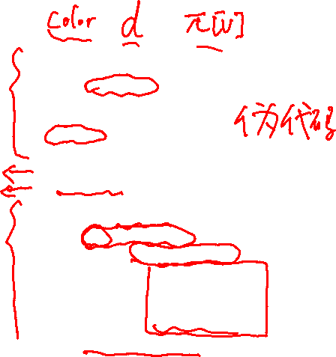
The Breadth-First Search
(more details)
G is given by its adjacency-lists.
Initialization:
  First Part: lines 1 – 4
  Second Part: lines 5 - 9
Main Part: lines 10 – 18
Enqueue(Q, v): add a vertex v to the end of the queue Q
Dequeue(Q): Extract the first vertex in the queue Q
  BFS(G, s)
  1 for each vertex u∈V[G]-{s}
  2 do color[u]<--WHITE
  3 d[u]<--∞
  4 π[u]<--NIL
  5 color[s]<--GRAY
  6 d[s]<--0
  7 π[s]<--NIL
  8 Q<--φ
  9 ENQUEUE(Q, s)
  10 while Q≠φ
  11 do u<--DEQUEUE(Q)
  12 for each v∈Adj[u]
  13 do if color[v]=WHITE
  14 then color[v]<--GRAY
  15 d[v]<--d[u]+1
  16 π[v]<--u
  17 ENQUEUE(Q, v)
  18 color[u]<--BLACK

Slide 7

What does the BFS do?
Given a graph G = (V, E), the BFS returns:
  d[v], proved to be the shortest distance from s to v
  π[v] , the predecessor of v in the search, which can be used to derive a shortest path from s to vertex v.
BFS actually returns a shortest path tree in which the unique simple path from s to node v is a shortest path from s to v in the original graph.
In addition to the two arrays d[v] and π[v], BFS also uses another array color[v], which has three possible values:
  WHITE: represented “undiscovered” vertices;
  GRAY: represented “discovered” but not “processed” vertices;
  BLACK: represented “processed” vertices.

Slide 8
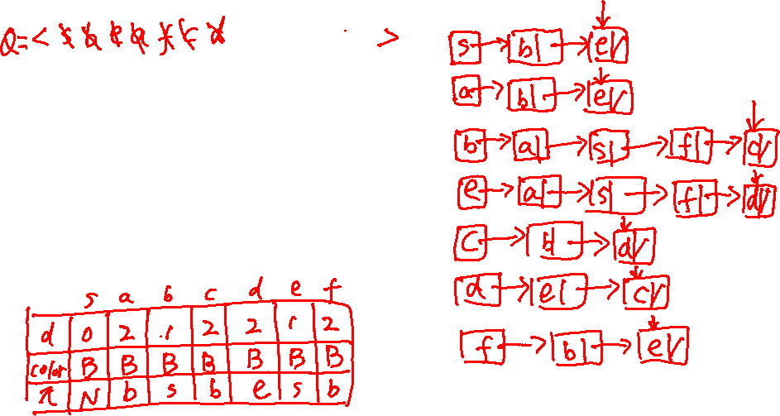

Example of Breadth-First Search
source vertex: s
b
c
a
s
f
e
d

Slide 9
Example(Continued)
Initialization
vertex u
s a b c d e f
color[u]
d[u]
π[u]
G W W W W W W
0 ∞ ∞ ∞ ∞ ∞ ∞
NIL NIL NIL NIL NIL NIL NIL
Q = <s>
(put s into Q (discovered),
mark s gray (unprocessed))
b
c
a
s
0
f
e
d

Slide 10
Example(continued)
b
1
c
While loop, first iteration
  Dequeue s from Q. Find Adj[s]=<b, e>
  Mark b,e as “G”
  Update d[b], d[e], π[b], π[e]
  Put b, e into Q
  Mark s as “B”
Q=<b, e>
a
s
0
f
e
d
1
vertex u
s a b c d e f
color[u]
d[u]
π[u]
B W G W W G W
0 ∞ 1 ∞ ∞ 1 ∞
NIL NIL s NIL NIL s NIL

Slide 11
Example(continued)
b
1
c
2
While loop, second iteration
  Dequeue b from Q, find Adj[b]=<s, a, c, f>
  Mark a, c, f as “G”,
  Update d[a], d[c], d[f], π[a], π[c],π[ f]
  Put a, c, f into Q
  Mark b as “B”
Q=<e, a, c, f>
a
2
s
0
f
2
e
d
1
vertex u
s a b c d e f
color[u]
d[u]
π[u]
B G B G W G G
0 2 1 2 ∞ 1 2
NIL b s b NIL s b

Slide 12
Example(continued)
While loop, third iteration
  Dequeue e from Q, find Adj[e]=<s, a, d, f>
  Mark d as “G”, mark e as “B”
  Update d[d], π[d],
  Put d into Q
Q=<a,c,f,d>
2
b
1
c
a
2
s
0
f
2
e
d
2
1
vertex u
S a b c d e f
color[u]
d[u]
π[u]
B G B G G B G
0 2 1 2 2 1 2
NIL b s b e s b

Slide 13
Example(continued)
While loop, fourth iteration
  Dequeue a from Q, find Adj[a]=<b, e>
  mark a as “B”
Q=<c, f, d>
2
b
1
c
a
2
s
0
f
2
e
d
2
1
vertex u
s a b c d e f
color[u]
d[u]
π[u]
B B B G G B G
0 2 1 2 2 1 2
NIL b s b e s b

Slide 14
Example(continued)
While loop, fifth iteration
  Dequeue c from Q, find Adj[c]=<b, d>
  mark c as “B”
Q=<f, d>
2
b
1
c
a
2
s
0
f
2
e
d
2
1
vertex u
s a b c d e f
color[u]
d[u]
π[u]
B B B B G B G
0 2 1 2 2 1 2
NIL b s b e s b

Slide 15
Example(continued)
2
While loop, sixth iteration
  Dequeue f from Q, find Adj[f]=<b,e>
  mark f as “B”
Q=<d>
2
b
1
c
a
2
s
0
f
2
2
e
d
2
1
vertex u
s a b c d e f
color[u]
d[u]
π[u]
B B B B G B B
0 2 1 2 2 1 2
NIL b s b e s b

Slide 16
Example(continued)
2
While loop, seventh iteration
  Dequeque d from Q, find Adj[d]=<c,e>
  mark d as “B”
Q is empty
2
b
1
c
a
2
s
0
f
2
2
e
d
2
1
vertex u
s a b c d e f
color[u]
d[u]
π[u]
B B B B B B B
0 2 1 2 2 1 2
NIL b s b e s b

Slide 17
Example(continued)
2
b
1
c
2
While loop, eighth iteration
Since Q is empty, stop
a
2
s
0
f
2
2
e
d
2
1
vertex u
s a b c d e f
color[u]
d[u]
π[u]
B B B B B B B
0 2 1 2 2 1 2
NIL b s b e s b

Slide 18

What does BFS produce
BFS creates a prodecessor subgraph G_{π} = (V_{π}, E_{π}), where
  V_{π}= {u∈V| π[u]≠NIL}∪{s}
  E_{π}= {(π[u], u)| where π[ ] is computed in the BFS(G, s) calls}
  prodecessor subgraph is a tree since it is connect and | E_{π} |=| V_{π} |-1
1
2
b
c
2
a
2
s
0
f
2
2
e
d
2
1
The red edges form a tree //note there are |V|-1 edges

Slide 19
Our Goal
Shortest-path distance δ(s, v):
  the minimum number of edges in any path from vertex s to vertex v; if there is no path from s to v, then
  δ(s, v)=∞.
Shortest path:
  A path of length δ(s, v): s → v.

Slide 20
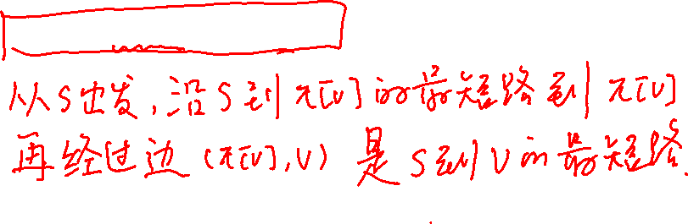
Recall what does the BFS return?
The BFS returns:
  d[v], proved to be the shortest distance from s to v
  π[v] , the predecessor of v in the search, which can be used to derive a shortest path from s to vertex v.
What we need to prove:
  δ(s, v) = d[v]
  s → v = s → π[v] +(π[v] , v)

Slide 21
An Important Property
Lemma 22.1: Let G=(V, E) be a directed or undirected graph, and let s ∈ V be an arbitrary vertex. Then, for any edge (u, v) ∈ E, δ(s, v) ≤ δ(s, u)+1.
Proof：
  If u is reachable from s, then so is v. In this case, the shortest path from s to v can not be longer than the shortest path from s to u followed by the edge (u, v) and thus the inequality holds.
  If u is not reachable from s, then δ(s, u)=∞, and the inequality holds.

Slide 22
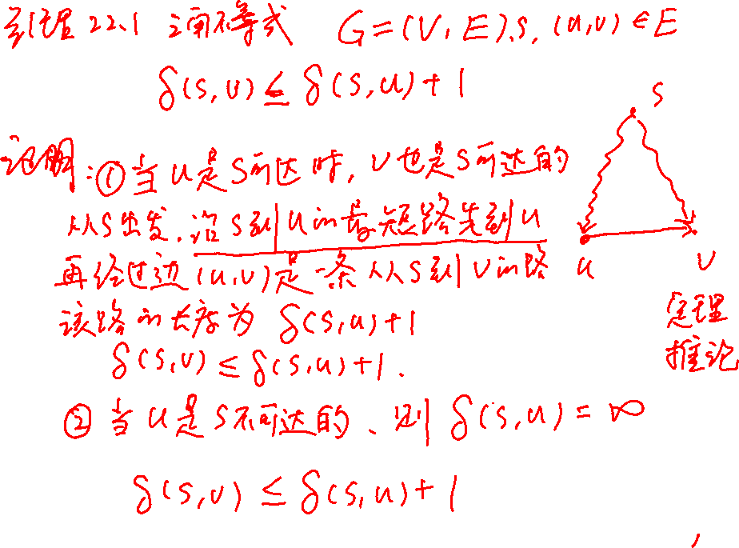

Slide 23
A Property of the BFS
Lemma 22.2: Let G=(V, E) be a directed or undirected graph, and suppose that BFS is run on G from a given source vertex s ∈ V. Then upon termination, for each vertex v ∈ V , the value d[v] computed by BFS satisfies d[v] ≥ δ(s, v).

Slide 24
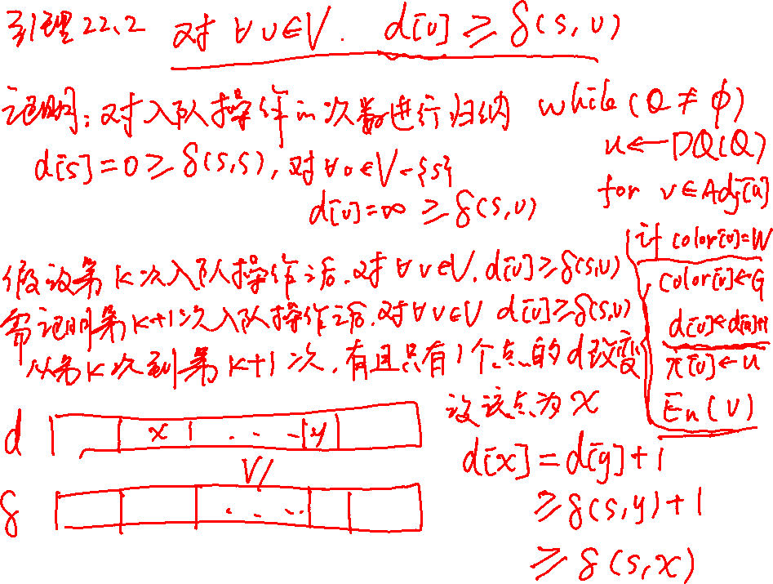

Slide 25
Proof of Lemma 22.2
Proof：
  We use induction on the number of ENQUEUE operations. Our inductive hypothesis is that d[v] ≥ δ(s, v) for all v ∈ V .
  The basis of the induction is the situation immediately after enqueuing s in line 9 of BFS. The inductive hypothesis holds here, because d[s] =0= δ(s, s) and d[v] = ∞ ≥ δ(s, v), v∈ V -{s}.
  For the inductive step, consider a white vertex v that is discovered during the search from a vertex u.
  We obtain
  d[v] = d[u] +1(line 15 )
  ≥ δ(s, u)+1(inductive hypothesis )
  ≥ δ(s, v) (Lemma 22.1)

Slide 26
Proof of Lemma 22.2
  Vertex v is then enqueued, and it is never enqueued again because it is also grayed and the then clause of lines 14–17 is executed only for white vertices.
  Thus, the value of d[v] never changes again, and the inductive hypothesis is maintained.

Slide 27
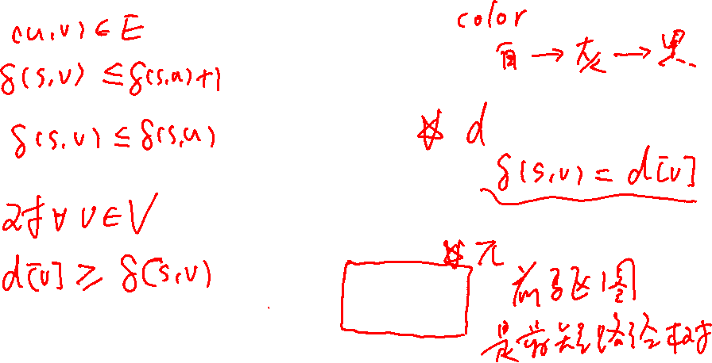
BFS
  BFS(G, s)
  1 for each vertex u∈V[G]-{s}
  2 do color[u]<--WHITE
  3 d[u]<--∞
  4 π[u]<--NIL
  5 color[s]<--GRAY
  6 d[s]<--0
  7 π[s]<--NIL
  8 Q<--φ
  9 ENQUEUE(Q, s)
  10 while Q≠φ
  11 do u<--DEQUEUE(Q)
  12 for each v∈Adj[u]
  13 do if color[v]=WHITE
  14 then color[v]<--GRAY
  15 d[v]<--d[u]+1
  16 π[v]<--u
  17 ENQUEUE(Q, v)
  18 color[u]<--BLACK

Slide 28

A property of the Queue
Lemma 22.3
Suppose that during the execution of BFS on a graph G=(V, E) , the queue Q=<v₁, v₂, …, v_{r} >, where v₁ is the head of Q and v_{r} is the tail.
Then d[v_{r}] ≤ d[v₁] +1 and d[v_{i}] ≤ d[v_{i+1}], for 1≤i≤r-1.

Slide 29

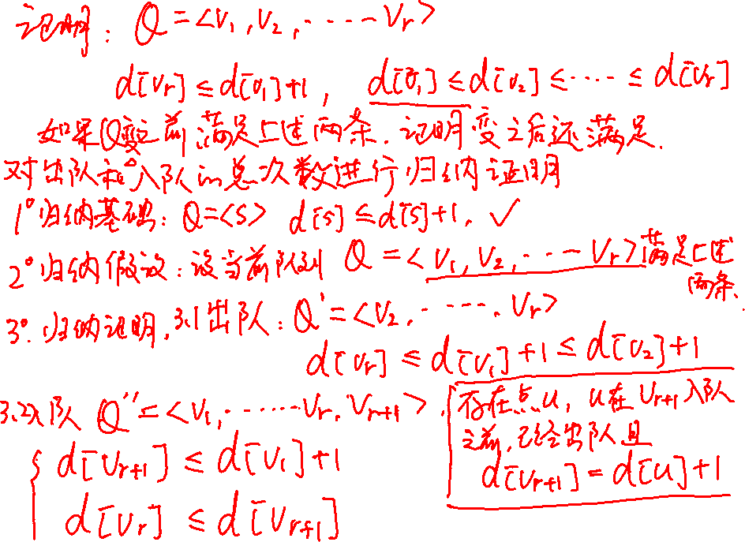

Slide 30
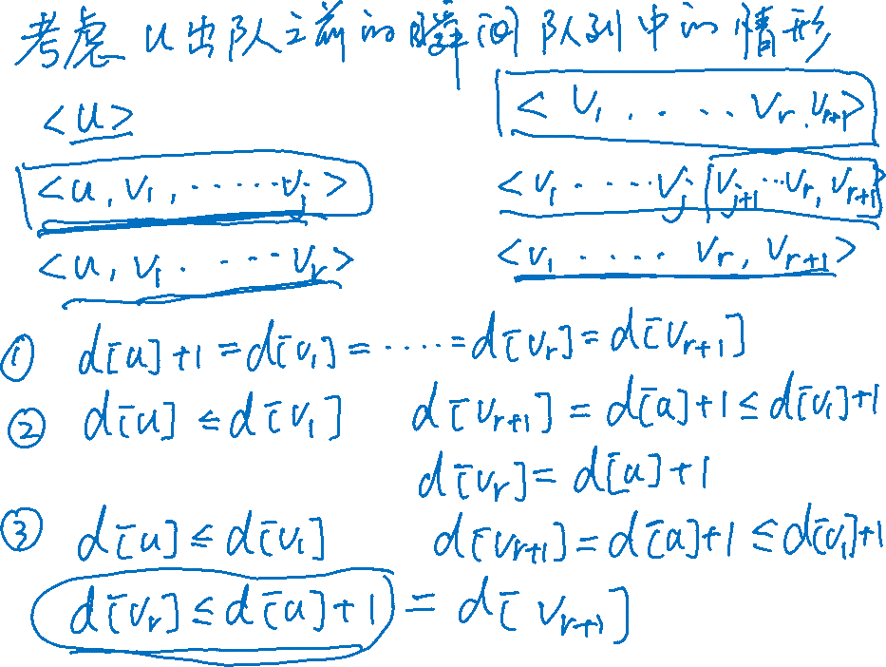

Slide 31
Proof of Lemma 22.3(1)
The proof is by induction on the number of queue operations. Initially, when the queue contains only s, the lemma certainly holds.
For the inductive step, we must prove that the lemma holds after both dequeuing and enqueuing a vertex. If the head v₁ of the queue is dequeued, v₂ becomes the new head. (If the queue becomes empty, then the lemma holds vacuously.)
By the inductive hypothesis, d[v₁] ≤ d[v₂],
d[v_{r}] ≤ d[v₁] +1 ≤ d[v₂] +1, d[v_{i}] ≤ d[v_{i+1}] , 2≤i≤r-1.
Thus, the lemma follows with v₂ as the head.

Slide 32
Proof of Lemma 22.3(2)
In order to understand what happens upon enqueuing a vertex, we need to examine the code more closely. When we enqueue a vertex v in line 17 of BFS, it becomes v_{r+1} . At that time, we have already removed vertex u, whose adjacency list is currently being scanned, from the queue Q.
By the inductive hypothesis, the new head v₁ has d[v₁] ≥ d[u]，or from line 15 we have d[v₁] = d[u]+1. Thus, d[v_{r+1}]= d[v]=d[u]+1≤ d[v₁]+1.
From the inductive hypothesis, we also have d[v_{r}] ≤ d[u]+1,
or from line 15 we have d[v_{r}] = d[u]+1，
and so d[v_{r}] ≤ d[u]+1 = d[v]=d[v_{r+1}].
The remaining inequalities are unaffected. Thus, the lemma follows when v is enqueued.

Slide 33
Proof of Lemma 22.3
Proof:
  对入队和出队操作次数进行归纳证明。我们证明入队或出队操作之后，引理总成立。
  当Q=<s>时, 引理中的性质成立。
  v₁出队，v₂成为队首。则依据归纳假设
  d[v₁] ≤ d[v₂], d[v_{r}] ≤ d[v₁]+1 ≤ d[v₂]+1, d[v_{i}] ≤ d[v_{i+1}], 2≤i≤r-1。
  v入队，成为队尾v_{r+1} 。之前存在u出队，此时算法正在搜索u的邻接链表, 发现白色顶点v。
  d[v₁] ≥ d[u] 或 d[v₁] = d[u] +1，d[v_{r}] ≤ d[u]+1 或 d[v_{r}] = d[u]+1 （归纳假设，或算法15行）
  d[v_{r+1}]= d[v] = d[u]+1 （算法第15行）
  d[v_{r+1}] = d[u]+1 ≤ d[v₁]+1; d[v_{r}] ≤ d[u]+1= d[v_{r+1}]。

Slide 34

A Corollary（推论）
Corollary 22.4:
Suppose that vertices v_{i} and v_{j} are enqueued during the execution of BFS, and that v_{i} is enqueued before v_{j}.
Then d[v_{i}]≤ d[v_{j}] at the time that v_{j} is enqueued.
Proof:
Immediate from Lemma 22.3 and the property that each vertex receives a finite d value at most once during the course of BFS.

Slide 35
A Corollary（推论）
推论22.4: v_{i}先于v_{k}入队，则 d[v_{i}] ≤ d[v_{k}]。
先入队的距离小。
一旦入队，d[]值就不发生变化。

Slide 36
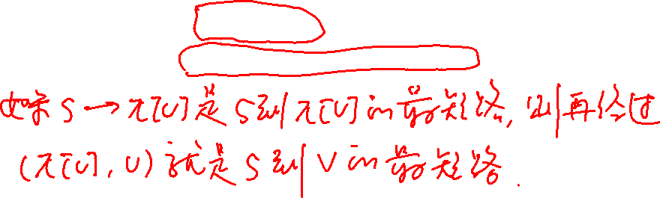
Correctness of BFS
定理22.5： δ(s, v)=d[v]
s → v = s → π[v] +(π[v] , v)

Slide 37
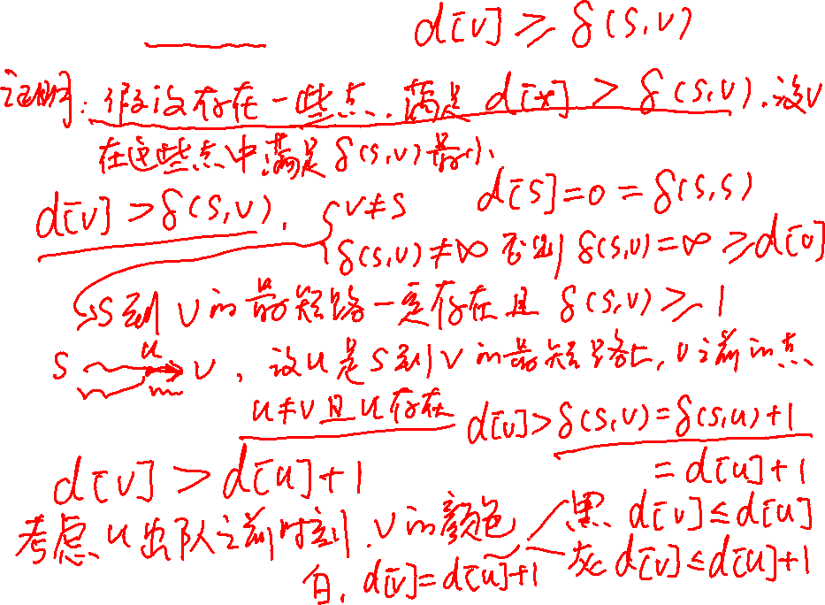
定理22.5： δ(s, v)=d[v]

Slide 38
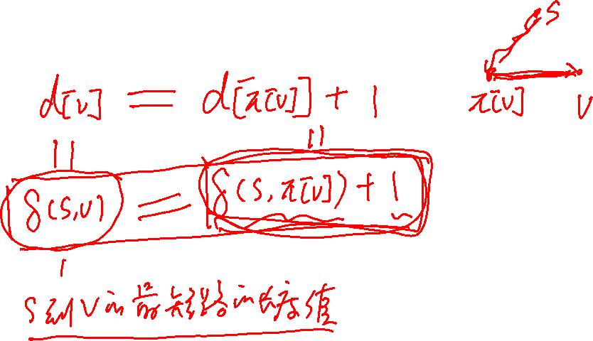
定理22.5：s → v = s → π[v] +(π[v] , v)

Slide 39
Correctness of BFS
定理22.5： δ(s, v)=d[v]
s → v = s → π[v] +(π[v] , v)
证明：（part 1）
  反证法。假设存在一些顶点，它们的d[]值不等于最短路径距离。设v是这些顶点中，最短路径距离最小的。（v ≠ s）
  d[v] ≥ δ(s, v) （引理22.2），因此d[v] > δ(s, v) 。v和s之间 必然存在一条最短路径 s → v ，否则 δ(s, v) =∞ ≥ d[v] 。设u是这条最短路径上v的前驱，即s → u — v。因此, δ(s, v) = δ(s, u) +1。这意味着δ(s, u) < δ(s, v) , 根据v的选择方式， d[u] =δ(s, u)
  d[v] > δ(s, v)= δ(s, u) +1= d[u] +1。
  接下来分析当u出队时，v可能的三种颜色：W，G，B。
  我们证明每一种情况下,上式都不可能成立。

Slide 40
Correctness of BFS
定理22.5：δ(s, v) = d[v]
s → v = s → π[v] +(π[v] , v)
证明：（part 2）
  v是白色的, d[v] = d[u] +1。(算法15行)
  v是黑色的, v已经出队, d[v] ≤ d[u] 。(推论22.4)
  v是灰色的, v在顶点w的邻接链表里, w先于u出队.
  d[v] = d[w]+1, d[w] ≤ d[u] , 从而 d[v] ≤ d[u] +1。
  综上，假设的v是不可能存在的。因此d[v] =δ(s, v).
  所有s不可达的顶点的d[]值都是∞。
  （part 3）
  如果π[v]=u，则d[v] = d[u] +1，s → u +(u , v) 是s到v的最短路径。

Slide 41
Predecessor subgraph
BFS creates a predecessor subgraph G_{π} = (V_{π}, E_{π}), where
  V_{π}= {u∈V| π[u]≠NIL}∪{s}
  E_{π}= {(π[u], u)| where π[ ] is computed in the BFS(G, s) calls}
The predecessor subgraph G_{π} = (V_{π}, E_{π}) is a shortest path tree if
  V_{π} consists of vertices reachable from s。
  For all v ∈ V_{π} , there is a unique simple path form s to v in G_{π} that is also a shortest path from s to v in G.
The edges in E_{π} are called tree edges (树边)。

Slide 42
Breadth-first Tree
引理22.6: BFS得到前驱图G_{π} = (V_{π}, E_{π})是shortest path tree。
证明：
  算法16行π[v]=u 当且仅当 (u, v) ∈ E且δ(s, v)<∞（意味着v是从s可达的）。因此V_{π}中包含了所有从s可以到达的顶点。 G_{π} 是树，每个顶点到s都有唯一的一条路径。根据定理22.5， s → π[v] +(π[v] , v) 是s到v的最短路径。从而树中每个顶点到s的路径都是最短路径。
  如何归纳的？
  δ(s, v) = d[v] = d[π[v]] +1= δ(s, π[v]) +1，这意味着，s → π[v] +(π[v] , v) 是s到v的最短路径。

Slide 43
Example of Breadth-first Tree
Question:
How do you construct a shortest
path from s to any vertex
by using the following table?
2
b
1
c
2
a
2
s
0
f
2
2
e
d
2
1
vertex u
s a b c d e f
color[u]
d[u]
π[u]
B B B B B B B
0 2 1 2 2 1 2
NIL b s b e s b

Slide 44
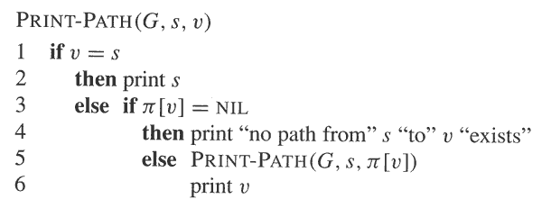
The Answer

Slide 45
BFS for disconnected graph
We can modify BFS so that it returns a forest.
More specifically, if the original graph is composed of connected components C₁, C₂, …,C_{k}, then BFS will return a tree corresponding to each C_{i}.

Slide 46
BFS for disconnected graph
BFS_GENERAL(G)
1 for each vertex u ∈V
2 color[u]←WHITE;
3 d[u]← ∞;
4 π[u]←NIL;
5 for each vertex u ∈V
6 if d[u] = ∞
7 then BFS(G, u);

Slide 47
Analysis of the Breadth-First Search Algorithm
We assume that it takes one unit time to test the color of a vertex, or to update the color of a vertex, or to compute d[v] = d[u] + 1, or to set π[v] = u, or to en-queue, or to de-queue.
The following analysis is valid for connected graphs.
  The initialization requires O(V) time units.
  In the while loop, each vertex u is en-queued and de-queued exactly once. So, each adjacency list Adj[u] is scanned exactly once after u is de-queued. So scanning the adjacency lists needs time O(E).
Total time is: T(V, E) = O(V+E).

Slide 48
Conclusion
Content
  BFS：algorithm，proof of its correctness，cases，analysis of its time complexity
Homework
  22.2-2 and 22.2-8

