Slide 1

Lecture 3
Depth First Search
The DFS algorithm
The time complexity of DFS algorithm
Properties of the DFS

Slide 2
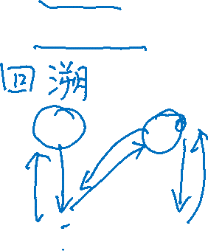
DFS Algorithm
The basic idea of Depth First Search algorithm
  Deeper: 检测最新扫描的顶点的出边，选择一条。
  Backtrack:当前顶点的所有出边都检测完,
  则从哪来回哪去。
An example used to illustrate the basic idea:
u
v
w
x
y
z

Slide 3

Four Arrays for DFS Algorithm
u. color: the color of each vertex u
  WHITE means undiscovered
  GRAY means discovered but not finished processing
  BLACK means finished processing.
u.π:the predecessor of u, indicating the vertex from which u is discovered.
u.d: discovery time, a counter indicating when vertex u is discovered.
u.f: finishing time, a counter indicating when the processing of vertex u (and the processing of all its descendants ) is finished.

Slide 4
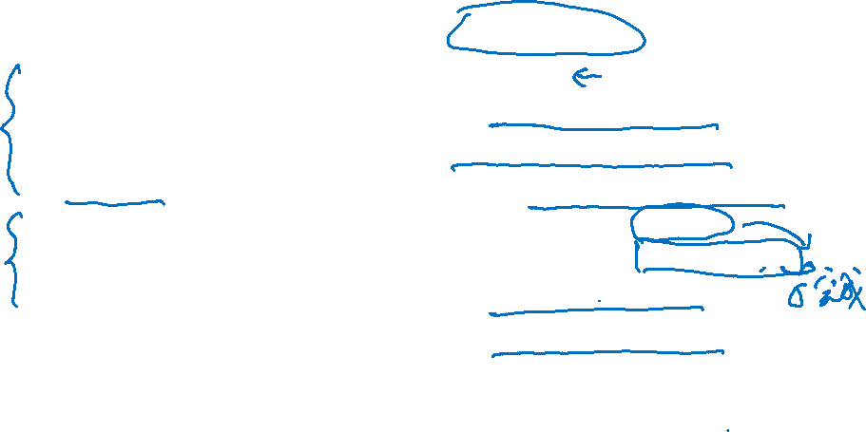

DFS Algorithm
DFS(G)
1 for each vertex u∈V[G]
2 do u. color ← WHITE
3 u.π ← NIL
4 time ← 0
5 for each vertex u∈V[G]
6 do if u. color = WHITE
7 then DFS-VISIT(u)
DFS-VISIT(u)
1 u. color = GRAY
2 u.d ← time ← time +1
3 for each v ∈ Adj[u]
4 do if v . color = WHITE
5 then v .π ← u
6 DFS-VISIT(v)
7 u. color ← BLACK
8 u.f ← time ← time + 1
a global variable
u.d : discovery time
u.f: finishing time

Slide 5
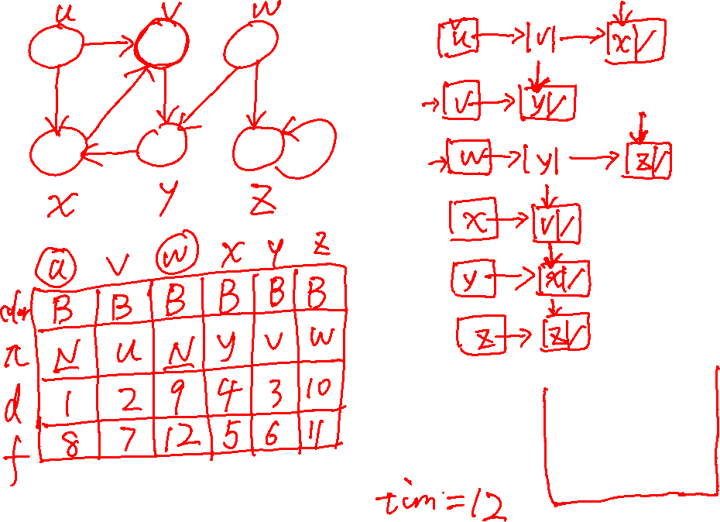

Slide 6
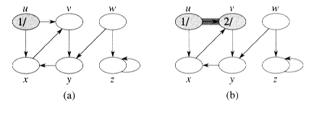
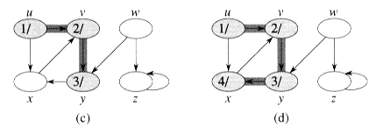
DFS Algorithm (Example –directed graph)

Slide 7
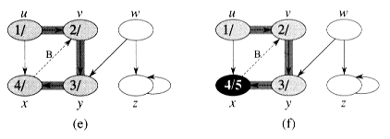
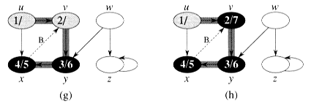
Example –directed graph (continued)

Slide 8
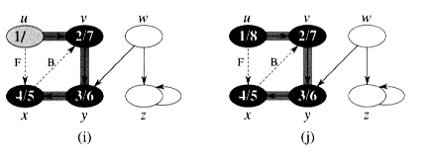
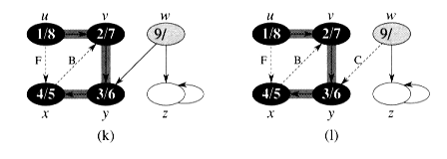
Example –directed graph (continued)

Slide 9
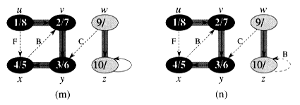
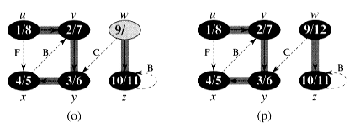
Example –directed graph (continued)

Slide 10
DFS Algorithm (Example – undirected graph)
a
d
b
c
g
e
f

Slide 11
Example – undirected graph (continued)
a
1/
d
b
c
g
e
f

Slide 12
Example – undirected graph (continued)
1/
a
d
2/
b
c
g
e
f

Slide 13
Example – undirected graph (continued)
1/
a
d
2/
b
3/
c
g
e
f

Slide 14
Example – undirected graph (continued)
1/
a
d
2/
b
3/
c
g
e
f
4/

Slide 15
Example – undirected graph (continued)
1/
a
d
2/
b
3/
c
g
e
f
4/5

Slide 16
Example – undirected graph (continued)
1/
a
d
2/
b
3/6
c
g
e
f
4/5

Slide 17
Example – undirected graph (continued)
1/
a
d
b
2/7
3/6
c
g
e
f
4/5

Slide 18
Example – undirected graph (continued)
1/8
a
d
2/7
b
3/6
c
g
e
f
4/5

Slide 19
Example – undirected graph (continued)
1/8
a
9/
d
2/7
b
3/6
c
g
e
f
4/5

Slide 20
Example – undirected graph (continued)
1/8
a
9/
d
2/7
b
3/6
c
g
e
10/
f
4/5

Slide 21
Example – undirected graph (continued)
1/8
a
9/
d
2/7
b
3/6
c
g
e
10/11
f
4/5

Slide 22
Example – undirected graph (continued)
1/8
a
9/
d
2/7
b
3/6
12/
c
g
e
10/11
f
4/5

Slide 23
Example – undirected graph (continued)
1/8
a
9/
d
2/7
b
3/6
c
g
12/13
e
10/11
f
4/5

Slide 24

Example – undirected graph (continued)
1/8
a
9/14
d
2/7
b
12/13
3/6
c
10/11
g
e
f
4/5

Slide 25

What does DFS do?
Given a graph G, it traverses all vertices of G and
Constructed a collection of rooted trees
Outputs three arrays: d, f, π
DFS forest: DFS creates a depth-first forest
F = (V, E_{f}),
where E_{f} = {(u.π, u)| u∈ V , u.π ≠Nil }
π is computed in the DFS-VISIT calls

Slide 26

Problem
Consider: how does the order of vertices in adjacency list influence the result of DFS?
a
a
b
c
b
c
d
e
d
e

Slide 27
Properties of DFS (1)
Definition: In a rooted forest(especially, DFS forest), any vertex u on the simple path from the root to v is called an ancestor of v, and v is called a descendant of u.
u = v.π if and only if DFS-VISIT(v) was called during a search of u’s adjacency list. u is called the parent of v.
Vertex v is a descendant of vertex u in the depth-first forest if and only if v is discovered during the time in which u is gray.

Slide 28
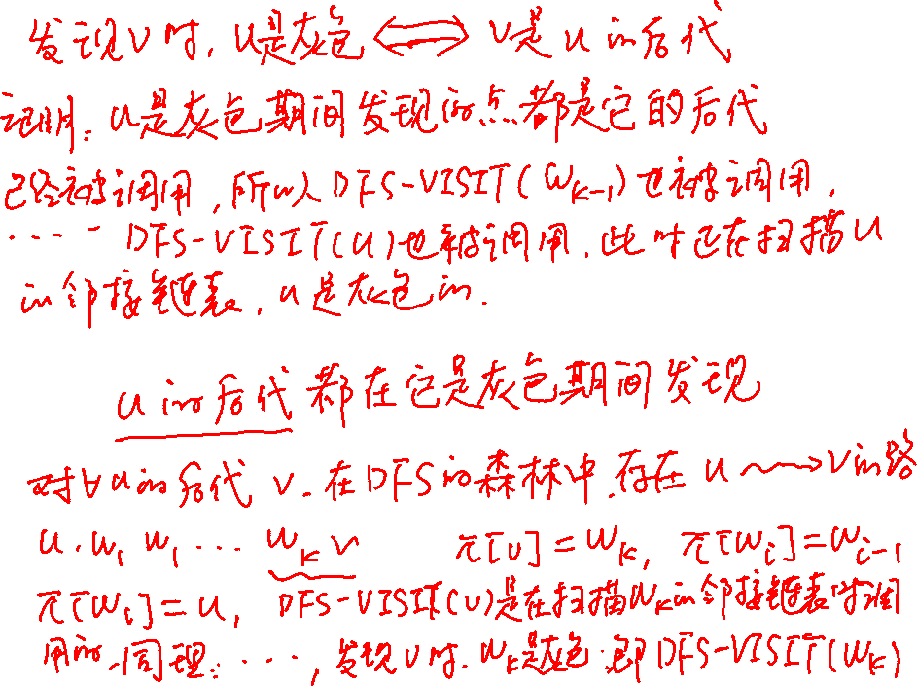


Slide 29
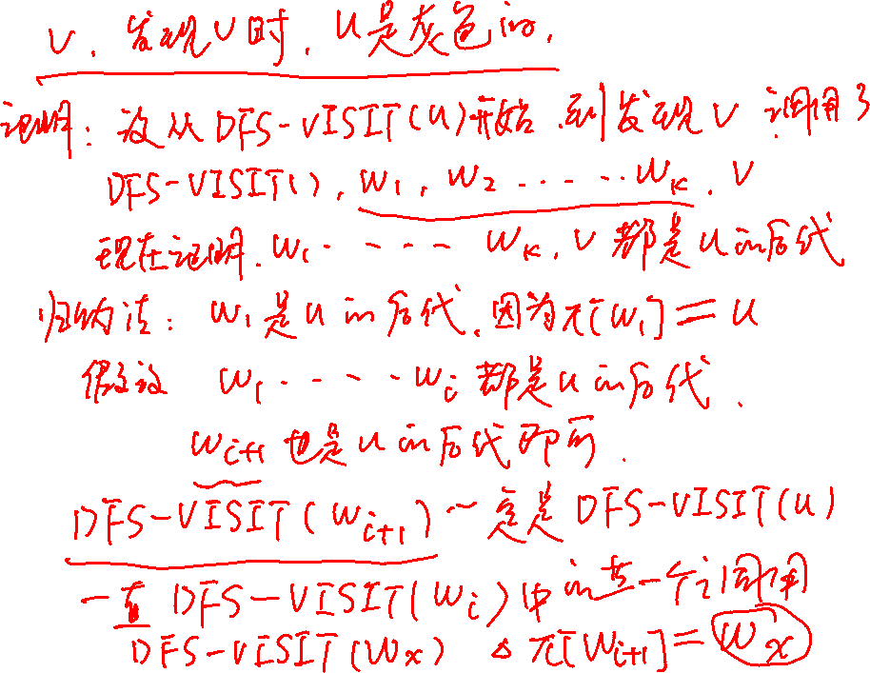

Slide 30
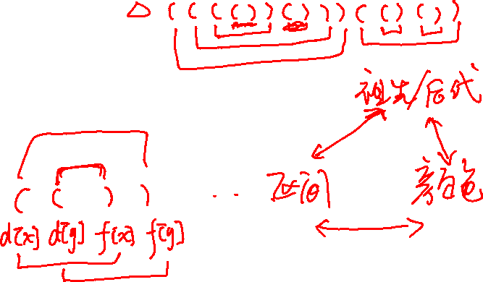
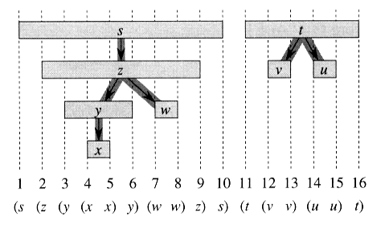
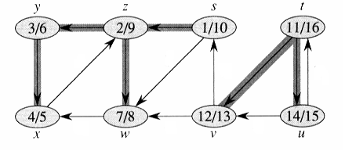
Properties of DFS (2)
The discovery and finishing time have parenthesis structure.
In detail, if we use “(u” to represent the discovery of u, and “u)” the finishing of u, then the history of discoveries and finishings makes a well-formed expression in the sense that the parentheses are properly nested
(a)
(b)

Slide 31
Properties of DFS (2)
Theorem 22.7 parenthesis theorem(括号定理): In any depth-first search of a (directed or undirected) G=(V, E), for any two vertices u and v, exactly one of the following three conditions holds:
  the intervals [v.d, v.f] and [u.d, u.f] are entirely disjoint, and neither u nor v is a descendant of the other in the depth-first forest.
  the interval [u.d, u.f] is contained entirely within the interval [v.d, v.f] , and u is a descendant of v in a depth-first tree, or
  the interval [v.d, v.f] is contained entirely within the interval [u.d, u.f] , and v is a descendant of u in a depth-first tree.

Slide 32
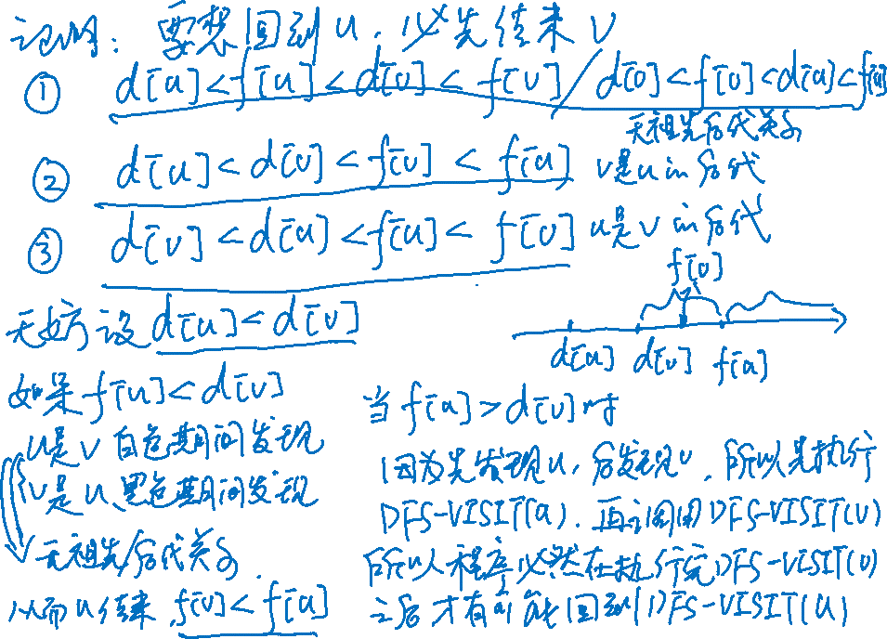

Slide 33
Proof of Parenthesis Theorem
We begin with the case in which u.d < v.d. We consider two subcases, according to whether v.d < u.f or not.
  v.d < u.f, so v was discovered while u was still gray, which implies that v is a descendant of u. Moreover, since v was discovered more recently than u, all of its outgoing edges are explored, and v is finished, before the search returns to and finishes u. In this case, therefore, the interval [v.d, v.f] is contained entirely within the interval [u.d, u.f].
  In the other subcase, u.f< v.d, and by inequality (22.2), thus,
  u.d < u.f < v.d < v.f, that is, the intervals [u.d, u.f] and [v.d, v.f] are disjoint. Because the intervals are disjoint, neither vertex was discovered while the other was gray, and so neither vertex is a descendant of the other.
The case in which v.d < u.d is similar, with the roles of u and v reversed in the above argument

Slide 34
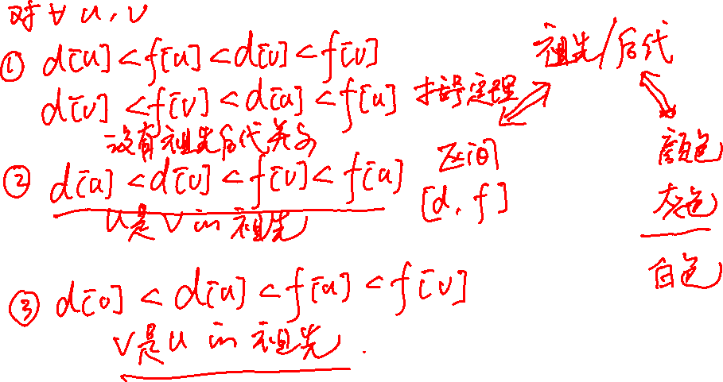

Slide 35
Nesting of descendants’ intervals
Corollary 22.8: Vertex v is a proper descendant of vertex u in the depth-first forest for a graph G if and only if u.d< v.d < v.f < u.f.

Slide 36
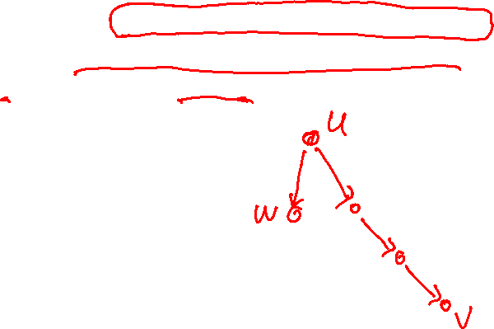
Properties of DFS (3)
Theorem 22.9 (White-Path Theorem)
  In a depth-first forest of a (directed or undirected) graph G = (V, E), vertex v is a descendant of vertex u if and only if at time u.d that the search discovers u, vertex v can be reached from u along a path consisting entirely of white vertices.

Slide 37
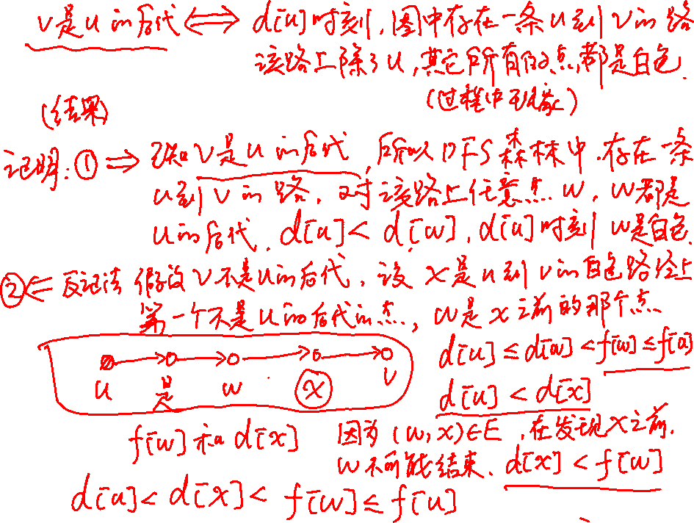

Slide 38
Proof of White-Path Theorem
=>Assume v is a descendant of u, there is a unique path from u to v in the DFS forest. Let w be an arbitrary vertex on the path from u to v in the depth-first forest, then w is a descendant of u. By the nesting of descendants’ interval corollary, u.d<w.d, and so at time u.d, w is white.

Slide 39
Proof of White-path theorem
<=(By contradiction) Suppose at time u.d, there is a path from u to v consisting only of white vertices, but v does not become a descendant of u in the depth-first tree. Without loss of generality, assume that every other vertex along the path becomes a descendant of u. (otherwise, let v be the closest vertex to u along the path that does not become a descendant of u.) Let w be the predecessor of v in the path. Hence, w is a descendant of u, and by Corollary Nesting of descendants’ intervals, w.f <= u.f. Note that v must be discovered after u is discovered, but before w is finished. Therefore, u.d<v.d< w.f <= u.f. Parenthesis Theorem then implies that the interval [v.d, v.f] is a subinterval of [u.d,u.f]. By Corollary Nesting of descendants’ intervals, v must be a descendent of u.

Slide 40
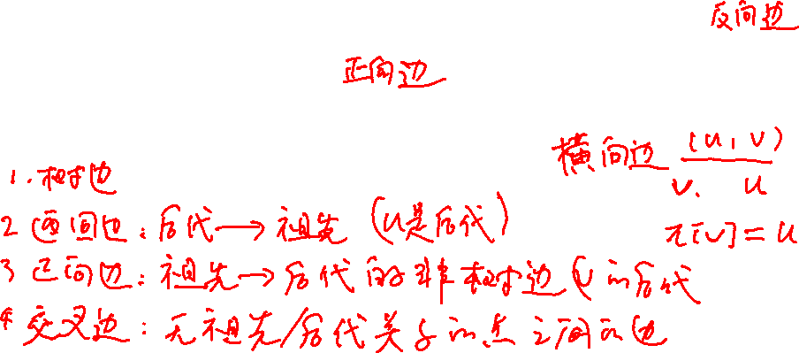
Classification of Edges (directed)
Let G_{π} = (V, E_{π}) be the depth-first forest produced by a depth first search on directed graph G = (V, E), then the edges of G can be classified into four categories(the non-tree edges are classified according to the relationship with the end points):
  Tree edges: edges in G_{π} 。(树边)
  Back edges: edges (u, v) connecting a vertex u to an ancestor v. Self-loops in directed graphs are considered to be back edges.(返回边)
  Forward edges: those non-tree edges (u, v) connecting a vertex u to a descendant v.(前向边)
  Cross edges: all other edges. They can go between vertices in the same depth-first tree as long as neither vertex is ancestor of the other, or they go between vertices in different trees. (交叉边)
Recalling that for each pair of vertices u,v, there are only three probabilities between them:
u is a descendant of v, opposite, neither

Slide 41

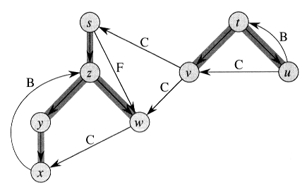
Classification of Edges (Directed)

Slide 42
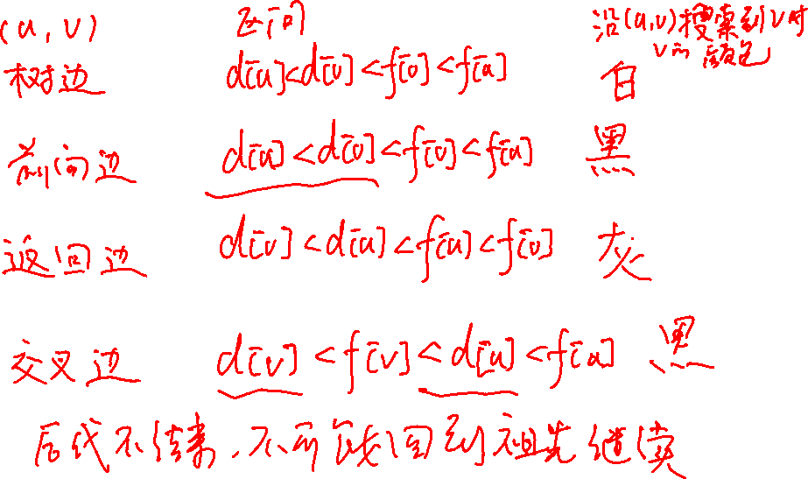

Slide 43
Observation (directed)
In a depth-first search, an edge (u, v) can be classified according to the color of v when (u, v) is first explored:
  WHITE indicates a tree edge
  GRAY indicates a back edge
  BLACK indicates a forward or cross edge
    How to distinguish a forward edge and a cross edge?
      u.d < v.d means a forward edge
      u.d > v.d means a cross edge
Accordingly, DFS algorithm can be modified to classify edges as it encounters them. How?

Slide 44
Classification of Edges (Undirected)
In an undirected graph, (u, v) and (v, u) are in fact the same edge. To avoid ambiguity, we classify the edge according to whichever of (u, v) or (v, u) is encountered first during the execution of the DFS algorithm.
Theorem 22.10 In a depth-first search of an undirected graph G, every edge of G is either a tree edge or a back edge.
无向图中只有树边和返回边.

Slide 45
Proof of Theorem 22.10
Let (u, v) be an arbitrary edge of G, and suppose without loss of generality that u.d <v.d. Then the search must discover and finish v before it finishes u (while u is gray), since v is on u’s adjacency list.
  If the first time that the search explores edge (u, v), it is in the direction from u to v, then v is undiscovered (white) until that time, for otherwise the search would have explored this edge already in the direction from v to u. Thus, (u, v) becomes a tree edge.
  If the search explores (u, v) first in the direction from v to u, then (u, v) is a back edge, since u is still gray at the time the edge is first explored.
u
w
v

Slide 46
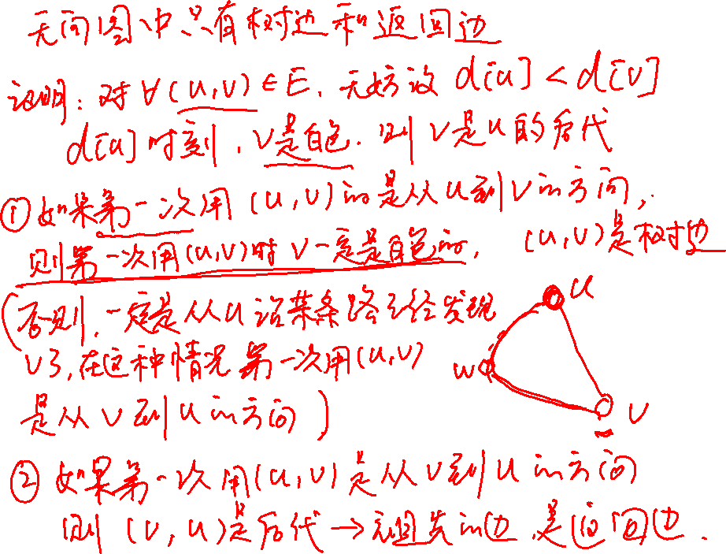

Slide 47
Classification of Edges (Undirected)
1/8
a
9/14
d
2/7
b
12/13
3/6
c
10/11
g
e
f
4/5

Slide 48
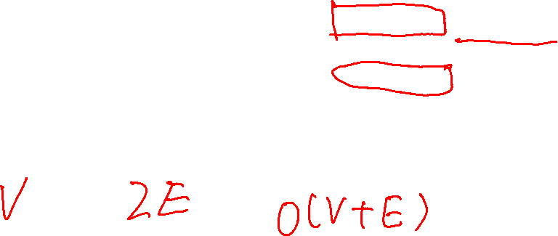
Running time analysis of DFS
DFS(G)
for each u in V
do u.color←white;
  u.π←NIL;
time=0; O(V)
for each u in V
do if u.color white // O(V)
then DFS-VISIT(u); //T(u)
DFS-VISIT(u)
u.color =gray;
time ← time+1;
u.d ← time; // O(1)
for each v ∈adj[u]
do if v.color =white // O(|adj[u]|)
then v.π ← u;
DFS-VISIT(v);
u.color ← black;
time ← time+1;
u.f ← time; // O (1)

Slide 49
Running time analysis of DFS
Since each vertex is grayed exactly once, for each u, DFS-VISIT(u) is called exactly once.
During DFS-VISIT(u) , Adj[u] is scanned exactly once, so T(u)= O(1 + |Adj[u]|).
So, ∑ T(u) = O(V+E)
Hence, total time T(V, E)= O(V+E)

Slide 50
Conclusion
The DFS algorithm
The time complexity of DFS algorithm
Properties of the DFS
  v是u的后代当且仅当扫描v时,u是灰色的.
  括号定理
  后代的区间是祖先的子区间
  白色路径定理
Classification of edges
  有向图4种
  无向图2种

Slide 51
Homework
22.3-2
22.3-8
22.3-9
22.3-13(a correctness proof is preferred)

Slide 52
Next Class
Topological Sort
-- (for directed acyclic graph)
Strongly Connected Components Decomposing
-- (for directed graph)

