Slide 1

Lecture 4
Applications of Depth-First Search
Topological Sort
-- (for directed acyclic graph)
Strongly Connected Components Decomposing
-- (for directed graph)

Slide 2

The first application:
Topological Sort
Directed acyclic graph (abbreviated as dag) are used in many applications to indicate precedences among events.
A topological sort of a directed acyclic graph G = (V, E) is a linear ordering of all its vertices such that if G contains an edge (u, v), then u appears before v in the ordering.
1
2
1
3
4
2
3
4
How about if G contains a cycle?

Slide 3
Applications of Topological Sort
Courses arrangement in schools
Genome rearrangement
A general life-related application—dressing order
Graph Theory
Data Structure
Graph Algorithms
Java Language
Advanced Mathematics
Can you give the topological order?

Slide 4
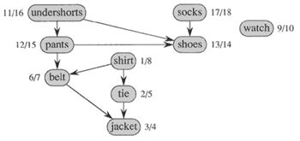
Application--Dressing Up

Slide 5
Topological Sort Problem
The problem
  Input: A directed acyclic graph G = (V, E).
  Output: A topological order of all the vertices of G.

Slide 6
The Algorithm
Topological-Sort（G）
  1, call DFS(G) to compute finishing times v.f for each vertex v.
  2, as each vertex is finished, insert it onto the front of a linked list
  3, return the linked list of vertices.

Slide 7
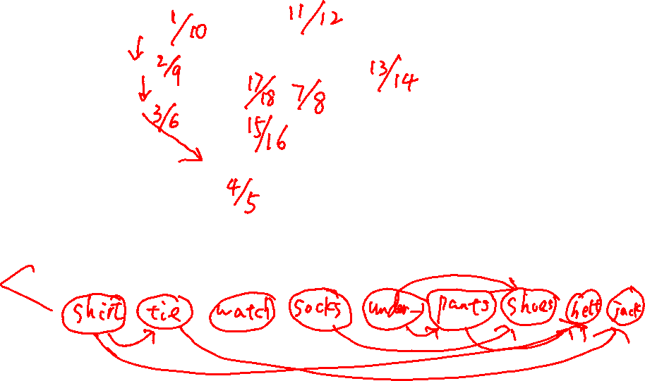
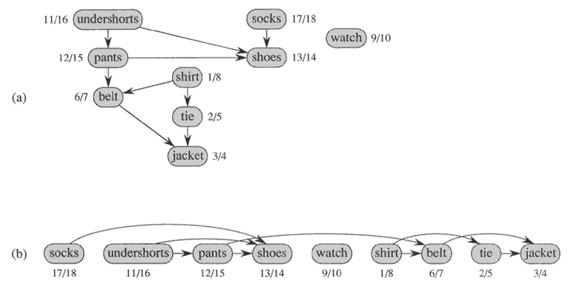
Application--Dressing Up

Slide 8
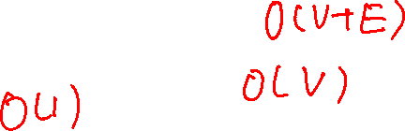
Time Complexity
Topological-Sort（G）
  1, call DFS(G) to compute finishing times v.f for each vertex v.
  2, as each vertex is finished, insert it onto the front of a linked list
  3, return the linked list of vertices.
Time Complexity Analysis:
  Line 1: O(V + E)
  Line 2: O(V)
  Line 3: O(1)
  Total: O(V + E)

Slide 9
A Property for DAG
Lemma 22.11： A directed graph G is acyclic if and only if a depth-first search of G yields no back edges.
Proof:
  =>: (Proof by contradiction) Suppose that there is a back edge (u, v). Then, vertex v is an ancestor of vertex u in the depth-first forest. Since there is also a path from v to u in G, the back edge (u, v) completes a cycle. Hence, a contradiction.
  <=: (Proof by contradiction) Suppose that G contains a cycle c. Let v be the first vertex to be discovered in c, and let (u, v) be the preceding edge in c. At time v.d, the vertices of c form a path of white vertices from v to u in G. By the white-path theorem, vertex u becomes a descendant of v in the depth-first forest. Therefore, (u, v) is a back edge. Hence, a contradiction.

Slide 10
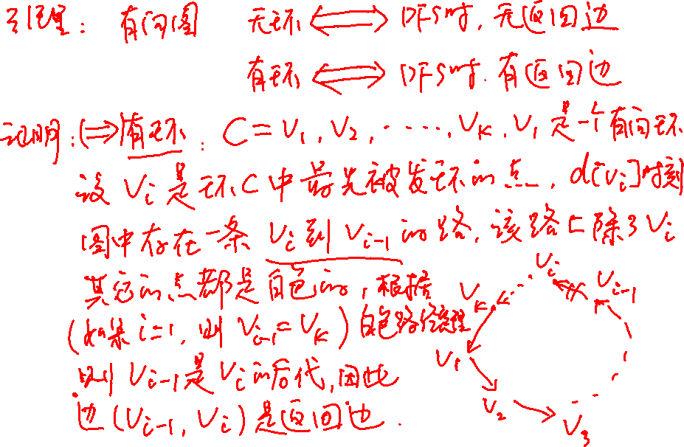
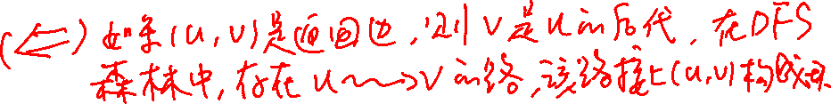

Slide 11
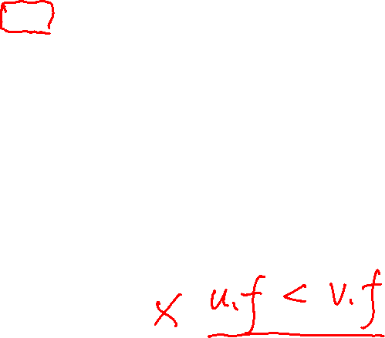
Correctness Proof of the Algorithm
Theorem 22.12: TOPOLOGICAL-SORT(G) produces a topological sort of a directed acyclic graph G.
Proof：Suppose that DFS is run on a given dag G = (V, E). It suffices to show that if (u, v) is an edge in G, then u.f >v. f.
By lemma 22.11, (u, v) cannot be a back edge, therefore, there are only three cases:
  (u, v) is a tree edge, u is ancestor of v, u.f> v.f;
  (u, v) is a forward edge, u is ancestor of v, u.f > v.f;
  (u, v) is a cross edge, when u is still being processed, v is black, u.f> v.f;
In all the three cases, we have u.f> v.f, so the proof is done.
A question: how about a back edge?

Slide 12
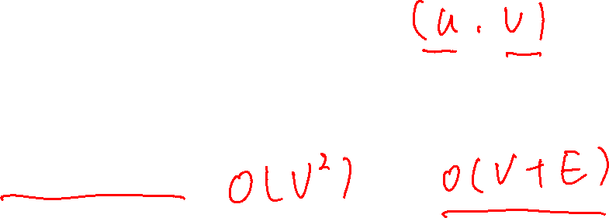
Another Method for Topological Sort
Repeat:
  Select a vertex v whose in-degree is zero, append it to the end of a list.
  Delete v and all edges leaving it.
Return the list.
  Proof sketch:
    for any (u,v)∈E, the in-degree of v can not be zero before deleting u, which implies u appears in front of v.
Exercise 22.4-5

Slide 14
Strongly Connected Components Decomposing
A strongly connected component of a directed graph G = (V, E) is a vertex induced sub-graph G’=(V’, E’) of G, such that :
  (1) Every pair of vertices in V’ are reachable from each other in G’;
  (2) Any other sub-graph that contains more vertices than G’ does not satisfy (1).
Is {1,2,3} a strongly connected component?
Is {1,2,3,4} a strongly connected component?
And {5}?
2
1
3
4
5

Slide 15
The Strongly Connected Components Decomposition Problem
The problem:
  Input: A directed graph G = (V, E).
  Output: All the strongly connected components of G.
Notes:
Sometimes, Strongly Connected Component is abbreviated as SCC, while Strongly Connected Components is abbreviated as SCCs.

Slide 16
An Example used to illustrate the procedure of SCCs Decomposing based on DFS algorithm
Give all the strongly connected components of the following graph.
Give the DFS forest of the following directed graph.
a
d
b
c
g
e
f

Slide 17
Observations
For each tree in a depth-first forest of a graph G:
  It contains all the vertices in the same SCC.
  But, it may also contain some that are not!
1/8
a
9/14
d
b
2/7
10/11
12/13
3/4
c
g
e
f
5/6
Observation: Running DFS algorithm on the original graph alone, we can’t find all SCCs correctly.

Slide 18

What happens if we reverse the edges of the original graph and depth-first search the new graph in decreasing f order?
9/14
12/13
10/11
1/8
g
c
a
b
2/7
f
d
5/6
3/4
e

Slide 19
An Example used to illustrate the procedure of SCCs Decomposing based on DFS algorithm
Give all the strongly connected components of the following graph.
Give the DFS forest of the following directed graph.
a
d
b
c
g
e
f

Slide 20
Observations
For each tree in a depth-first forest of a graph G:
  It contains all the vertices in the same SCC.
  But, it may also contain some that are not!
1/8
a
9/14
d
b
2/7
10/11
12/13
3/4
c
g
e
f
5/6
Observation: Running DFS algorithm on the original graph alone, we can’t find all SCCs correctly.

Slide 21
What happens if we reverse the edges of the original graph and depth-first search the new graph in decreasing f order?
9/14
12/13
10/11
1/8
g
c
a
b
2/7
f
d
5/6
3/4
e

Slide 22
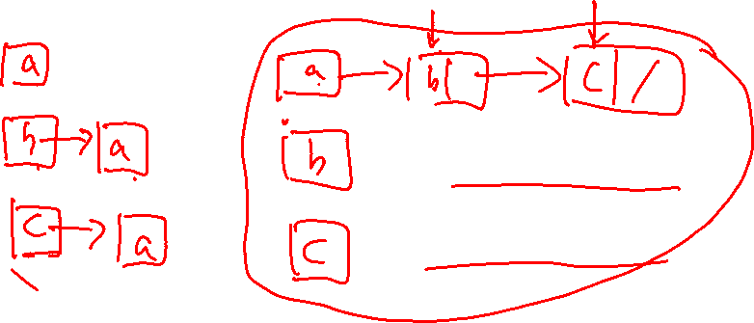
Transpose of a directed graph G
Definition:
Given a directed graph G = (V, E), the transpose of G is the graph G^{T}=(V, E^{T}), where E^{T}={(v, u)| (u, v)∈E}.
Given an adjacency-list representation of G, the time to create G^{T} is O(V + E). Why?

Slide 23
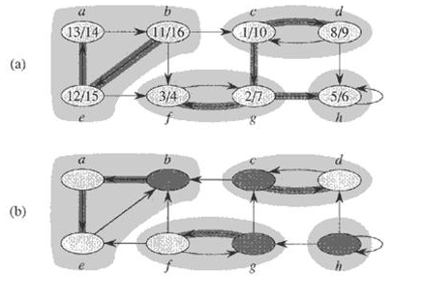
An Example
(a): The graph G with its SCCs shaded
(b): The transpose G^{T} of G with SCCs shaded

Slide 24
Relationship Between G and G^{T}
Given a directed graph G = (V, E)
  G and G^{T} have exactly the same strongly connected components, or in other words,
  u and v are reachable from each other in G if and only if they are reachable from each other in G^{T}.

Slide 25
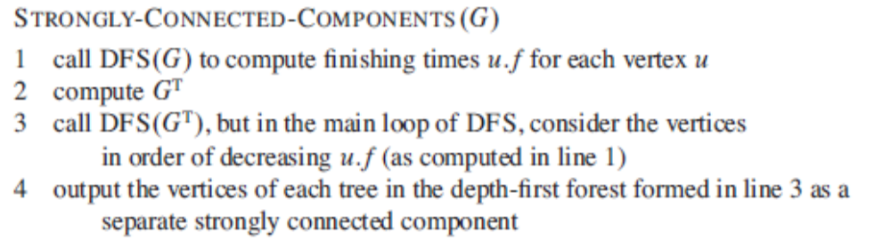
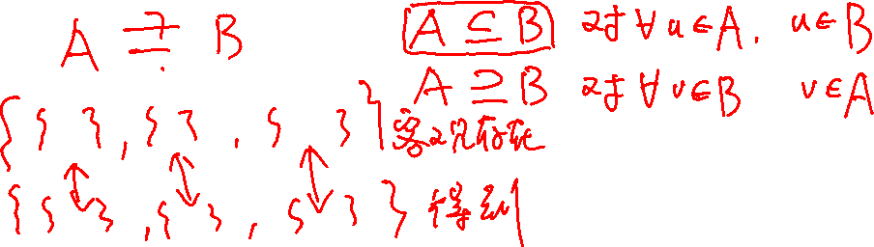
The Algorithm

Slide 26
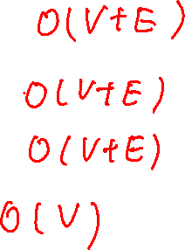
Time Complexity
Time Complexity:
line 1, line 2, line 3: Θ(V + E)
line 4: Θ(V)
total: Θ(V + E)

Slide 27
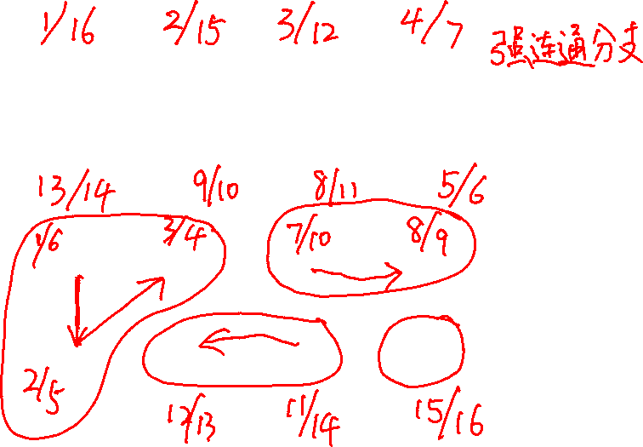
An example

Slide 28
Preparations – Part 1
The Component Graph
The component graph G^{SCC} = (V^{SCC}, E^{SCC}) of a directed graph G = (V, E) is defined as follows:
  Suppose that G has strongly connected components C₁, C₂, …, C_{k}
  the vertex set V^{SCC} = {v_{i} | v_{i} corresponds to component C_{i} of G, i = 1,2, …, k}
  the edge set E^{SCC} = {(v_{i}, v_{j}) | G contains a directed edge (x, y) for some x ∈ C_{i} and some y ∈ C_{j} , i, j = 1, 2 , …, k, i≠ j }
Another way: Contracting edge with vertices in the same strongly connected component.

Slide 29
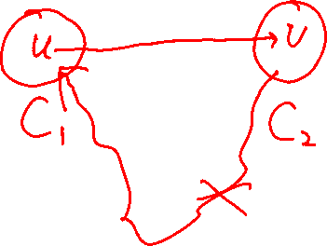
Preparations – Part 1
A Key Property of The Component Graph
Lemma 22.13 :The component graph G^{SCC} = (V^{SCC}, E^{SCC}) is a directed acyclic graph.
Proof:(by contradiction)
  Suppose that G^{SCC} is cyclic, that is, there exist two vertices v₁, v₂ ∈V^{SCC} such that v₁ and v₂ are reachable from each other.
  Since v₁ and v₂ represent the two strongly connected components C₁ and C₂ of G respectively.
  Then according to the definition of component graph, vertices in C₁ and C₂ are reachable from each other, which contradicts the definition of strongly connected component.

Slide 30
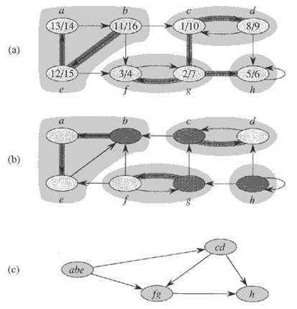
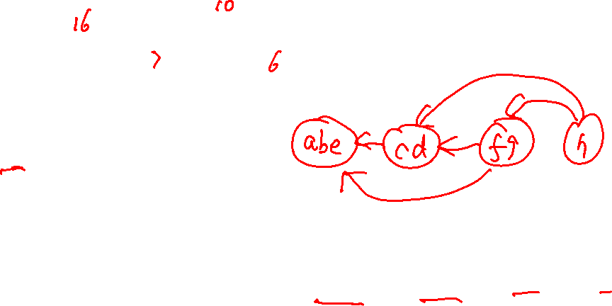

Preparations – Part 1
An Example
(a): The graph G with its SCCs shaded
(b): The transpose G^{T} of G with SCCs shaded
(c): The component graph G^{SCC} = (V^{SCC}, E^{SCC}) of G

Slide 31
Preparations – Part 2
Relationship between the SCCs and the f[]’s
Extension of the notation for d[⋅] and f[⋅] to sets of vertices
If U ⊆ V, define
  d(U) = min_{u∈U}{d[u]}, the discovery time of vertex set U, that is, the earliest discovery time of any vertex in U;
  f(U) = max_{u∈U}{f[u]}, the finishing time of vertex set U, that is, the latest finishing time of any vertex in U.

Slide 32
Preparations – Part 2
Relationship between the SCCs and the f[]’s
引理22.14: 设C 和 C’ 是两个强连通分支，如果存在边(u, v) ∈ E, 其中 u ∈ C ，v ∈ C’，则f(C) > f(C’)。
证明：分两种情况
  第一次DFS先扫描的C中的某个顶点，d(C) < d(C’)
  第一次DFS先扫描的C’中的某个顶点， d(C’)< d(C)
u
v
x
y
C
C’

Slide 33
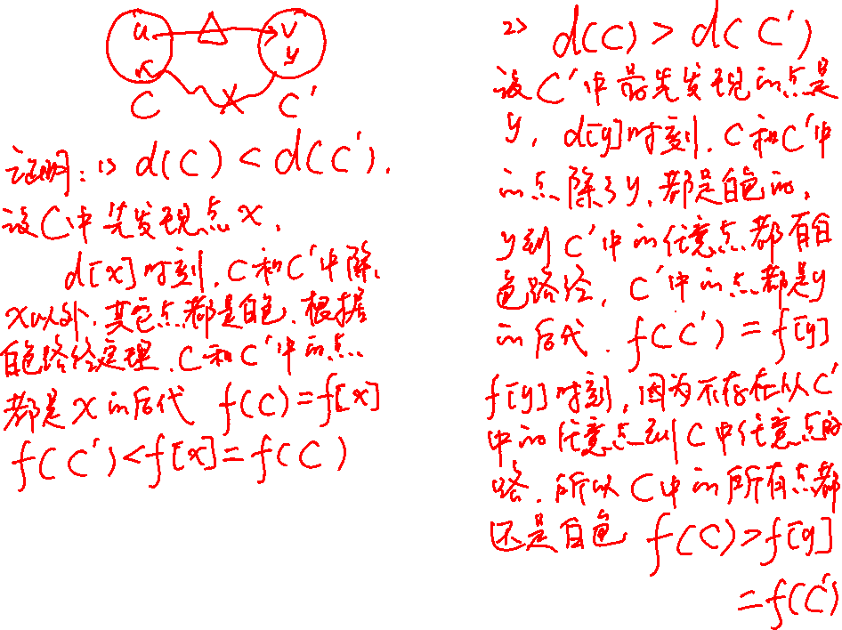

Slide 35
Preparations – Part 2
Proof of Lemma 22.14 (continued)
Case 1: d(C) < d(C’)
  设x是C中第一个被扫描的顶点，则d[x]时刻，C和C’中的所有顶点都是白色的。x到C中的每个顶点都存在一条由白色顶点构成的路径；同时，边(u,v)的存在，使得x到C’中的每个顶点w也有一条白色路径:x∼u→v∼w，根据白色路径定理, C和C’中的所有顶点都是u的后代，由于后代的区间都是祖先区间的子区间，所以f[x]=f(C)>f(C’).
u
v
x
y
C
C’

Slide 36
Preparations – Part 2
Proof of Lemma 22.14 (continued)
Case 2: d(C’)< d(C)
  设y是C’中第一个被扫描的顶点，则d[y]时刻，C’中的所有顶点都是白色的。x到C’中的每个顶点都存在一条由白色顶点构成的路径，根据白色路径定理C’中的所有顶点都是u的后代，由于后代的区间都是祖先区间的子区间，所以f[y]=f(C’).
  d[y]时刻，C中的所有顶点都是白色的。因为 (u, v) 是从 C 到 C’的边，引理22.13保证，不存在从C’ 到 C的路径，所以y不存在任何路径通向C中的顶点，所以，f[y]时刻，C中的所有顶点还是白色的。因此对任意的w∈C， f[w]>f[y]，即f(C) > f(C’).
u
v
x
y
C
C’

Slide 37
Preparations – Part 2
Relationship between the SCCs and the f[]’s
Lemma 22.14 Let C and C’ be two distinct strongly connected components in directed graph G = (V, E). Suppose that there is an edge (u, v) ∈ E, where u ∈ C and v ∈ C’. Then f(C) > f(C’).
  Proof:
u
v
x
y
C
C’
Case 1: d(C) < d(C’) Case 2: d(C) > d(C’)

Slide 38
Preparations – Part 2
Proof of Lemma 22.14 (continued)
Case 1: d[C] < d[C’]
Let x be the first vertex discovered in C. At time d[x], all vertices in C and C’ are white. There is a path in G from x to each vertex in C consisting only of white vertices. Because (u, v) ∈ E, for any w∈C’, there is also a path from x to w in G consisting only of white vertices. By the white-path theorem, all vertices in C and C’ become descendants of x in the depth-first tree. By Corollary 22.8, f[x]=f(C)>f(C’).
u
v
x
y
C
C’

Slide 39
Preparations – Part 2
Proof of Lemma 22.14 (continued)
Case 2: d[C] > d[C’]
Let y be the first vertex discovered in C’. At time d[y], all vertices in C’ are white and there is a path in G from y to each vertex in C’ consisting only of white vertices. By white-path theorem, all vertices in C’ become descendants of y in the depth-first tree, and by Corollary 22.8, f[y]=f(C’). At time d[y], all vertices in C are white. Since there is an edge (u, v) from C to C’, Lemma 22.13 implies that there cannot be a path from C’ to C. Hence, no vertex in C is reachable from y. At time f[y], therefore, all vertices in C are still white. Thus, for any vertex w∈C, we have f[w]>f[y], which implies that f(C) > f(C’).
u
v
x
y
C
C’

Slide 40
Preparations – Part 2
A Corollary
Corollary 22.15：Let C and C’ be distinct strongly connected components in directed graph G = (V, E). Suppose that there is an edge (u, v) ∈ E^{T}, where u ∈ C and v ∈ C’. Then f(C) < f(C’).
E^{T}中的边都是从先结束(f[]小)的到后结束的(f[]大) 。
  Proof: (u, v) ∈ E^{T} ➔ (v, u) ∈ E, G and G’ has the same strongly connected components, Lemma 22.14 implies
  f(C) < f(C’).
Note: Here, the finishing times are got from the first depth-first search

Slide 41
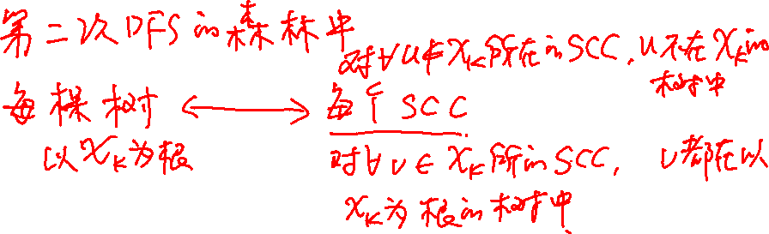
Final Destination
Correctness Proof of the Algorithm
Theorem 22.16 ： STRONGLY-CONNECTED-COMPONENTS(G) correctly computes the strongly connected components of a directed graph G.

Slide 42
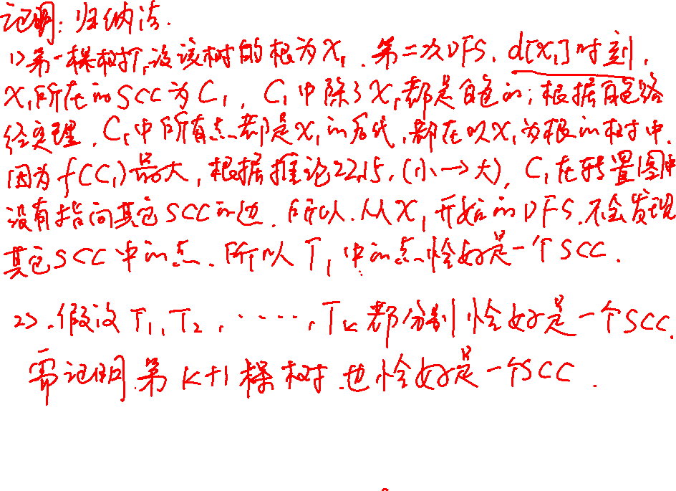

Slide 43
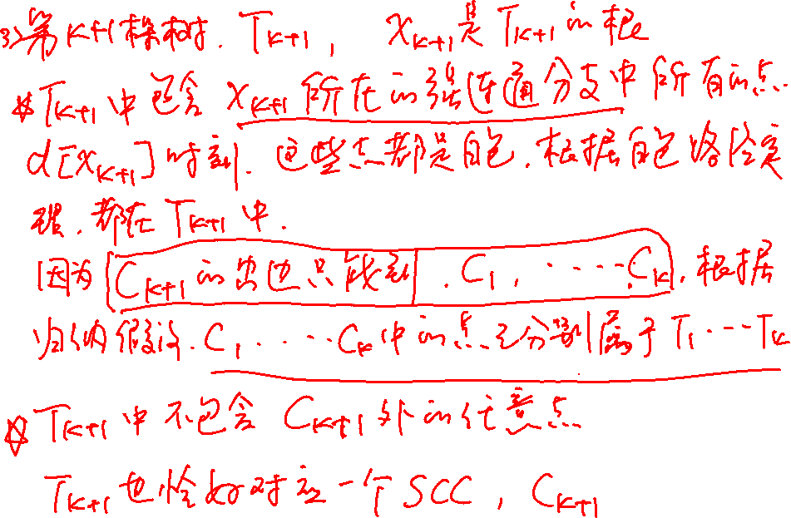

Slide 44
Proof
我们证明对G^{T}进行DFS得到的每一棵树都对应一个强连同分支。对找到的树的序号k进行归纳证明。
当k=1时，设u是该树的根，对应的强连同分支为C，f[u]是所有顶点结束时间最大的， f[u]= f(C)； d[u]时刻，C中的顶点都是白色的，根据白色路径定理，C中的所有顶点都是u的后代，从而都在以u为根的树中。
根据推论22.15，C中顶点不可能有出边到C之外的顶点，从而u不存在到任何其它连通分支中顶点的路径。所以，以u为根的树中，包含且只包含C中的所有顶点。
归纳假设：前k棵树都对应强连通分支

Slide 45
Proof Continued
则找到第k+1棵树时，设u是该树的根，对应的强连同分支为C，f[u]是未扫描的顶点中结束时间最大的， f[u]= f(C)> f(C’), C’是任意尚未找到的连通分支 ；此时C中的顶点都是白色的，根据白色路径定理，C中的所有顶点都是u的后代，从而都在以u为根的树中。
根据推论22.15，在 G^{T}中，C中顶点只可能有出边到C之外的已经找到的强连通分支中的顶点，从而u不存在到任何其它未找到的连通分支中顶点的路径，在对G^{T}进行DFS时，所有未找到的强连通分支中的顶点都不是u的后代。所以，以u为根的树中，包含且只包含C中的所有顶点。

Slide 46
Proof (Continued)
T₂
C_{T1}
C_{T2}
……
C_{Tk}
T₁
T_{k}
T_{k+1}
?
C
u
……

Slide 47
Review the Example

Slide 48
Proof (continued)
Proof: we will prove that the vertices of each tree form a strongly connected component, by induction on the number k of depth-first trees found in the depth-first search of G^{T} in line 3.
  Basic step: k = 0, it is trivially true.
  Inductive hypothesis: the first k trees produced in line 3 are strongly connected components.
  Inductive step: Consider the (k+1)st tree produced.
    Let the root of the (k+1)st tree be vertex u, and let u be in strongly connected component C. By induction hypothesis, no vertices in C had been searched before, and since u has the biggest f[] among all the remaining vertices in G^{T}, f[u] = f[C] > f[C’] for any strongly connected component C’ other than C that has yet not been visited.
    At time d[u], all other vertices of C are white. By the white-path theorem, all other vertices of C are descendants of u in its depth-first tree.
    Moreover, by induction hypothesis, Corollary 22.15 and f[C] > f[C’] got above, any edge in G^{T} that leaves C must point to SCCs that have already been visited. Thus, no vertex in any SCC other than C will be a descendant of u during the depth-first search of G^{T}.
  Thus, the vertices of the depth-first tree in G^{T} that is rooted at u form exactly one strongly connected component

Slide 49
Conclusion
Topological Sort algorithm
-- (for directed acyclic graph)
  A key property for DAG
  Proof of the correctness of the algorithm
Strongly Connected Components Decomposing
Algorithm-- (for directed graph)
  A key property of the component graph
  The relationship between the SCCs and the f[]’s
  Proof of the correctness of the algorithm

Slide 50
Homework
22.4-2
22.4-5
22.5-5
22.5-7
Probem 22-3

