Slide 1
Lecture 6
Properties of MST
Properties of MST
Second-best MST
Bottleneck Spanning Tree

Slide 2

Properties of MST
Property 1:
  Let (u, v) be a minimum-weight edge in a graph G = (V, E), then (u, v) belongs to some minimum spanning tree of G.
  Proof: Let A be the empty set of edges. Then A is a subset of some minimum spanning tree, and A does not include (u, v). Then cut (u, V-u) respects A. Edge (u, v) is a light edge crossing cut (u, V-u). According to theorem 23.1, (u, v) is a safe edge for A. Hence, (u, v) belongs to some minimum spanning tree.
  Another method: Suppose T is an arbitrary MST, and (u, v) is not in T. Then T+(u, v) contains a cycle. Let f be any edge other than (u, v) on the cycle, then T +(u, v) - f is another MST and it contains (u, v).

Slide 3
Properties of MST
Property 2
  Let T be a minimum spanning tree of a graph G, and let L be the sorted list of the edge weights of T, then for any other minimum spanning tree T’ of G, the list L is also the sorted list of edge weights of T’.
    A corollary of Property 3.
    If all the edge weights are distinct, then MST is unique.
Property 3
  Let T be a minimum spanning tree of a graph G, and let T’ be an arbitrary spanning tree of G, suppose the edges of each tree are sorted in non-decreasing weight order, that is, w(e₁)≤w(e₂) ≤… ≤w(e_{n-1}) and w(e₁’)≤w(e₂’) ≤… ≤w(e_{n-1}’), then for 1 ≤ i ≤ n-1, w(e_{i}) ≤w(e_{i}’).

Slide 4
Proof of Property 3
  (Prove by contradiction) Suppose without loss of generality that there exists an index i≥1 such that w(e₁) ≤w(e₁’), w(e₂) ≤w(e₂’), …, w(e_{i-1}) ≤w(e_{i-1}’), but w(e_{i}) >w(e_{i}’). This indicates that w(e_{n-1}) ≥ w(e_{n-2})≥ … ≥ w(e_{i})>w(e_{i}’) ≥ w(e_{i-1}’) ≥… ≥ w(e₁’). So, if we add any e_{x}’∈{ e₁’, e₂’, …, e_{i}’} onto T, then either e_{x}’ is an edge of {e₁, e₂,…, e_{i-1}}, or a cycle is formed which includes only edges in {e_{x}’, e₁, e₂,…, e_{i-1}}. Thus each e_{x}’∈{ e₁’, e₂’, …, e_{i}’} is included in a connected component of {e₁, e₂, .., e_{i-1}}. Thus if we add all the edges { e₁’, e₂’, …, e_{i}’} onto T and delete {e_{i}, …, e_{n-1}}, { e₁’, e₂’, …, e_{i}’} are still included in the connected component of {e₁, e₂, .., e_{i-1}}. Thus {e₁’, e₂’, …, e_{i}’ ,e₁, e₂, .., e_{i-1}} have the same number of connected components as {e₁, e₂, .., e_{i-1}} have, i.e., n-i+1. A contradiction, since {e₁’, e₂’, …, e_{i}’} are tree edges, they can have at most n-i connected components.

Slide 5
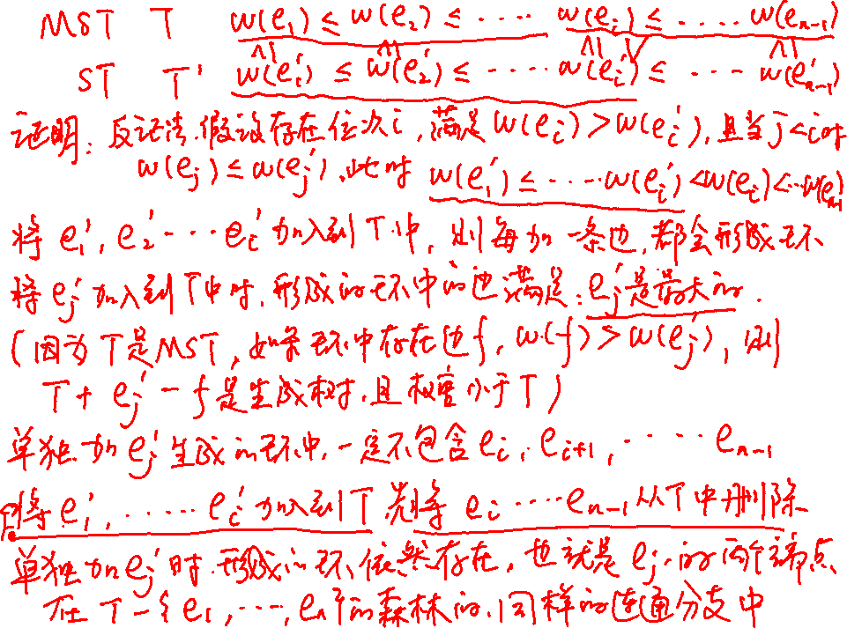

Slide 6
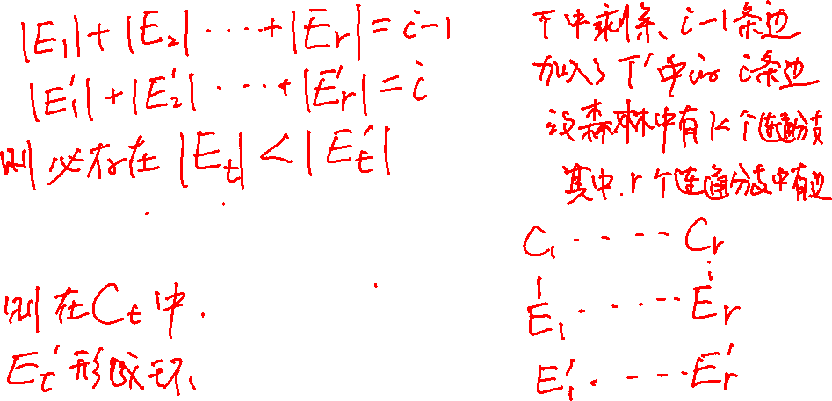
{e₁’, …, e_{i}’} are all included in the components of G_{i-1},
So, red edges cannot have less components.
edges in {e₁, …, e_{i-1}}
edges in {e₁’, …, e_{i}’}

Slide 7
Second-best MST
Let G = (V, E) be an undirected, connected graph with weight function w: E → R, and suppose that | E | ≥ | V | and all edge weights are distinct, a second-best minimum spanning tree is a spanning tree T such that w(T) = min_{T’’∈Γ-{T’}}{w(T’’)}, where Γ is the set of all spanning trees of G, and T’ is a minimum spanning tree of G.

Slide 8
MST Property
Let G = (V, E) be an undirected, connected graph with weight function w: E → R, and suppose that | E | ≥ | V | and all edge weights are distinct. Then the minimum spanning tree of G is unique.
  According to Property 2.

Slide 9
Second-best MST Properties
The second-best minimum spanning tree can not be unique.
2
1
4
2
MST
1
3
4
2
5
3
1
1
4
5

Slide 10

Second-best MST Properties
A second-best minimum spanning tree can be obtained from the minimum spanning tree by replacing a single edge from the tree with another edge not in the tree.
  By contradiction. Suppose T₁ is the MST and T₂ is a second-best MST, and they differ by at least two edges, we will get another spanning tree T₃ which is not equal to T₁ but better than T₂, thus contradicts that T₂ is second-best.

Slide 11
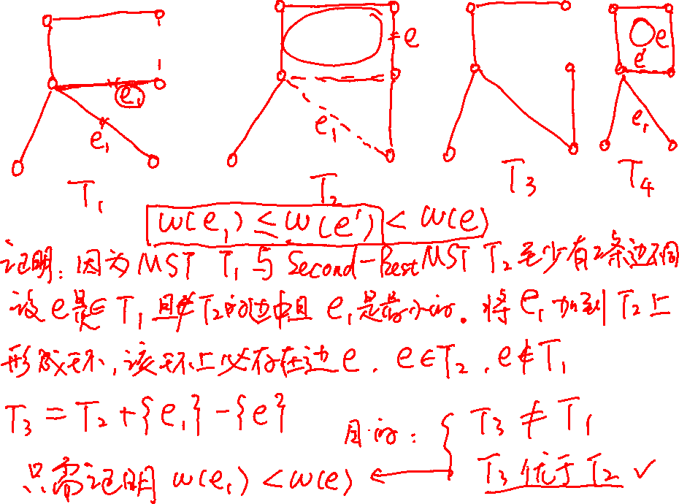

Slide 12
  Suppose e₁ is the minimum edge in T₁\ T₂.
  Then T₂ U {e₁} contains a cycle on which there must be some edge e which belongs to T₂ but not belongs to T₁, since otherwise T₁ has a cycle.
  Let T₃=T₂ U {e₁} \e. Then T₃ is a spanning tree.
  We claim that
  T₃ is better than T₂.
  T₃ is not equal to T₁.
  Thus, contradicts to that T₂ is a second-best MST.

Slide 14
  Proof of 1: We claim that w(e) > w(e₁). Proof by contradiction: assume that w(e) < w(e₁). If we add e to T₁, we get a cycle C, which contains some edge e' in T₁ but e' is not in T₂. (otherwise, T₂ would contain a cycle). Therefore, the set of edges T₄ = T₁ - {e'} U {e} form a spanning tree, and we must have w(e') < w(e), since otherwise T₄ would be a spanning tree with weight less than w(T₁ ). Thus, w(e') < w(e) < w(e₁), which contradicts our choice of e₁ as the edge in T₁ - T₂ of minimum weight. Since T₃=T₂ U {e₁} \e, T₃ is better than T₂.
  Proof of 2: T₃ differs from T₂ by only one edge, while T₁ differs from T₂ by at least two edges, so, T₃ is not equal to T₁.
  Thus, we have formed a spanning tree T₃ whose weight is less than w(T₂) but is not T₁. Hence, contradicts that T₂ is a second-best minimum spanning tree.

Slide 15
Compute the Second-best MST
Idea: use the property in previous page:
  (u, v): an edge of T, (x, y): an edge in G but not in T
  w(T’) = w(T) + (w(x, y) – w(u, v))
Let T be a spanning tree of G and for any two vertices u, v ∈V, let max[u, v] be the maximum weight among all edges on the unique path between u and v in T.
How to compute max[u, v]?

Slide 16
Compute_max(T)
for each pair of vertices u, v ∈V
do max[u, v] ← 0
for each vertex s ∈V
do BFS (T, s) //E(T)=O(V)
BFS(T, s)
for each vertex u ∈V
do color[u] ← WHITE
color[s] ←GRAY
Q ←Φ
ENQUEUE(Q, s)
while Q ≠ Φ
do u ← DEQUEUE(Q)
for each v ∈ Adj[u]
do if color[v] = WHITE
then color[v] ←GRAY
max[s, v] ← max{w(u, v), max[s, u]}
ENQUEUE(Q, v)
color[u] ← BLACK

Slide 17
Compute the Second-best MST
Second-Best-MST(G)
Compute a MST T for G
Compute max[u, v] for each pair of vertices in T
For each edge (u, v) in G but not T, compute the difference w(u, v) – max[u, v]
Find the smallest positive difference and replace the max_edge[u, v] with corresponding edge (u, v).
Note: max_edge[u, v] means the edge with maximum weight in the path connecting u and v in T. It can be easily computed.

Slide 18
Time Complexity Analysis
Compute-max(T): O(V²)
Second-Best-MST(G): O(ElogV + V²)

Slide 19
Bottleneck Spanning Tree
A bottleneck spanning tree T of a connected, weighted and undirected graph G is a spanning tree of G whose largest edge weight is minimum over all spanning trees of G.
  Let T₁, T₂, …, T_{m} are all the spanning trees G, and the largest edge of each tree is e_{t1}, e_{t2}, …, e_{tm.} If w(e_{ti}) ≤ w(e_{tj}) for 1 ≤ j ≤ m and j ≠ i, then T_{i} is a bottleneck spanning tree.
  The value of a BST T is the weight of the maximum-weight edge in T.
  The bottleneck spanning tree may not be unique.

Slide 20
BST vs MST
Every minimum spanning tree is a bottleneck spanning tree.
  Property 3 implies it.
  Another proof: Let T be a MST and T’ be a BST, let the maximum-weight edge in T and T’ be e and e’, respectively. Suppose for the contrary that the MST T is not a BST, then we have w(e)>w(e’), which also indicates that the weight of e is greater than that of any edges in T’. Removing e from T disconnects T into two subtrees T₁ and T₂, there must exist an edge f in T’ connecting T₁ and T₂, otherwise, T’ is not connected. T₁∪T₂ ∪{f} forms a new tree T’’ with w(T’’) = w(T) - w(e) + w(f) < w(T), A contradiction to the fact that T is MST, thus, a MST is also a BST.

Slide 21
The BST Problem
The Problem:
  Input: A weighted, connected and undirected graph G.
  Output: A BST T of G.
A solution:
  Kruskal’s and Prim’s Algorithm works for the BST problem.
More efficient algorithm exist for the problem?

Slide 22
A Verification Problem
A verification problem:
  Input: A graph G = (V, E; W) and an integer b
  Output: TRUE if the value of the bottleneck spanning tree of G is at most b and FALSE otherwise
How to solve this problem in linear time?

Slide 23
CHECKBOTTLENECK(G, b)
for each vertex u ∈ V[G]
do color[u] ←WHITE
u ←randomly chosen vertex in G
DFS(u, b) //O(V+E)
for each vertex u ∈V[G]
do if color[u] = WHITE
then return FALSE
return TRUE
DFS(u, b)
color[u] ←GRAY
for each v ∈Adj[u]
do if color[v] = WHITE and w(u, v)≤b
then DFS(v, b)
color[u] ←BLACK

Slide 24
Solve the BST Problem
BOTTLENECK(G)
sort the weights of edges of G in non-decreasing order: e[1], e[2], …, e[| E |]
start ← 1
end ← | E |
while start < end
do middle ← ⎣(start + end)/2⎦
if CHECKBOTTLENECK(G, e[middle]) = FALSE
then start ←middle
else end ←middle //in the end there is a BST with value =e[end],
u ← randomly chosen a vertex of G
call DFS(u, e[start]) to build a spanning tree

Slide 25
Solve the Problem in Linear Time
Time complexity:
Sorting:O(ElogV)
Finding the value of BST: O((V+E)logV)=O(ElogV)
Total:O(ElogV)
Can the problem be solved in linear time?
Please think it carefully, anyone who finds the solution will be given an extra bonus.
Will it be unsolved all our lives?

Slide 26
23.1-5
证明:设C=v₀, v₁,…,v_{k}是一个圈,其中边e=(v₀, v_{k})是权值最重的边。
只需要构造一棵不包含e=(v₀, v_{k})的MST即可。
设T是一棵包含e=(v₀, v_{k})的MST，则删除e会使T变成两个连通分支V₁，V₂，v₀∈V₁，v_{k}∈V₂。依次检测顶点v₁,…,v_{k}，找到第一个在V₂中的顶点v_{i}(这样的v_{i}一定能找到，因为v_{k}∈V₂)，从而e’=(v_{i-1}, v_{i})是穿过割(V_{1,}V₂)的一条边，并且w (v₀, v_{k})≥ w(v_{i-1}, v_{i})。则T’=T-e+e’是一棵新的MST。

Slide 27
23-4(a)
证明: 设T中的边按照权值非递减顺序依次为e₁, e₂,…, e_{n-1},
即算法依次保留边e₁, e₂,…, e_{n-1}。设边集A_{i} ={ e₁, e₂,…, e_{i}}，1≤i≤n-1则只需要证明每个A_{i} 都是某棵最小生成树的子集。
用归纳法证明。
i=1时，设T’是一棵最小生成树，如果(u, v)=e₁∈T’, 结论自然成立。如果e₁∉T’，则在T’中存在u到v的路径p。因为删除e₁会使图不连通，即删除e₁会使顶点集合V划分为两个子集V₁和V₂，其中u∈V₁，v∈V₂。则路径p中存在1条边(x, y)满足x∈V₁，y∈V₂，并且(x, y)已经被删除了，否则如果p中所有边都没被删除，删除e₁不会使图不连通。既然(x, y)已经被删除了，根据算法是按照权值由大到小的顺序删边的，所以w(x, y)≥ w(u, v)。则T’’=T’ - (x, y)+(u, v)必然是一棵最小生成树。

Slide 28
Continued
设对边集A_{i}时结论成立，现在证明边集A_{i+1}也是某棵最小生成树的子集。
设A_{i} ={ e₁, e₂,…, e_{i}}是最小生成树T’的子集，如果(u, v)=e_{i+1}∈T’, 结论自然成立。如果e_{i+1}∉T’，则在T’中存在u到v的路径p。因为删除e_{i+1}会使图不连通，即删除e₁会使顶点集合V划分为两个子集V₁和V₂，其中u∈V₁，v∈V₂。则路径p中存在1条边(x, y)满足x∈V₁，y∈V₂，并且(x, y)已经被删除了，否则如果p中所有边都没被删除，删除e₁不会使图不连通。既然(x, y)已经被删除了，根据算法是按照权值由大到小的顺序删边的，所以w(x, y)≥ w(u, v)。则T’’=T’ - (x, y)+(u, v)必然是一棵最小生成树。现在只需要证明T’’包含A_{i} ={ e₁, e₂,…, e_{i+1}}中的所有边，因为T’’与T’只有1条边不同，所以只需要证明(x,y)∉A_{i}，这显然是成立的，因为(x, y)已经被删除了，而{ e₁, e₂,…, e_{i}}是没被删除的。
证明完毕！

Slide 29
23-4(c)
证明：算法实际上是在图G中删除一些圈上权值最重的边，最后得到一棵MST。
设删除的边依次为e₁, e₂…,e_{m-n+1}，剩余的图依次是G₀, G₁,…,G_{m-n+1}，其中G=G₀，G_{m-n+1}=T，m=|E|，n=|V|。
我们证明G_{i+1}的MST同时也是G_{i}的MST即可。
前面23.1-5已经证明了存在G_{i+1}的MST T’同时也是G_{i}的MST，而G_{i+1}的所有MST的大小与T’一样的，所有它们都与G_{i}的MST的大小一样，所以他们都是G_{i}的MST。
从而G_{m-n+1}必然是G_{m-n},…, G_{o}的MST。

Slide 30
Experiment-1
给定一个有向图G，从G中删除一些边，将G变为有向无环图。
要求：
  图用邻接链表存储
  能对具体小事例运行出正确结果
  能跟助教讲清楚你的算法思想
  不要求删除的边数最少

