Slide 1
Lecture 7
Single-Source Shortest Paths Problems
Related Notions
Variants of Shortest-Paths Problems
Properties of Shortest-Paths and Relaxation
The Bellman-Ford Algorithm

Slide 2

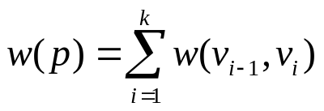
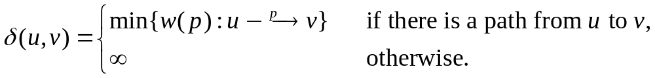
Shortest Paths—Notions
Given a weighted, directed graph G = (V, E; W), the weight of path p = <v₀, v₁, …, v_{k}> is the sum of the weights of its constituent edges, that is,
The shortest-path weight from u to v is defined as
A shortest path from vertex u to v is any path p with weight w(p) = δ(u, v).

Slide 3
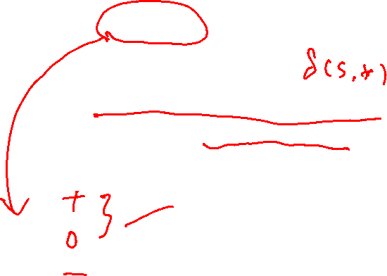
Single-source shortest path problem
Input: A weighted directed graph G=(V, E; W) and a source vertex s.
Output: Shortest-path weight from s to each vertex v in V, and a shortest path from s to each vertex v in V if v is reachable from s.

Slide 4
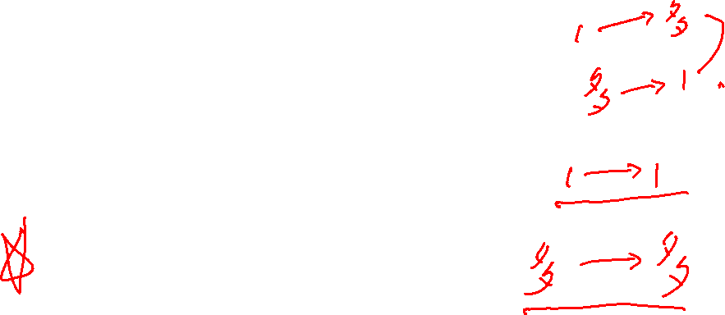
Variants of Single-source shortest-path problem
Single-source shortest-paths problem
Single-destination shortest-paths problem
--- reverse the direction of edge
Single-pair shortest-path problem
--- consider u as source vertex
All-pairs shortest-paths problem
--- topic of next chapter

Slide 5
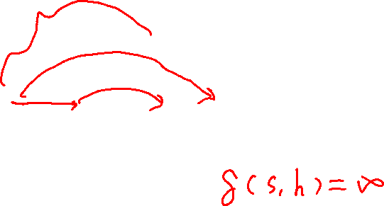
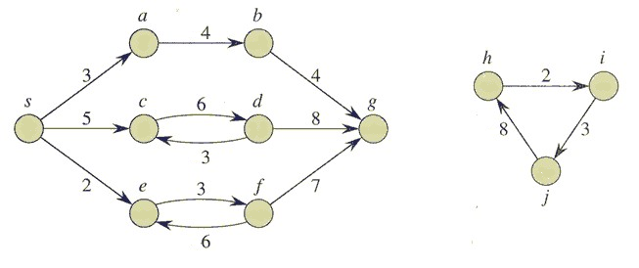

Shortest paths – an example

Slide 6
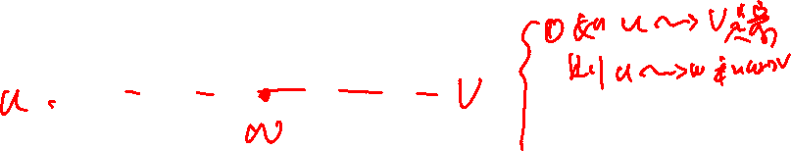
Optimal Substructure of Shortest Paths
Lemma 24.1 (Subpaths of shortest paths are shortest paths)
Given a weighted, directed graph G = (V, E; W), let p = <v₁, v₂, …, v_{k}> be a shortest path from vertex v₁ to vertex v_{k} and, for any i and j such that 1 ≤ i ≤ j ≤ k, let p_{ij} = <v_{i}, v_{i+1}, …, v_{j}> be the subpath of p from vertex v_{i} to vertex v_{j}. Then, p_{ij} is a shortest path from v_{i} to v_{j}.

Slide 7
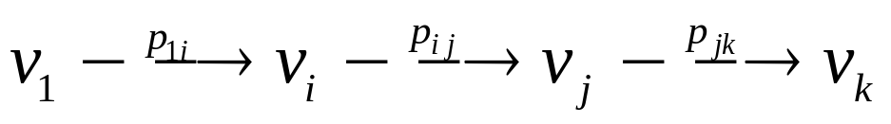


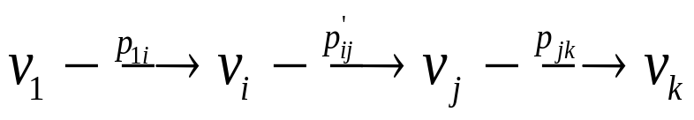
Proof
The path p can be decomposed into
Then we have w(p)=w(p_{1i})+w(p_{ij})+w(p_{jk}).
Assume thet there is a path from v_{i} to v_{j} with weight w( )< w(p_{ij}).
Then is a path from v₁ to v_{k} whose weight is less than w(p), which contradicts the assumption that p is a shortest path from v₁ to v_{k} .

Slide 8
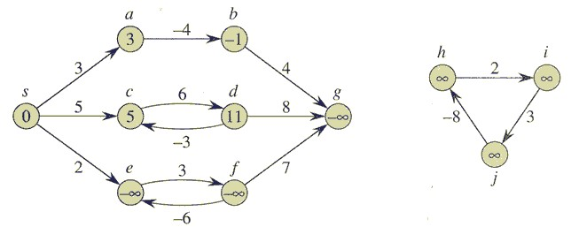
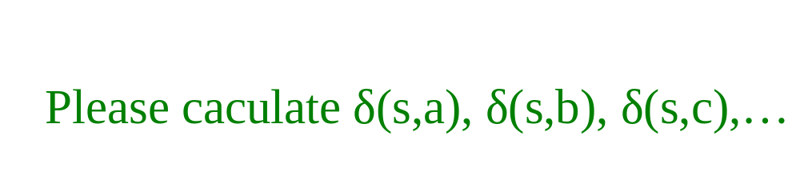
Negative-weight edge and negative-weight cycle
If there is a negative-weight cycle on some path from s to v,
we define δ(s, v) = -∞.

Slide 9
Cycles
Three typies of cycle: negative-weight cycle,
positive-weight cycle,
0-weight cycle
Can a shortest path contains a cycle?
We can assume that when we are finding shortest paths, they are cycle-free. Any acyclic path contains at most |V| distinct vertices, it also contains at most |V|-1edges.Thus, we can restrict our attention to shortest paths of at most |V|-1 edges.

Slide 10
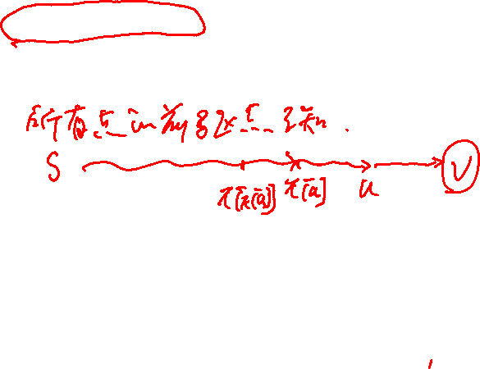
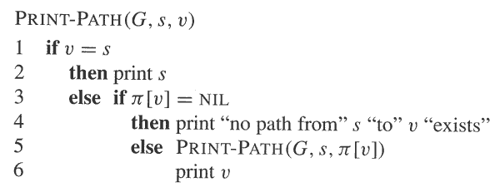
Representing Shortest-Paths
Given a graph G = (V, E), maintain for each vertex v ∈V a predecessor π[v] that is either another vertex or NIL.
Given a vertex v for which π[v] ≠ NIL, the procedure PRINT-PATH(G, s, v) prints a shortest path from s to v.

Slide 11
Predecessor subgraph
Predecessor subgraph G_{π} = (V_{π}, E_{π}):
  V_{π} = {v ∈V: π[v] ≠ NIL} ∪{s}
  E_{π} = {(π[v] , v) ∈E: v ∈V_{π} -{s}}
We shall prove that π values produced by the algorithms in
this chapter have the property that at termination G_{π} is a “shortest-paths tree”

Slide 12

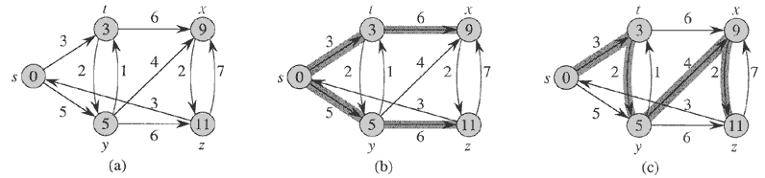
Shortest-Paths Tree
Let G = (V, E;W) be a weighted, directed graph, and assume that G contains no negative cycles that are reachable from s. A shortest-paths tree rooted at s is a directed sub-graph G’=(V’, E’), where V’⊆V and E’⊆E, such that
  V’ is the set of vertices reachable from s in G,
  G’ forms a rooted tree with root s, and
  For all v ∈V’, the unique simple path from s to v in G’ is a shortest path from s to v in G.
The shortest-path tree may not be unique.

Slide 13
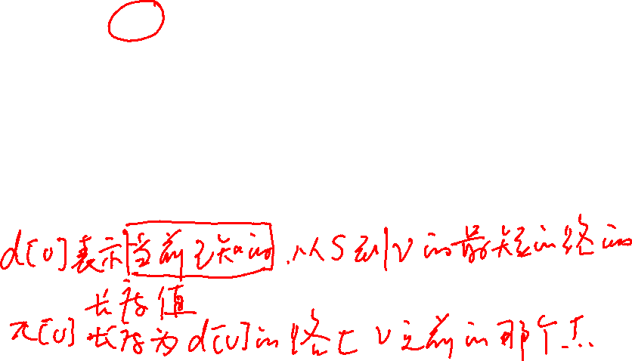
The technique of Relaxation
In our shortest-paths problem, we maintain an attribute d[v], which is an upper bound on the weight of a shortest path from source s to v.
We call d[v] a shortest-path estimate.
i.e., d[v] is an estimate of δ(s, v).
The term Relaxation is used here for an operation that tightens an upper bound.

Slide 14
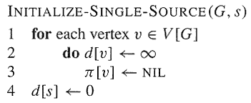
Relaxation--Initialization
The initial estimate of δ(s, v) can be given by:

Slide 15
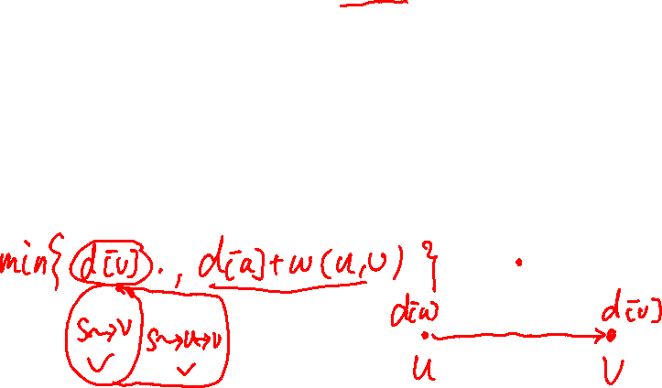
Relaxation Process
Relaxing an edge (u, v) consists:
  Testing whether we can improve the shortest path from s to v found so far by going through u to v, and if so,
  Updating d[v] and π[v].
A relaxation step may either decrease the value of the shortest-path estimate d[v] and update v’s predecessor π[v], or cause no change.

Slide 16
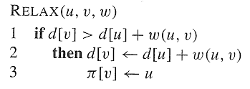
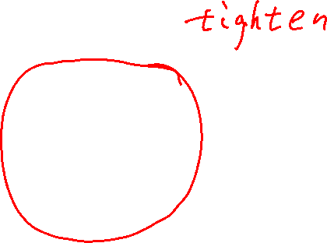
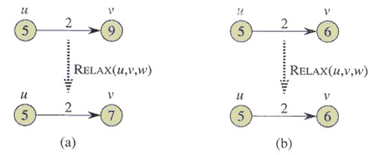
A Relaxation Step

Slide 17
Some notes about Relaxation
Note:
  Each algorithm in this chapter calls INITIALIZE-SINGLE-SOURCE and then repeatedly relaxes edges.
  Relaxation is the only means by which shortest-path estimates d[] and predecessors π[] change.
  The algorithms differ in how many times they relax each edge and the order in which they relax edges.
  Bellman-Ford algorithm relaxes each edge many times, while Dijkstra’s algorithm and the algorithm for directed acyclic graphs relax each edge exactly once.

Slide 18
Properties of Shortest Paths and Relaxation
Triangle inequality (Lemma 24.10)
  For any edge (u, v) ∈E, we have δ(s, v) ≤ δ(s, u) + w(u, v)
Upper-bound property (Lemma 24.11)
  We always have d[v] ≥ δ(s, v) for all vertices v ∈V, and once d[v] achieves the value δ(s, v), it never changes.
No-path property (Lemma 24.12)
  If there is no path from s to v, then we always have d[v] = δ(s, v) = ∞.

Slide 19
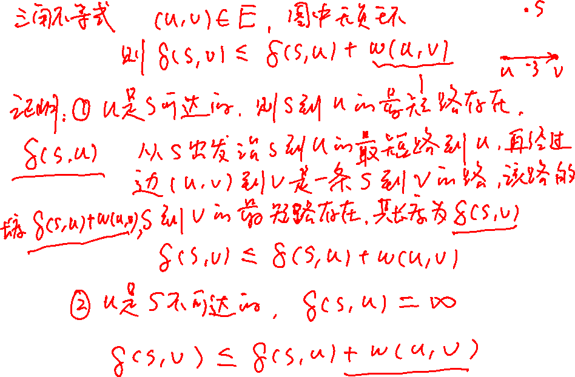

Slide 20
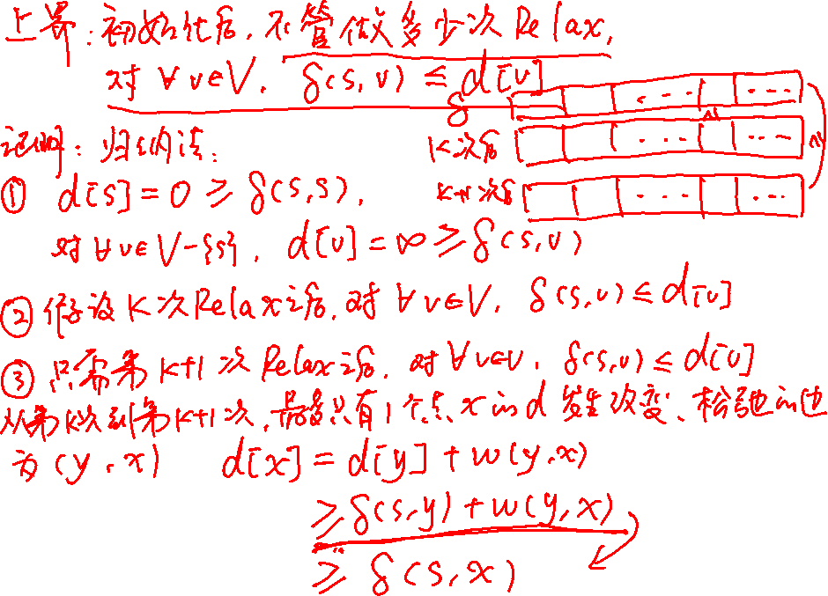

Slide 21

Properties of Shortest Paths and Relaxation
Convergence property (Lemma 24.14)
  If s ~→ u→ v is a shortest path from s to v in G, and if d[u] = δ(s, u) at any time prior to relaxing edge (u, v), then d[v] = δ(s, v) at all times afterward.
Path-relaxation property (Lemma 24.15)
  If p = <s, v₁, …, v_{k}> is a shortest path from s to v_{k}, and the edges of p are relaxed in the order (s, v₁), (v₁, v₂), …, (v_{k-1}, v_{k}), then after relaxing all the edges, d[v_{k}] = δ(s, v_{k}).
  Note that other relaxations may take place among these relaxations.

Slide 22
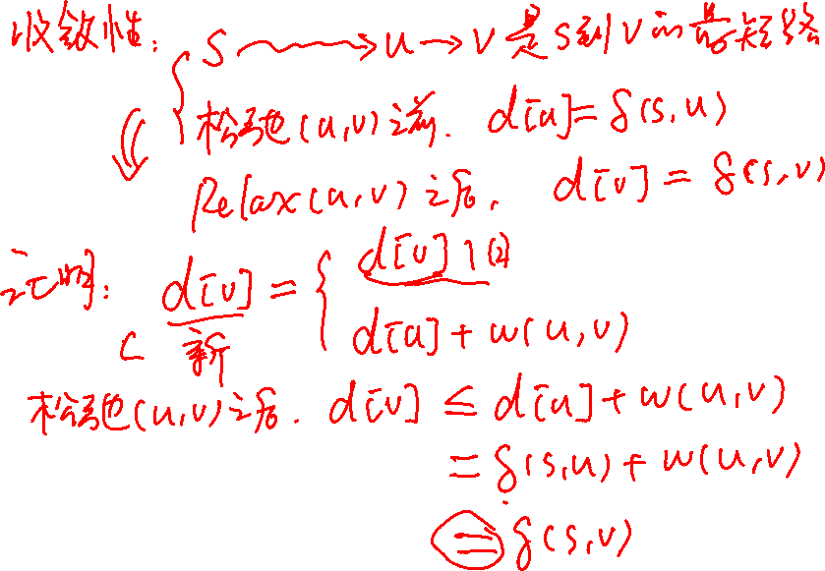
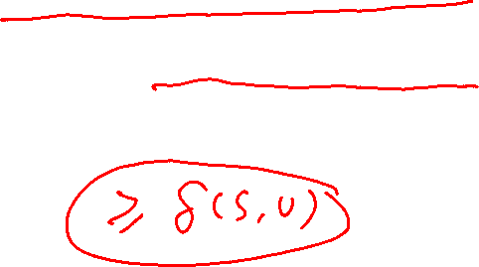

Slide 23
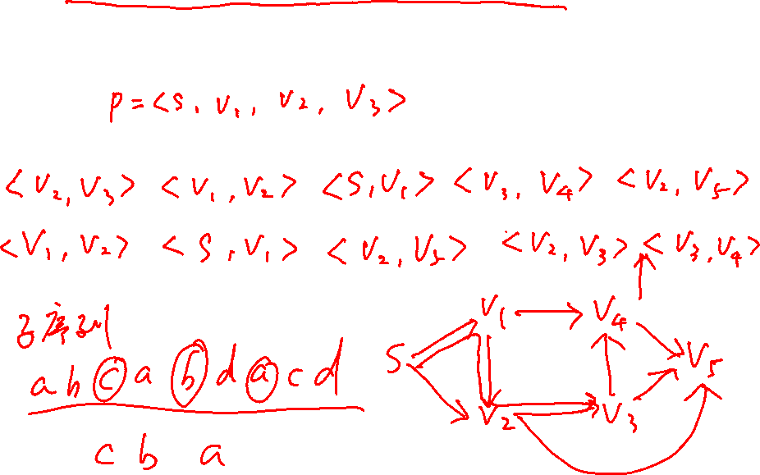
Path-relaxation property (Lemma 24.15)
  If p = <s, v₁, …, v_{k}> is a shortest path from s to v_{k}, and the edges of p are relaxed in the order (s, v₁), (v₁, v₂), …, (v_{k-1}, v_{k}), then after relaxing all the edges, d[v_{k}] = δ(s, v_{k}). Note that other relaxations may take place among these relaxations.

Slide 24
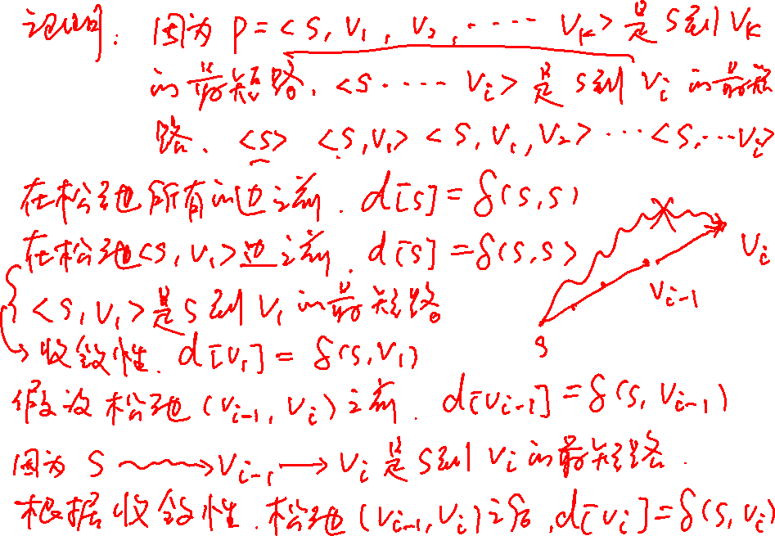

Slide 25
Properties of Shortest Paths and Relaxation
Predecessor-subgraph property (Lemma 24.17)
  Once d[v] = δ(s, v) for all v ∈V, the predecessor subgraph is a shortest-paths tree rooted at s.
Note: Proofs for all these properties can be found in your textbook.

Slide 26
Single-source shortest path problem
Input: A weighted directed graph G=(V, E; W) and a source vertex s.
Output: Shortest-path weight from s to each vertex v in V, and a shortest path from s to each vertex v in V if v is reachable from s.

Slide 27
The Bellman-Ford Algorithm
To solve the single-source shortest-paths problem
  The algorithm returns a boolean value indicating whether or not there is a negative-weight cycle that is reachable from the source.
  If there is a negative-weight cycle reachable from the source s, the algorithm indicates no solution exists.
  If there are no such cycles, the algorithm produces the shortest paths and their weights.

Slide 28
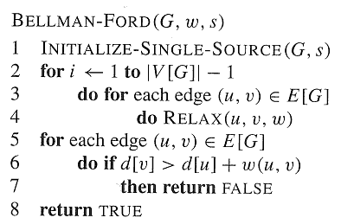
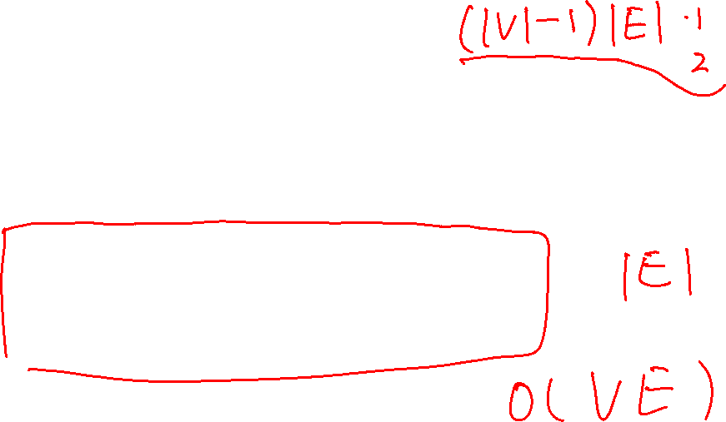
The Bellman-Ford O(VE) Algorithm

Slide 29
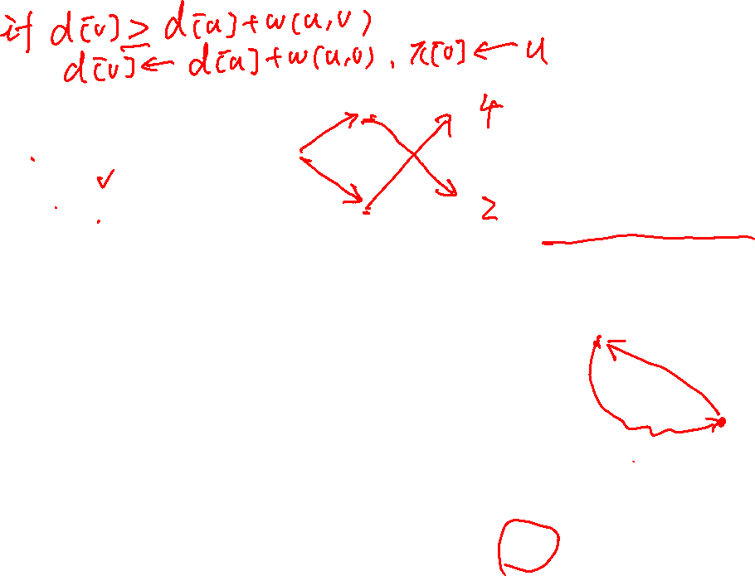
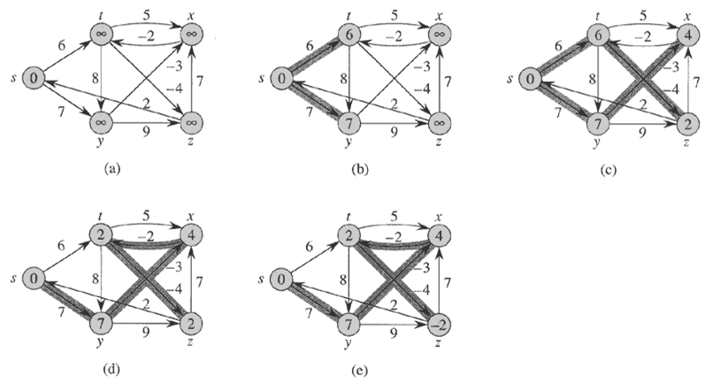
Note: each pass relaxes the edges in the order:
(t,x), (t,y), (t,z), (x,t), (y,x), (y,z), (z,x), (z,s), (s,t), (s,y)

Slide 30
Time Complexity of The Bellman-Ford
The time complexity is O(VE)

Slide 31
Correctness of The Bellman-Ford
Lemma 24.2
  Let G = (V, E) be a weighted, directed graph with source s and weight function w: E→R, and assume that G contains no negative cycles that are reachable from s. Then, after the | V | - 1 iterations of the for loop of lines 2-4 of BELLMAN-FORD, we have d[v] = δ(s, v) for all vertices v reachable from s.

Slide 32
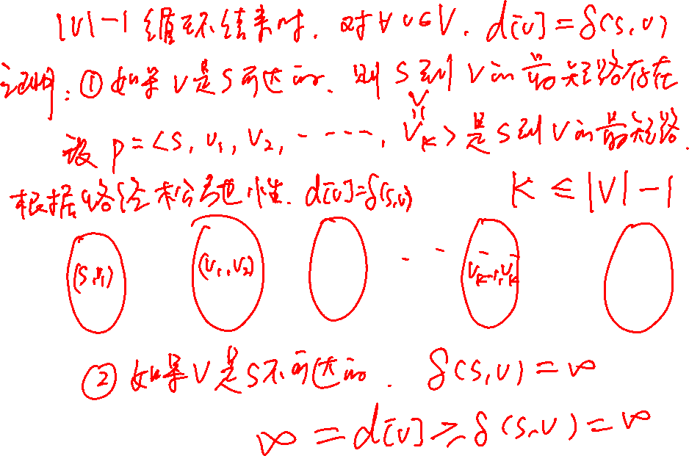

Slide 33
Proof of Lemma 24.2
Proof: Consider any vertex v that is reachable from s, and let p = <v₀, v₁, …, v_{k}>, where v₀ = s and v_{k} = v, be any acyclic shortest path from s to v. Path p has at most | V |-1 edges, and so k ≤ | V |-1. Each of the | V |-1 iterations of the for loop of lines 2-4 relaxes all |E| edges. Among the edges relaxed in the ith iteration, the edge in P is (v_{i-1}, v_{i}), for i = 1, 2, …, k. By the path-relaxation property, d[v] = d[v_{k}] = δ(s, v_{k}) = δ(s, v).

Slide 34
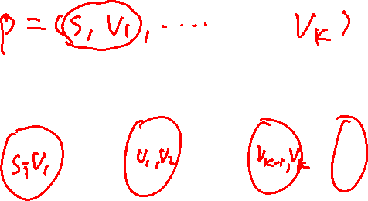
Correctness of The Bellman-Ford
Corollary 24.3
  Let G = (V, E) be a weighted, directed graph with source s and weight function w: E→R. Then for each vertex v ∈V, there is a path from s to v if and only if BELLMAN-FORD terminates with d[v] < ∞ when it is run on G.
  Proof :Exercise 24.1-2.
  (⇒)If there is a path P=<v₀, v₁,…, v_{k}> from s to v, where s=v₀, v=v_{k}, we show by induction that after the ith iteration, d[v_{i}]<∞.
  (⇐) By the no-path property.

Slide 35
Correctness of The Bellman-Ford
Theorem 24.4
  Let BELLMAN-FORD be run on a weighted, directed graph G = (V, E) with source s and weight function w: E→R. If G contains no negative cycles that are reachable from s, then the algorithm returns TRUE, we have d[v] = δ(s, v) for all vertices v ∈V, and the predecessor subgraph G_{π} is a shortest-paths tree rooted at s. If G does contain a negative weight cycle reachable from s, then the algorithm returns FALSE.

Slide 36
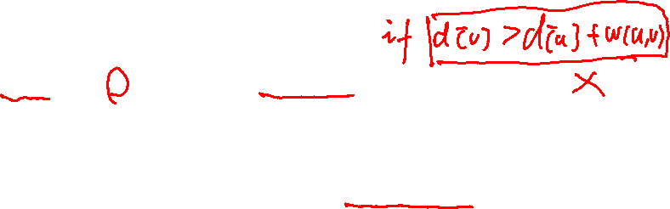
Proof of Theorem 24.4
Suppose G contains no negative-weight cycles that are reachable from s.
  Prove that at termination, d[v] = δ(s, v), for all vertices v in V.
    Case 1: v is reachable from s; --> Lemma 24.2
    Case 2: v is not reachable from s; --> No Path Property
  Prove that the algorithm returns TRUE
    For each edge (u,v),
    d[v]= δ(s, v) ≤ δ(s,u)+w(u,v) = d[u]+w(u,v).
Suppose that G contains a negative-weight cycle that is reachable from s.
  Prove that the algorithm returns FALSE
    For each edge on a negative-weight cycle C=<v₀,v₁…,v_{k}>, where v₀=v_{k}
    d[v_{i}] ≤d[v_{i-1}]+w(v_{i-1},v_{i}), for 1 ≤ i ≤ k.
    Summing both sides of equations yields 0 ≤ w(C), contradiction.

Slide 37
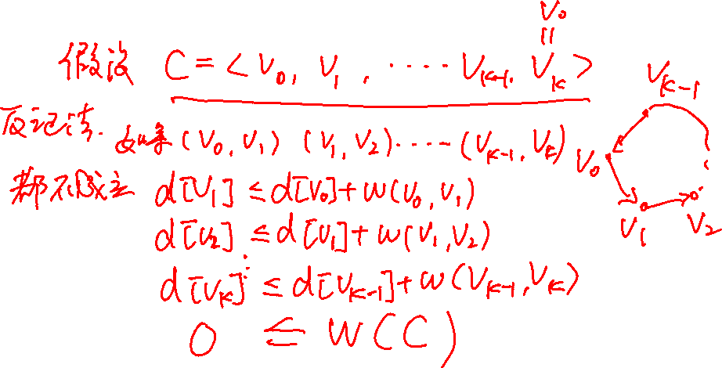
Conclusion
Relaxation
The Bellman-Ford Algorithm

Slide 38
Homework
24.1-1,24.1-6

