Slide 1
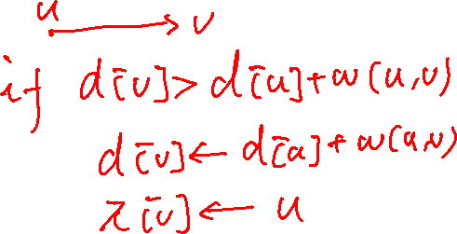
Lecture 8
Single-Source Shortest Paths Problems Continued
Single-Source Shortest Paths in Directed Acyclic Graphs
Dijkstra’s Algorithm
Difference constraints

Slide 2

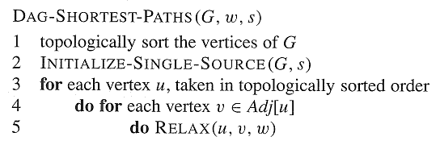
Single-Source Shortest Paths in Directed Acyclic Graphs
Time Complexity: O(V + E)

Slide 3
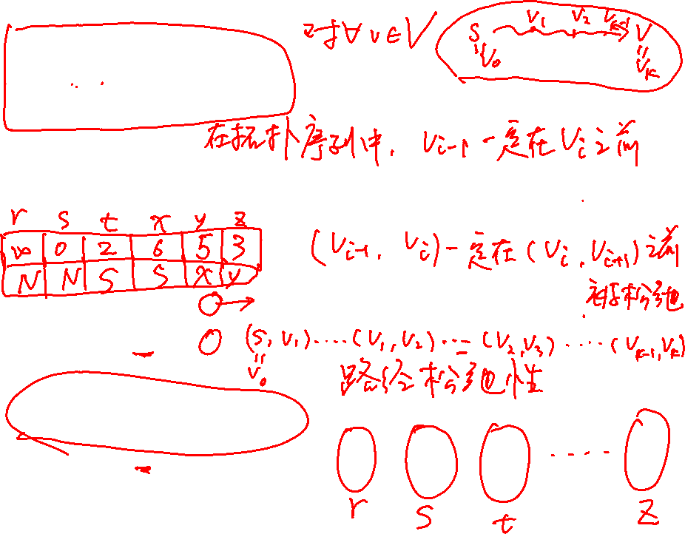
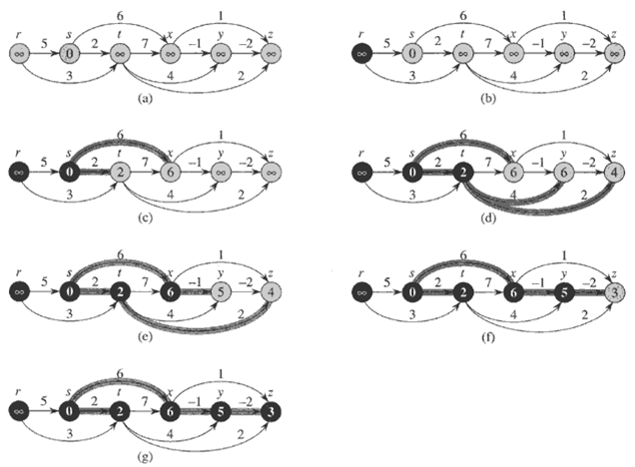

Slide 4
Correctness of the Algorithm
Theorem 24.5
  If a weighted, directed graph G = (V, E) has source vertex s and no cycles, then at the termination of the DAG-SHORTEST-PATHS procedure, d[v] = δ(s, v) for all vertices v ∈V, and the predecessor subgraph G_{π} is a shortest-paths tree rooted at s.
Proof.
  We first show that d[v] = δ(s, v) for all vertices v ∈V at the termination.
  If v is not reachable from s, then d[v] = δ(s, v)=∞ by the no-path property.

Slide 5
Proof Continued
  Now, Suppose that there is a shortest path P=<v₀,v₁,…,v_{k}>, where v₀=s and v_{k}=v. Since we process the vertices in topological order, the edges on P are relaxed in the order (v₀,v₁), (v₁,v₂), …., (v_{k-1},v_{k}).The path relaxation property implies that d[v_{i}]= δ(s, v_{i}) for all i.
  By the predecessor-subgraph property, G_{π} is a shortest-paths tree.

Slide 6
Application:
Determine Critical Path
Pert Chart:
  edges represent jobs and weights represent the times required to perform particular jobs.
  If edge (u,v) enters v and edge (v,w) leaves v, then job (u,v) must be performed prior to job (v,w).
  A path through this dag represents a sequence of jobs that must be performed in a particular order.
  A critical path is a longest path through the dag.

Slide 7

Two method
Negating the edge weight.
Replace “∞” with “- ∞” and “>” with “<”.

Slide 8
Dijkstra’s Algorithm
  Problem solved
  Correctness
  Time complexity
  Similarities to BFS and PRIM

Slide 9
Problem Solved by Dijkstra’s
Single-source shortest-paths problem
Edge weight >=0
Input: A graph G=(V, E) and a source s, and a nonnegative function w: E→R⁺
Output: For each vertex v, shortest path weight δ(s,v), and a shortest path if exists.

Slide 10
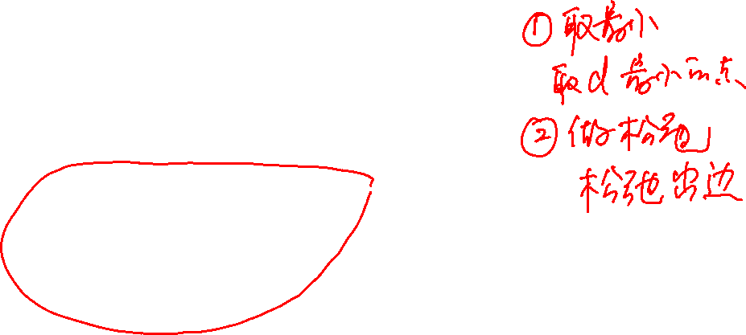
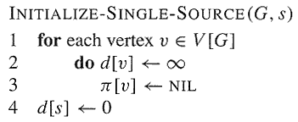
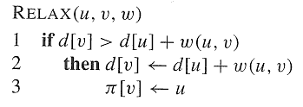
The Dijkstra Algorithm
DIJKSTRA(G,w,s)
Initialize-Single-Source(G,s)
S←∅
Q←V[G]
while Q≠∅
do u←EXTRACT-MIN(Q)
S←S∪{u}
for each v ∈Adj[u]
do RElAX(u,v,w)

Slide 11
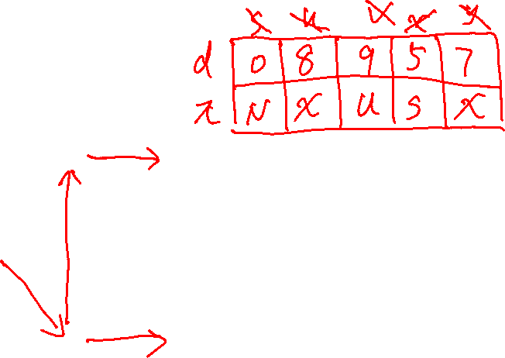
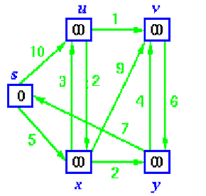
Dijkstra’s Algorithm - example
Initial Graph
Source
Mark 0
Distance to all nodes marked ∞

Slide 12
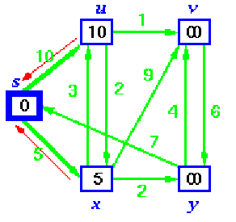
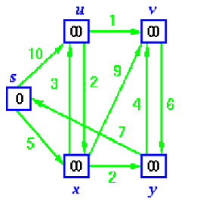
Dijkstra’s Algorithm - Operation
S={s}
Initial Graph
Source
Relax edges leaving source
S= ∅

Slide 13
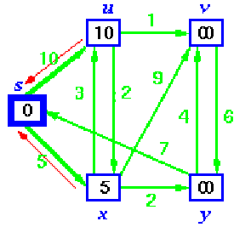
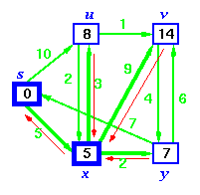
Dijkstra’s Algorithm - Operation
Relax u and a shorter path via x
exists
Relax y
Red arrows show
predecessors
Sort vertices and
choose closest

Slide 14
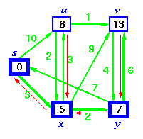
Dijkstra’s Algorithm - Operation
Relax v and a shorter path via y
exists
Sort vertices and
choose closest
S is now { s, x }

Slide 15

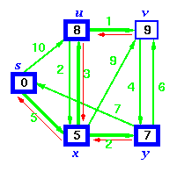
Dijkstra’s Algorithm - Operation
Update d[v]
S is now { s, x, y }
Sort vertices and
choose closest, u

Slide 16
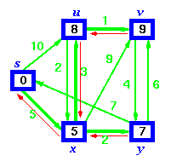
Dijkstra’s Algorithm - Operation
S is now { s, x, y, u }
Finally add v

Slide 17
Dijkstra’s Algorithm - Operation
S is now { s, x, y, u }
Pre-decessors show shortest paths sub-graph

Slide 18
Correctness of Dijkstra’s
Theorem 24.6
  Dijkstra’s algorithm, run on a weighted,directed graph G=(V, E), with non-negative weight function w and source s, terminates with d[u]= δ(s,u) for all vertices u∈V.
Proof (by contradiction)
  Since S=V in the end, we only need to prove that for each vertex v added to S, there holds d[v]= δ(s, v) when v is added to S.
  Suppose that u is the first vertex for which d[u] ≠ δ(s, u) when it was added to S
  Note
    u is not s because d[s] = 0= δ(s, s)
    There must be a path s→...→u, since
    otherwise d[u]= δ(s, u) = ∞.
    Since there’s a path, there must be a shortest path (note there is no negative cycle).

Slide 19
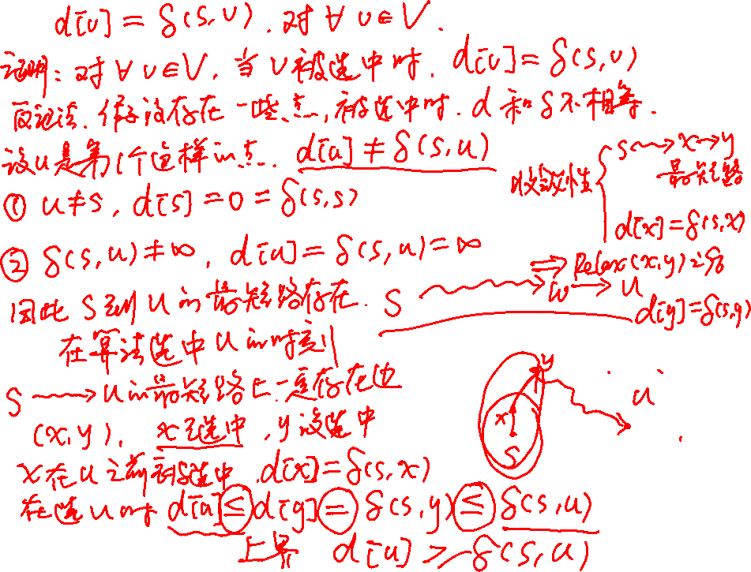

Slide 20
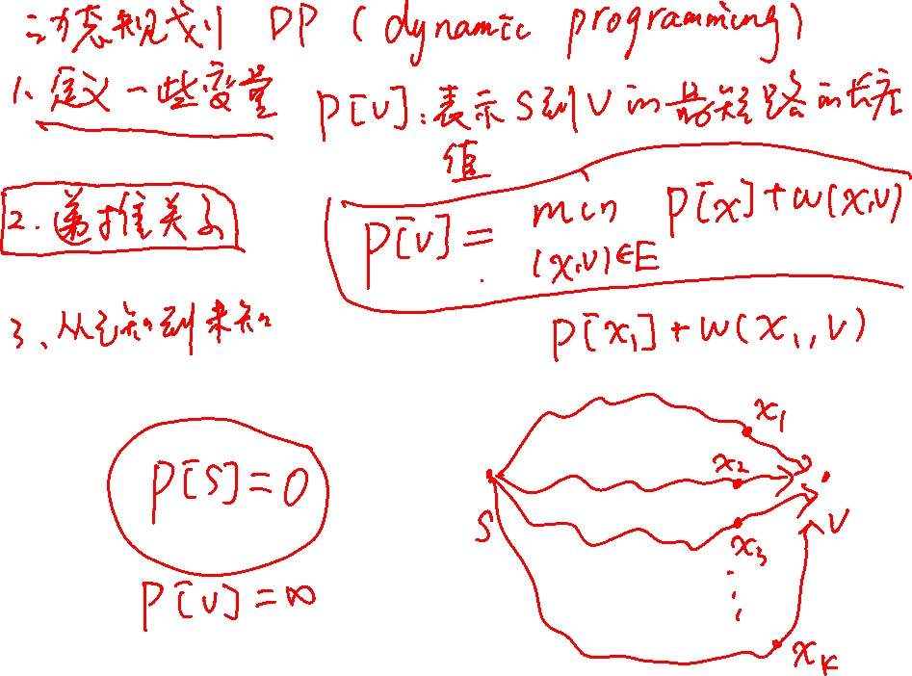

Slide 21
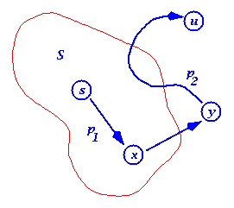
Dijkstra’s Algorithm - Proof
  Let s→x→y→u be a shortest path
  from s to u,
  where at the moment u is chosen to S,
  x is in S and y is the
  first outside S
  When x was added to S, d[x] = δ(s, x)
  Edge x→y was relaxed at that time,
  so at time u is chosen, d[y] = δ(s, y)

Slide 22
Dijkstra’s Algorithm - Proof
  So, d[y]= δ(s, y) ≤ δ(s, u) ≤ d[u]
  But, when we chose u,
  both u and y are in Q,
  so d[u] ≤ d[y]
  (otherwise we would have chosen y)
  Thus the inequalities must be equalities
  d[y] = δ(s, y) = δ(s, u) = d[u]
  And our hypothesis (d[u] ≠ δ(s, u)) is contradicted!
1.Why the red inequality holds? How about negative edges exist?
2.When u is added to S, a shortest path s→u in S is found.

Slide 23
Dijkstra’s Algorithm - Time Complexity
Like that of PRIM’s
  If using arrays
    O( V² )
  Using special data structure
    O(VlgV+E) or less

Slide 24
Compared to BFS
DIJKSTRA(G,w,s)
INITIALIZE-SINGLE-SOURCE(G,s)
S←∅
Q←V[G]
while Q≠∅
do u←EXTRACT-MIN(Q)
S←S∪{u}
for each v ∈Adj[u]
do RELAX(u,v,w)
  BFS(G,s)
  For each vertex u ∈V,
  color[u]=W; d[u]=∞; π[u]=NIL; color[s]=G; d[s]=0;
  2. Q={s}.
  3. while Q is nonempty
    u=dequeue(Q)
    for each v ∈ adj[u],
    if(color[v]==W), do
    color[v]=G;
    d[v]=d[u]+1;
    π[v]=u;
    enqueue(Q,v);
    color[u]=B
Note: vertices in Q are in non-decreasing
order of d, and there are only two values
d, and d+1 in Q.

Slide 25
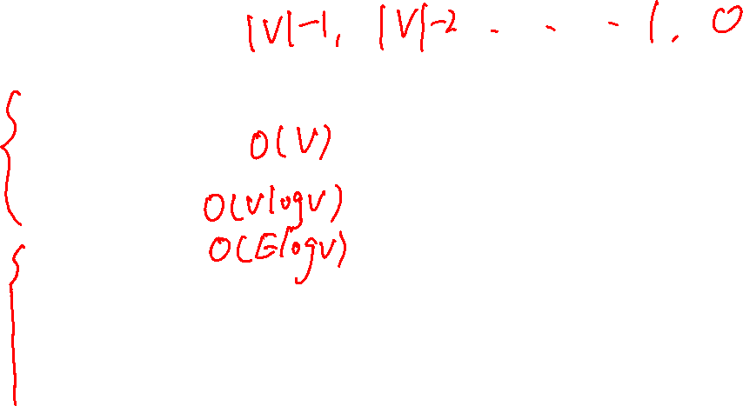
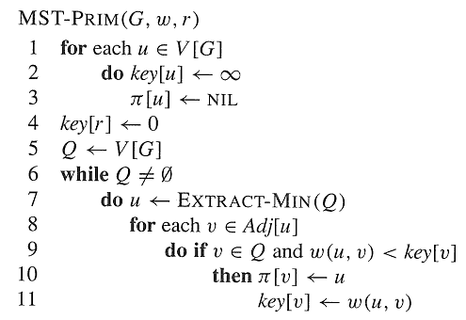
Compared to PRIM
DIJKSTRA(G,w,s)
for each u ∈V[G]
do d[u]←∞
π[u]←NIL
d[s]←0
S←∅
Q←V[G]
while Q≠∅
do u←EXTRACT-MIN(Q)
S←S∪{u}
for each v ∈Adj[u]
do if v ∈ Q and d[u]+w(u,v)<d[v]
then π[v]←u
d[v]←d[u]+w(u,v)

Slide 26
Linear Programming
Linear programming problem:
  Input: matrix A_{mn}, vector b_{m}, and vector c_{n}.
  Output: vector x_{n}, such that
  maximize cx
  subject to Ax<=b.
Notes
  This problem has polynomial time solution.
  Many problems can be converted into LP.

Slide 27
An Instance
单位产品所需原料数量（公斤） | 产品 Q1 | 产品 Q2 | 产品 Q3 | 原料供用量 （公斤/日）
原料P1 | 2 | 3 | 0 | 1500
原料P2 | 0 | 2 | 4 | 800
原料P3 | 3 | 2 | 5 | 2000
单位产品的利润 （千元） | 3 | 5 | 4

Slide 28
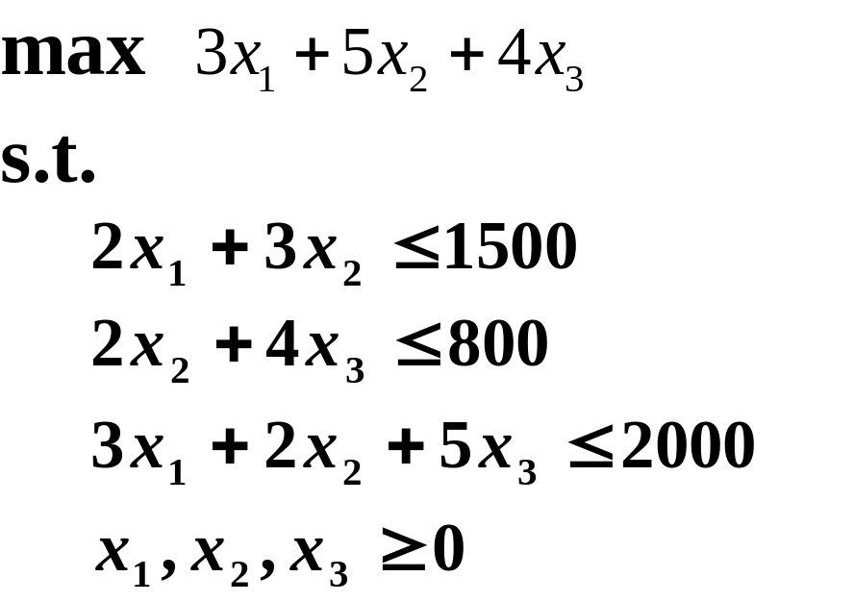
LP

Slide 29
Feasibility problem of LP
Feasible solution: x_{n}, subject to Ax<=b.
Feasibility problem of LP:
  Given Matrix A m×n, b m-vector
  Output: either a feasible solution x if one exists, or a judgment that no feasible solution exists.

Slide 30
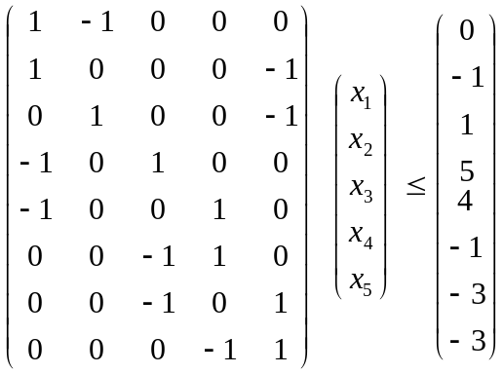
Systems of difference constraints
Each row of A contains exactly one “1” and one “-1”. All other elements are “0”.
Each row is a difference constraint:
  x_{j}-x_{i}<=b_{k}, 1<=k<=m.
An example
x₁-x₂<=0
x₁-x₅<=-1
x₂-x₅<=1
x₃-x₁<=5
x₄-x₁<=4
x₄-x₃<=-1
x₅-x₃<=-3
x₅-x₄<=-3
Solution x=(-5,-3,0,-1,-4); x’=(-5+d,-3+d,0+d,-1+d,-4+d)
(0,2,5,4,1)

Slide 31
Relations between solutions to DC
Lemma 24.8: Let x=(x₁,x₂,…,x_{n}) be a solution to a system Ax<=b of difference constraints, and let d be any constant. Then x+d=(x₁+d, …, x_{n}+d) is a solution to Ax<=b as well.
Proof. Easy(Book236)

Slide 32
Constraints graph
Given a system Ax<=b of difference constraints
The constraint graph is a weighted, directed graph G=(V, E;w), where:
  V={v₀,v₁,…,v_{n}} //v₀ is an extra vertex
  E={(v_{i},v_{j}):x_{j}-x_{i}<=b_{k} is a constraint}
  ∪{(v₀,v₁),(v₀,v₂),…,(v₀,v_{n})}. //each vertex is reachable from v₀
  w(v_{i},v_{j})=b_{k}, if x_{j}-x_{i}<=b_{k} is a constraint;
  w(v₀,v_{i})=0.

Slide 33
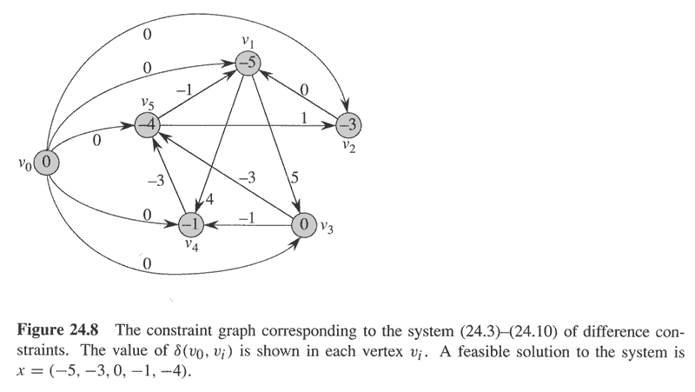
Constraint graph of example

Slide 34
Solve Difference Constraints by SSSP in constraint graph
Thoerem24.9: Given a system Ax<=b of difference constraints, let G=(V, E) be the corresponding constraint graph.
  If G contains no negative-weight cycles, then
x=(δ(v₀,v₁), δ(v₀,v₂), …, δ(v₀,v_{n}))
is a feasible solution for the system.
  If G contains a negative-weight cycle, then there is no feasible solution for the system.

Slide 35
Correctness of Theorem 24.9
Proof. (⇒)If G does not contain negative-weight cycles. Then shortest path is well defined. And since there is an edge from v₀ to each vertex, all shortest paths from v₀ is finite. Consider any edge (v_{i},v_{j})(any constraint). By the triangle inequality, δ(v₀,v_{j}) ≤ δ(v₀,v_{i})+w(v_{i},v_{j}) or, equivalently, δ(v₀,v_{j})- δ(v₀,v_{i}) ≤ w(v_{i},v_{j}). Thus, letting x_{i}= δ(v₀,v_{i}) and x_{j}= δ(v₀,v_{j}) satisfies the difference constraint x_{j}-x_{i} ≤ b_{k} =w(v_{i},v_{j}) that corresponds to edge (v_{i},v_{j}).

Slide 36
Proof continued
If G contains a negative-weight cycle C=<v₁,v₂,…,v_{k}>, where v₁=v_{k}. We will show that there is no feasible solution. Cycle C corresponds to the following difference constraints: x₂-x₁<=w(v₁,v₂); x₃-x₂<=w(v₂,v₃); …, x_{k}-x_{k-1}<=
w(v_{k-1},v_{k}), x₁-x_{k}<=w(v_{k},v₁). If there is a feasible solution x, it will satisfy all these k inequalities. It also satisfies the summation of the inequalities, i.e., 0<=w(C) , a contradiction to C is negative-weighted.

Slide 37
Property of DC
Observation(According to Theorem24.9):
  A difference constraints system has a solution
  ⇔ constraint graph contains no negative cycle, and x=(δ(v₀,v₁), δ(v₀,v₂), …, δ(v₀,v_{n})) is a solution.
  A difference constraints system has no solution ⇔ constraint graph contains negative cycles.

Slide 38
Bellman-Ford solution to DC
Algorithm:
Compute constraint graph G;
Run Bellman-Ford on constraint graph G;
If Bellman-Ford returns True, then x=(δ(v₀,v₁), …, δ(v₀,v_{n})) is a solution to DC; if Bellman-Ford returns false, DC has no solution.

Slide 39
Conclusion
Relaxation and its properties
Bellman-Ford algorithm
Single-source shortest paths in DAG
Dijkstra’s algorithm
Difference constraints

Slide 40
Homework
24.1-6
24.3-2

