Slide 1
Lecture 9
All –Pairs Shortest Paths Problem
Matrix multiplication
Floyd-Warshall algorithm
Transitive closure
Johnson’s algorithm

Slide 2

All –pairs shortest paths problem
Problem: Given a directed graph G=(V, E), and a weight function w: E→R, for each pair of vertices u, v, compute the shortest path weight δ(u, v), and a shortest path if exists.
No negative cycles!
Output: a V×V matrix D=(d_{ij}), where, d_{ij} contains the weight of a shortest path from vertex i to vertex j.

Slide 3
Methods
Application of single source shortest path algorithms
Direct methods to solve the problem:
  Matrix multiplication
  Floyd-Warshall algorithm
  Johnson’s algorithm for sparse graphs
Transitive closure (Floyd-Warshall algorithm)

Slide 4
Motivation
Computer network
Aircraft network (e.g. flying time, fares)
Railroad network
Table of distances between all pairs of cities for a road atlas

Slide 5
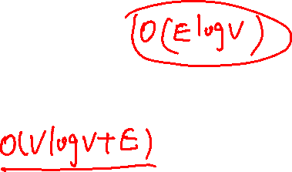
Single source shortest path algorithms
If edges are non-negative:
Running the Dijkstra’s algorithm n-times, once for each vertex as the source
running time: O(V² logV+VE) //using Fibonacci-heap

Slide 6
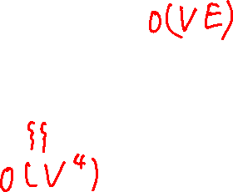
Single source shortest path algorithms
Negative-weight edges:
Bellman-Ford algorithm
Running time: O(V² E)

Slide 7
Dynamic Programming
Characterize the structure of an optimal solution.
Recursively define the value of an optimal solution.
Compute the value of an optimal solution in a bottom-up fashion.

Slide 8
Data structure
Adjacency matrix
w: E → ℜ as V x V matrix W
0 if i = j,
w_{ij} = weight of edge (i,j) if i ≠ j and (i,j) ∈ E,
∞ if i ≠ j and (i,j) ∉ E

Slide 9
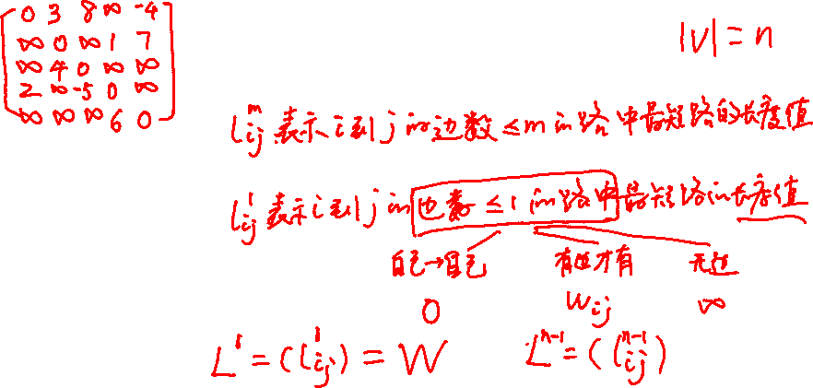
Matrix multiplication (idea)
l_{ij}^{(m)} : minimum weight of any path from i to j
that contains at most m edges
2
3
4
1
3
8
-4
1
-5
7
2
5
4
6

Slide 10
Matrix multiplication (idea)
k
l_{ik}^{(m-1)}
p
w_{kj}
i
j
l_{ij}^{(m-1)}
v

Slide 11
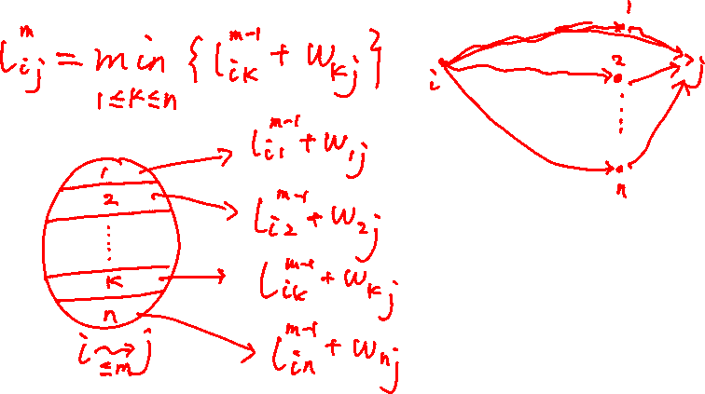

Matrix multiplication (idea)
l_{ij}^{(m)} = min (l_{ij}^{(m-1)}, min_{1≤k≤n} {l_{ik}^{(m-1)} + w_{kj}})
Check all possible predecessors k of j and compare!

Slide 12
Matrix multiplication (structure)
l_{ij}⁽¹⁾ = w_{ij}
l_{ij}^{(m)} = min (l_{ij}^{(m-1)}, min_{1≤k≤n} {l_{ik}^{(m-1)} + w_{kj}})
= min_{1≤k≤n} {l_{ik}^{(m-1)} + w_{kj}}

Slide 13
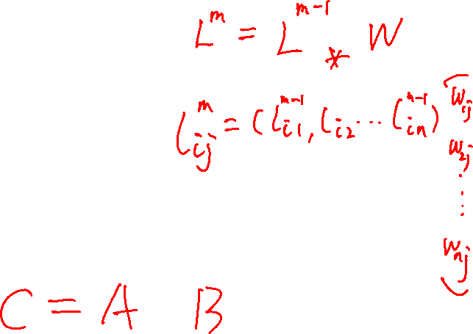
Matrix multiplication (structure)
Compute a series of matrices
L⁽¹⁾, L⁽²⁾, …, L^{(n-1)}
L^{(m)} = L^{(m-1)} ⋅ W
Final matrix L^{(n-1)} contains the final shortest-path weights

Slide 14
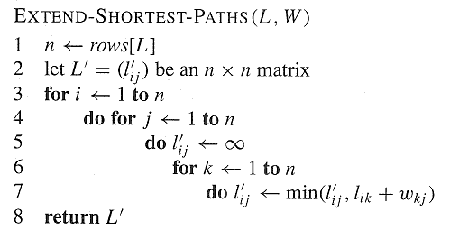
Matrix multiplication
(pseudo-code)

Slide 15
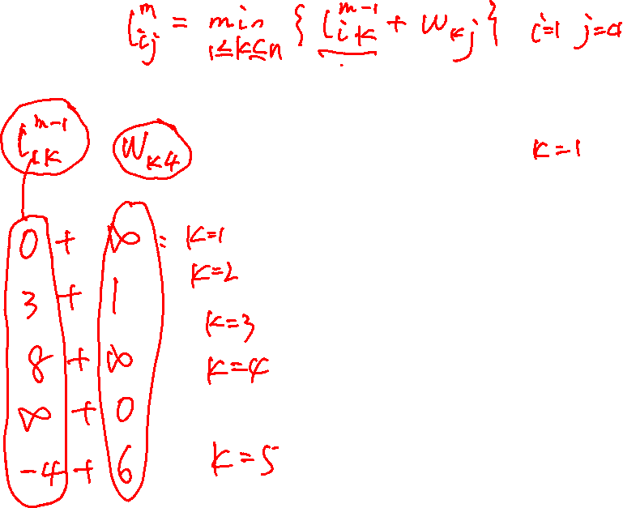
Matrix multiplication (example)
2
L₁₄⁽²⁾
3
4
1
3
8
-4
2
1
-5
7
5
4
6

Slide 16
Matrix multiplication (example)
2
L₁₄⁽²⁾
3
4
1
3
8
-4
2
1
-5
7
5
4
6

Slide 17
matrix multiplication (example)
2
L₁₄⁽²⁾
3
4
1
3
8
-4
2
1
-5
7
5
4
6

Slide 18
matrix multiplication (example)
2
L₁₄⁽²⁾
3
4
1
3
8
-4
2
1
-5
7
5
4
6

Slide 19
matrix multiplication (example)
∞
1
l₁₄⁽²⁾ = (0 3 8 ∞ −4) • ∞
0
6
= min (∞, 4, ∞, ∞, 2)
= 2

Slide 20
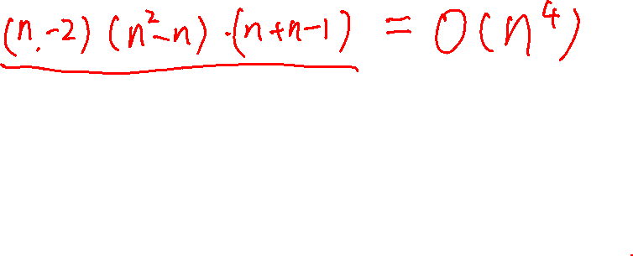
Relation to matrix multiplication
C = A ⋅ B
c_{ij} = Σ_{k=1}^{n} a_{ik} ⋅ b_{kj}
compare:
L^{(m)} = L^{(m-1)} ⋅ W
⇒ l_{ij}^{(m)} = min_{1≤k≤n} {l_{ik}^{(m-1)} + w_{kj}}

Slide 21
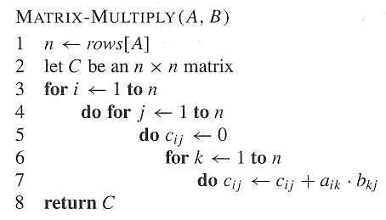
Relation to matrix multiplication

Slide 22
Matrix multiplication
(pseudo-code)

Slide 23
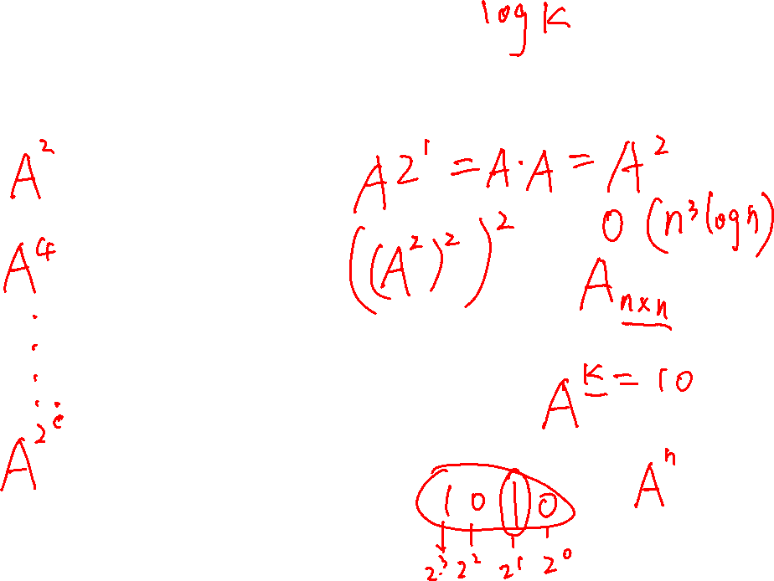
Matrix multiplication
Compute the sequence of n-1 matrices:
L⁽¹⁾ = L⁽⁰⁾ ⋅ W = W,
L⁽²⁾ = L⁽¹⁾ ⋅ W = W²,
L⁽³⁾ = L⁽²⁾ ⋅ W = W³,
…
L^{(n-1)} = L^{(n-2)} ⋅ W = W^{n-1}

Slide 24
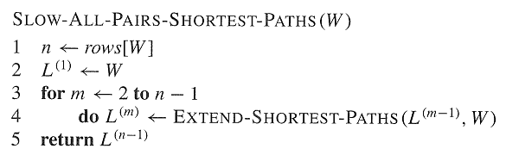
Matrix multiplication (pseudo-code)
How much space needed? Can you improve?

Slide 25
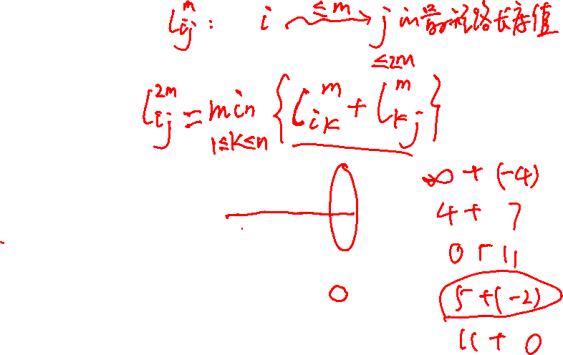
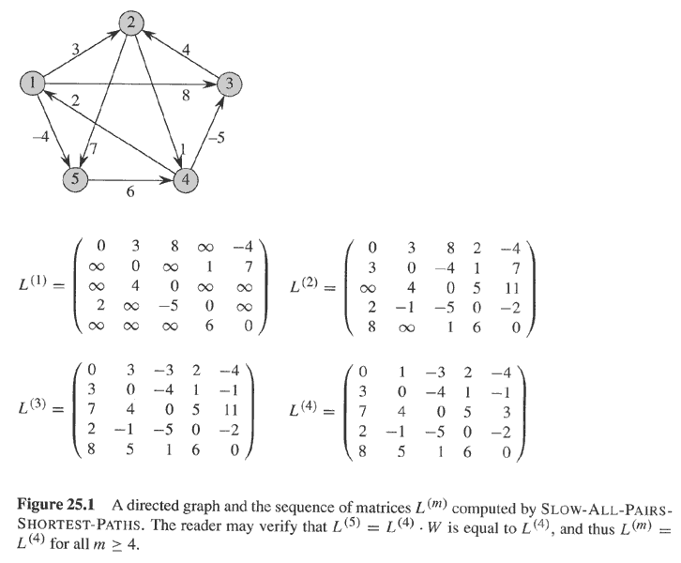
Matrix multiplication(example)

Slide 26
Matrix multiplication
(running time)
O(n⁴)
Improving the running time:
compute not all L^{(m)} matrices
interested only in L^{(n-1)}, which is equal to L^{(m)} for all integers m ≥ n-1

Slide 28
Improving the running time
Compute the sequence
L⁽¹⁾ = W,
L⁽²⁾ = W² = W ⋅ W,
L⁽⁴⁾ = W⁴ = W² ⋅ W²,
L⁽⁸⁾ = W⁸ = W⁴ ⋅ W⁴
...
We need only ⎡log(n-1)⎤ matrix products
O(n³ log n)

Slide 29
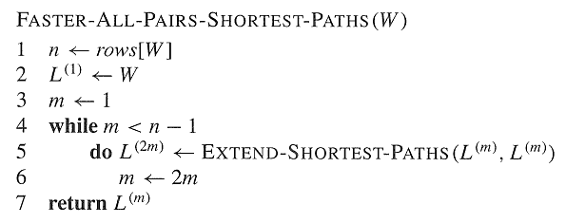
Improving running time

Slide 30
Floyd-Warshall algorithm
1
2
.
:
i
k-1
j
k
k+1
.
:
n

Slide 31
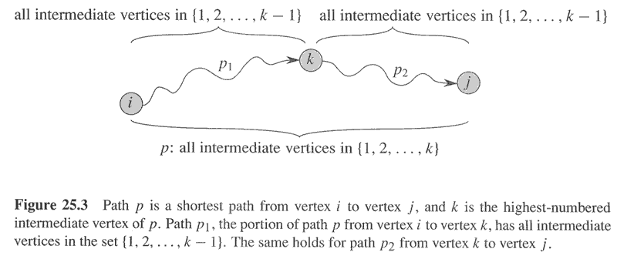
Floyd-Warshall algorithm

Slide 32
Floyd-Warshall algorithm
d_{ij}^{(k)}:shortest path weight from i to j with intermediate vertices in the set {1,2,…,k}
d_{ij}⁽⁰⁾ = w_{ij}
(no intermediate vertices at all)
d_{ij}^{(k)} = min(d_{ij}^{(k-1)}, d_{ik}^{(k-1)} + d_{kj}^{(k-1)}) if k ≥ 1
Result: D^{(n)} = (d_{ij}^{(n)}) = d(i,j)
(because all intermediate vertices are in the set {1, 2, …, n})

Slide 33
Floyd-Warshall algorithm
2
k=1: 4→3:-5; 4→2:5;4→5:-2
3
4
1
3
8
-4
2
1
-5
7
5
4
6

Slide 34
Floyd-Warshall algorithm
k=2: 4 → 5: − 2; 4 → 3:-5
4→2:5
2
3
4
1
3
8
-4
2
1
-5
7
5
4
6

Slide 35
Floyd-Warshall algorithm
2
k=3:4→2:-1;4→3:-5;
4→5:-2
3
4
1
3
8
-4
2
1
-5
7
5
4
6

Slide 36
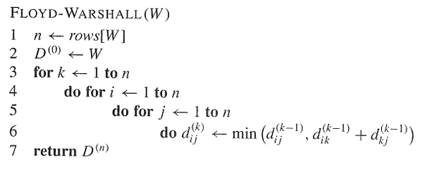
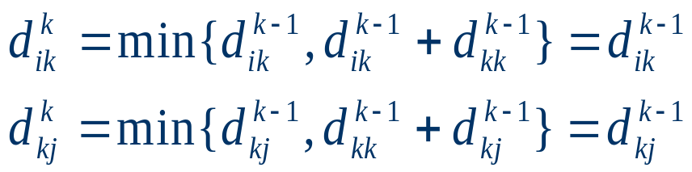
Floyd-Warhsall algorithm (pseudo-code)
Notice that:

Slide 37
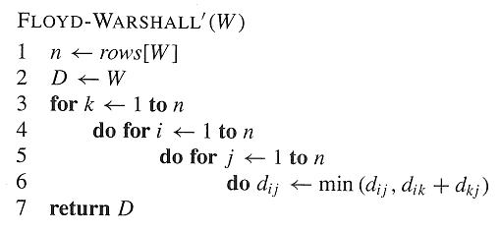
Floyd-Warhsall algorithm
(less space)

Slide 38
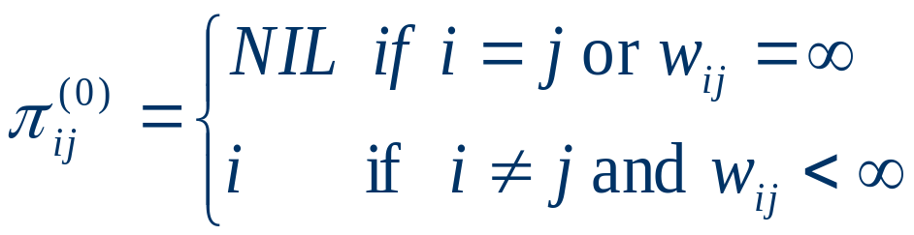
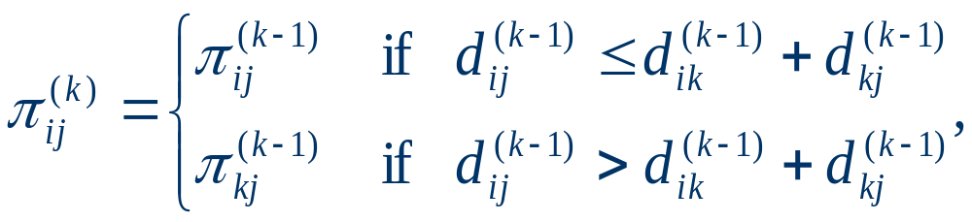
Constructing a shortest path
For k=0
For k>=1

Slide 39
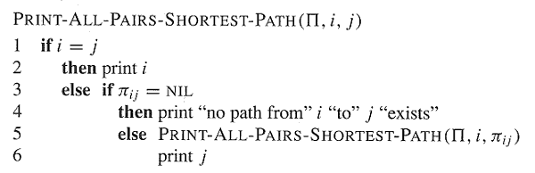
Print all-pairs shortest paths

Slide 40
Example:
2
3
4
1
3
8
-4
1
-5
7
2
5
4
6

Slide 41
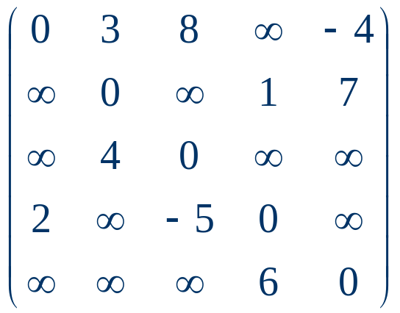
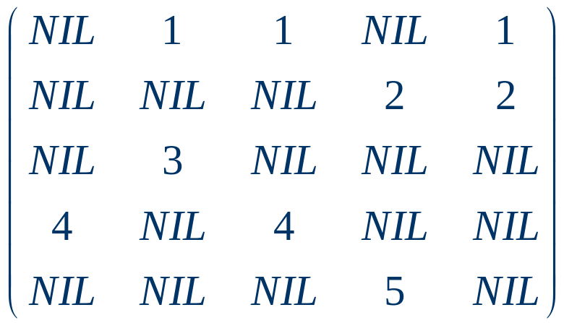

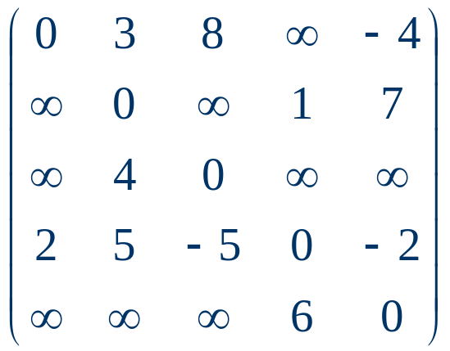
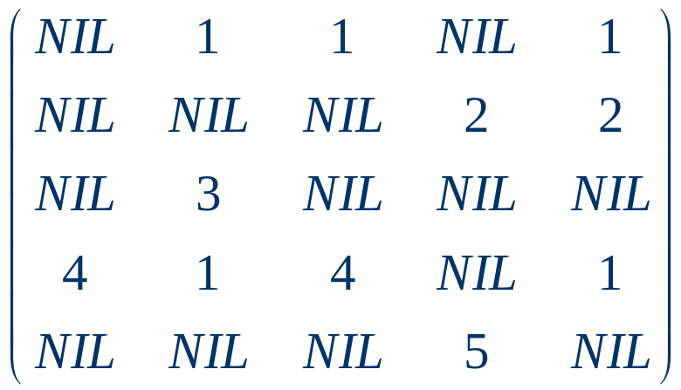
D⁽⁰⁾=
⁽⁰⁾=
D⁽¹⁾=
⁽¹⁾=

Slide 42
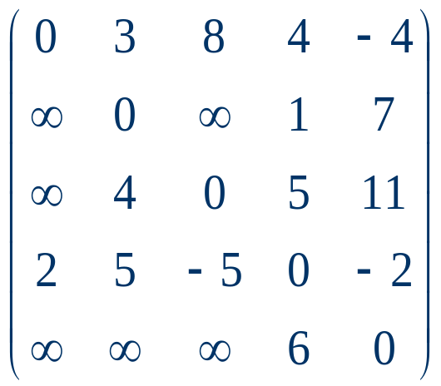
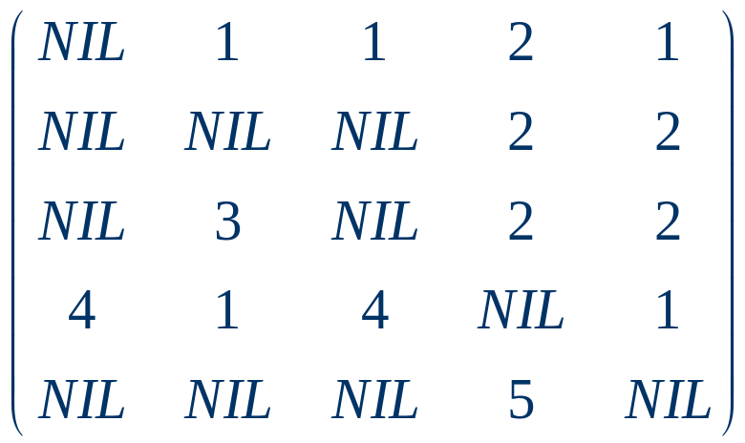
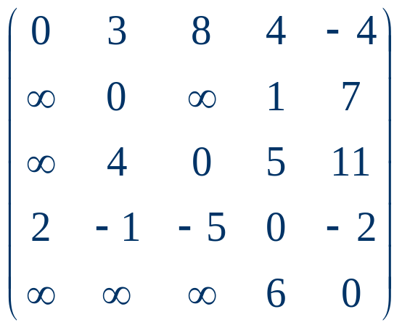
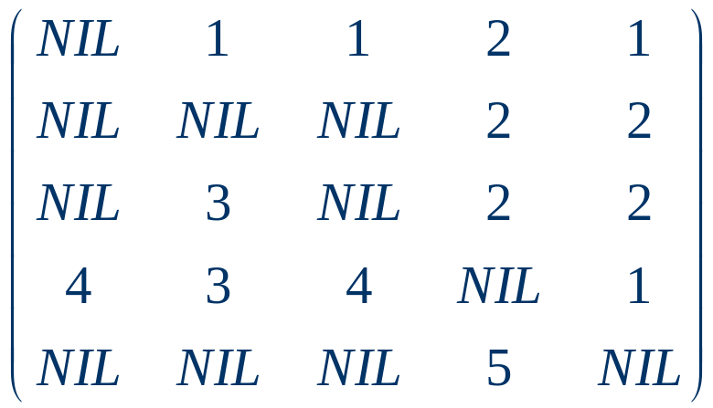
D⁽²⁾=
⁽²⁾=
D⁽³⁾=
⁽³⁾=

Slide 43
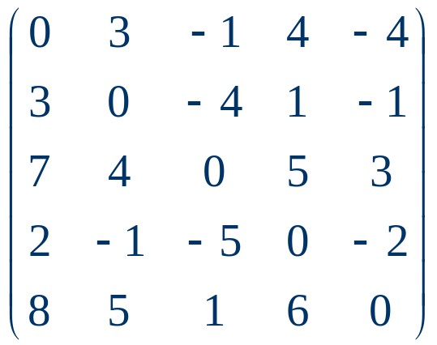
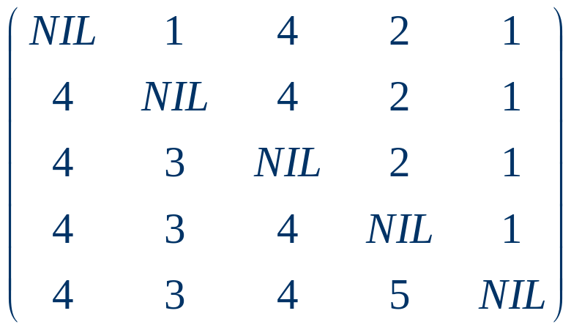

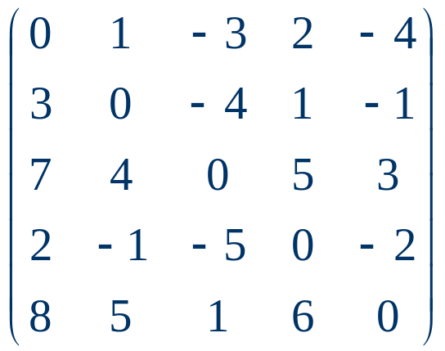
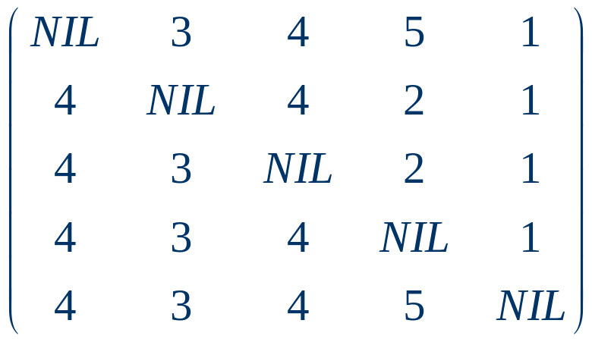
D⁽⁴⁾=
⁽⁴⁾=
⁽⁵⁾=
D⁽⁵⁾=

Slide 44
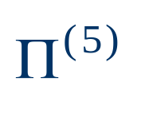
Shortest path from 1 to 2 in
2
4
3
1
3
8
1
-4
-5
7
2
5
4
6

Slide 45
Transitive closure (the problem)
Find out whether there is a path from i to j and compute
G* = (V,E*),
where E* = {(i,j): there is a path from i to j in G}
a
c
b
i
j

Slide 46
Transitive closure
One way:
set w_{ij} = 1 and
run the Floyd-Warshall algorithm
running time O(n³)

Slide 47
transitive closure
Another way:
substitute “+” and “min” by AND and OR
in Floyd’s algorithm
running time O(n³)

Slide 48
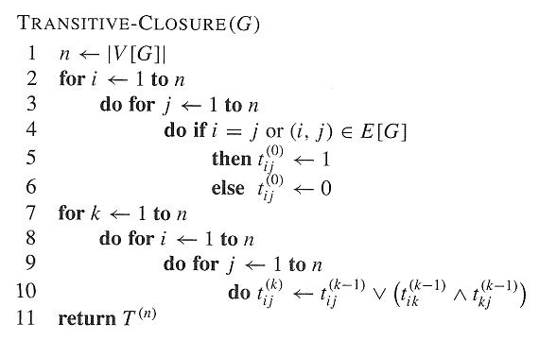
Transitive closure (pseudo-code)

Slide 49
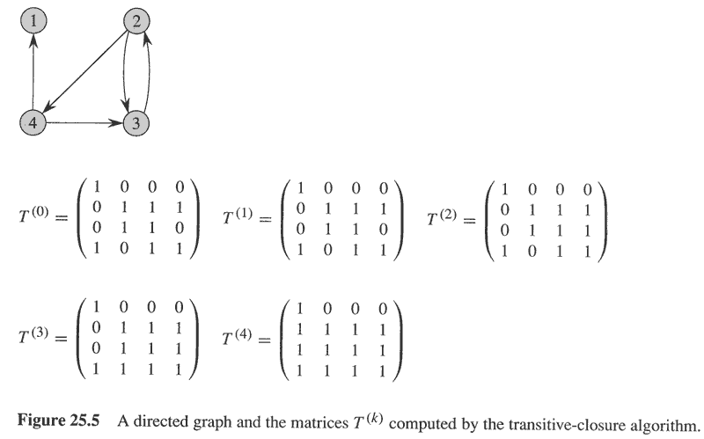
Transitive closure

Slide 50
Table of running times
algorithm | running time
Dijkstra‘s | O(n² log n+nm)
Bellman-Ford | O(n ²m)
matrix multiplication | O(n⁴)
improved matrix mult. | O(n³ log n)
Floyd-Warshall | O(n³)
Johnson‘s Transitive closure | O(n² log n+nm) O(n³)

Slide 51
Homework
25.2-1（not compulsory）
25.2-5
25.2-8

