Slide 1
Los Angeles Crime Code Predictive Model
Tanush Kallem and Luke Flecker

Slide 2
Project Goal and Dataset Description
Dataset Description
Dataset reflects incidents of crimes in Los Angeles from 2020
Has 978,628 instances and 28 attributes
Attributes include: data, time, location, demographics, weapon used, etc.
Class is crime codes; the lower they are the worse the crime is
Project Goal
Build a machine learning model to predict crime codes from LA crime data.
Overcome data inconsistencies like location errors.
Support law enforcement with accurate crime predictions.

Slide 3
Data Preprocessing
Data Cleaning:
Attribute Removal
Missing Value Correction
Hidden Value Correction
Data Reduction:
Remove Redundant Attributes
Data Modification

Slide 4
Attribute Removal
Before we started cleaning our data, we removed attributes that had a missing percentage greater than 70%.
Crm Cd 2, Crm Cd 3, Crm Cd, 4 were removed
93%, 100%, 100% missing
Represent additional crimes to Crm Cd 1
Cross Street was removed
Had 84% missing.
Represents the cross street of the rounded address
Part 1-2 was removed
Classified crimes in either 1 or 2, with 2 being worse crimes
Modified version of class

Slide 5
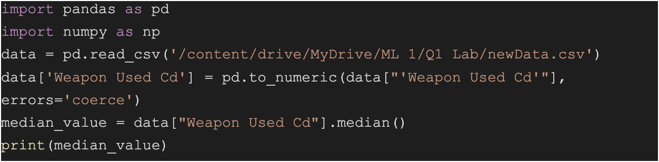
Missing Value Handling:
Weapon Used Cd: Due to this attribute having arbitrary codes, they were replaced with the median instead of the mean. This was done by first calculating the median through a python script.
Then, using Weka’s feature: ReplaceMissingWithUserConstant, we set the replacement value to the median we calculated.
Mocodes, Vict Sex, Vict Descent, Premis Desc, Weapons Used Cd, Weapon Desc all had missing values that were replaced with ReplaceMissingValues. This used the mean for numerical data and the mode for nominal data.

Slide 6
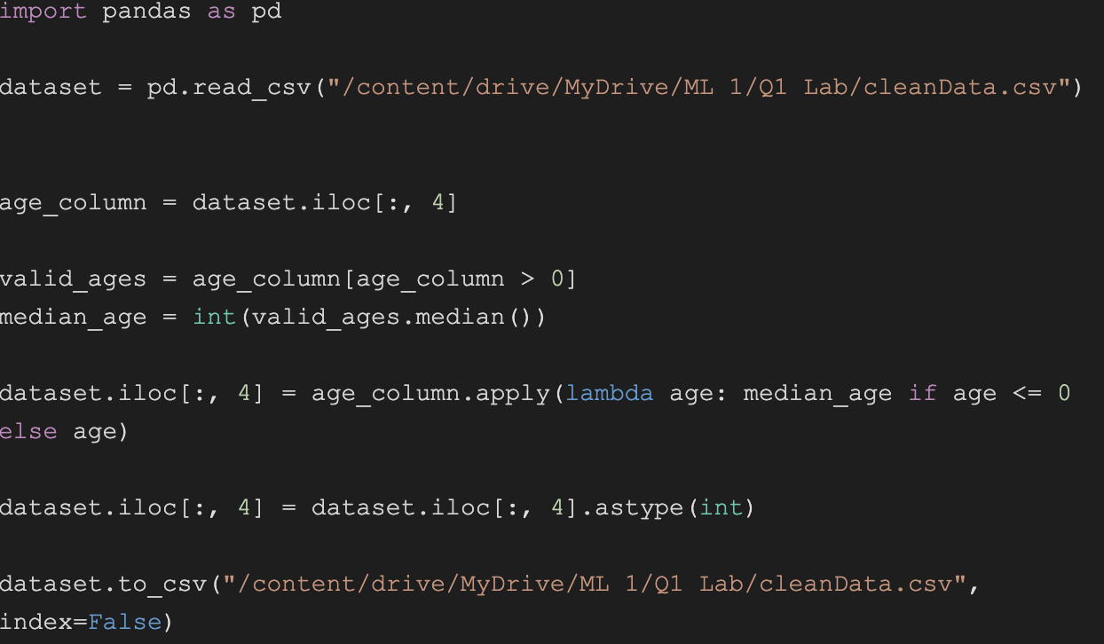
Hidden Value Handling
Vict Age: Had hidden values that were 0, -1
Vict Sex: Had hidden values that were ‘X’, ‘H’
Vict Desc: Had hidden values that were ‘X’
For each of these attributes, a python script was created that would calculate the median then replace the hidden values with the median. Below is the python script for Vict Age

Slide 7
Removing Redundant Attributes
Crm Cd 1: Removed due to the description stating it was the same as Crm Cd
AREA NAME, Crm Cd Desc, Premis Desc, Weapon Desc,Status Desc: Removed as these are all descriptions of other attributes
Location: Could be derived from LAT and LONG

Slide 8
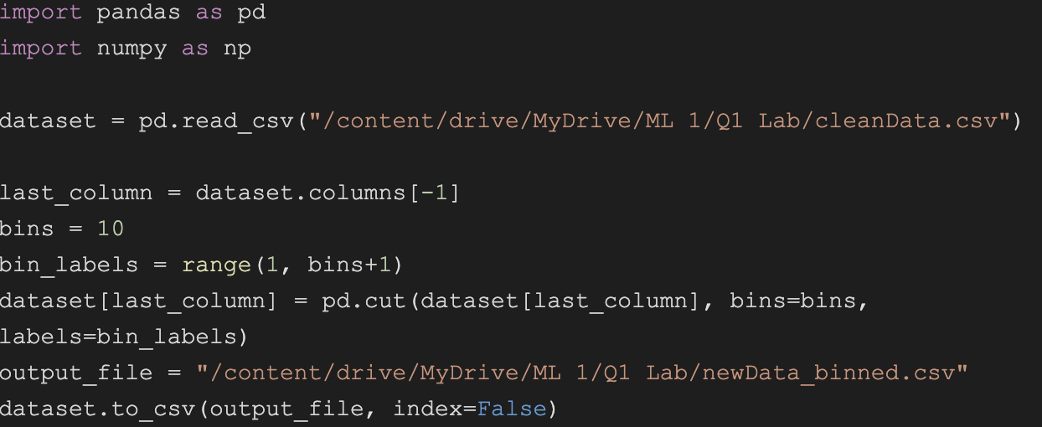
Data Modification
Mocodes: Was given as a string, however, it represents a series of codes describing the crime. For compatibility StringToNominal was used to convert it to a nominal data type to perform further analysis.
Crm Cd: This attribute had 91 unique codes which all varied in frequency, and was numerical. To have an accurate model, we used equal width binning to split the data into 10 bins, causing our class to be a rating of the crime from 1-10, with 1 being the worst. Then, NumerictoNominal was used on the bins.

Slide 9
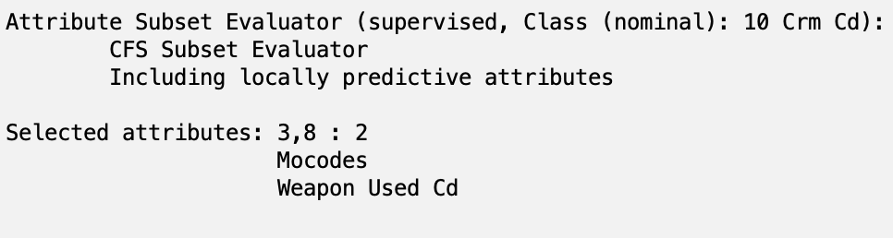
Attribute Selection
CfsSubsetEval:

Slide 10
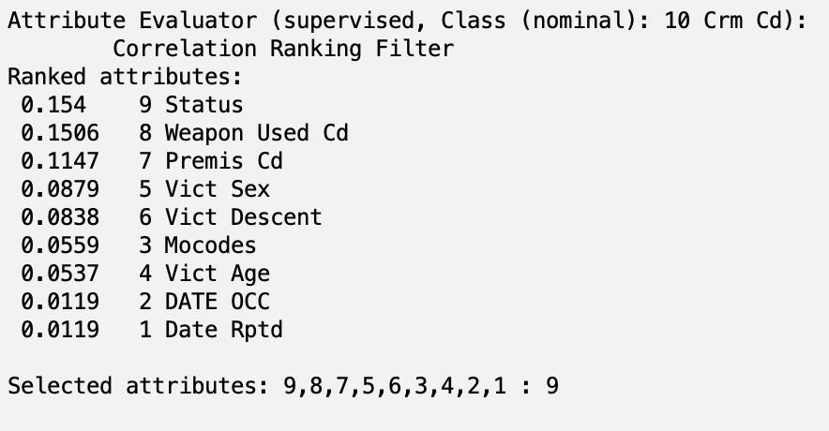
Attribute Selection
CorrelationAttributeEval: cutoff value of 0.06

Slide 11
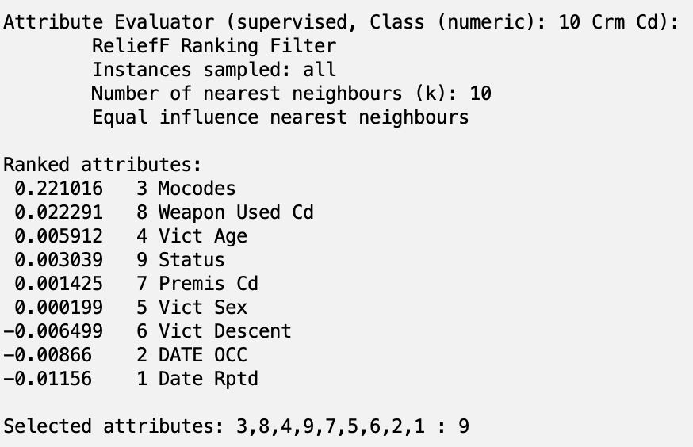
Attribute Selection
ReliefFAttributeEval: cutoff value of 0.001

Slide 12
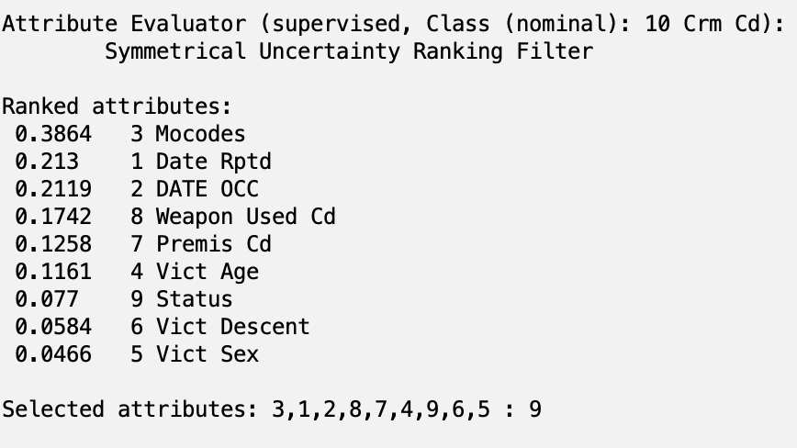
Attribute Selection
SymmetricalUncertAttributeEval: cutoff value of 0.15

Slide 13
Attribute Selection
Personal Selection: The following attributes were removed
Status: other external factors that could affect the status of the case such as the efficiency of the officers assigned it.
Weapon Used Cd: Many of the weapons used were STRONG-ARM (HANDS, FIST, FEET OR BODILY FORCE,
Date Rptd: DATE OCC would give us a more accurate timeline of when the crime happened compared to the date that it was reported.

Slide 14
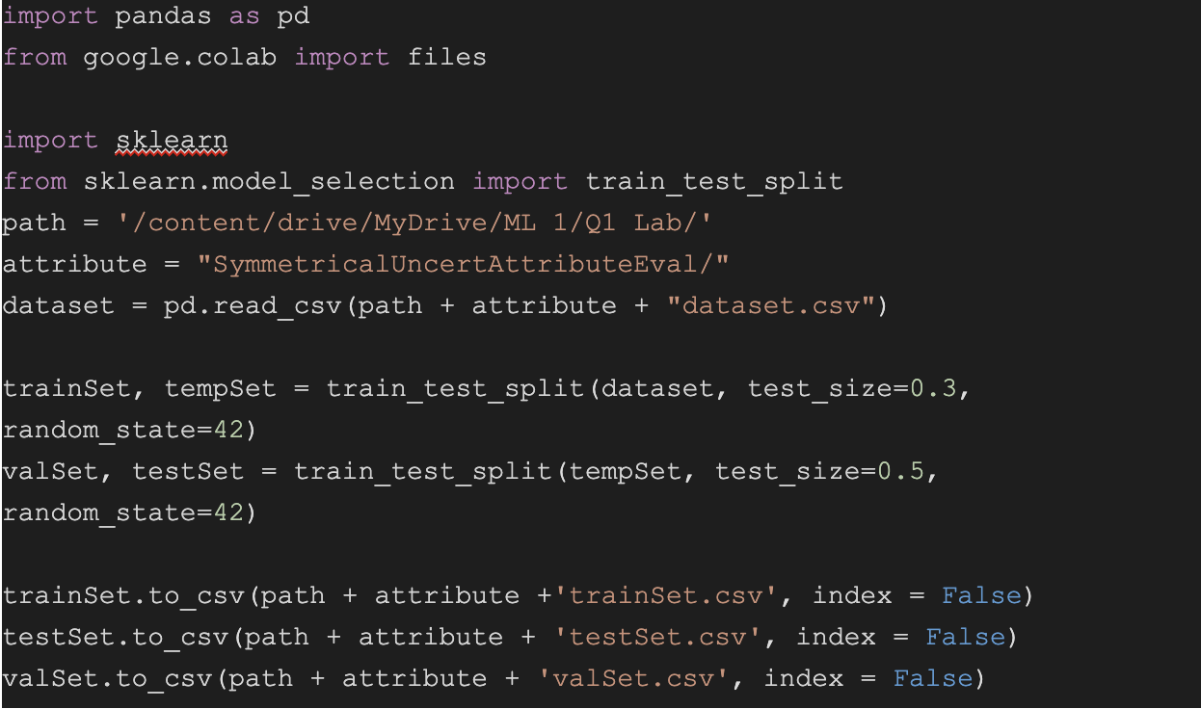
Train-Test-Validation Split
A 70-15-15 split was performed on all the attribute selections seperately.

Slide 15
Classifiers
NaiveBayes Classifier: Assumes independence between attributes and uses Bayes theorem to classify.
DecisionTable Classifier: Uses a tabular representation of rules, where each rule is a unique combination of attribute values.
J48 Classifier: Decision tree related to C4.5 that splits data based on the attribute that gives the biggest information gain.
Random Forest Classifier: Creates multiple decision trees and combines them to improve classification.

Slide 16
Diagram
Cleaned Data
CfsSubsetEval
CorrelationAttributeEval
ReliefFAttributeEval
SymmetricalUncertAttributeEval
Personal Selection
Train-Test-Val
Train-Test-Val
Train-Test-Val
Train-Test-Val
Train-Test-Val
Naive Bayes
DecisonTable
J48
Random Forest
Naive Bayes
DecisonTable
J48
Random Forest
Naive Bayes
DecisonTable
J48
Random Forest
Naive Bayes
DecisonTable
J48
Random Forest
Naive Bayes
DecisonTable
J48
Random Forest
20 models

Slide 17
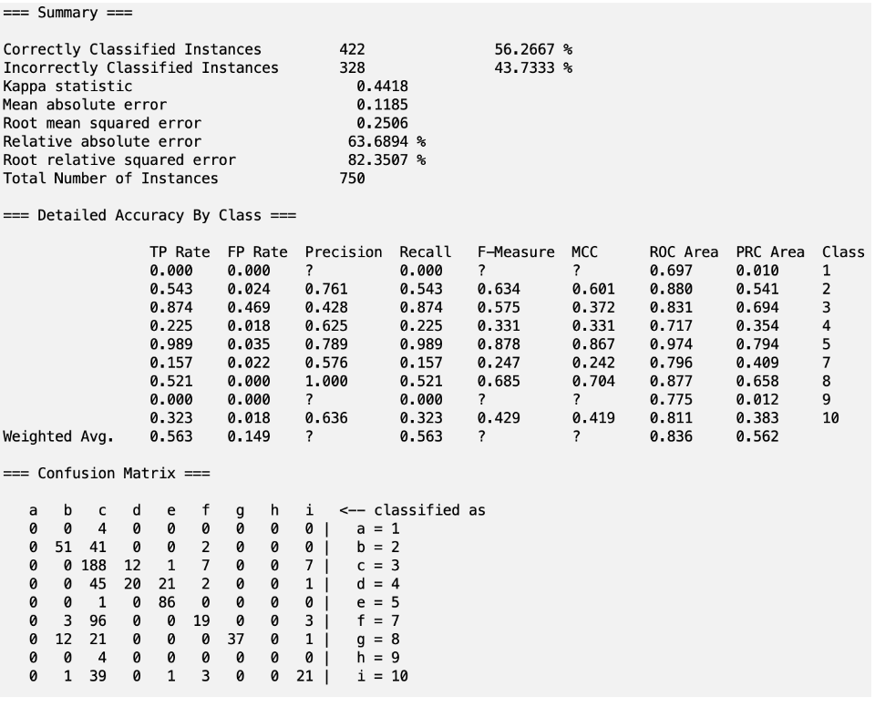
Top 5 Classifiers
ReliefFAttributeEval with J48:
ReliefFAttributeEval with J48 --- 56.27%
CfsSubsetEval with J48 --- 56.13%
ReliefFAttributeEval with Random Forest --- 55.20%
CorrelationAttributeEval with J48 --- 54.80%
CorrelationAttributeEval with Random Forest --- 51.87%

Slide 18
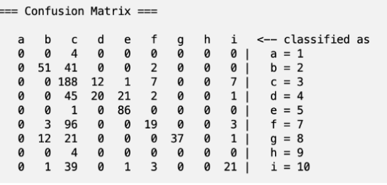
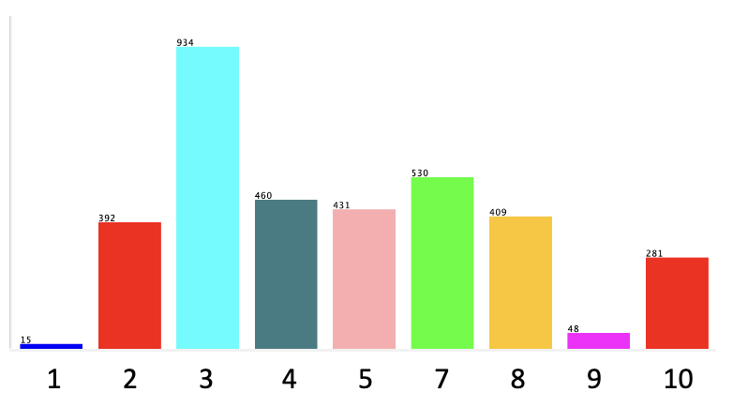
Analysis
The confusion matrix displayed a strong tendency for “3”, as seen below:
This is explained by the abundance of “3” instances compared to the dataset:
Taking “3” out, increased the accuracy to 97.7%

Slide 19
Analysis
The confusion matrix also shows that the inaccurate results the model predicted were close to the actual value (ignoring ‘3’):
This is also seen by the classification having a Mean Absolute Error of 0.1185.

Slide 20
Future Improvements
Discretization: Further discretizing the data to simplify the classification problem could result in a significant improvement in accuracy.
Resampling Techniques: Addressing the imbalanced nature of the dataset through techniques like Synthetic Minority Oversampling Technique (SMOTE)
Using PCA: Create new attributes that are more closely correlated to the class
Regression: Try using regression to predict actual crime codes

Slide 21
References
Data: https://catalog.data.gov/dataset/crime-data-from-2020-to-present
Weka Rules: http://weka.sourceforge.net/doc.dev/weka/classifiers/rules/DecisionTable.html

