Slide 1

Employee Burnout Analysis/prediction

Slide 2
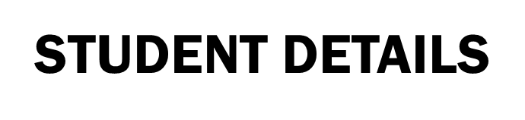

Name: Shaik Sameer Ahmad
Email id: sameerahmad_shaik@srmap.edu.in
Admission Number: AP22110011328
Degree : Btech
Year: 2nd Year
Branch: Computer Science Engineering
College/University: SRM University
Summer Internship: Intern under Edunet foundation through SRM University
Domain: Artificial intelligence and machine learning(03-06-2024 to 25-07-2024)

Slide 3
PROJECT TITLE/Problem Statement
Project Title: Employee Burnout Analysis
Problem Statement :Employee burnout is a significant issue affecting organizations worldwide, leading to decreased productivity, increased absenteeism, and higher turnover rates. Burnout is characterized by chronic work-related stress, resulting in exhaustion, cynicism, and reduced professional efficacy. This project aims to develop a robust and accurate predictive model using machine learning techniques to analyze and predict employee burnout levels based on various factors such as workload, work-life balance, support from management, and job satisfaction. By identifying at-risk employees early, organizations can implement targeted interventions to improve employee well-being and overall organizational health.

Slide 4
AGENDA:
Project Title: Employee Burnout Prediction using linear regression
Data Overview
Exploratory Data Analysis
Data Visualisation
One-hot encoding
Outlier detection and Removal
Normalization
Model Training
Linear Regression
Model Validation and Evaluation

Slide 5
PROJECT OVERVIEW
Purpose
1.Proactive Identification: Detect early signs of burnout in employees to take preventive measures.
2. Enhance Well-Being: Implement wellness programs such as offering flexible work hours to employees experiencing high stress.
3. Improve Productivity: Reduce absenteeism and improve overall productivity by addressing factors that contribute to burnout.
4.Boost Retention Rates: Identify employees at risk of burnout and provide targeted support.
5.Support Organizational Health: Foster a healthier work environment by regularly monitoring burnout levels.

Slide 6
Scope
This project entails collecting data from employee surveys and HR records, focusing on key features such as job role, resource allocation, and mental fatigue scores.
The data will be cleaned, preprocessed to handle missing values, and normalized for consistency.
A linear regression model will be developed and evaluated using metrics like Mean Absolute Error (MAE) and R-squared to ensure accuracy.
Objectives
The primary objectives are to integrate relevant data sources and develop a highly accurate linear regression model to predict employee burnout. The project seeks to identify significant predictors of burnout, such as job role and mental fatigue, enabling the early detection of potential burnout cases. This will facilitate timely and effective interventions, provide actionable insights for organizational improvements, and support strategies to enhance overall employee well-being and productivity.

Slide 7
WHO ARE THE END USERS of this project?
Target Audience:
HR Departments: Human Resource departments in organizations are the primary users. They are responsible for managing employee welfare and addressing burnout issues.
Organizational Leaders: Includes CEOs, managers, and team leaders who need insights into employee well-being to maintain productivity.
Policy Makers: Individuals who create policies related to workplace health and employee engagement.

Slide 8
YOUR SOLUTION AND ITS VALUE PROPOSITION
Solution Description:
Predictive Model: Developed a Linear Regression model to predict employee burnout rates based on various features such as workload, mental fatigue score, and resource allocation.
Detailed EDA and Preprocessing: Comprehensive data analysis and preprocessing steps to ensure data quality and model accuracy.
Visualization: Extensive use of visualizations to understand data patterns and correlations.
The model uses several Python libraries :
NumPy is used to create n dimensional arrays and performing some operations on these arrays.
Pandas is used for manipulating the data in the data frame.
Matplotlib is used for plotting the data.
Seaborn is used to enhance visualization of data in data frame.
Scikit-learn is used for data preprocessing and in model developing.

Slide 9
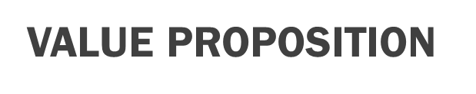
Accurate Predictions: The model provides reliable predictions of burnout rates, enabling organizations to take proactive measures.
Data-Driven Insights: Helps in identifying key factors contributing to burnout, allowing targeted interventions.
Improved Employee Well-being: By addressing burnout, organizations can enhance employee satisfaction and retention.
Cost Savings: Reducing burnout leads to lower turnover rates and associated hiring and training costs.

Slide 10
How did you customize the project and make it your own
Customization:
Detailed EDA: Conducted in-depth exploratory data analysis to understand data distributions, correlations, and patterns.
Outlier Detection and Removal: Implemented robust outlier detection and removal techniques to improve model accuracy.
Feature Engineering: Created new features and used one-hot encoding for categorical variables to enhance model performance.
Innovative and Unique Aspects:
EDA Visualizations: Used advanced visualizations to uncover hidden patterns and insights in the data.
Correlation Analysis: Conducted comprehensive correlation analysis to identify the most impactful features.
Outlier Handling: Improved model accuracy by detecting and removing outliers using the IQR method.

Slide 11
MODELLING
Techniques Used: Linear Regression for prediction.
Methodologies:
Data Cleaning: Removal of null values and irrelevant features.
EDA: Visualization of data distributions and correlations.
Feature Engineering: One-hot encoding of categorical variables.
Scaling: MinMaxScaler for feature normalization.
Model Training: Linear Regression model.
Evaluation: Metrics like MSE, RMSE, MAE, and R-squared.

Slide 12
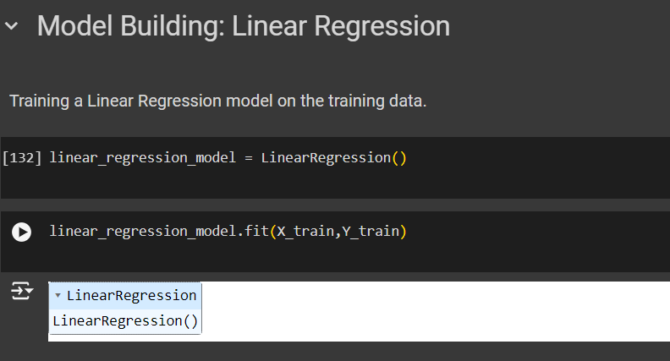
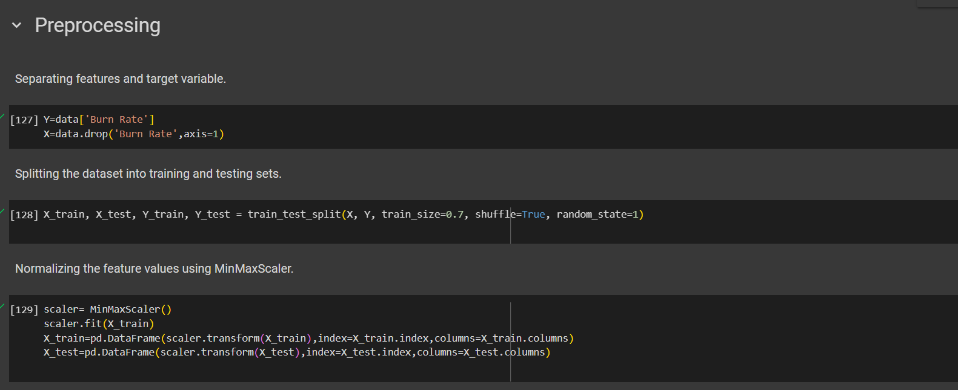
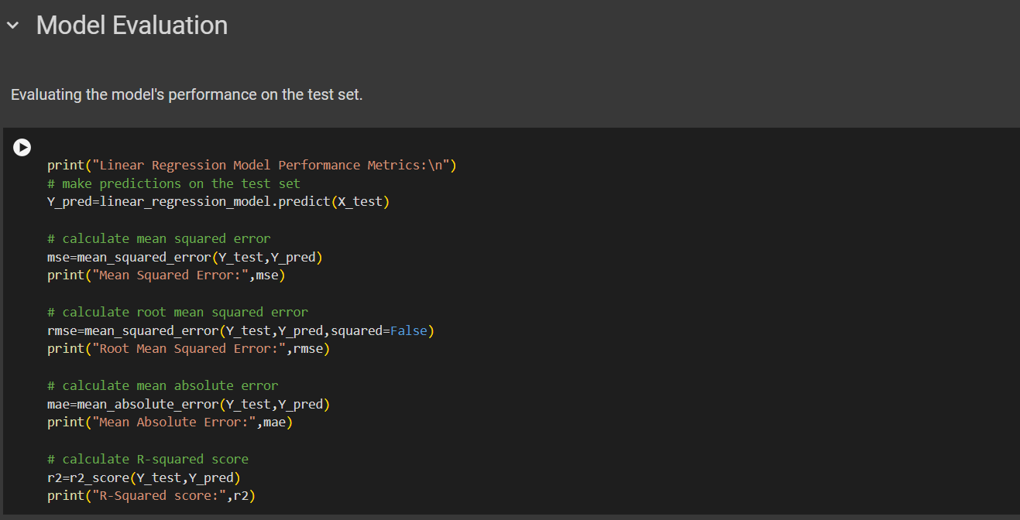
MODELLING
Preprocessing
Model building
Model Evaluation

Slide 13
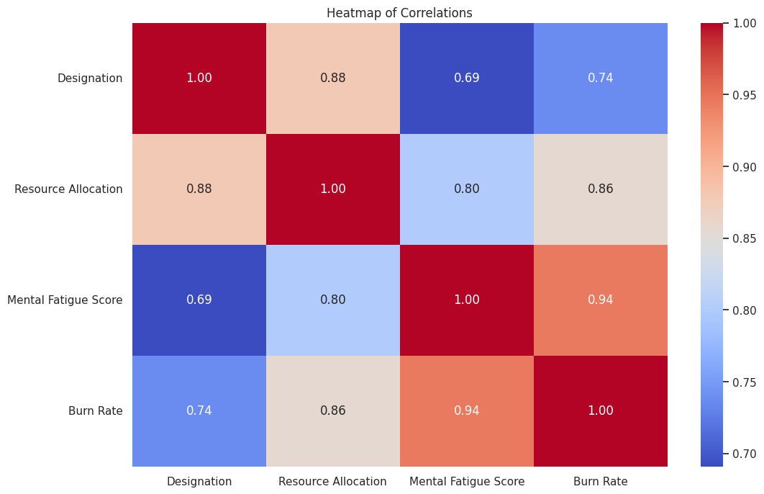
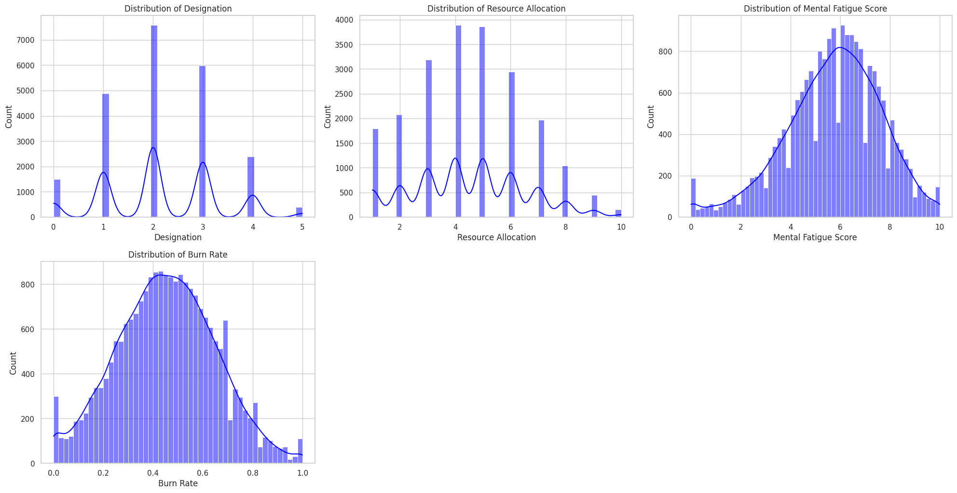
Results
Distribution of numerical features.
Heatmap of correlations.

Slide 14
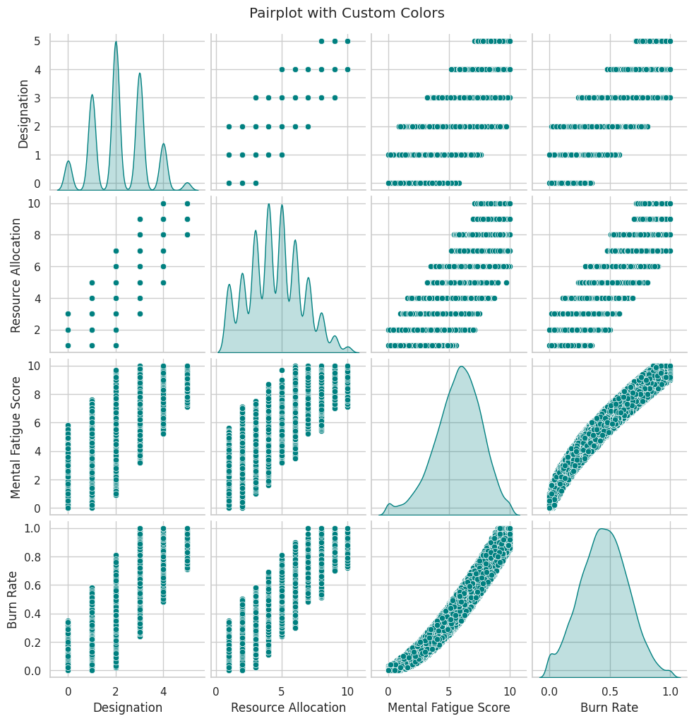
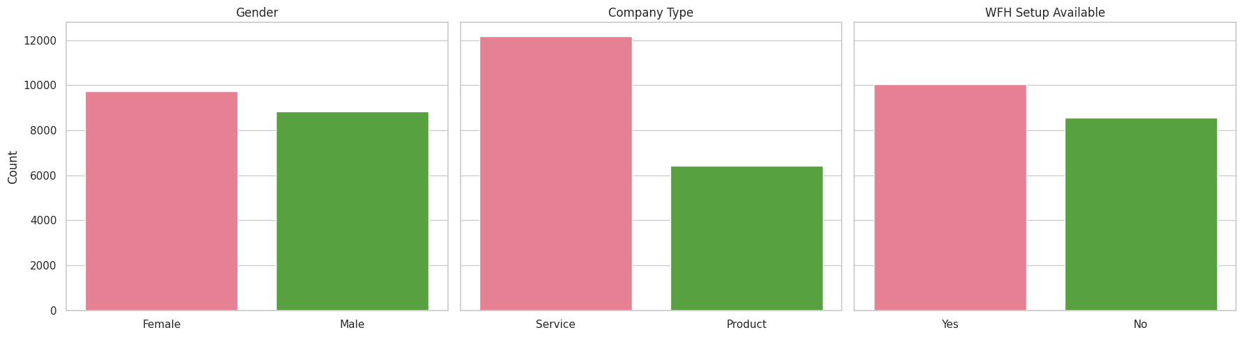
Results
Visualisation of Categorical columns
Pairplot analysis

Slide 15
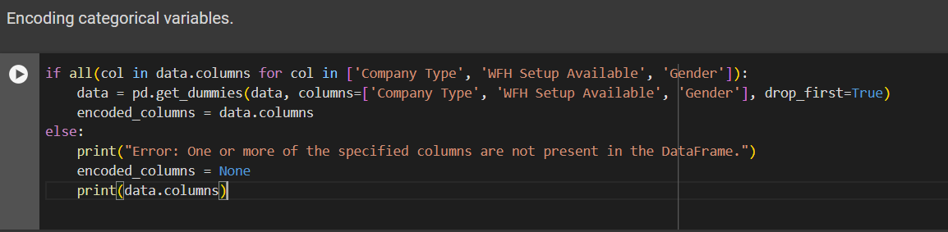
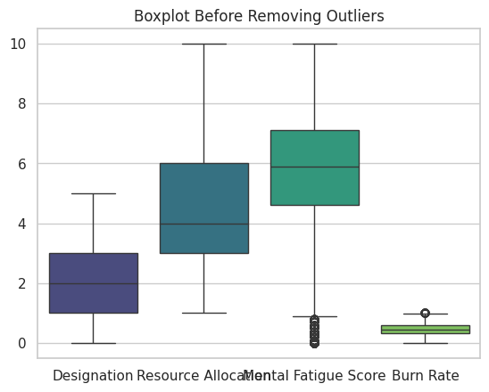

Boxplot before and after removing Outliers

Slide 16
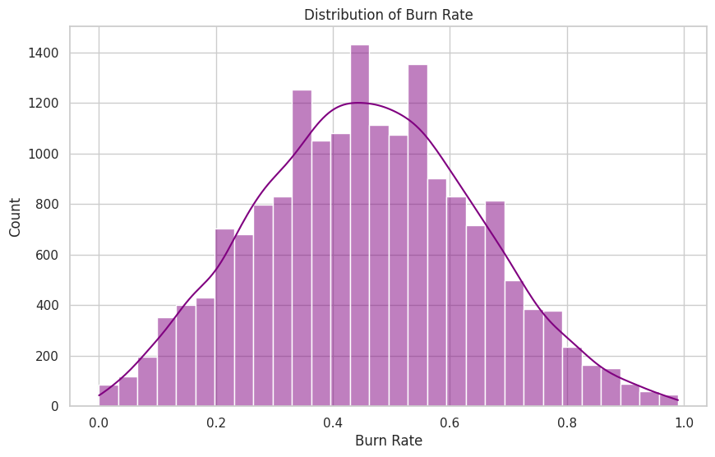
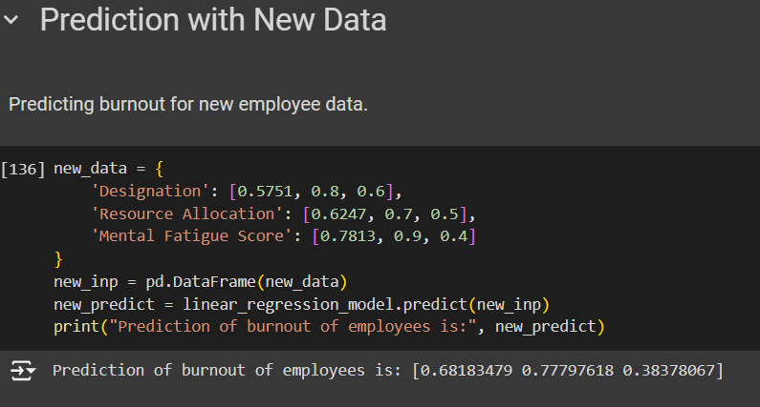
Distribution of burnrate
Prediction of Burnout through inputs

Slide 17
Links:
https://github.com/15Sameer/Employee_Burnout_Analysis
https://www.kaggle.com/datasets/blurredmachine/are-your-employees-burning-out?select=train.csv

