Slide 1
Named entity recognition for product listings

Slide 2
Table of Contents
Introduction
Problem Statement
Literature review
Implementation
Results
Conclusion

Slide 3
Introduction
Named Entities (NEs) are proper names in texts, i.e. the names of persons, organizations, locations, times and quantities
Person’s name (James, Robert, Mary, etc.),
Countries (United States, Canada, China, etc.,),
Organization (Google, Facebook, etc.)
NE Recognition (NER) is a sub-task of Information Extraction (IE)
NER is also an important task for texts in specific domains such as ecommerce and biomedical texts.
Used for Recommendation systems, Internal search engines.

Slide 4
Problem Statement
Given below are the listings of the ecommerce websites Amazon/ebay
Prada Saffiano Double Zip Tote
Authentic GUCCI Jackie Handbag leather
Chanel Leo Lion Flap Bag Chevron Lambskin Medium
Identify Prada, GUCCI, Chanel as Brands from the above sentences, Handbag, Flap Bag, Zip Tote are Product Types, Medium is size, colour and so on.

Slide 5
Literature Review
Rule based NER
Conditional Random Fields
Long Short Term Memory
Bidirectional Encoder Representations from Transformers

Slide 6
Rule Based NER
Rule based Named Entity Recognition uses a knowledge-based recognition process that relies on lists of datasets, such as a list of company names for the company category, to make inferences.
Because of this, its accuracy can vary greatly based on how relevant the datasets are to the input text.

Slide 7
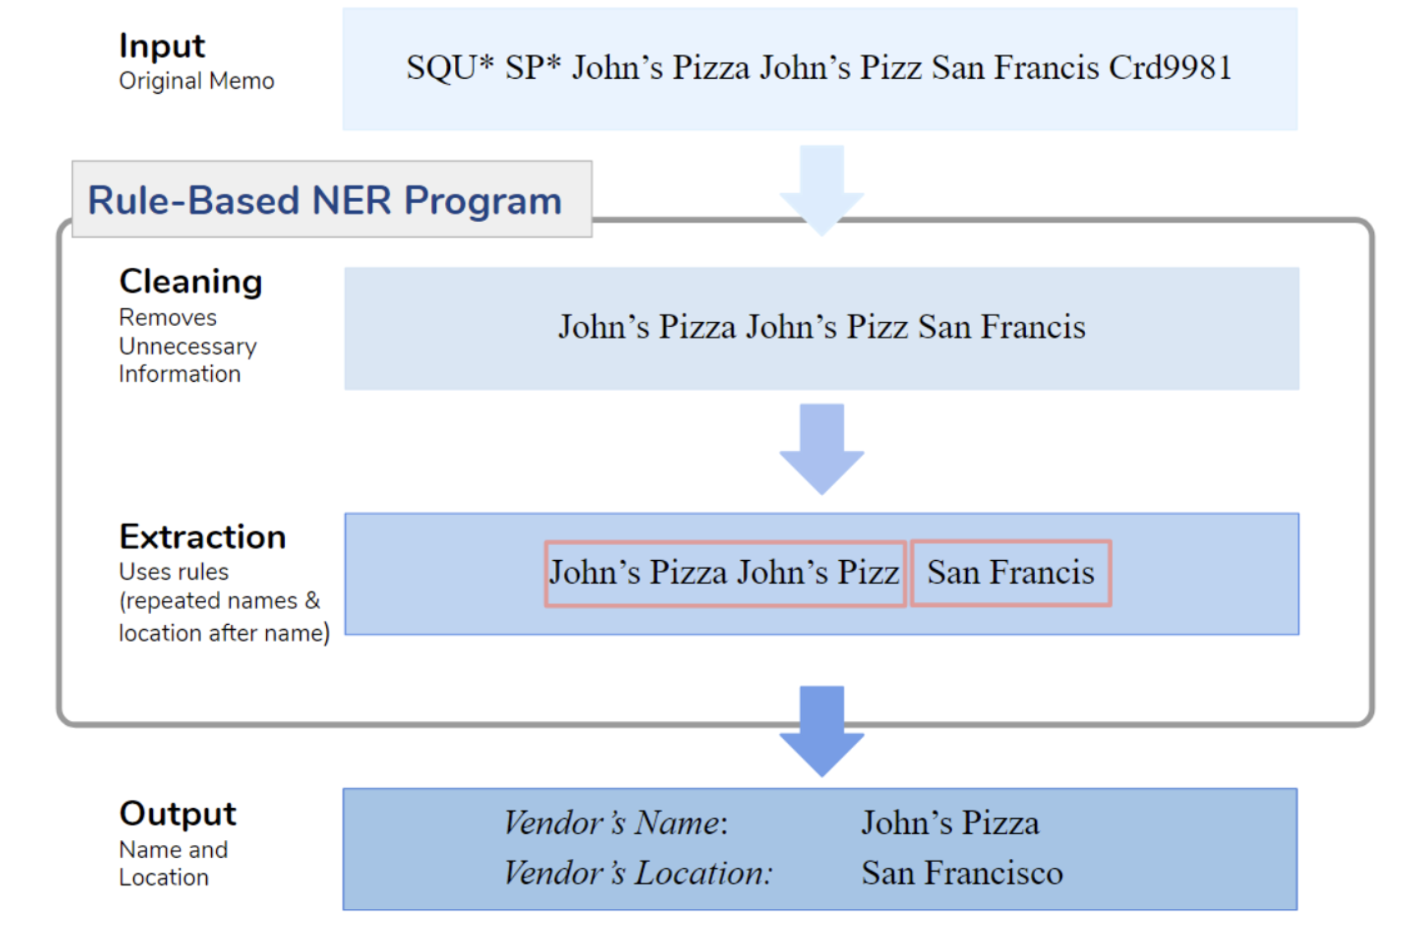
Example of Rule based NER

Slide 8
Conditional Random Fields
A conditional random field uses the contextual information and the state of the neighbours for prediction task.
A linear chain CRF is a popular type of a CRF model, which assumes that the tag for the present word is dependent only on the tag of just one previous word.
One problem with the linear chain CRFs is that they are capable of capturing the dependencies between labels in the forward direction only

Slide 9
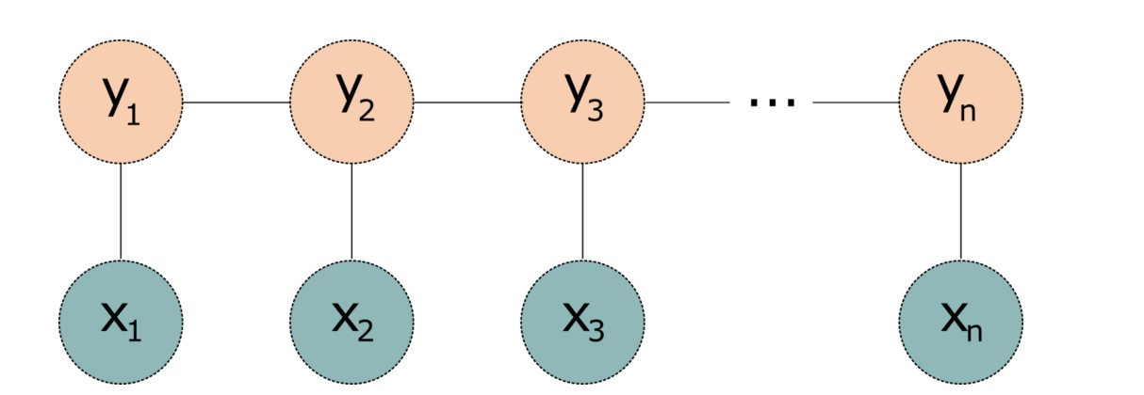
Conditional Random Fields

Slide 10
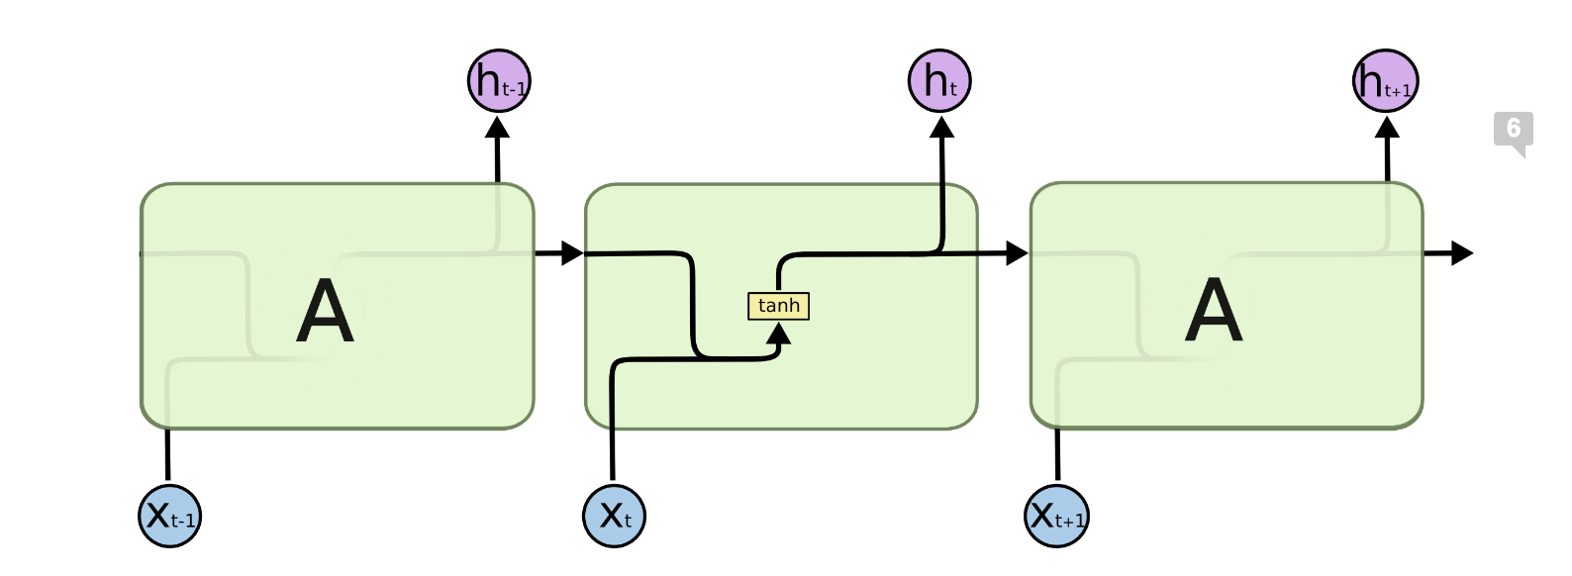
Recurrent neural networks

Slide 11
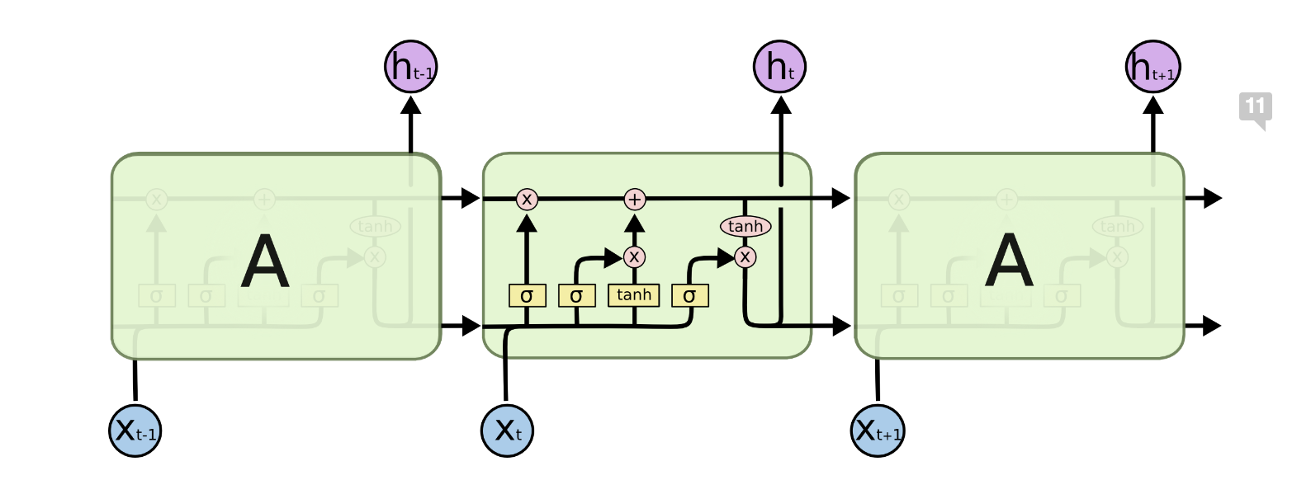
Long Short Term Memory

Slide 12
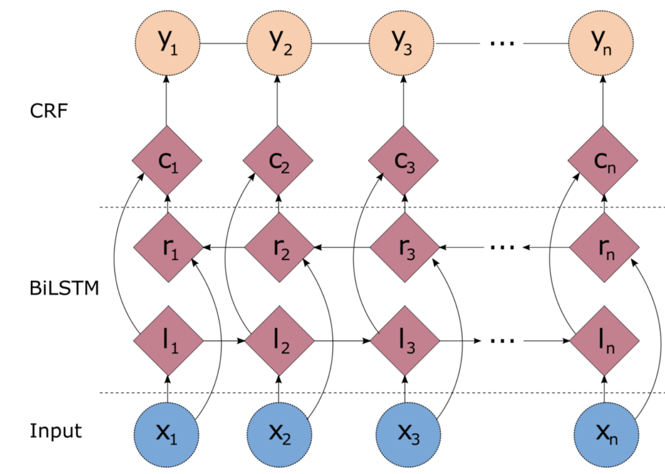
Bidirectional LSTM with CRF

Slide 13
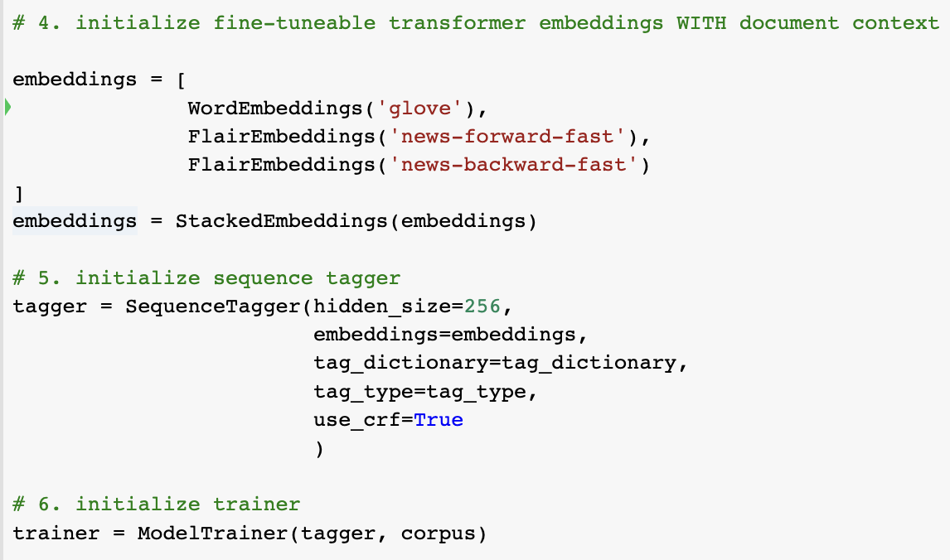
NER implementation using Flair(BiLSTM-CRF)
Flair is a PyTorch library based NLP.

Slide 14
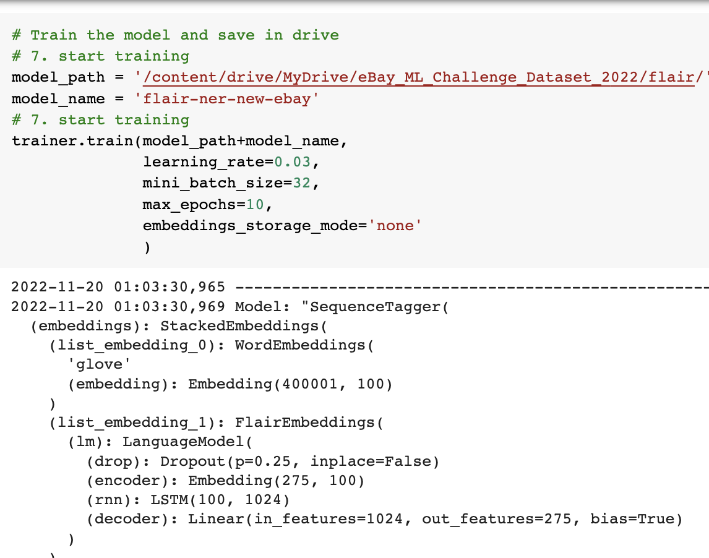
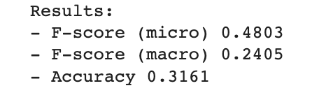
NER implementation using Flair(contd.)

Slide 15
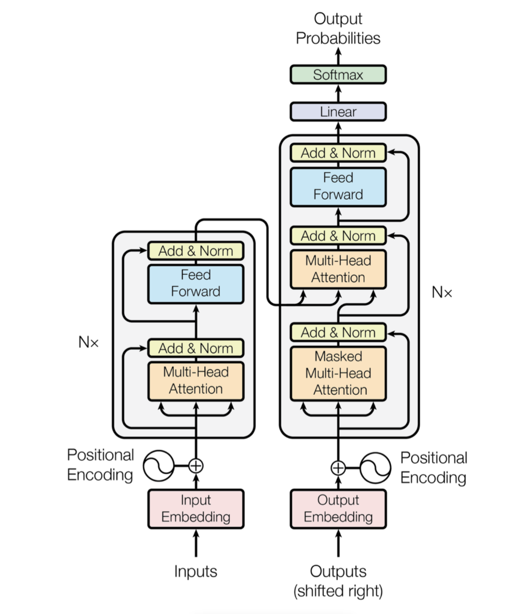
Transformer

Slide 16
BERT
Stacking on encoders together form BERT, which are useful in solving questions like Machine Translation, sentiment analysis, NER and so on.
BERT has been pre trained to understand the language and context.
It has to be fine tuned to learn specific task(NER).

Slide 17
Fine tuning BERT for NER
Preprocessing
Annotate using IOB tagging
Initialize a tokenizer from pretrained BERT model
Using BertForTokenClassification class
Training loop
Testing accuracy

Slide 18
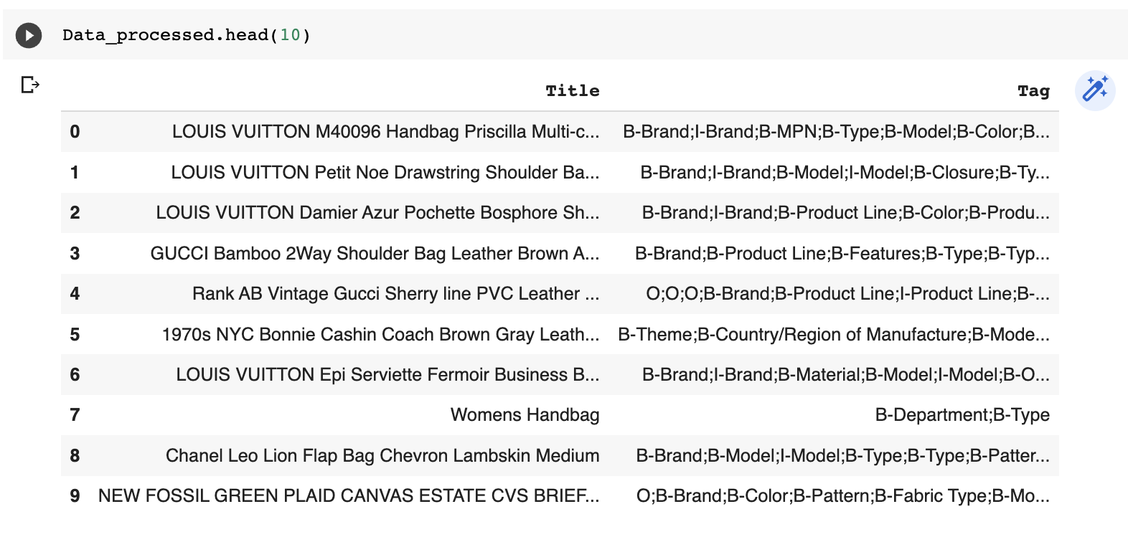
Preprocessing, Annotate using IOB tagging

Slide 19
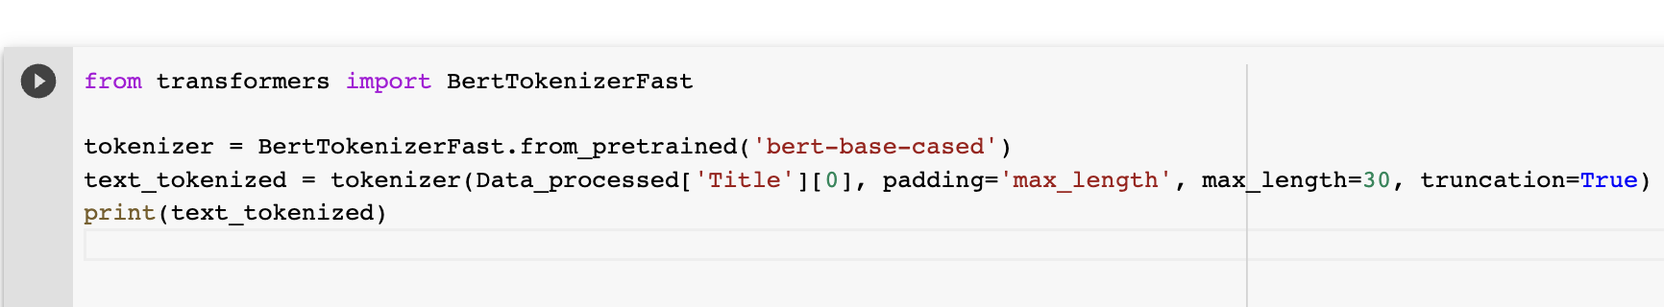
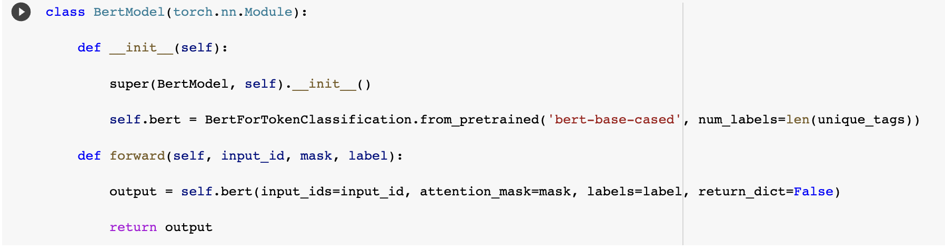
Tokenizing

Slide 20
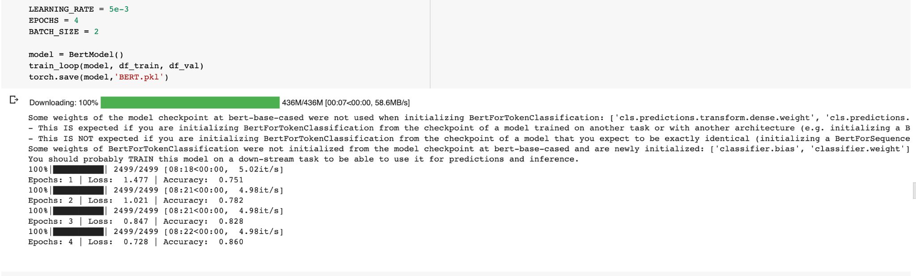
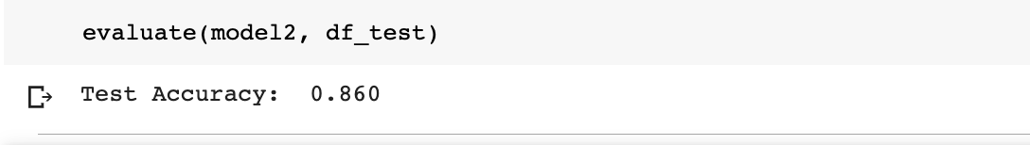
Training, testing accuracy

Slide 21
Output Example
Title : LOUIS VUITTON M40096 Handbag Priscilla Multi-color canvas Multi-color canvas
Tag : ['B-Brand', 'I-Brand', 'B-MPN', 'B-Type', 'B-Model', 'B-Color', 'B-Color', 'B-Color', 'B-Fabric Type', 'B-Color', 'B-Color', 'B-Color', 'B-Fabric Type']

Slide 22
Conclusion
To Conclude, BERT has given better results on the Named entity recognition task.

Slide 23
References
https://www.dominodatalab.com/blog/named-entity-recognition-ner-challenges-and-model
https://medium.com/inside-machine-learning/what-is-a-transformer-d07dd1fbec04
https://towardsdatascience.com/named-entity-recognition-with-bert-in-pytorch-a454405e0b6a

