Slide 1
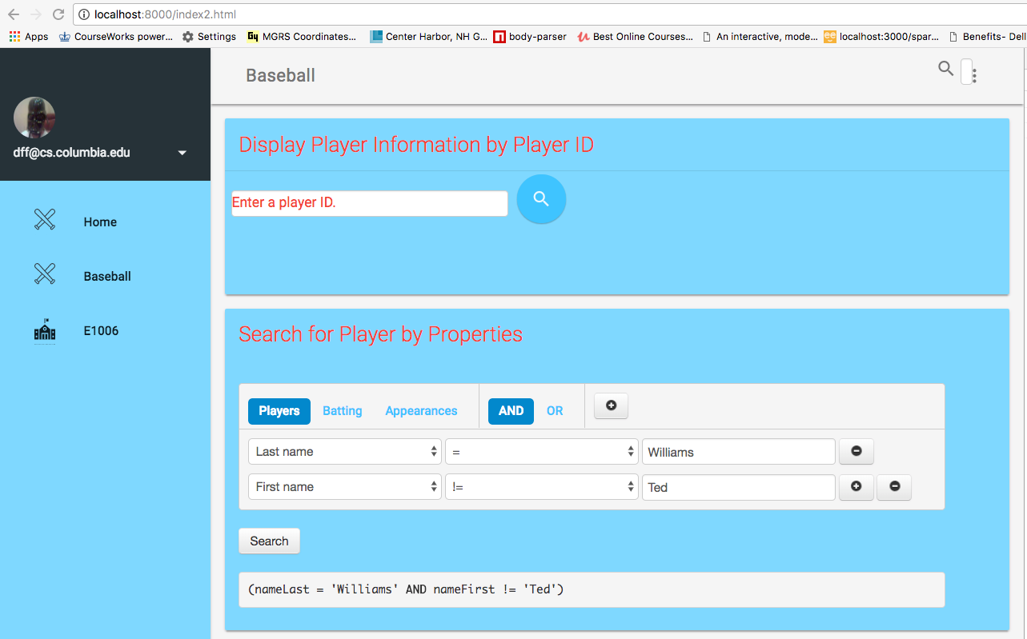
Enter playerID
Maps to GET /api/players/<value>
Enter <column><OP><value>
Maps to GET /api/players?<query>
Choose
Resource

Slide 2
