Slide 1
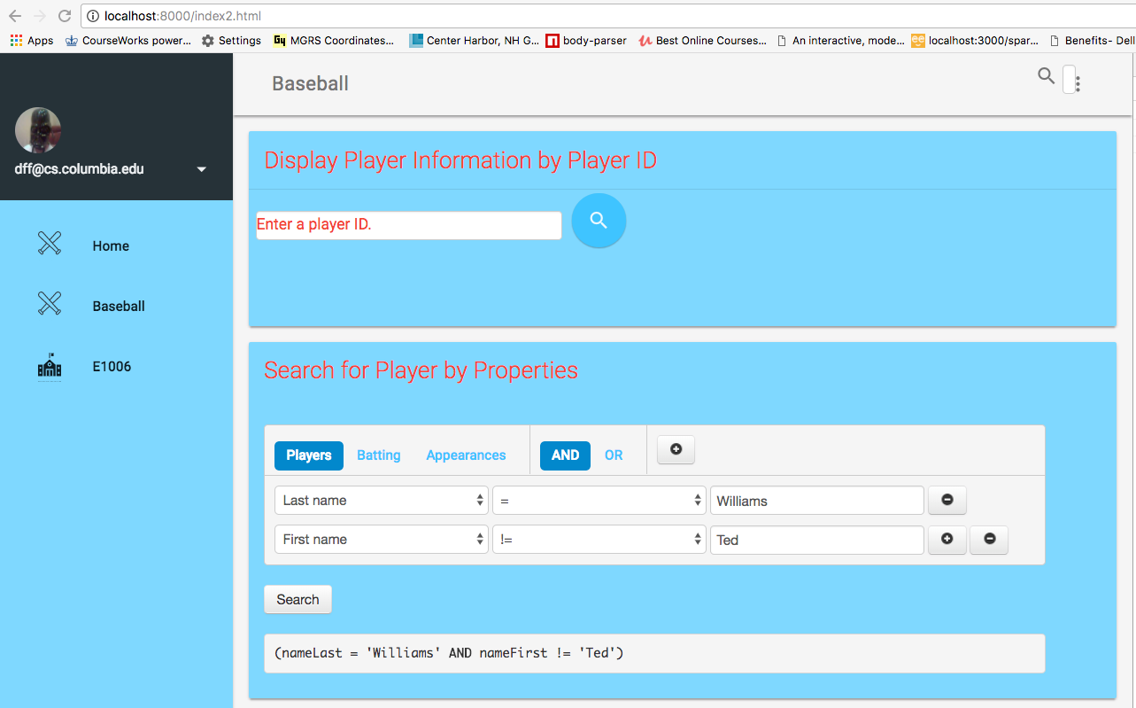
Enter playerID
Maps to GET /api/players/<value>
Enter <column><OP><value>
Maps to GET /api/players?<query>
Choose
Resource

Slide 2
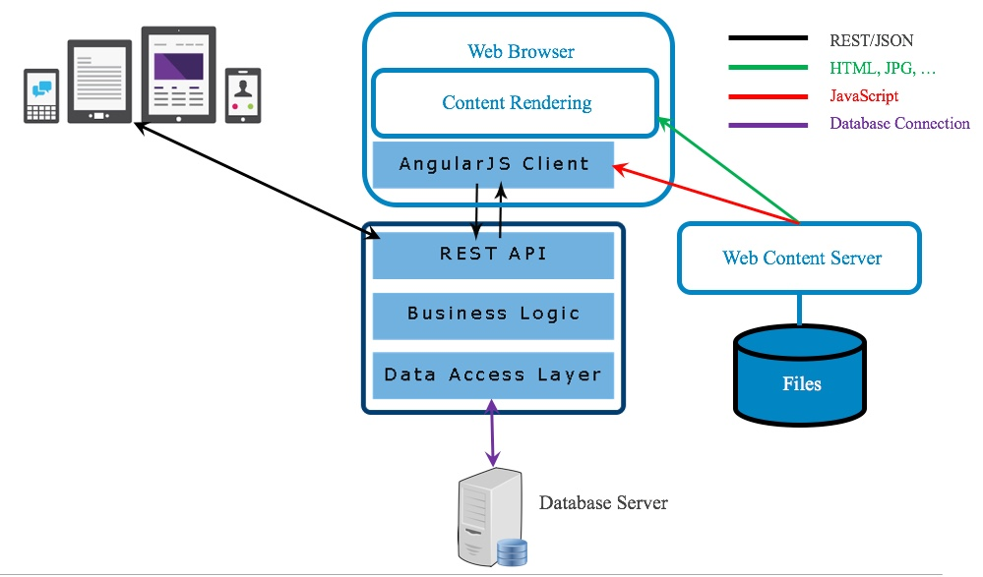
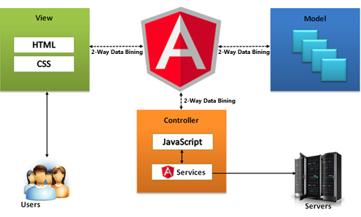
Primary
Focus

Slide 3
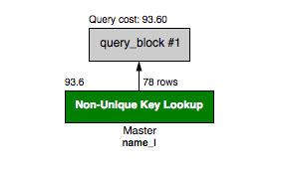
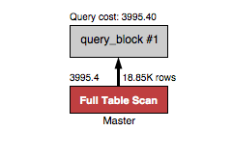
The query that uses an index is 50x more efficient in this example.
SELECT
nameLast, nameFirst
FROM
Master
WHERE
nameLast='Williams';
SELECT
nameLast, nameFirst
FROM
Master
WHERE
nameLast='Williams';

Slide 5
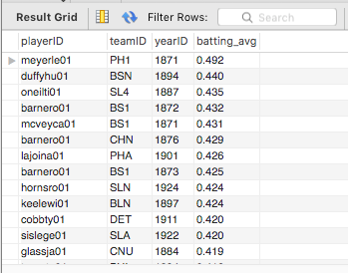
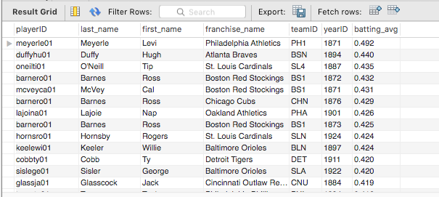
SELECT and PROJECT on Batting
But, I really want the names. Why not store them also?

Slide 6
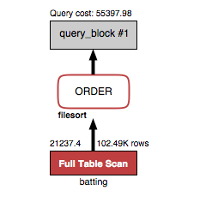

Slide 7
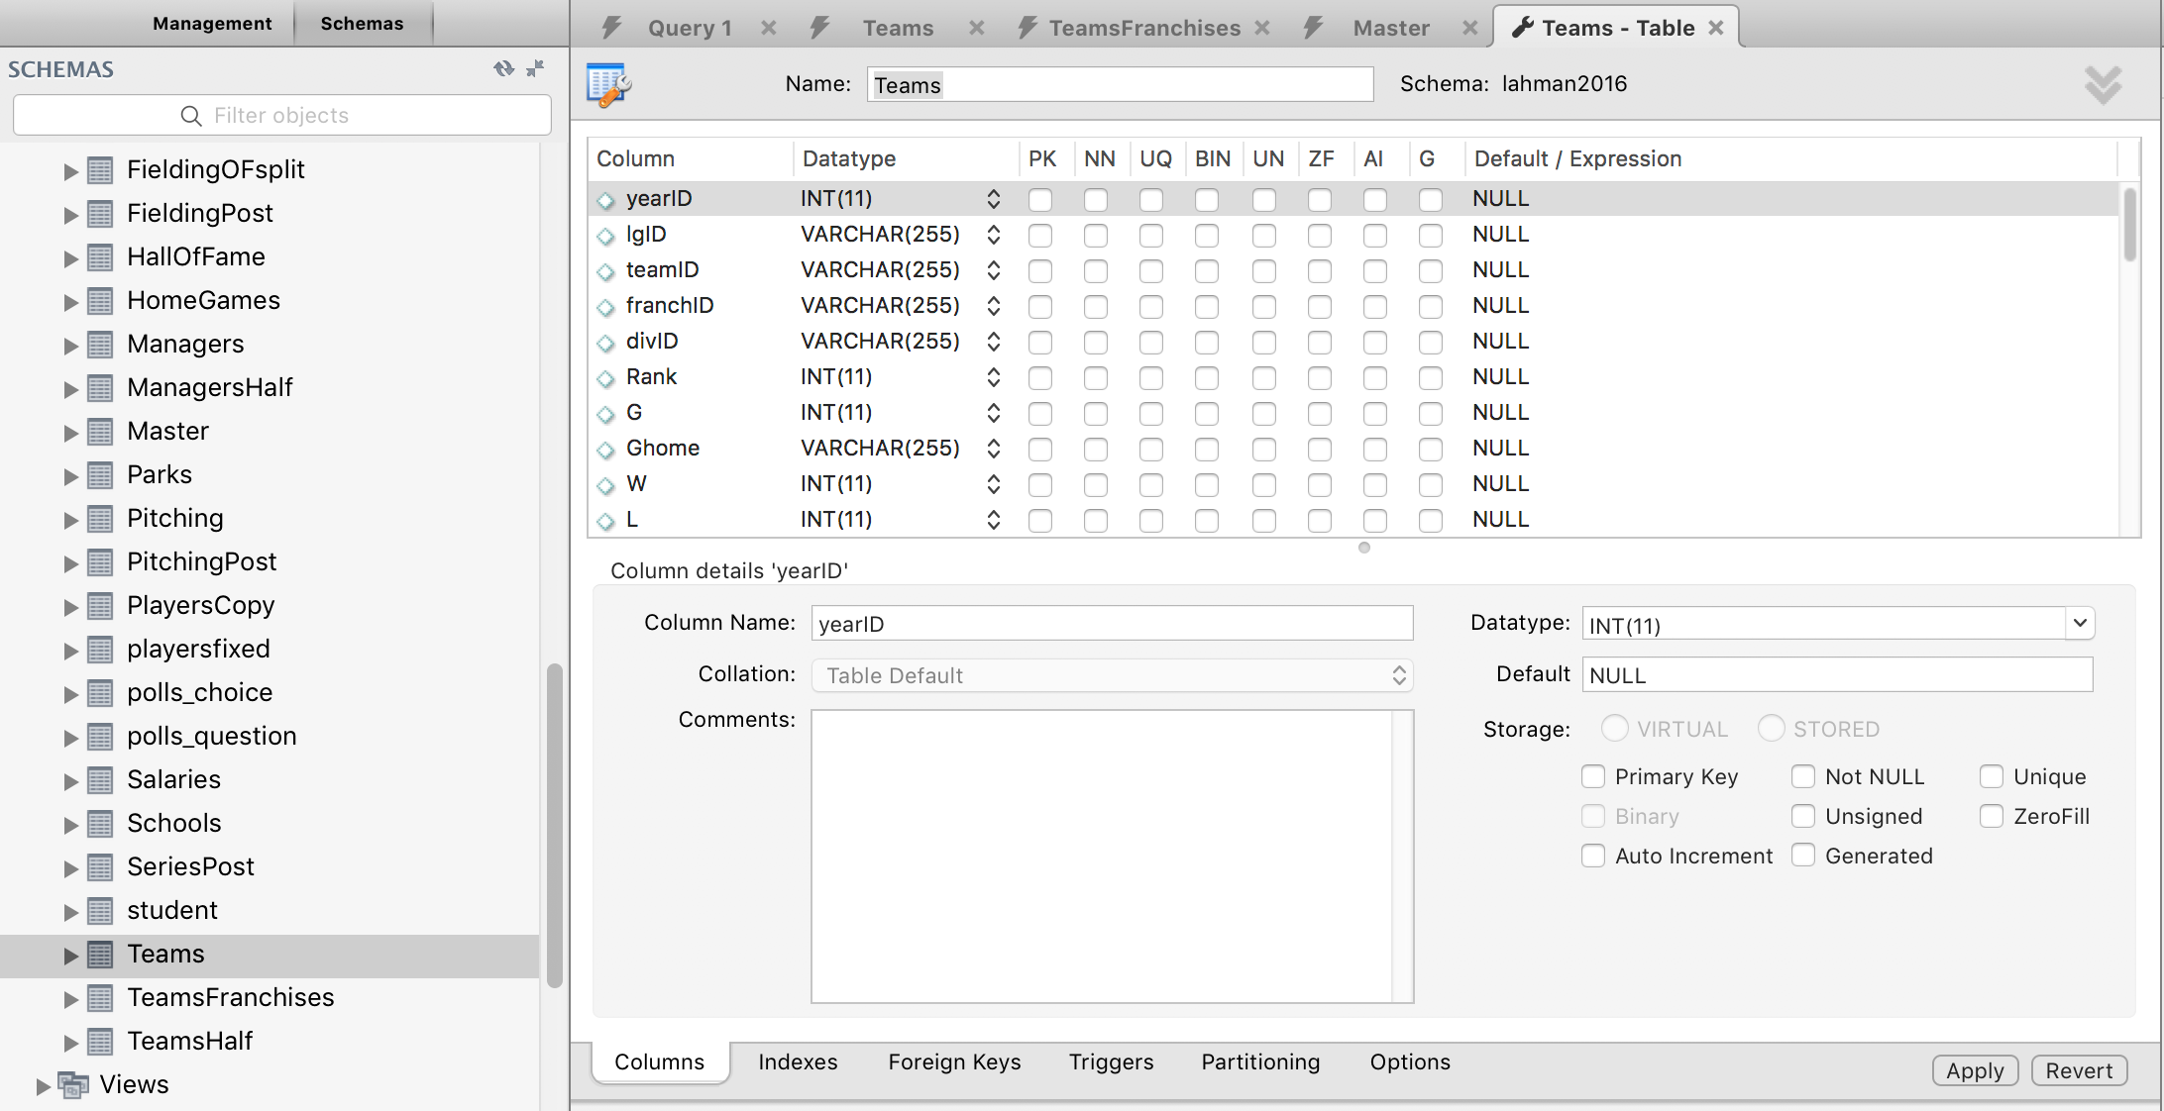
Column constraints
Right click
Alter table.
Type of constraint to define/change.

Slide 8
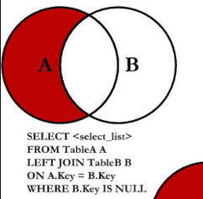
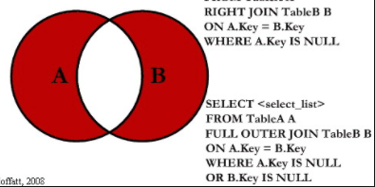
A = Master, B = AwardsPlayers
Set difference is Players that did not win an award.
UNION – INTERSECTION is
Players and each Award the player did not win.
What if I only want to know the players who did not win and Award but do not care about which one?
SELECT DISTINCT and do not choose awardID.

Slide 9
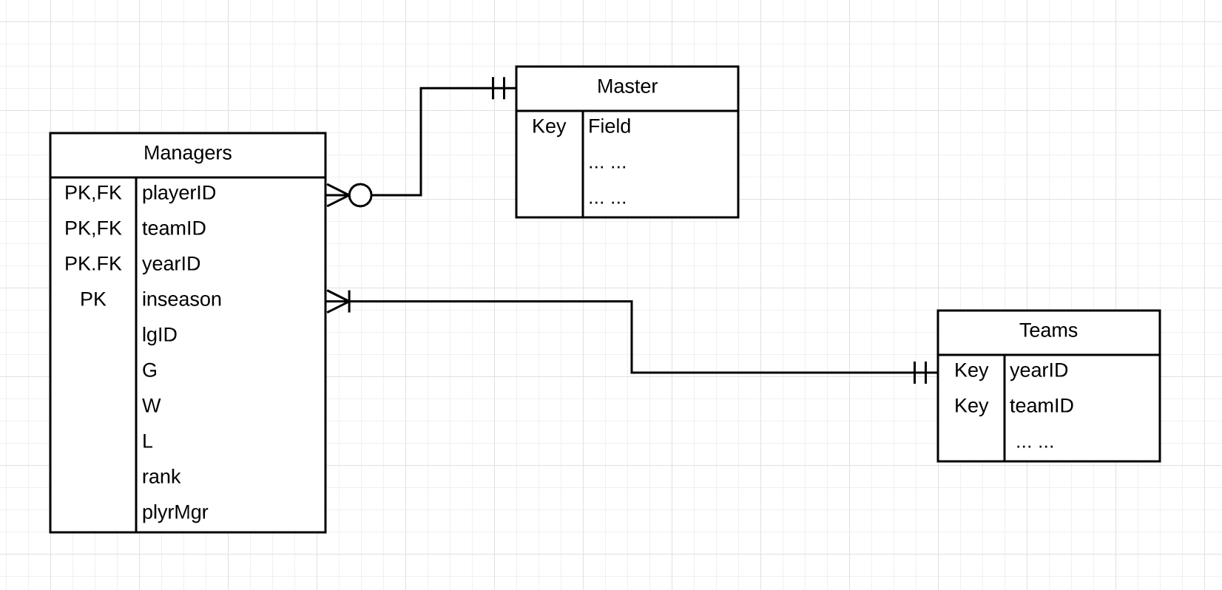
Master is

Slide 10
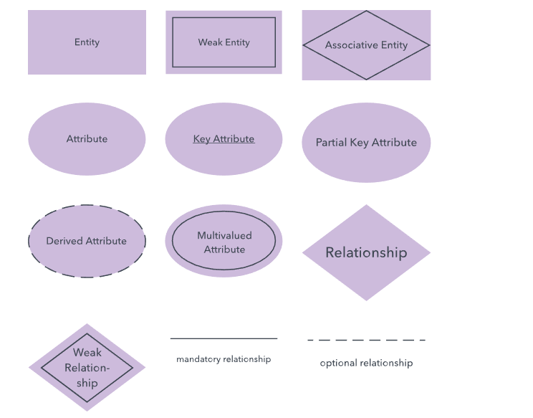
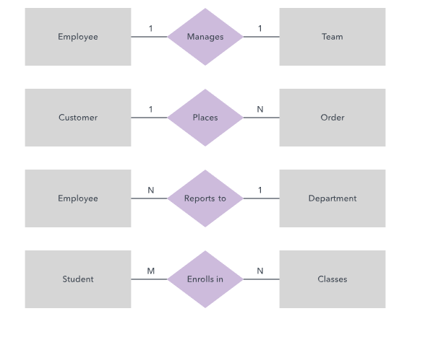

Slide 11
UML relationship types.
Relatively easy to model because the entity schema and data are linked only by foreign keys.
A course section uses a classroom.
A course section has a student.
A student’s calendar owns appointments.
More complex to model because the entity schema and instance data are deeply related.
A student is a person.
A professor realizes course instructor

Slide 13
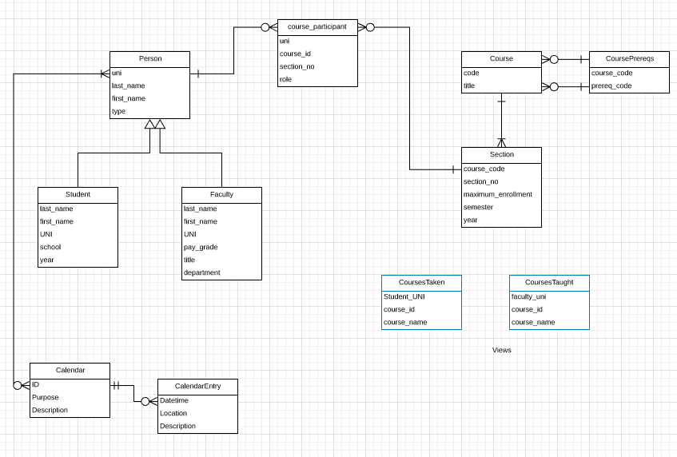
Associative
Entity
Weak
Entity

