Slide 1
BlusterCritter Output
P3_JoeyBloom_Assign45_BlusterCritter

Slide 2
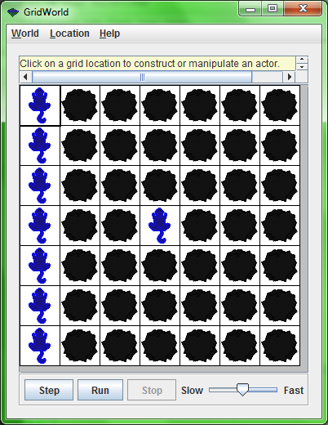
Courage value: 1. if 1 or more critters are within 2 squares of the bluster critter in the center, then the bluster critter will darken.

Slide 3

All critters here are outside 2 block range, so critter brightens. After 5 steps:

Slide 4
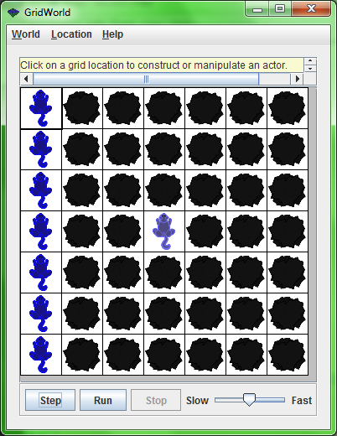
After 10 steps:

Slide 5
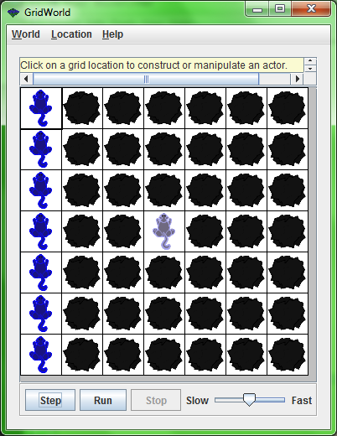
After 20 steps:

Slide 6
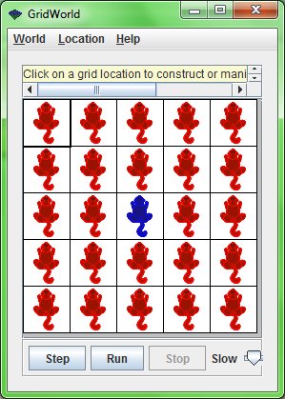
Red: Critter
Blue: BlusterCritter
Courage Value 24

Slide 7
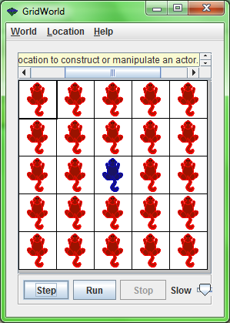
2 block area around BlusterCritter is filled with 24 Critters, so BlusterCritter will darken. After 5 steps:

Slide 8

After 10 steps:

Slide 9

After 20 steps:

