Slide 1
QuickCrab OUTPUT
P3_JoeyBloom_Assign46_QuickCrab

Slide 2
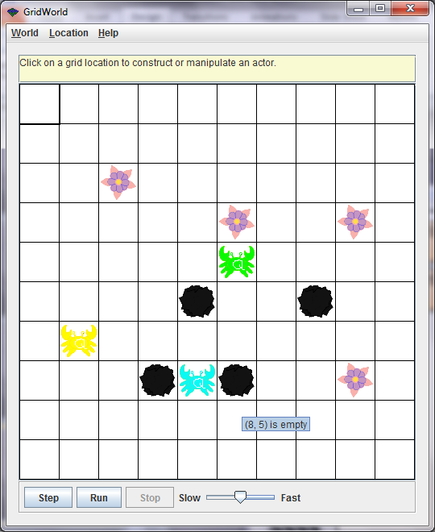
Initial Setup
Notice the neatly sketched Q on the QuickCrabs’ backs

Slide 3
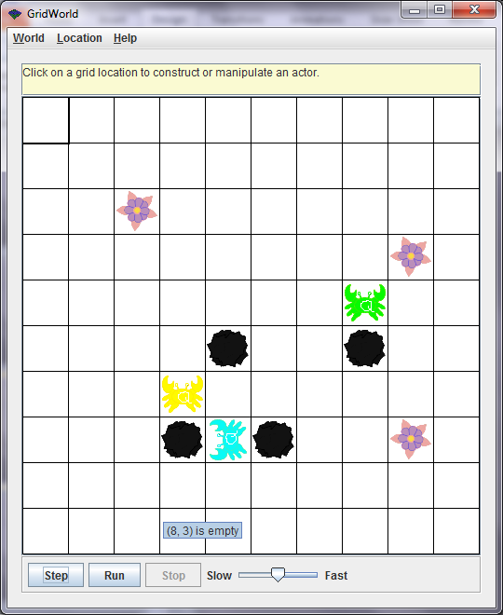
Step 1
green crab ate a flower and moved
Yellow crab stepped 2 right
Blue crab turned

Slide 4
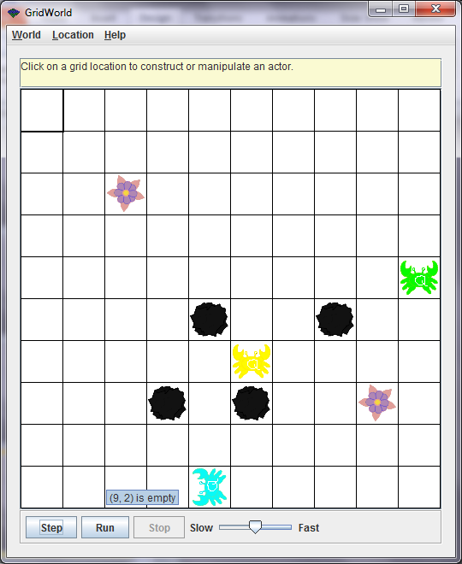
Step 2
Green crab ate another flower and moved 2
Yellow crab moved 2 again
Blue crab moved 2

Slide 5
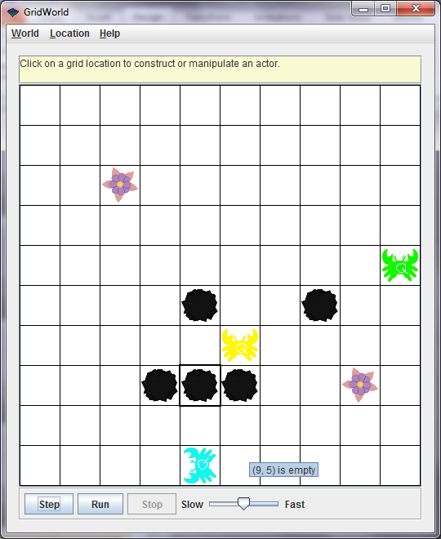
Add Rock to trap blue crab

Slide 6
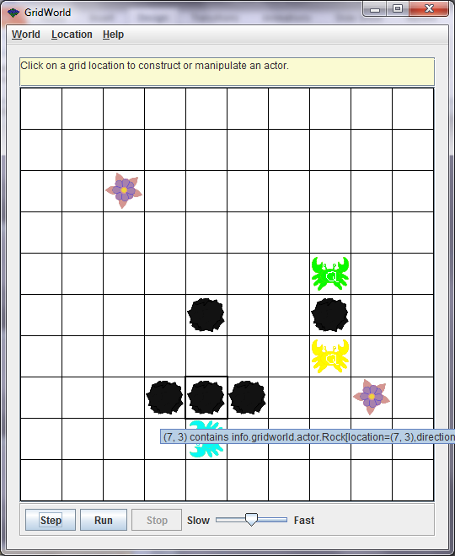
Step 3
Blue Can’t move 2, so moves like a CrabCritter

Slide 7
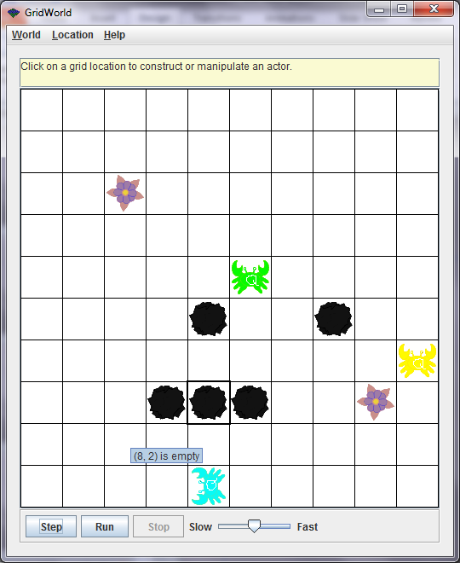
Blue won’t jump over rock

