Slide 1
Knight’s Tour Output

Slide 2
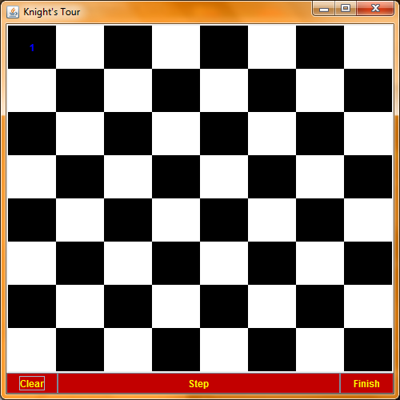
Initial Setup

Slide 3
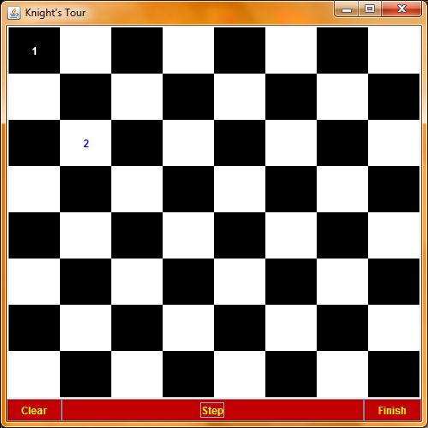
Click “step.” The knight moves randomly to an available space. One sees that the current position of the knight is colored blue.

Slide 4
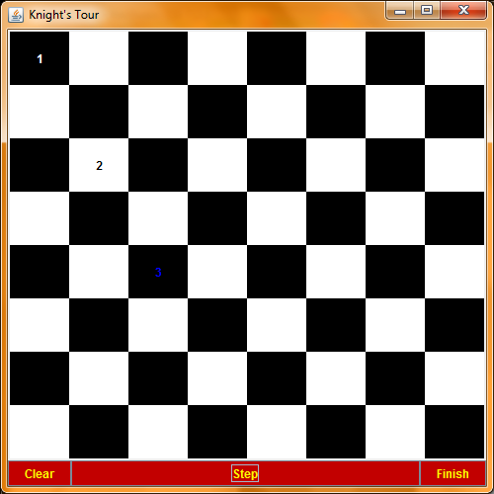
Click “step.” again. The knight takes a 3rd move.

Slide 5

Step 4.

Slide 6

Step 5.

Slide 7
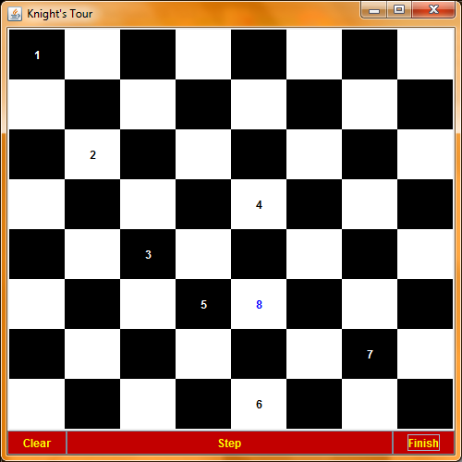
Get Bored? Click “Finish.” Watch as the knight moves quickly on its own.

Slide 8
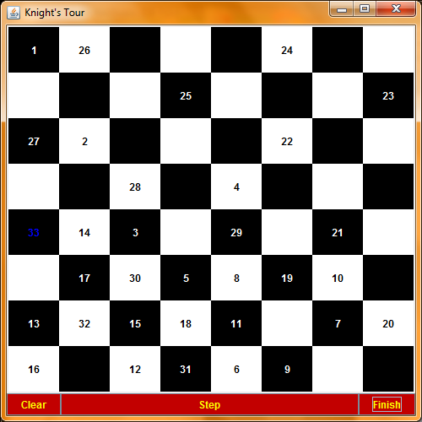
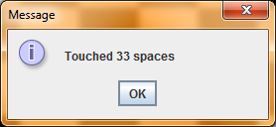
Finished! Click “ok.”

Slide 9
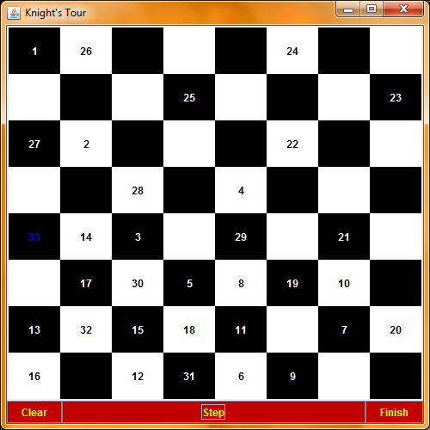
Here is the completed attempt at the Knight’s Tour. Click “Clear” to start over.

Slide 10
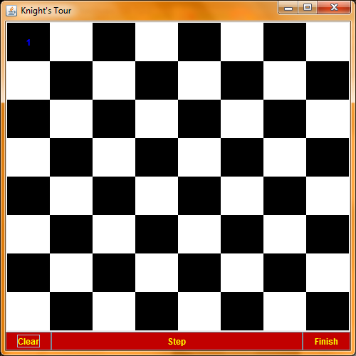
Cleared.

