Slide 1
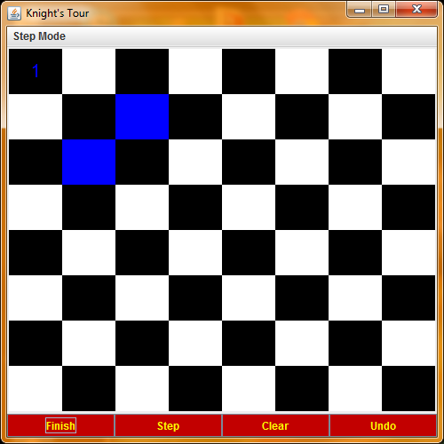
Initial View

Slide 2
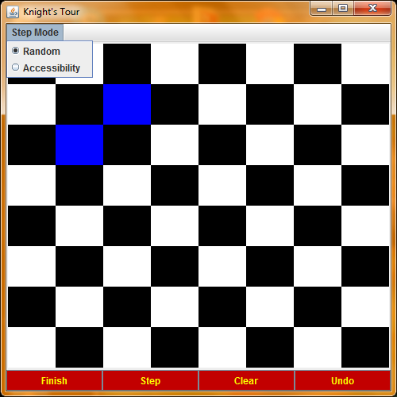
Select Step Mode: This dictates how the step button moves the knight. The knight can move randomly, or the knight can move to the space with the lowest accessibilty.

Slide 3

Let’s choose accessibility for now, but at any time before, during or after the tour, one may change the step mode.

Slide 4
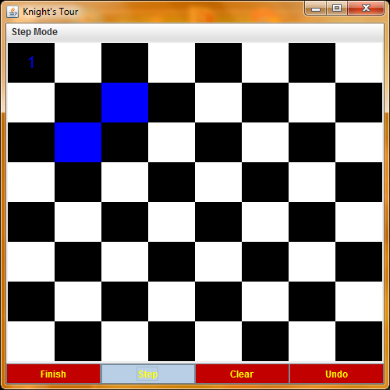
Let’s play! The knight is at 1,1. The blue highlighted squares represent the knight’s available moves. Click step to see the knight move.

Slide 5
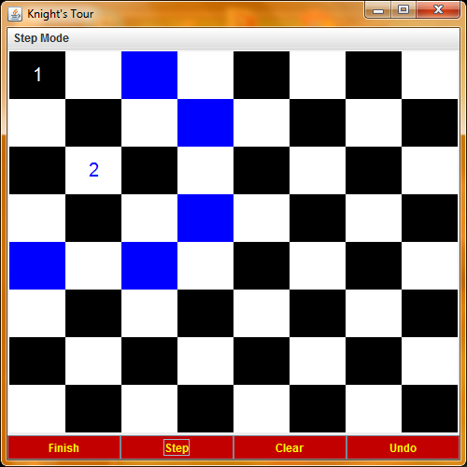
Voila! The knight moved. It is now in the square marked with a blue number 2. Note that the number 1 is no longer blue because the knight moved away from that space. Click step again!

Slide 6
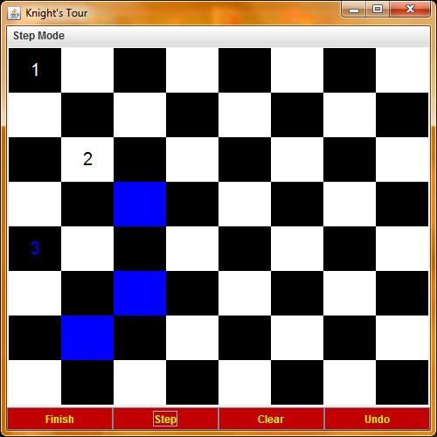
This is the knight’s third move. Notice that the blue highlighted squares, showing the available spaces for the next move, change each time the knight moves.

Slide 7
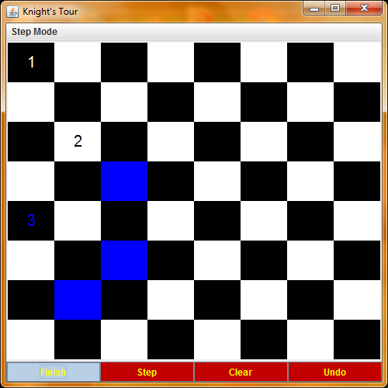
Click finish to watch the knight step repeatedly until he can’t move anymore.

Slide 8
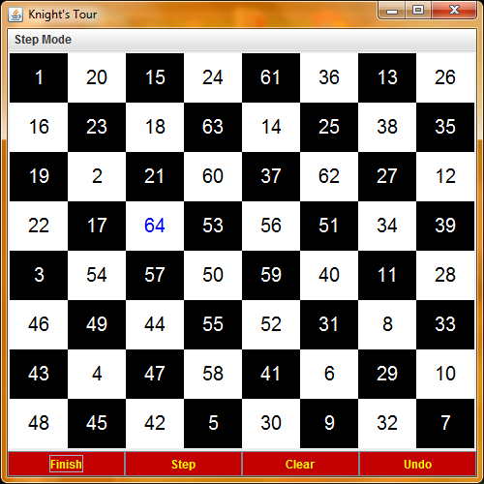
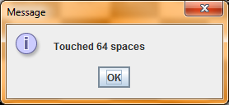
Watch as the Knight’s Tour is completed before your eyes!

Slide 9
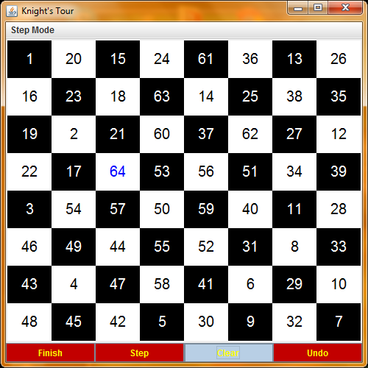
Click “Ok” to dismiss the dialog and then click clear to start the tour over.

Slide 10
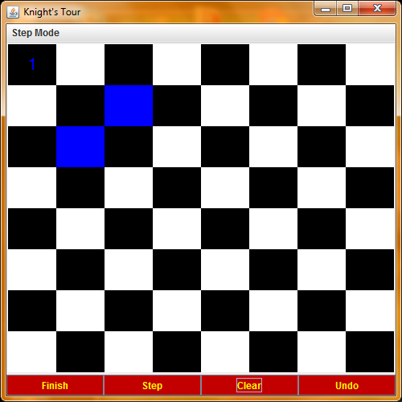
Click on the space circled in green.

Slide 11
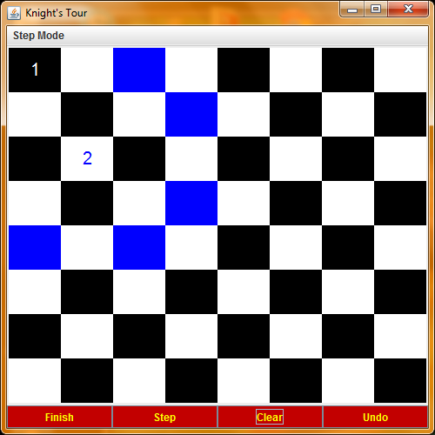
The knight has moved to the space you clicked! You can move the knight by clicking spaces or using the step button.

Slide 12
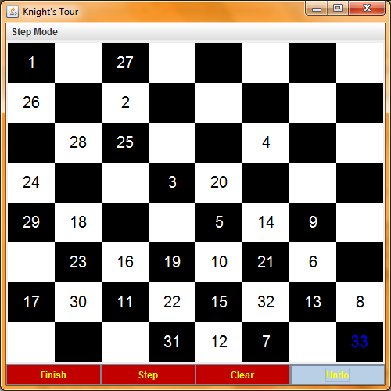
Scene: You’ve set the step mode to Random and you clicked finish. You’re now stuck with only 33 spaces. You see that if you had moved slightly differently, you could have done better. Try the undo button…

Slide 13
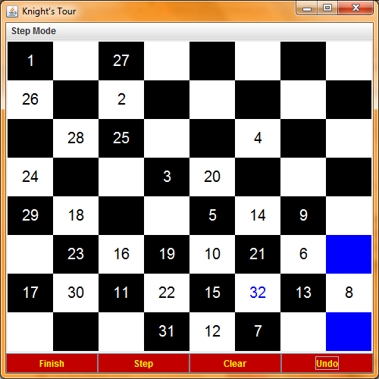
As if by magic, your last move has been undone! (One can undo as many moves as desired.)

