Slide 1
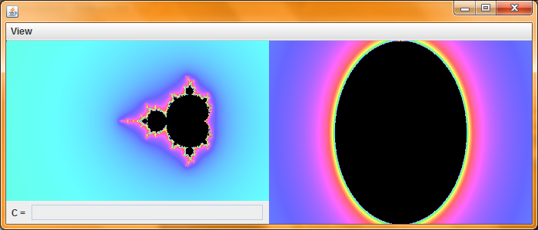
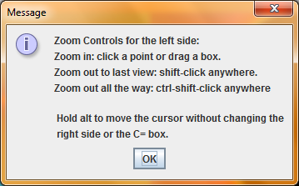
Startup

Slide 2
Orientation
On the left is the Mandelbrot set. On the right is the Julia set corresponding to the point on the mandelbrot set that the mouse is over. By moving the mouse around on the mandelbrot set, the Julia set on the right changes.

Slide 3
Zooming
Follow the instructions on the initial message dialog. You can zoom by clicking a point or by dragging a box. You can zoom out to your last view or all the way out to the first view.

Slide 4
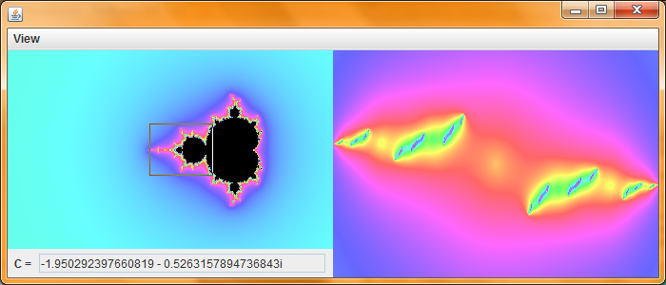
Dragging a box

Slide 5
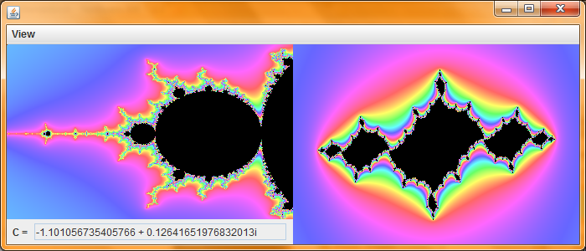
Zoomed in after dragging a box

Slide 6
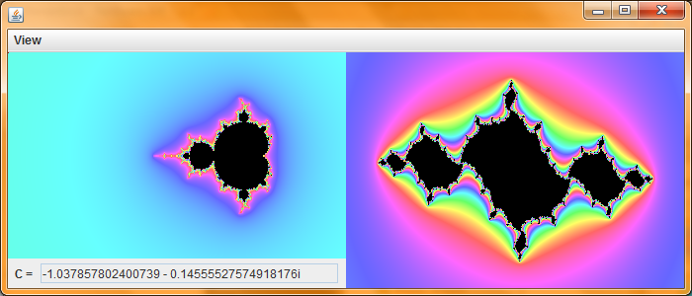
Shift-click to zoom back out.

Slide 7
File Saving
You can save the view you are looking at by clicking view -> export…
You can look at what files you have saved under the “dist\views” folder.
You can import a saved view by clicking view -> import…

Slide 8
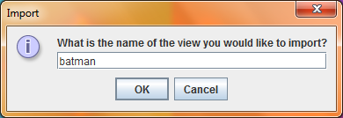
Importing batman…

Slide 9
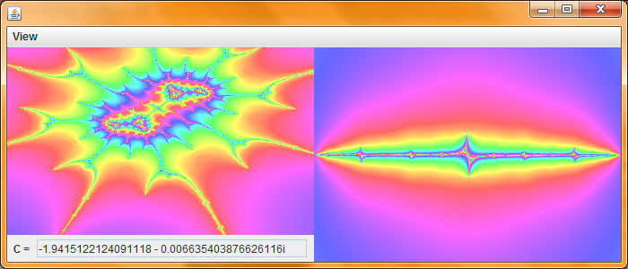
Imported!

