Slide 1

Data-X: Setup and prerequisites installation on Mac OSX
Data ^{X}
About Me:
Ikhlaq Sidhu Chief Scientist & Founding Director, Sutardja Center for Entrepreneurship & Technology IEOR Emerging Area Professor Award, UC Berkeley

Slide 2
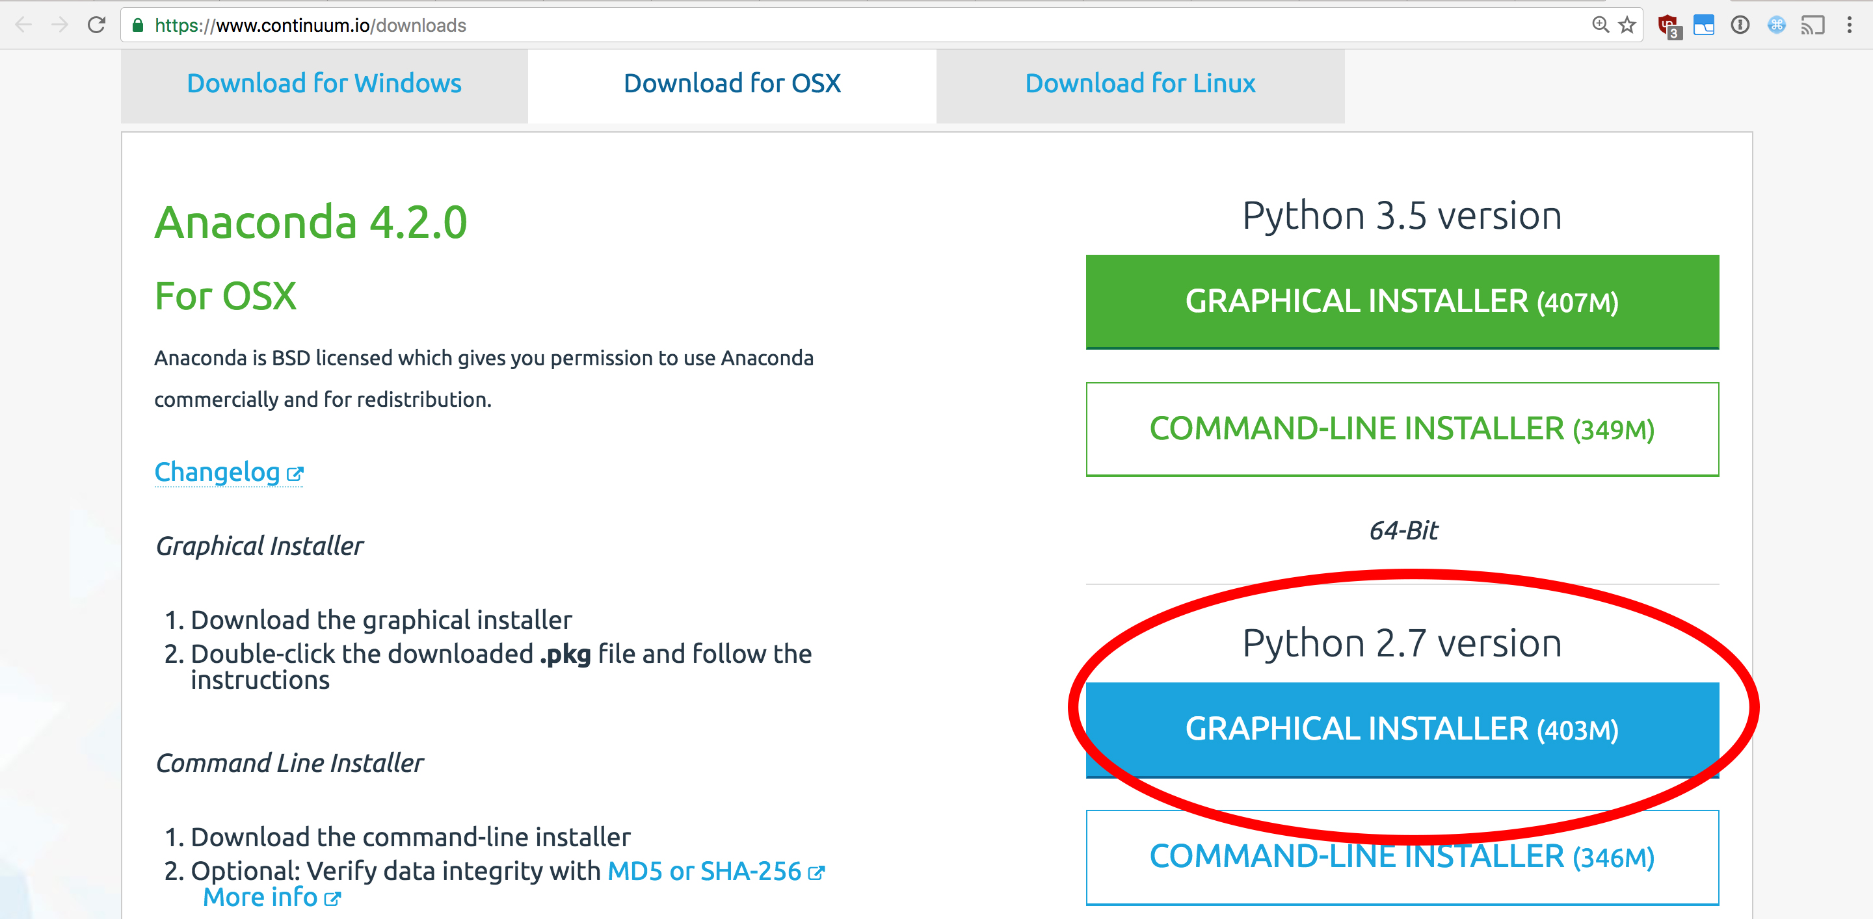
Install Anaconda with Python 2.7 www.continuum.io/downloads

Slide 3
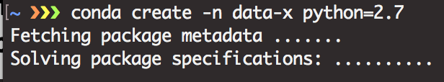
Create Virtual Environment for Data-X & Install Jupyter Notebook
Open Terminal
Run the command:
conda create -n data-x python=2.7
To activate Virtual environment:
source activate data-x
To deactivate Virtual environment:
source deactivate

Slide 4
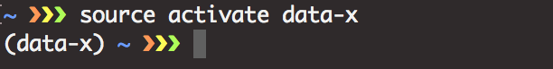
Always Run Virtual Environment
N.B. Run: source activate data-x
every time you open a new terminal window.

Slide 5
Install Data-X package dependencies
List of packages
jupyter
numpy
pandas
matplotlib
scipy
scikit-learn
scikit-image
sqlalchemy
nltk
seaborn
Anaconda comes with many packages
pre-installed, but if you want to
install additional packages (or update
existing ones you can run):
Install package by running:
conda install [package name]
Install packages by running:
conda install [pkg1] [pkg2] [pkg3]

Slide 6
Install Correct version of OpenCV
Run
conda install -c https://conda.binstar.org/menpo opencv

Slide 7
Install Beautifulsoup4, TensorFlow, Keras & Graphlab-Create
Run:
conda install -c anaconda beautifulsoup4=4.5.3
conda install -c conda-forge tensorflow
conda install h5py
conda install -c conda-forge Keras

Slide 8
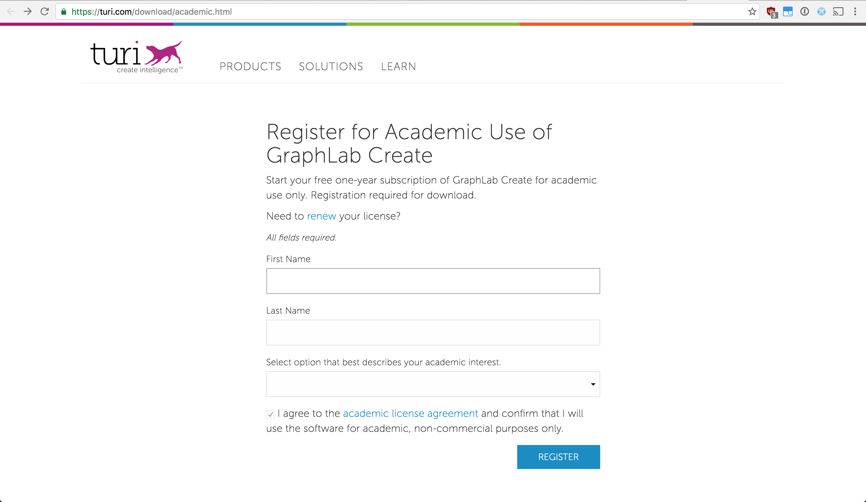
Install Graphlab-Create https://turi.com/download/academic.html

Slide 9
Install Graphlab-Create When you have registered your information press ”View Instructions” under Install with pip. Go to step three and in your terminal run (with your specific [email address] and [license code]):
pip install --upgrade --no-cache-dir https://get.graphlab.com/GraphLab-Create/2.1/ [email address]/[license code]/GraphLab-Create-License.tar.gz
# run if Kernel crashes:
conda install -c conda-forge backports.shutil_get_terminal_size

Slide 10
Install Python 3 as a Virtual Environment
If you want to run Python 3 and Python 2 from the same Anaconda installation, then simply create a Virtual Environment for Python 3
In the Terminal, run the command:
conda create -n data-x_py3 python=3 ipykernel
source activate data-x_py3
sudo python -m ipykernel install --user
To activate Python 3 Virtual environment:
source activate data-x_py3
To deactivate Python 3 Virtual environment:
source deactivate
Note: If you have installed Anaconda with Python 3, then change all 3’s in the code above to to 2 in order to install a Python 2 kernel.
Please note, many functions, modules and libraries differ between the two versions of Python. However, any issue can usually be solved quite easily by googling the error message and at the top of your script running:
from __future__ import absolute_import, division, print_function

Slide 11
End of Section

