Slide 1

Pandas Overview Data-X: A Course on Data, Signals, and Systems
Data ^{X}
About Me:
Ikhlaq Sidhu Chief Scientist & Founding Director, Sutardja Center for Entrepreneurship & Technology IEOR Emerging Area Professor Award, UC Berkeley

Slide 2
Agenda
Introduction to pandas (45 min?) including stock market data example
In class exercise with pandas and time series (40 min)
Project Selection (1 hr)
HW for next week will be sent via bcourses in Notebook format:
Review Ref CS03: pandas in 10 min
Notebook versions available at data-x.blog in module-02

Slide 3
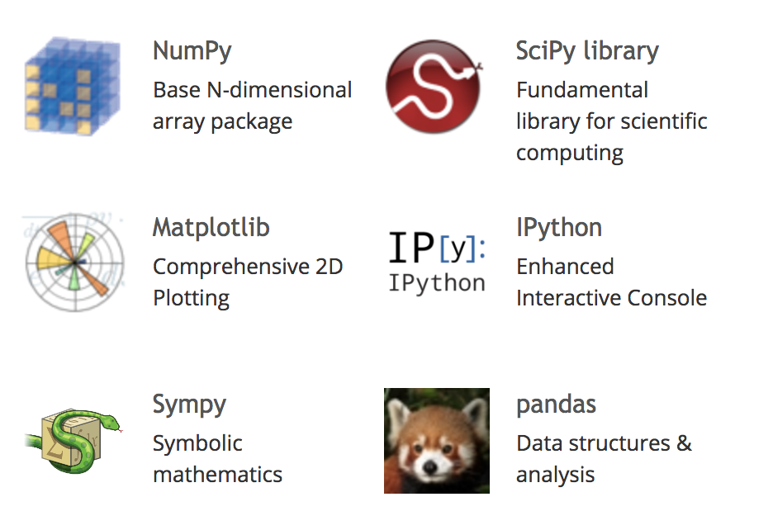
How Does Pandas Fit In?
Python is great: easy to understand, compact, flexible – “duct tape of internet”
Python was not originally built for data analytics
Sci-Py extends to mathematics, science, and engineering
Numpy allows arrays and matrix math
Pandas provides a table structure

Slide 4
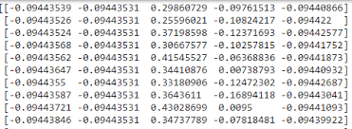
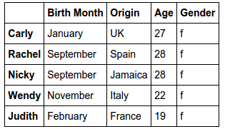
Pandas lets us construct tables, called Data Frames
With NumPy, we can store and manipulate a matrix
m =
With Pandas, we can store and manipulate a full table
df =

Slide 5
Pandas has an object called a Data Frame which is like a table
Wes Mckinney

Slide 6
Data Structures - High Level
List:
L = [0, b, “hello”]
What is L2 = [0, b, (b,bat)]?
Numpy Array: (vector)
arr = np.array([5,4,3,2,1])
Numpy Array: (matrix)
mat =
np.array([[5,4],[3,2],[1,0]])
Using the Axis:
mat.sum(axis=0)
mat.min(axis=1)
0
B
“hello”
L
5
4
3
2
1
arr
5 4
3 2
1 0
mat

Slide 7
Data Structures - High Level
dog 20
cat 10
Mouse 1
Dictionary:
d = { ‘dog’:20, ‘cat’:10, ‘mouse’:1}
What is d[‘cat’]?
Pandas Data Frame:
Made of Dictionary of
‘labels’ and numpy-like arrays called Series
d2 = { ‘dog’:ar1, ‘cat’:ar2, ‘mouse’:ar3}
df = pd.DataFrame(d2)
What is df[‘cat’]?
d
d2
dog [array 1]
cat [array 2]
Mouse [array 3]
df
Index dog cat mouse
1
2
3
4
5
20
25
20
28
31
10
11
9
7
12
1
2
1
1
2
* Actually made from the Series object in Pandas

Slide 8
Code Example in Python Notebook
Get Stock Data
Use Pandas to get a CSV format
Slice the Table
Convert to Numpy Array Format
Sample Numpy Operations

Slide 9
More topics in the 10 Min Guide to Pandas Notebook
Indexing

Slide 10
End of Section

