Slide 1

Data X: Sentiment Analysis A Course and Lab for Data, Signals, and Systems
Data ^{X}
About Me:
Ikhlaq Sidhu Chief Scientist & Founding Director, Sutardja Center for Entrepreneurship & Technology IEOR Emerging Area Professor Award, UC Berkeley
From SCET Mckinsey Algorithms Project: Dhiren Bhatia, Robert (I-Hsiang) Chang, Zach Travis, Daisy Zhe Wang

Slide 2
Prospects of Sentiment Analysis:
 | Marketing | Customer Support | Crisis Management
Past | Paper Survey Focus group | Call center Walk-ins | Ad-hoc Non scientific
Present | Electronic surveys Questionnaires | eService Online chat | Scientific But often delayed
Future | Voluntary reviews. Real time monitoring | Reach out to customers Participate in discussion | Scientific Active, More anticiaption

Slide 3
Case Example for Sentiment Analysis
“Great spot 8th October 2005, 1 night.”
“Stay in hotels 20-30nights a year: Stayed here twice Nont Impressed Other options should be considered if staying downtown.”
4.0
2.0
“I recently stayed at the Mobile Marriott on a business trip. Being my first time in Mobile, I did not know what to expect of the hotel or the city. With a little hesitation, I booked the Mobile Marriott due to the its location alone (it is right on Airport Boulevard next to the interstate and in the middle of everything). On my arrival, I was met with the usual smile, however the agent actually shook my hand, thanked me for selecting their hotel, and on finding out it was my first time in Mobile, he took the time to suggest some places and dining options for me to visit while I was there. This all sounds great for a small quiet hotel, but the hotel was packed for the GMAC bowl (I even scored some tickets). The room was nice, not modernized but comfortable and clean - the most important thing I look for. I dined in their restuarant and had room service during my stay - both were good. Served quickly and cooked to order. The one thing that really stands out at this hotel is that the staff are genuinely friendly. Every person I encountered took a moment to recognize me. When I stood in the lobby, they approached me to talk. I really was made to feel special, for lack of a better word. I would definitely come back to the Mobile Marriott and have recommended it to my colleagues, two of which it turns out will only stay at this hotel as well. As for Mobile, its a nice city - nicer than I anticipated. While no one looks forward to life on the road, I have no hesitations about returning to this city and hotel."
5.0

Slide 4
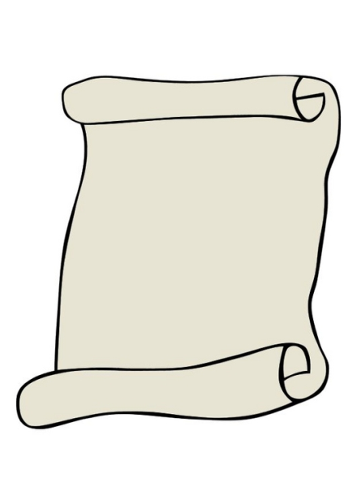

Bag-of-Words Model (I) – Learning
Training Documents
Sentences
Marriott is
a great hotel. (+)
Marriott is
a great hotel. (+)
......
We hate it. (-)
1. Extract
Sentences
2. Extract
Bag-of-Words
…...
a
We hate it. (-)
great
hate
it
Marriott
3. Extract Feature
Vectors
hotel
is
We
Naïve Bayes
Classifier
Feature Vector
Positive/
Negative
4.Learn Multinomial
Naïve Bayes Model
a
great
…...
is
we

Slide 5
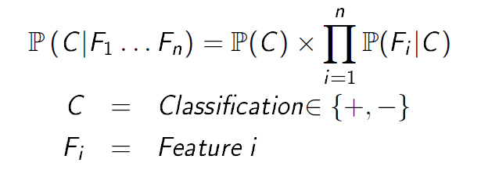
CET Research
Naïve Bayes Classifier:
A Bayes classifier is a simple probabilistic classifier based on applying Bayes’ Theorem.
Positive
Negative
a
great
…...
is
we
no
hate
…...
a
the
.2
.7
.2
.1
.2
.7
.2
.1

Slide 6
CET Research
Bag-of-Words Model (II) – Inference
New Documents
Sentences
New Documents
1. Extract
Sentences
Marriott is
a great hotel.
Feature Vector
Marriot has
good service.
…….
We love it.
Bag-of-Words
a
great
it
hate
2. Extract Feature
Vectors
Marriott
hotel
is
We
3. Infer the Sentiment
on new documents
Naïve Bayes
Classifier
Positive/
Negative
Marriot has
good service. (+)
…….
We love it. (+)
a
great
…...
is
we
.2
.7
.2
.1

Slide 7
Dictionary Model:
Same Learning-Inference process
Replace Bag-of-Words with Sentiment Dictionary
More human effort but more accurate!
80%+ accuracy for the dictionary model
Can reach 90%+ with more engineering:
Handling negative tones, entity association, sarcasm, ...
Part-of-speech tagging, Named Entity Recognition, Co-reference, …

Slide 8
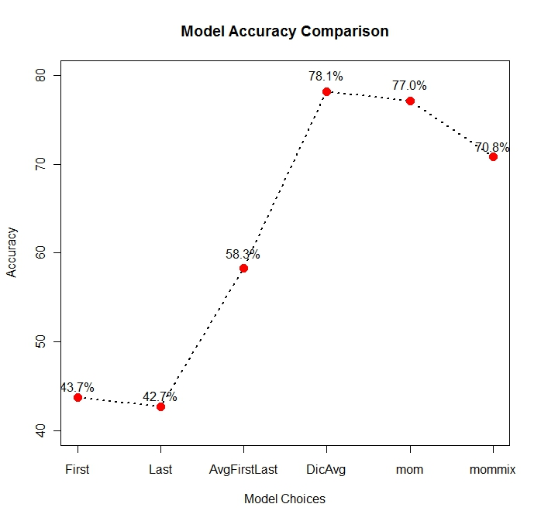
Model Comparison:

Slide 9
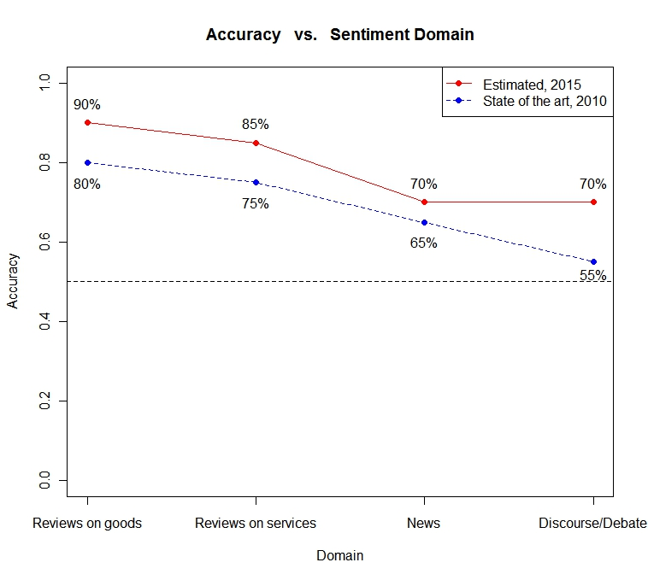
Data Complexity:
Business Applications

Slide 10
Presentation to MCKinsey & Company
Part III : Sentiment Exampe
Dhiren Bhatia, Robert (-Hsiang) Chang, Zach Travis, Daisy Zhe Wang

Slide 11
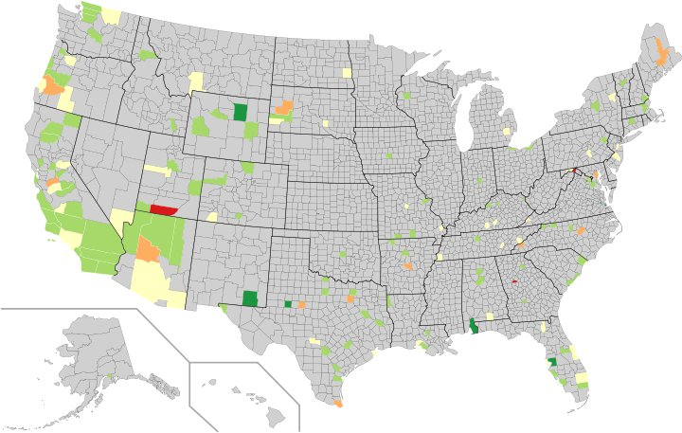
Sentiment Dashboard: Heat Map
5 (Good)
4
3
2
1(Bad)

Slide 12
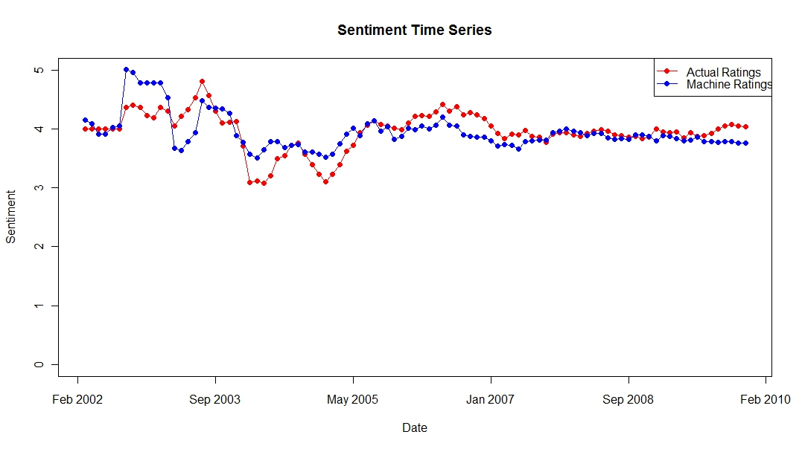
Sentiment Dashboard: Time Series

Slide 13
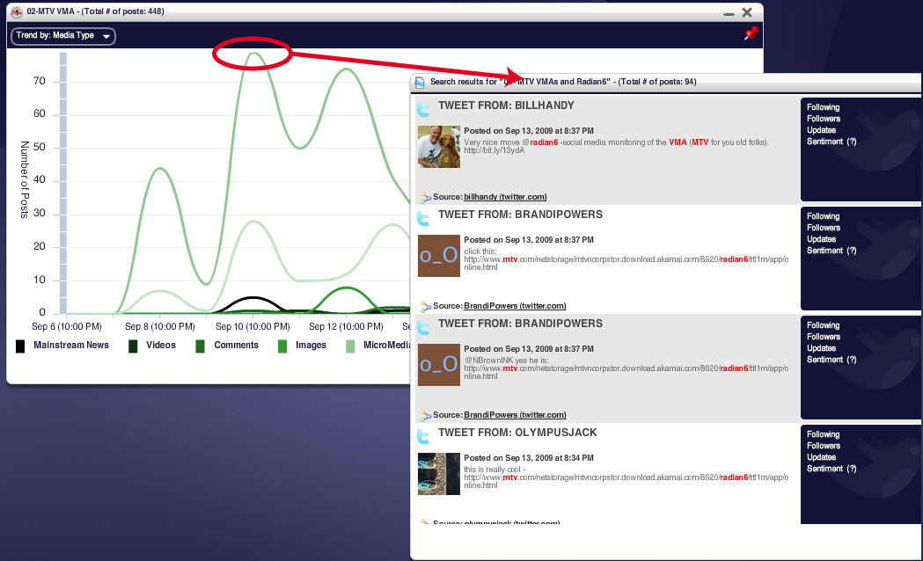
Sentiment Dashboard: Drill Down
Source: Radian6

Slide 14
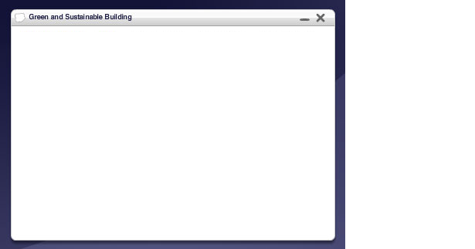
Sentiment Dashboard: Word Cloud
Marriott Word Cloud
staff
Service
Pool
Bed
Front Desk
Bathroom
Breakfast
clean
Price
Noise
Lobby
Buffet
Parking
Size = Frequency of the word
Color = Red (Negative), Green (Positive)

Slide 15
Case Example Conclusion:
Explosion of social media and emergence of new online social activity
Reputation and brand Image have profound economic impact on consumer purchasing behaviors
New business opportunities!
Sentiment Analysis Technology can enable automatic and active monitoring of sentiment as word of mouth develops
What is possible: A tool with different dash-boards to track different entities and different data sources with drill down and statistics
Ultimately, businesses that develop novel ways of using the technology will gain enormous business advantage.

Slide 16
End of Section

