Slide 1

Data-X : A Course and Lab for Data, Signals, and Systems
Introduction to Deep Learning
(using Tensor Flow) Nathan Cheng, Ikhlaq Sidhu
Data ^{X}
About Me:
Ikhlaq Sidhu Chief Scientist & Founding Director, Sutardja Center for Entrepreneurship & Technology IEOR Emerging Area Professor Award, UC Berkeley

Slide 2
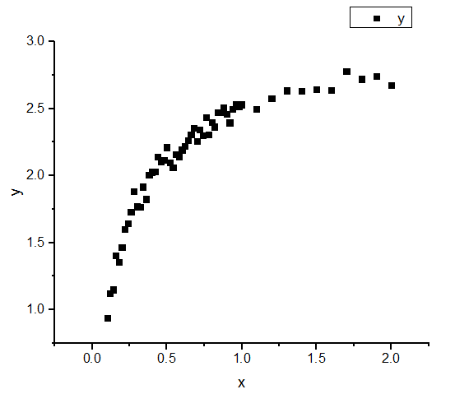
What about nonlinear modeling?
Given x, predict y
Clearly, a straight line will fall short
http://www.originlab.com/doc%5Cen/Tutorial/images/Linear_Fit_For_Kinetic_Models/Linear_Fit_Kinetic_Model_10.png

Slide 3
What about nonlinear modeling?
One Solution
Increase number of parameters
http://www.originlab.com/doc%5Cen/Tutorial/images/Linear_Fit_For_Kinetic_Models/Linear_Fit_Kinetic_Model_10.png

Slide 4
What about nonlinear modeling?
Problems
Have to guess which parameters are useful to the model
High risk of overfitting (if too many parameters are chosen, model may not generalize well)
Becomes far too computationally expensive given a lot of features and higher degree parameters
http://www.originlab.com/doc%5Cen/Tutorial/images/Linear_Fit_For_Kinetic_Models/Linear_Fit_Kinetic_Model_10.png

Slide 5
Deep learning: layering of linear and nonlinear classifiers

Slide 6
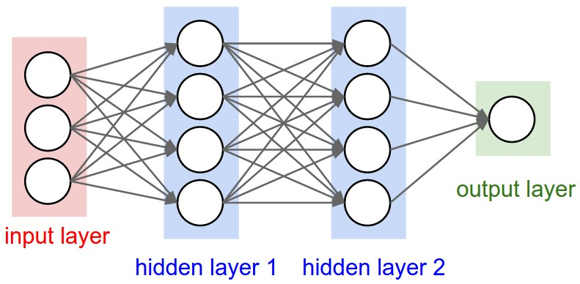
Neural Networks
Learning and information modeling inspired by the way neurons work in the brain
http://cs231n.github.io/assets/nn1/neural_net2.jpeg
Each circle is a neuron—takes inputs
The neurons in the hidden layers are equipped with an activation function (will see an example later)
The arrows represent axons—weighs inputs
Takes weighted sum over neurons

Slide 7
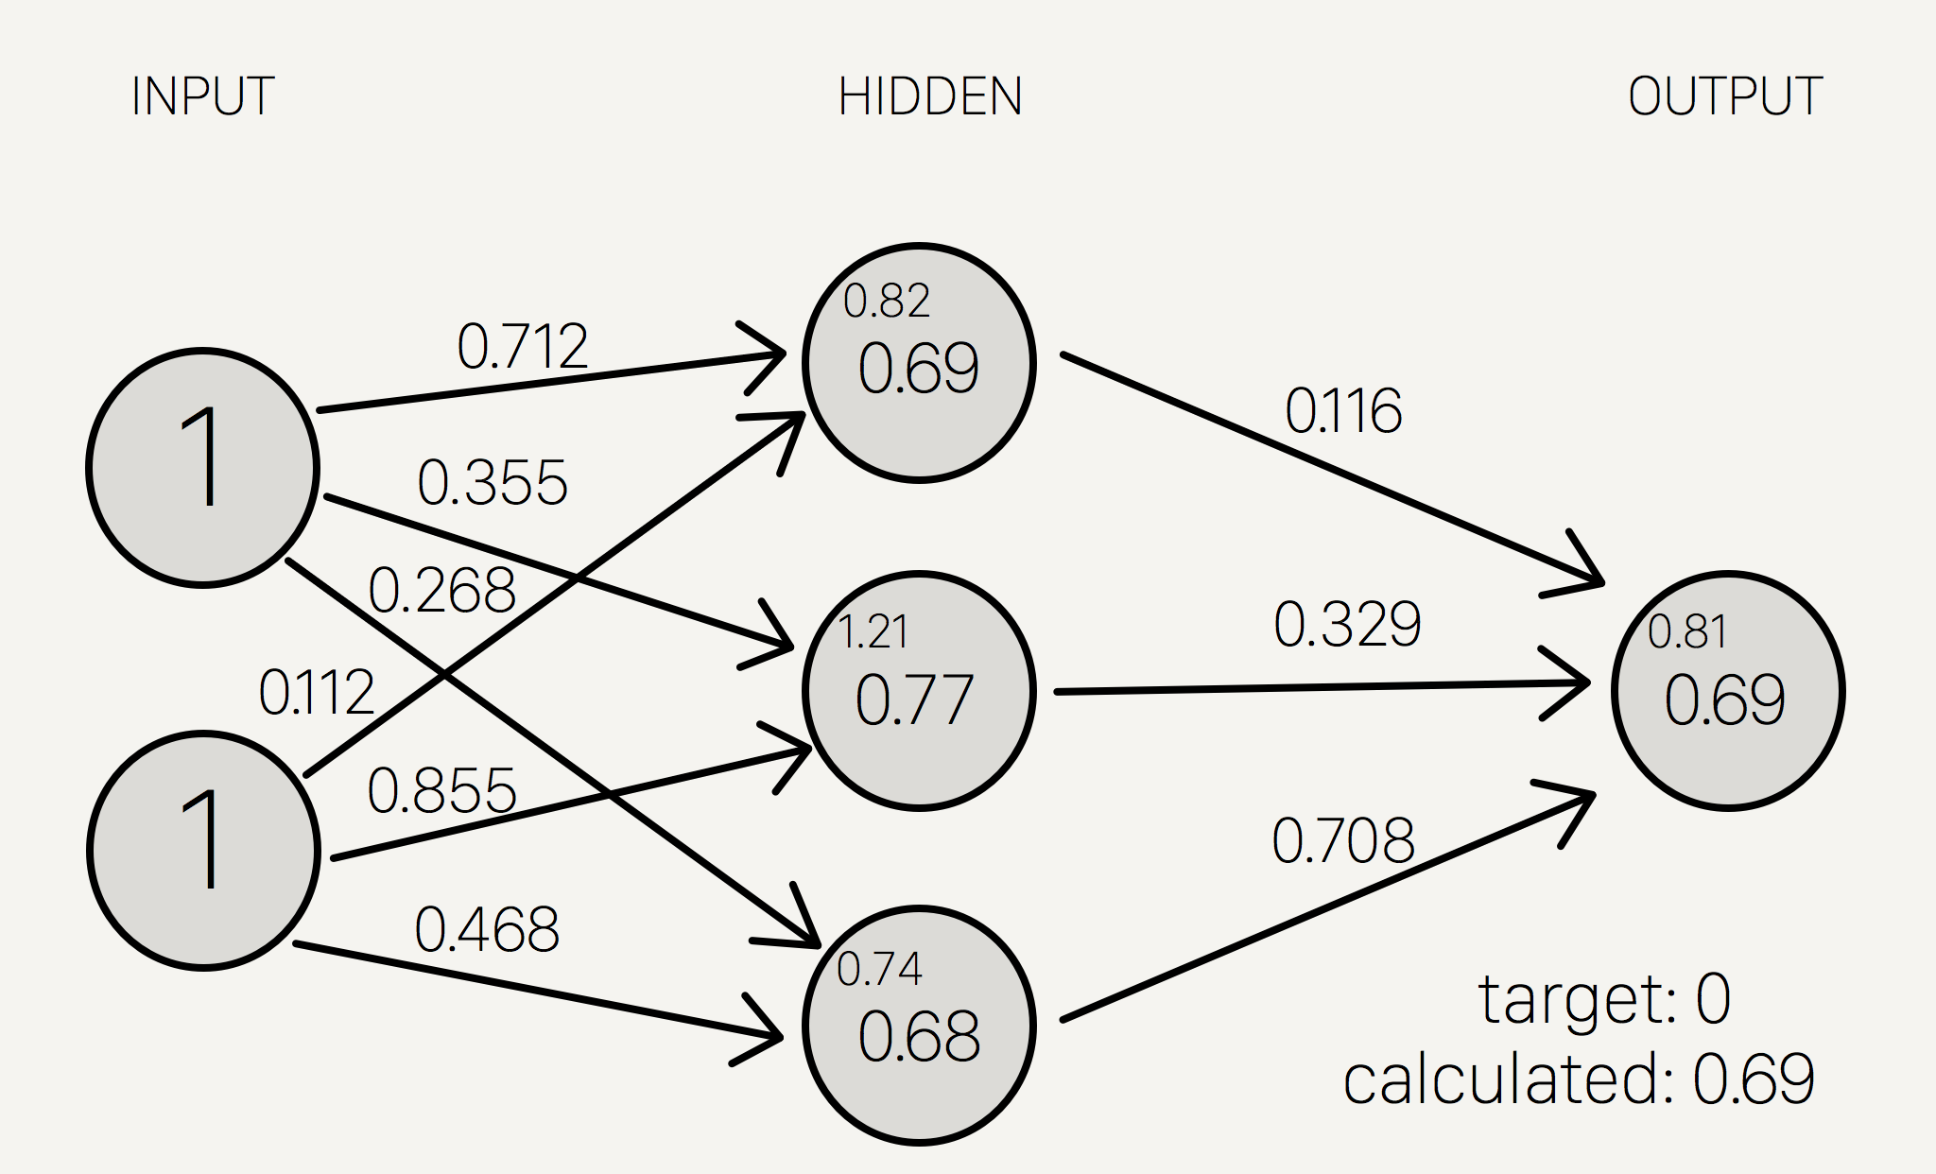

Example Network and Forward Propagation
Activation Function—Logistic Sigmoid Function
http://i.imgur.com/UNlffE1.png
This is the architecture of a neural network. In order to make a prediction, we do what is called forward propagation.

Slide 8
Example Network and Forward Propagation
Activation Function—Logistic Sigmoid Function
http://i.imgur.com/UNlffE1.png
First, we feed in our inputs into the input layer. In this case, we have two features, each with a value of 1.

Slide 9
Example Network and Forward Propagation
Activation Function—Logistic Sigmoid Function
http://i.imgur.com/UNlffE1.png
The relevant axon weights will then take weighted sums and send them to the next layer. In this case, the first hidden neuron gets a value of 1*(0.712) + 1*(0.112)

Slide 10
Example Network and Forward Propagation
Activation Function—Logistic Sigmoid Function
http://i.imgur.com/UNlffE1.png
But 0.82 is only the pre-activation value. We need to then apply our activation function to 0.82, giving us f(0.82) = 0.69. This is the value for the neuron.

Slide 11
Example Network and Forward Propagation
Activation Function—Logistic Sigmoid Function
http://i.imgur.com/UNlffE1.png
The same process is applied to each neuron.

Slide 12
Example Network and Forward Propagation
Activation Function—Logistic Sigmoid Function
http://i.imgur.com/UNlffE1.png
0.69*(0.116) + 0.77*(0.329) + 0.68*(0.708) = 0.81

Slide 13
Example Network and Forward Propagation
Activation Function—Logistic Sigmoid Function
http://i.imgur.com/UNlffE1.png
f(0.81) = 0.69. This is the output, or prediction, or our model.

Slide 14


Mathematical Representation
We can represent this model using matrices, for example:
X gets input values:
W gets axon weights:
One step of forward propagation looks like:
http://i.imgur.com/UNlffE1.png

Slide 15
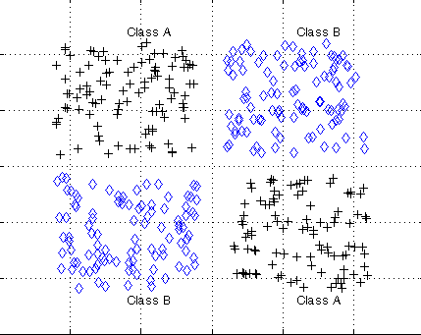
A Toy Problem: XOR
Temp
of Drink
1
XOR(A,B) evaluates to “true” if either A or B are “true” but not both.
Potential manifestation of this property:
Predicting whether a customer will enjoy a drink given A=temperature of the day and B=temperature of the drink
Clearly, this dataset is not linearly separable
0
1
Temp
of Day
Black pluses = customer enjoys drink = 1
Blue diamonds = customer does not enjoy drink = 0
(0=really cold, 1=really hot)
http://lab.fs.uni-lj.si/lasin/wp/IMIT_files/neural/nn06_rbfn_xor/html/nn06_rbfn_xor_2_newrb_01.png

Slide 16
+1
+1
A | B | f1 | f2 | y
0 | 0 | f(-10) = 0 | f(30) = 1 | f(-10) = 0
0 | 1 | f(10) = 1 | f(10) = 1 | f(10) = 1
1 | 0 | f(10) = 1 | f(10) = 1 | f(10) = 1
1 | 1 | f(30) = 1 | f(-10) = 0 | f(-10) = 0
-10
-30
30
A
20
f1
20
y
-20
20
20
B
-20
f2
Yellow neurons are equipped with the logistic sigmoid activation function f(t) = 1 / (1+e^-t)
f(>10) approx = 1
f(<-10) approx = 0
y represents level of enjoyment

Slide 17
+1
+1
A | B | f1 | f2 | y
0 | 0 | f(-10) = 0 | f(30) = 1 | f(-10) = 0
0 | 1 | f(10) = 1 | f(10) = 1 | f(10) = 1
1 | 0 | f(10) = 1 | f(10) = 1 | f(10) = 1
1 | 1 | f(30) = 1 | f(-10) = 0 | f(-10) = 0
-10
-30
30
A
20
f1
20
y
-20
20
20
B
-20
f2
Yellow neurons are equipped with the logistic sigmoid activation function f(t) = 1 / (1+e^-t)
f(>10) approx = 1
f(<-10) approx = 0
y represents level of enjoyment
NOTE: XOR(A,B) = (A or B) and (not (A and B))
f1 = A or B
f2 = not (A and B)
y = f1 and f2
Insight: we can see neural networks as a way of representing complex logical decisions

Slide 18
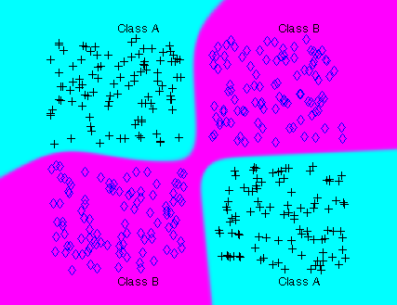
http://lab.fs.uni-lj.si/lasin/wp/IMIT_files/neural/nn04_mlp_xor/nn04_mlp_xor_04.png

Slide 19
Training Our Network—Backpropagation
How do we train our model?
The goal of training a neural network is to find the optimal axon weights such that the average error (defined by some loss function) between predicted outputs and actual outputs in a dataset is minimized
Recall that axon weights can be represented by weight matrices
An algorithm known as backpropagation (backward propagation of errors) was invented to train neural networks
Backpropagation is mathematically very rigorous, specific details are probably not too important
Conceptually: per training example set (input, correct output):
Calculate the error between the prediction and the actual output using some loss function
Do the equivalent of forward propagation using the error, but starting at the end of the model and propagating towards the input layers, keeping track of the changing error values
The weighted error values at each layer tells us, in a way, how much the layer is contributing to the overall error. They can also be used to calculate the gradient of the network
This is key, as we can now perform gradient descent or some other optimization algorithm
This sounds like a pain. Fortunately, Tensor Flow takes care of most of the difficult stuff behind the scenes

Slide 20
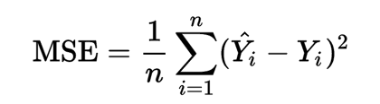
Loss Functions
In order to represent error, we need to choose a loss function
Loss function takes in two values, the actual input and the prediction, and returns the “error” between them
Rules of thumb:
Loss functions in neural networks should be differentiable
If the actual input and prediction are equal then the loss should be 0
There are countless loss functions to choose from. Here are some popular ones:
Cross Entropy. Good for classification. Source: Wikipedia
Error =
where y = target value (either 0 or 1) and y^ = the predicted value
this can be extended to vectors
Mean Squared Error. Good for regression. Source: Wikipedia
Loss functions are important—they determine what your network learns

Slide 21
Code and Tensor Flow

Slide 22

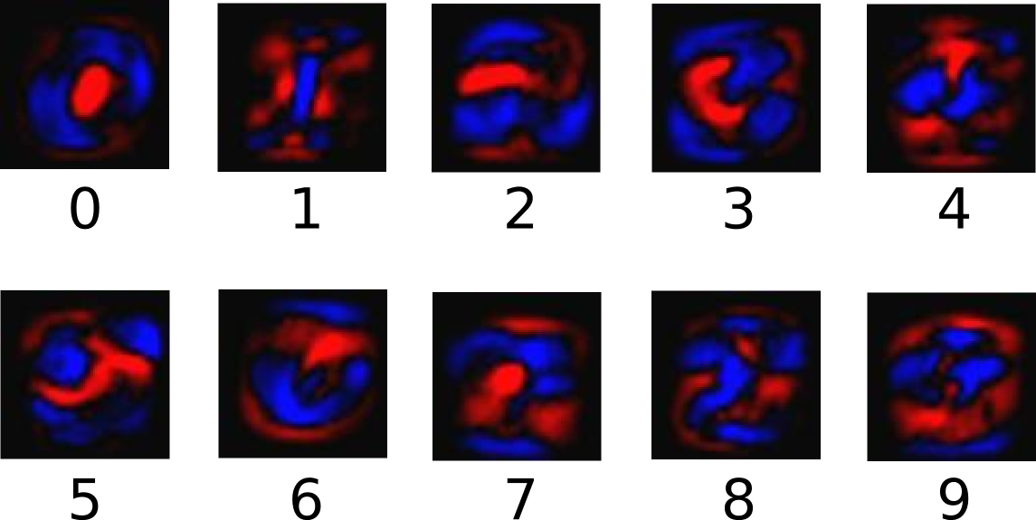
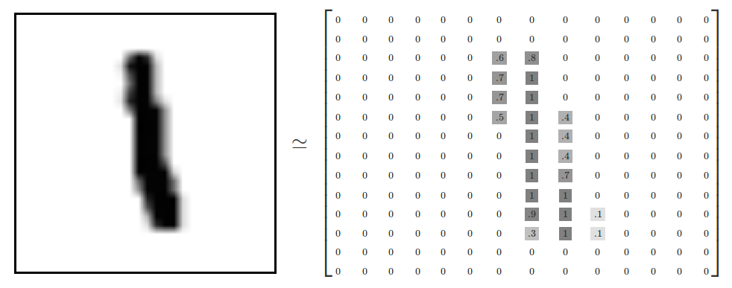
*We will first demonstrate Tensor Flow using a linear model. The following example is technically not “deep learning” yet, but it is easy to see how to generalize this example to more complex network architectures
**The following example and images are taken from https://www.tensorflow.org/versions/r0.9/tutorials/mnist/beginners/index.html

Slide 23
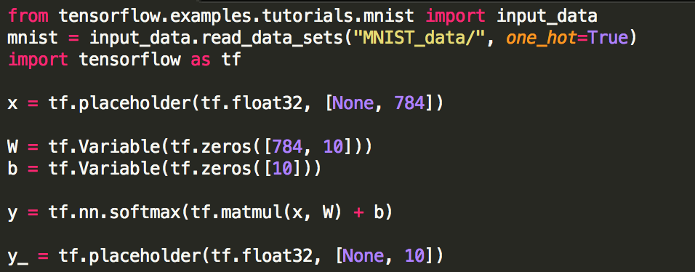
Import data and setup network graph

Slide 24
Setup loss and training functions

Slide 25
Evaluating accuracy

Slide 26
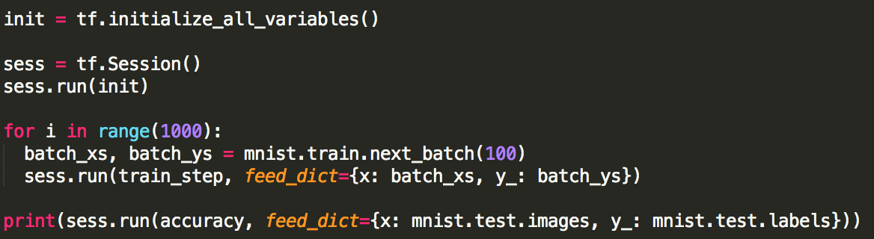
Initialize network and train
This model achieves about 92% accuracy

Slide 27
End of Section

