Slide 1
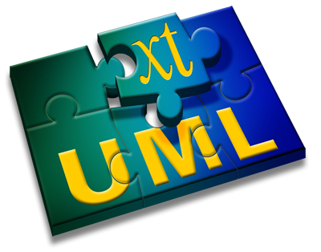
Introduction to Eclipse and BridgePoint
Levi Starrett

Slide 2
Topics to cover
Eclipse concepts
workbench, perspectives, views, editors
BridgePoint views and editors
model explorer
properties
canvas
palette

Slide 3
Eclipse concepts
Workbench
The workbench is the main working environment within Eclipse
The workbench has a current workspace containing settings and projects
The workbench can have a set of open perspectives
Perspective
A perspective is a set of views configured to provide the necessary tools for a specific task
Examples are Java, Debugging, C/C++, xtUML modeling

Slide 4
Eclipse concepts
View
A view is a tool to provide different presentations of information in the workspace
For example, the “Navigator” view provides a view of the workspace directory tree; the “Console” view shows standard output and standard error
Editor
Editors allow users to edit resources in the workspace
Different types of files can be associated with different editors

Slide 5
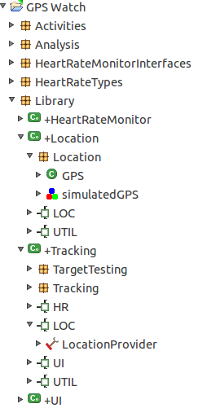
Model explorer
Provides a tree hierarchy view of the model
Elements can be created, deleted, renamed, from the model explorer context menu entries
Editors can be accessed by double clicking elements

Slide 6
Model explorer
Exercise

Slide 7
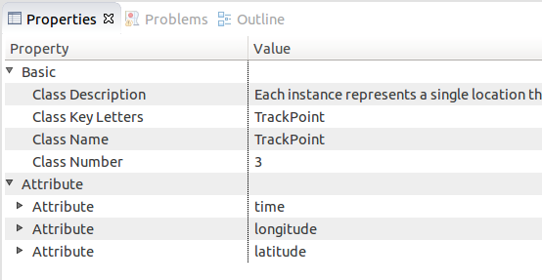
Properties
Allows user to view properties of a model element
Model element properties can be set through this view

Slide 8
Properties
Exercise

Slide 9
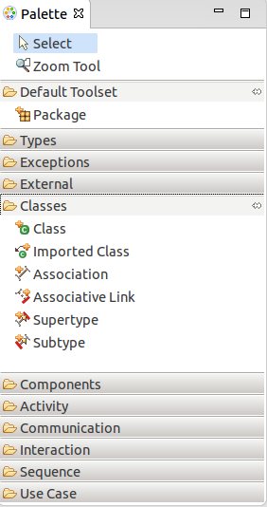
Palette
Available canvas drawing tools are accessed through the palette view
Tools are filtered based on what type of diagram is being edited
Tools are grouped into drawers containing tools for similar use

Slide 10
Palette
Exercise

Slide 11
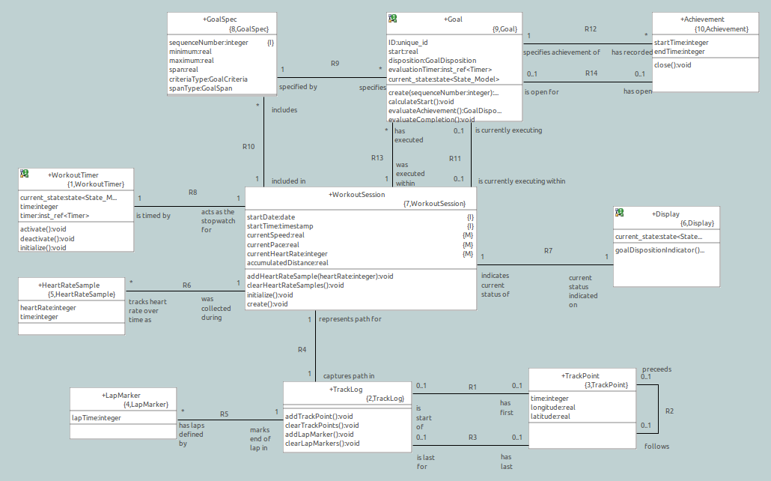
Canvas
Diagrams and elements can be edited graphically
Elements can be edited through context menus

Slide 12
Canvas
Exercise

Slide 13
Questions?

