Slide 1

MASL project modeling in xtUML
Levi Starrett

Slide 2
Overview
xtUML pattern
MASL pattern
MASL represented in xtUML

Slide 3
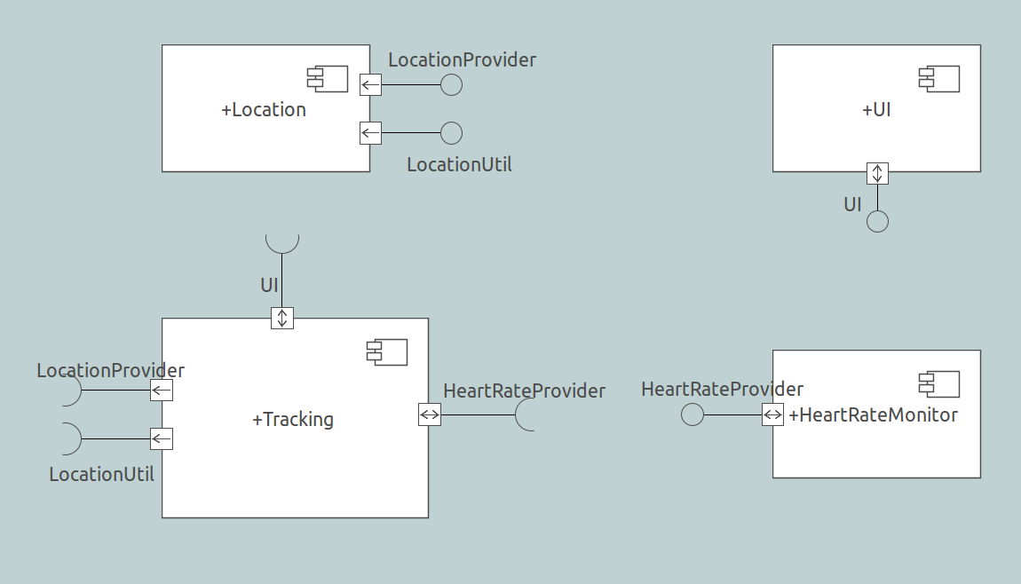
xtUML pattern
Many components, each defined individually with provided and required interfaces
The UI component provides an interface. Notice however that messages go both directions on this interface.

Slide 4
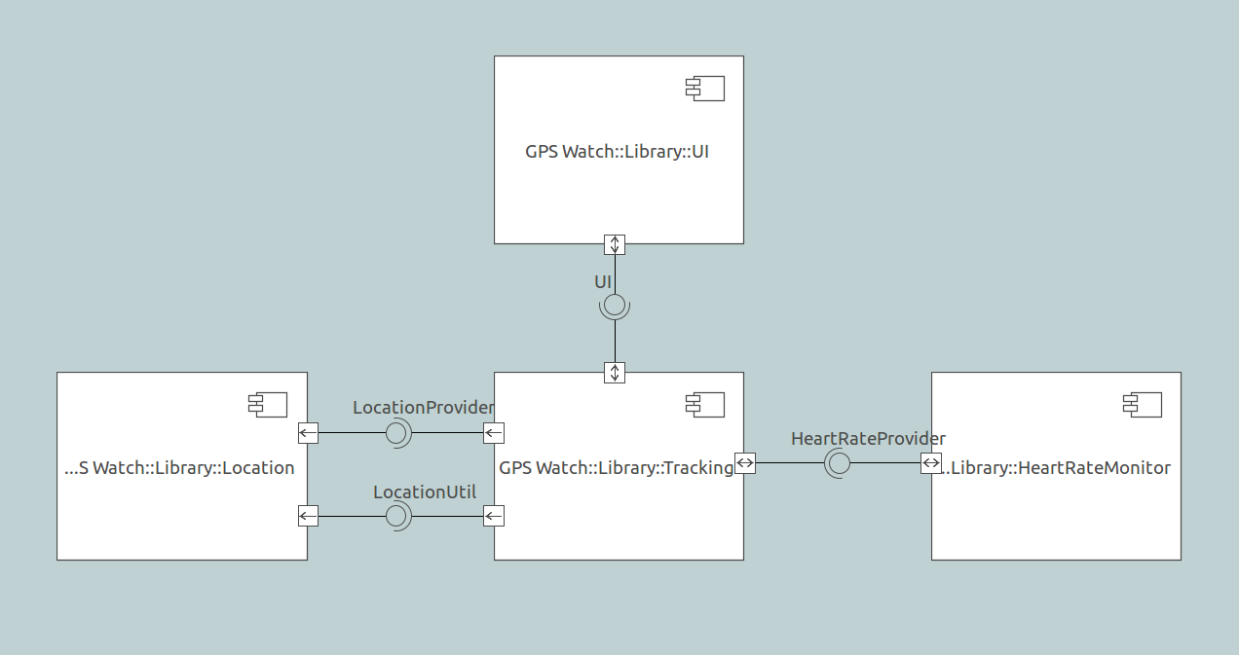
xtUML pattern
A system configuration package shows the components with each interface satisfied
Component reference shows path to the component definition
Satisfaction created by matching provision and requirement

Slide 5
MASL pattern
Domains define terminators specifying required services
Domains define public services that other domains can use
Projects define terminator services for each domain terminator that invoke public services of other domains
project terminator services can invoke multiple services from multiple domains!

Slide 6
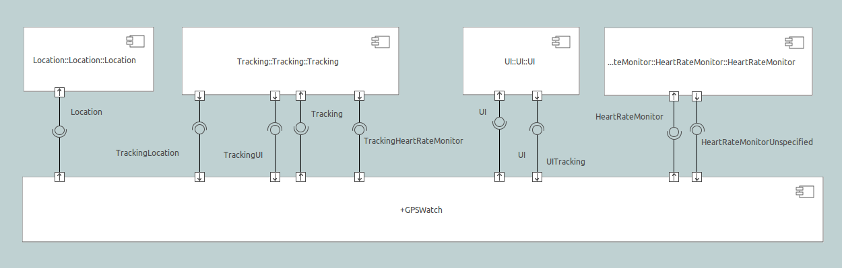
MASL represented in xtUML
Like the xtUML pattern, domains are defined as components and arranged in a separate system package
Each domain has one provision representing public services and any number of requirements representing terminators
Tracking needs a GPS location
UI button pressed

Slide 7
Questions?

