Slide 1

Engineering Process

Slide 2
Step 0 – git repositories
To begin the process of developing BridgePoint, an engineer or contractor must first fork the git repositories on Github
All of the xtUML repositories can be found at https://github.com/xtuml
More information about getting started as a developer can be found here

Slide 3
Step 1 – Issue
An engineering feature request or bug fix starts its journey when a customer, community member, or One Fact employee opens an issue in Redmine.
The issue has an assignee, due date, optional target version, description and other options
It is the assignee’s responsibility to mark the issue as “Acknowledged” or “In Progress” as appropriate

Slide 4
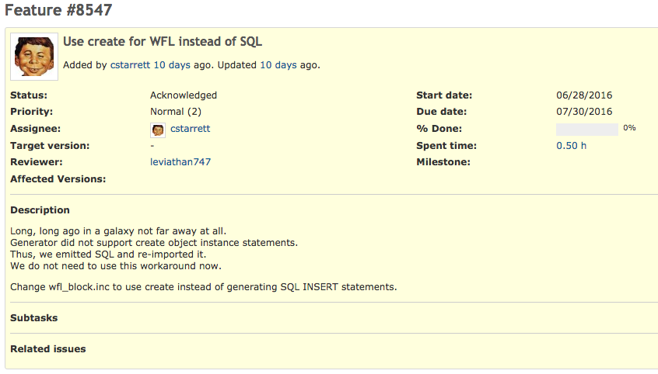
The issue number uniquely identifies an issue. It is required to be included in all commit messages for work against this issue
The due date is the target date for the issue to be completed
The assignee is the engineer or contractor responsible for the work
The description is a synopsis of the issue at hand. More information can be found in the documentation notes

Slide 5
Step 2 – Analysis
Once an issue has been assigned to a One Fact engineer or contractor, the assignee begins the process of analysis of the issue.
This purpose of this step is for the assignee to explore the challenges and feasibility of different approaches to the issue.
The product of this step is an analysis note.
Important components of an analysis note are requirements, analysis, and work required
For some issues (such as exploratory issues), the analysis is the end of the process

Slide 6
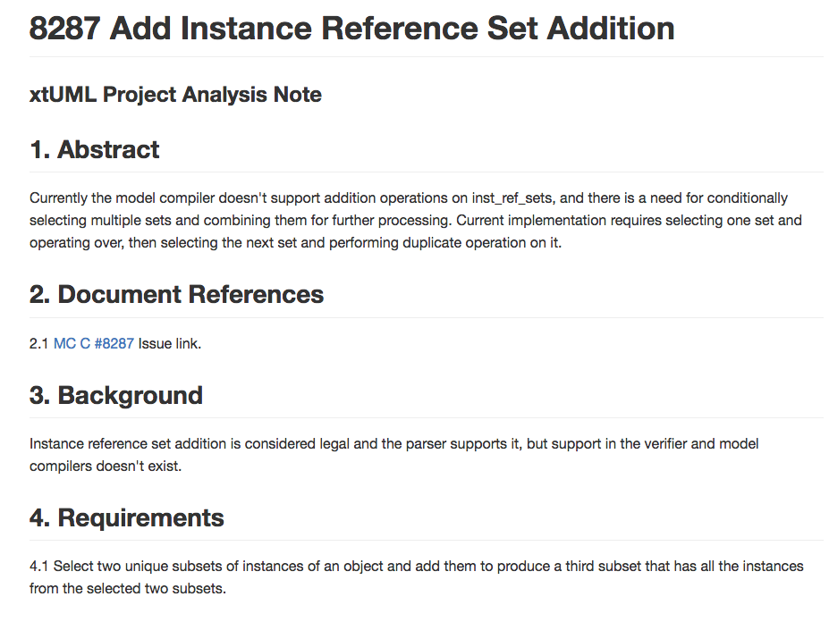
Example excerpt from an analysis note
Document references provide links to useful documentation or referenced documents. The link to the Redmine issue is always included

Slide 7
Note review
After an analysis note is drafted, a review meeting is called.
It is required for an analysis note to be reviewed with three attendees.
During the review, one person reads the note while another records minutes.
Any observations are recorded.
If all observations are minor, the author addresses them independently.
If there are any major observations, a re-review is required after the note is revised.

Slide 8
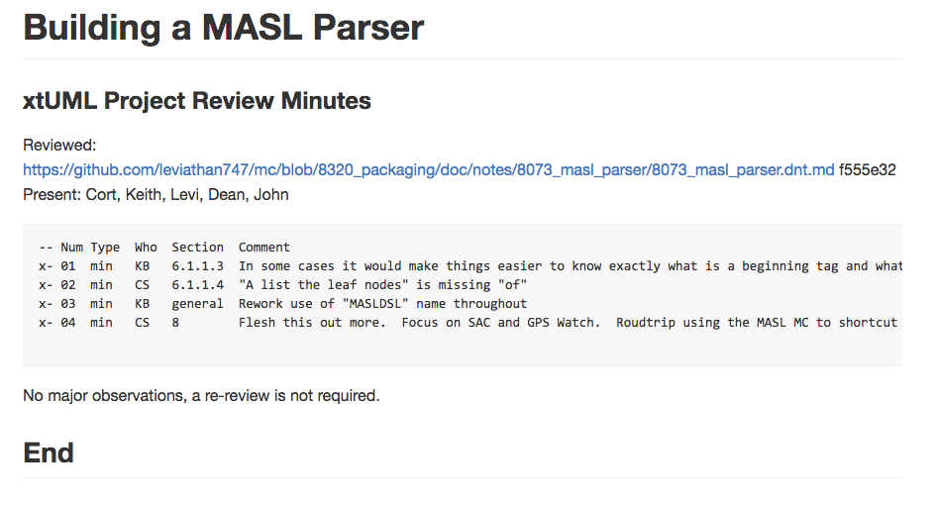
Example review minutes document
This particular review meeting did not result in major observations. A re-review was not required and the author revised based on the observations independently

Slide 9
Step 3 – Design
After analysis review, the design process begins
This is often the most involved step in the process. It includes making specific decisions about how to implement a solution to satisfy the requirements
Sometimes if an issue is straightforward, the assignee can start with the design phase and include any analysis in the design note
Important components of the design note are requirements, design, and unit test
A review meeting is required for the design phase

Slide 10
Step 4 – Implementation
In this phase, the assignee implements his solution based on the design
Challenges and decisions made during implementation are documented in the implementation note
All commits against a certain issue must contain “job #<issue number>” in the commit message
For small issues such as bug fixes, no analysis or design is necessary, and implementation is the start of the process
An implementation note may be reviewed, but a review meeting is not required

Slide 11
Code review
In some cases, it is desirable to have a code review meeting
Like a note review, three people are to be present in a code review meeting
The assignee reviews and comments on each file in a changeset
All observations are recorded at the end of the implementation note
For changes that do not have a code review meeting, the one who promotes the change reviews the code

Slide 12
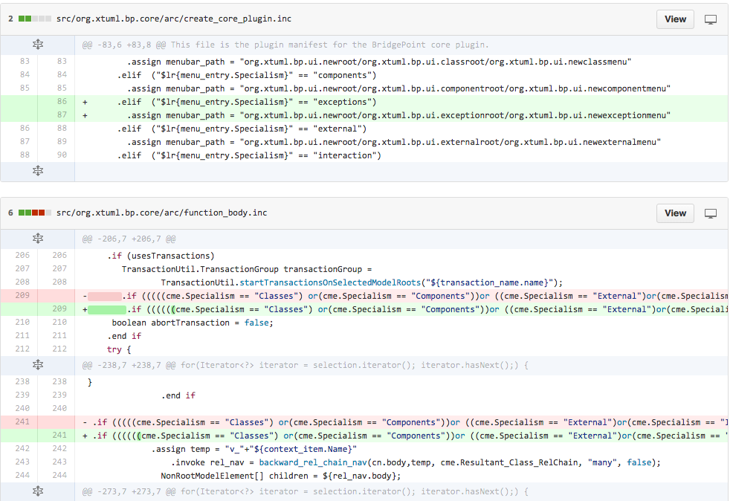
The Github pull request is sometimes used as a diff tool to conduct code reviews

Slide 13
Step 5 – Promotion
Once implementation is done, the work is ready to be submitted for promotion
The assignee opens a pull request on Github to the upstream repository and assigns one of the One Fact committers to service the request
The assignee marks the Redmine issue as “Resolved” at this point
The One Fact committer may communicate with the assignee and request that changes be made (especially if there was no code review meeting)
If the One Fact committer is satisfied with the work, it is pulled into the main branch and the Redmine issue can be marked “Closed”

Slide 14
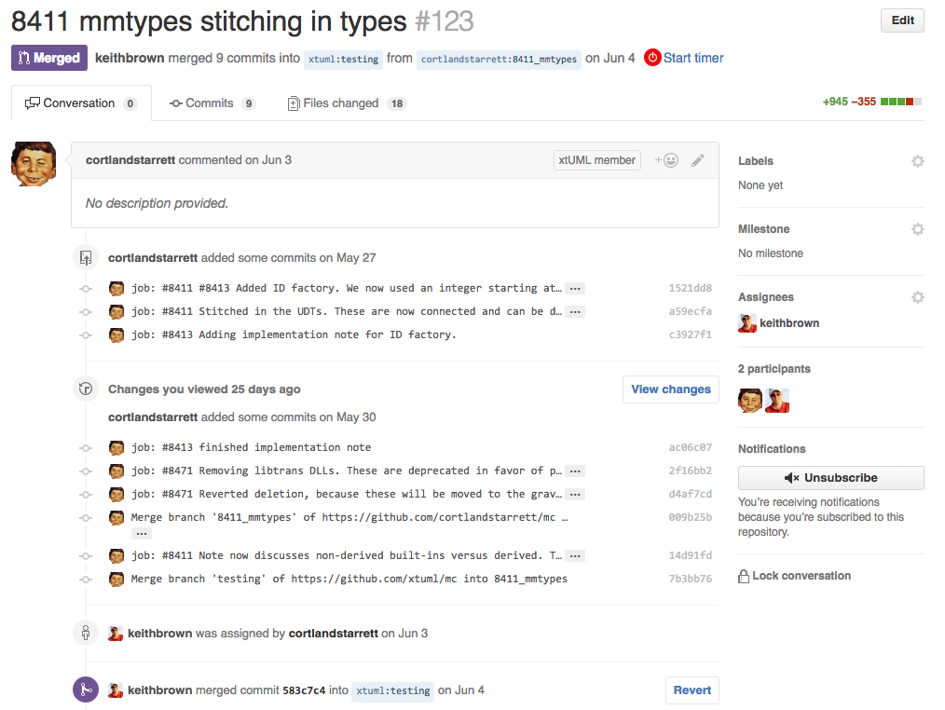
Example pull request
This pull request has been merged in
The assignee reviews the implementation note and services the pull request

Slide 15
Other resources
Browse the issues at https://support.onefact.net
Learn more about xtUML at https://xtuml.org
See note examples, templates, review minutes, and other BridgePoint documentation at https://github.com/xtuml/tree/master/doc-bridgepoint

