Slide 1

Introduction
Levi Starrett

Slide 2
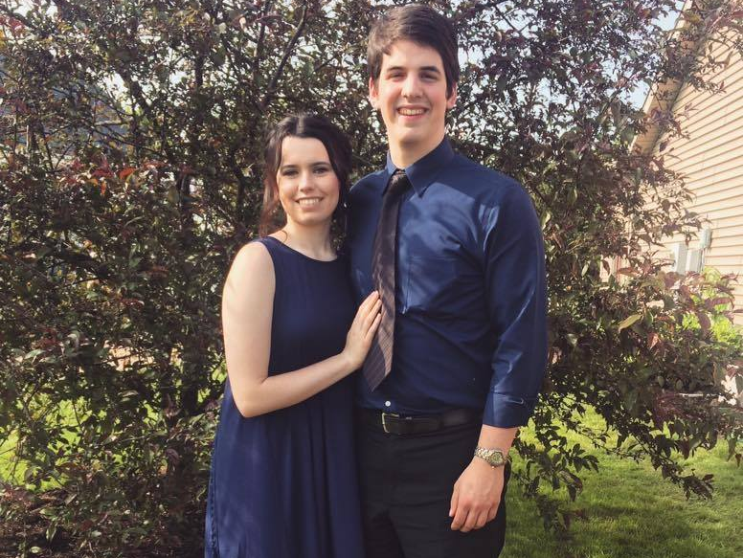
Courtney and Levi

Slide 3

Purdue University

Slide 4
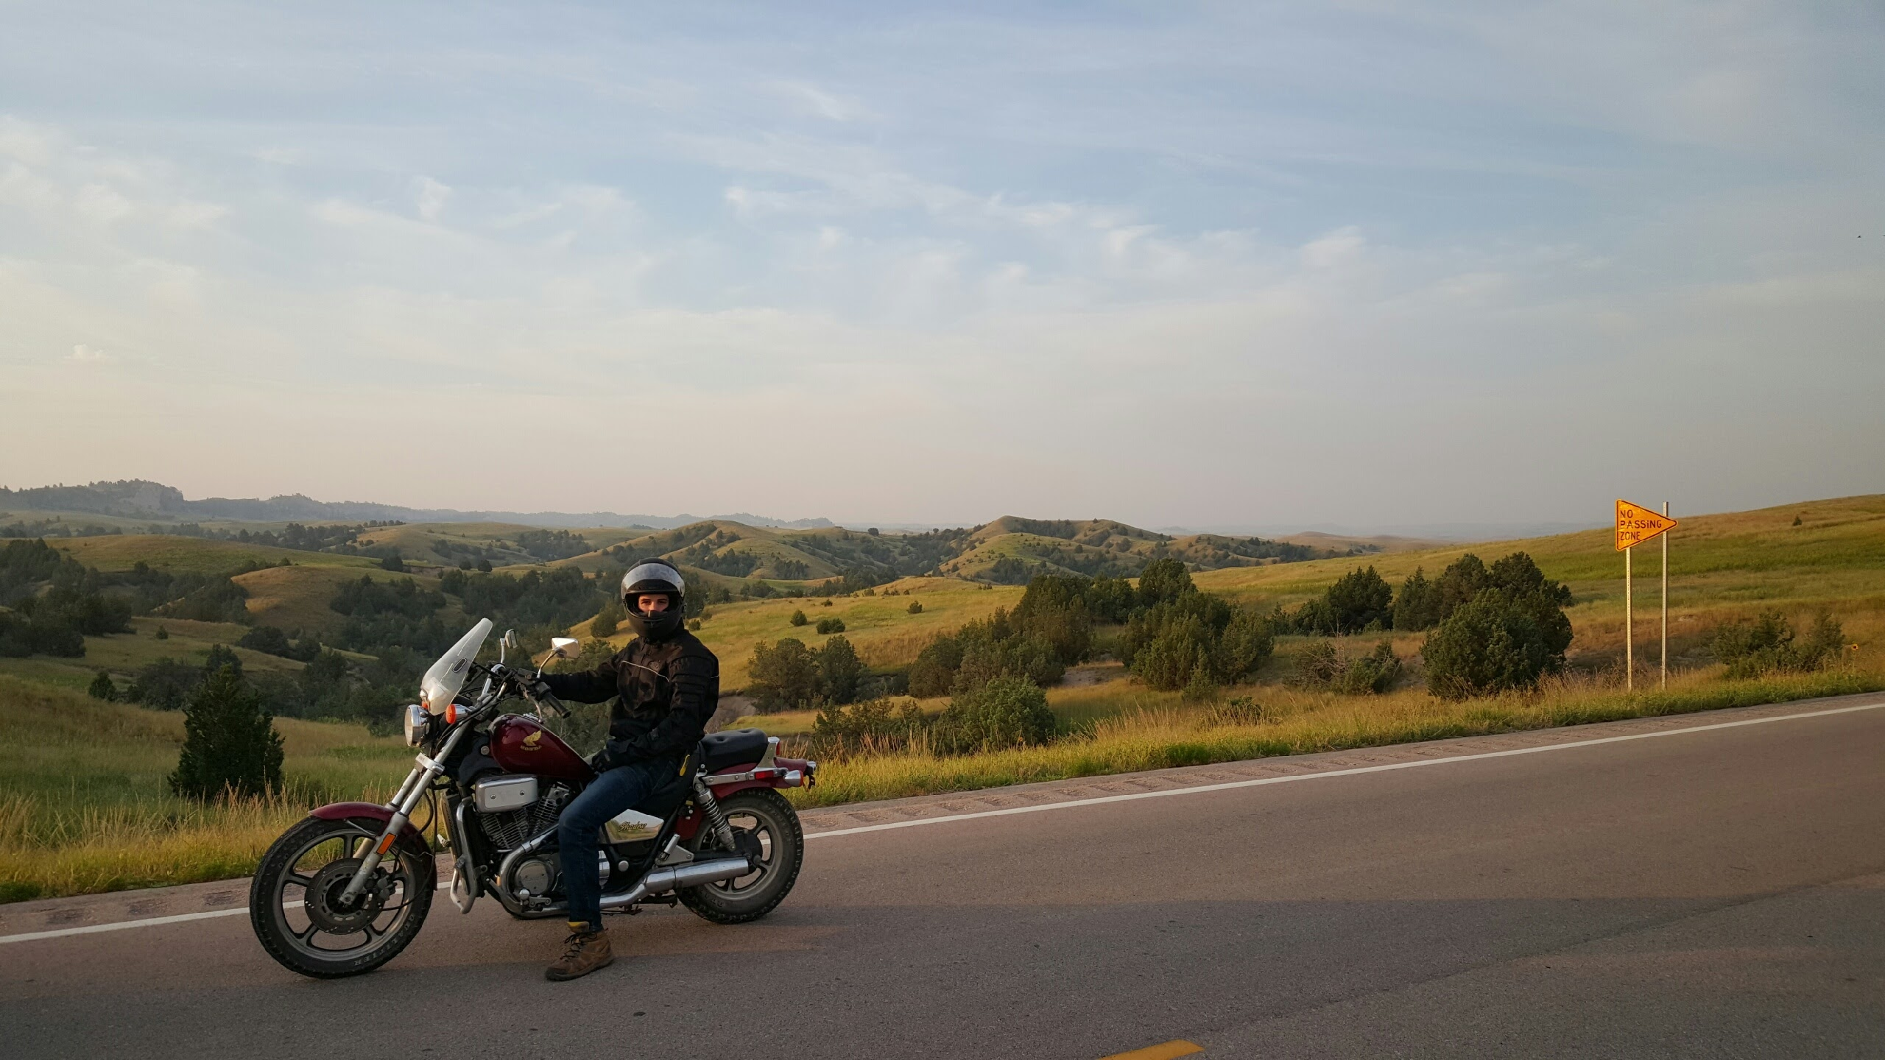
motorcycles

Slide 5

One Fact, Inc.

