Slide 1

xtUML/MASL differences
Levi Starrett

Slide 2
Important terminology
Class == Object
State machine == Transition table
Activity == any element that contains action language
We will discuss this more in depth

Slide 3
Components
Component == domain (for mapping)
Components form a compilation unit
Components are “wired” together in a system configuration diagram through interfaces
An application model can many system configurations
Test, deployment, etc.
Components are opaque from the outside

Slide 4
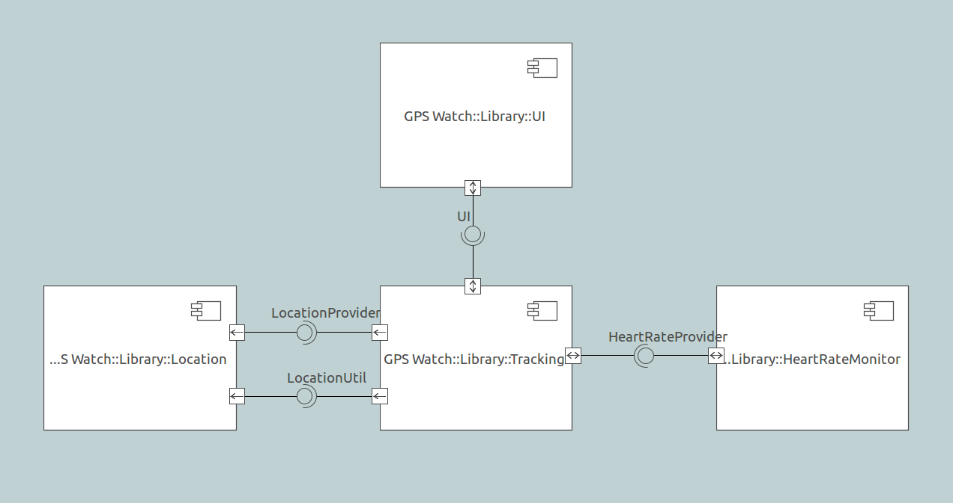
Components

Slide 5
Packages
Basis for organization in xtUML
Mechanism for visibility
Public/private/protected
MASL projects are mapped to a system configuration package

Slide 6
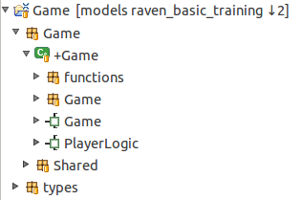
Packages
Package inside a component not visible to the outside world
Public package outside a component can be accessed by any element in this project or even other projects

Slide 7
Interfaces
The [only] mechanism for sending messages between components
Interfaces can be bidirectional
Interfaces can provide synchronous or asynchronous services
Signal = synchronous
Operation = asynchronous
Message = generalized term

Slide 8
Interfaces
Components can “provide” or “require” an interface
Interfaces are mapped to MASL terminators
Public domain services/functions are defined in a provided interface
Key Point: every component representing a MASL domain has one provided interface representing the public domain services and a required interface for each terminator

Slide 9
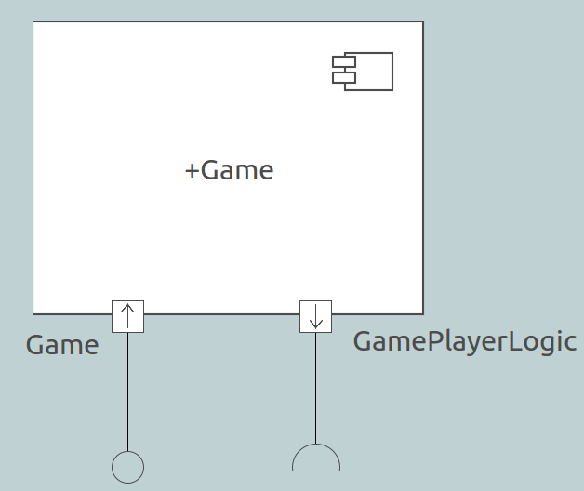
Interfaces
Provided interface representing the public domain functions
Required interface representing a terminator

Slide 10
Misc. differences
In xtUML, class identifiers are limited to three
Identifier 1 maps to MASL “preferred” identifier
In xtUML, relationships are not required to be formalized
xtUML does not have any notion of “exceptions”
Exceptional cases are handled by user callout functions and marking
This is a feature of the C model compiler

Slide 11
Activities
Recall: an activity is “any element that contains action language”
xtUML has seven types of activities
message
function
operation
state
derived attribute
transition
bridge

Slide 12
Activities
Message is a signal or operation on an interface
MASL terminator services/functions map to this activity
Function is a synchronous service not connected to another element
MASL domain services/functions map to this activity
Operation is an activity on a class
MASL object services/functions map to this activity
State is a state in a state machine (same as MASL)

Slide 13
Activities
xtUML messages, operations, and functions have return types
MASL services are given the “void” return type
xtUML states do not have formal parameters
State signatures derived from “same data” rule

Slide 14
Types
xtUML types are related directly to the typed element – no “typeref”
Typed elements are related to their data type and dimensions (for arrays)
MASL’s typing system is much more rich
MASL types and typerefs are mapped to xtUML types in a way to give the best path forward

Slide 15
Types
Any complex typeref is mapped to a publicly visible user defined type
sequence of ..., bag of ..., etc.
MASL user types are defined as a user defined type with type definition in description
User defined types for MASL are derived from MASLtype

Slide 16
Marking
Model compiler directives (MASL pragmas) do not exist in xtUML
Marking exists in the model compiler as mark files that are loaded and interpreted before the compiler is run
Use dynamic memory allocation, max string length, null checking enabled, etc.
MASL pragmas are mapped to xtUML model element description fields

Slide 17
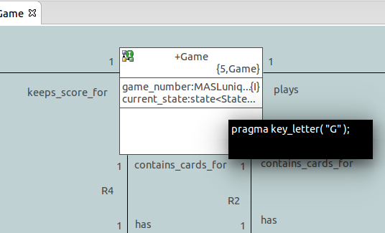
Marking

Slide 18
Questions?

