Slide 1
Cafe bill generator Presenting by 1602-20-737-020 :D. Leena ReDdy 1602-20-737-022 : J.LITHin sai Ram 1602-20-737-026 : Ch.Nikithanjali

Slide 2
Abstract
What is Cafe Bill Generator ?
As the name suggests it is a Bill Management system.
By using this Cafe Bill Management System ,you can easily Calculate the total bill of the customer .
Moreover the total bill is calculated including service charges and GST.
All you need to do is just fill the entry boxes with item quantities and click on generate bill then the program will display your total bill .

Slide 3
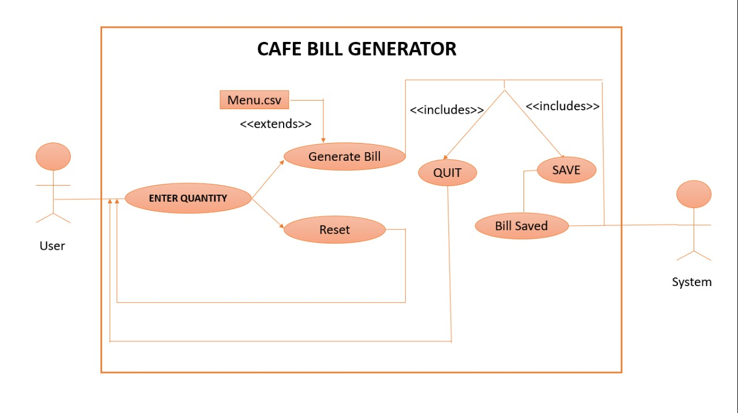
Use case Diagram

Slide 4
Technology Used
In this Program we have used the following modules:
Tkinter module to create the GUI-graphical user interface .
Time module to get the time at which the customer had generated the bill.
Numpy module to perform the various mathematical operations.
PIL-Python Image Library we are using ImageTk and Images to Show the Coffee image on the genrated Output Window.
Random module To generate some random unique identity number to the different customers.

Slide 5
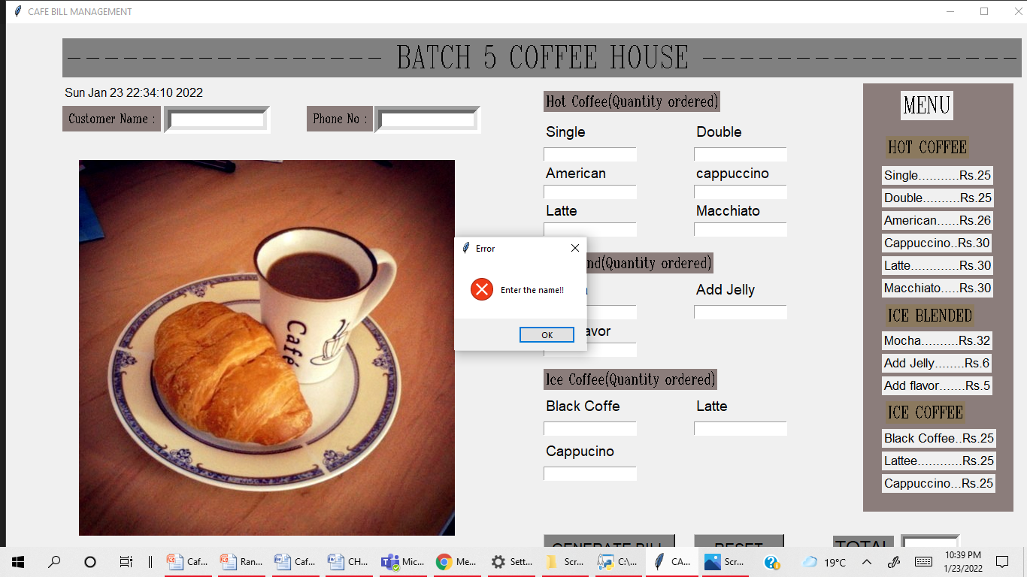
Execution

Slide 6
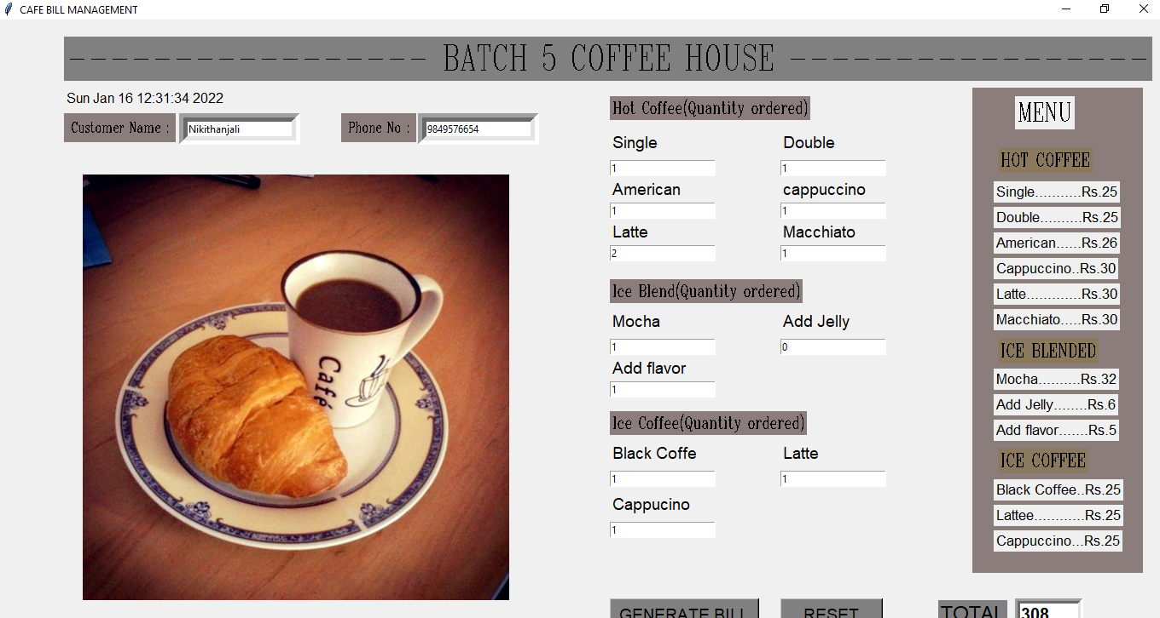

Slide 7
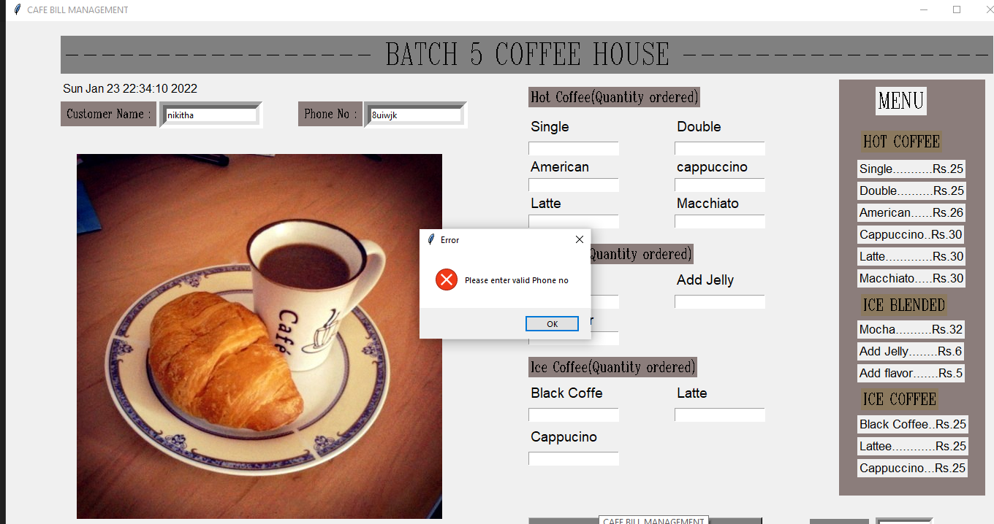

Slide 8
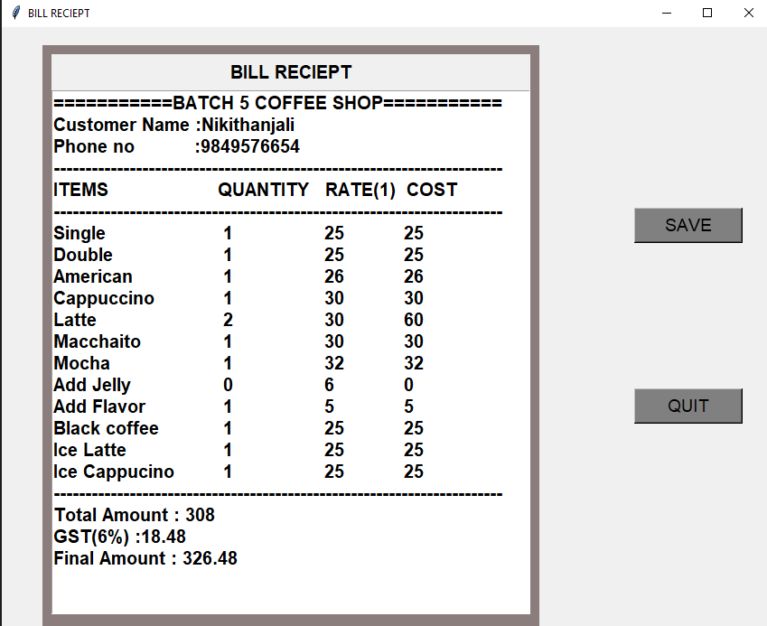

Slide 9
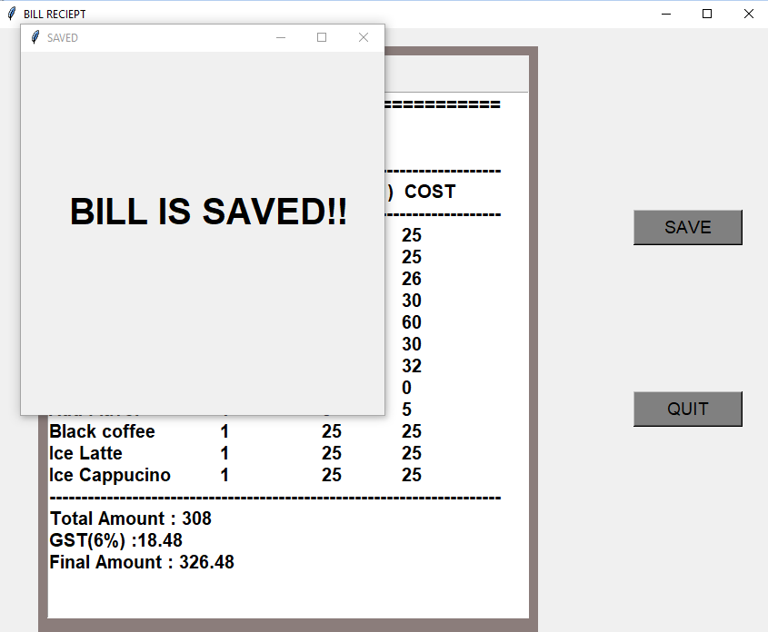

Slide 10
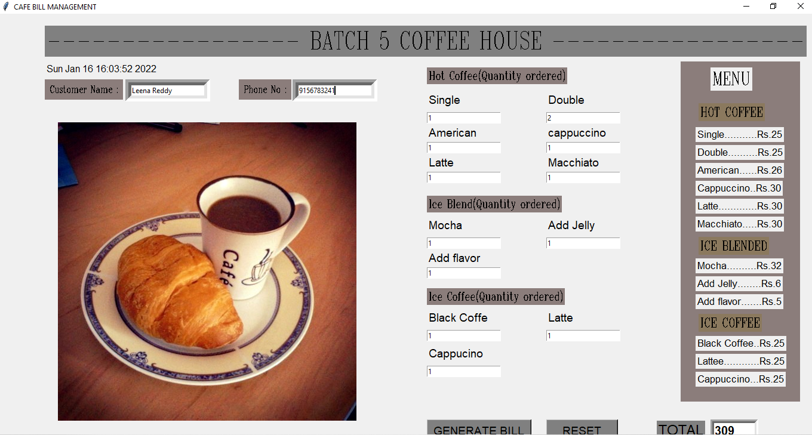

Slide 11
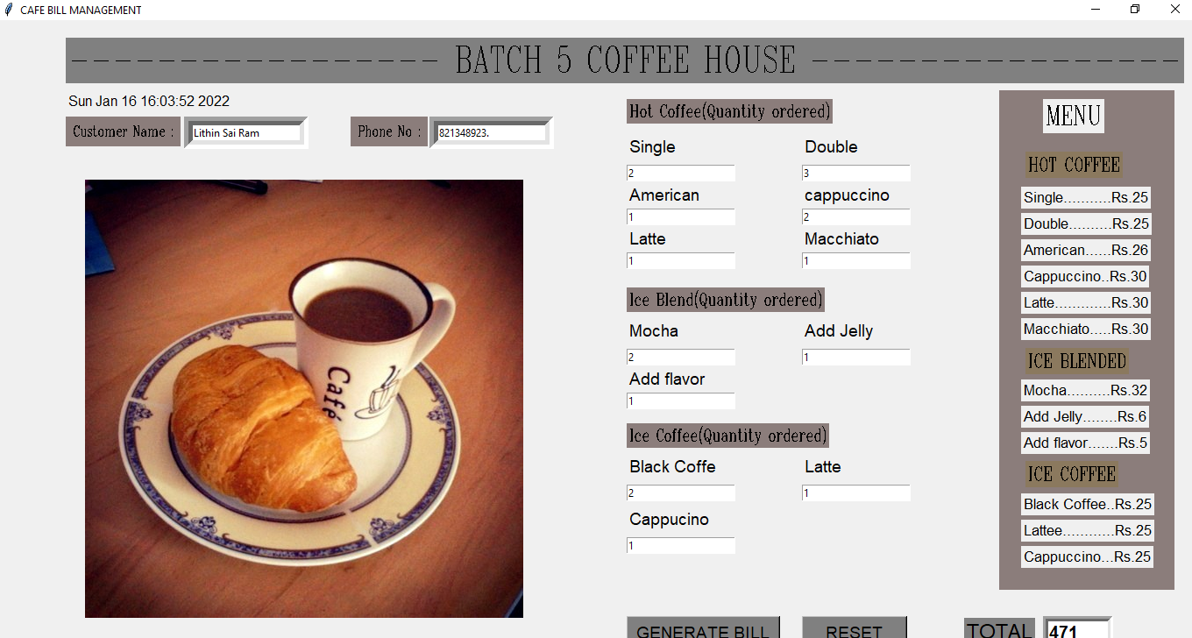

Slide 12
Conclusion
The Outcome of this Project is:
We have a system which takes the necessary choice of the customers according to the filter like category of the coffee.
This is achieved through an tkinter to create graphical user interface menu options.
Customers according to the choice can save the bill or can be exited from the program
If the customer choose to save the bill then bill will be saved in the file.
In Future if we want to change the price of any item then instead of changing the price in the code we can directly change it in the csv file these changes will reflect in the program.

