Slide 1

NORTHWIND STORE PERFOMANCE
By Minh – 04-01-2023

Slide 2
In the Northwind store, we’re selling foods and other revealment products.
It’s already end of Qtr2.2016, so we finality need a look back to see what we’ve done –or – how much we’ve gained.
We will make a dashboard to see that.

Slide 3
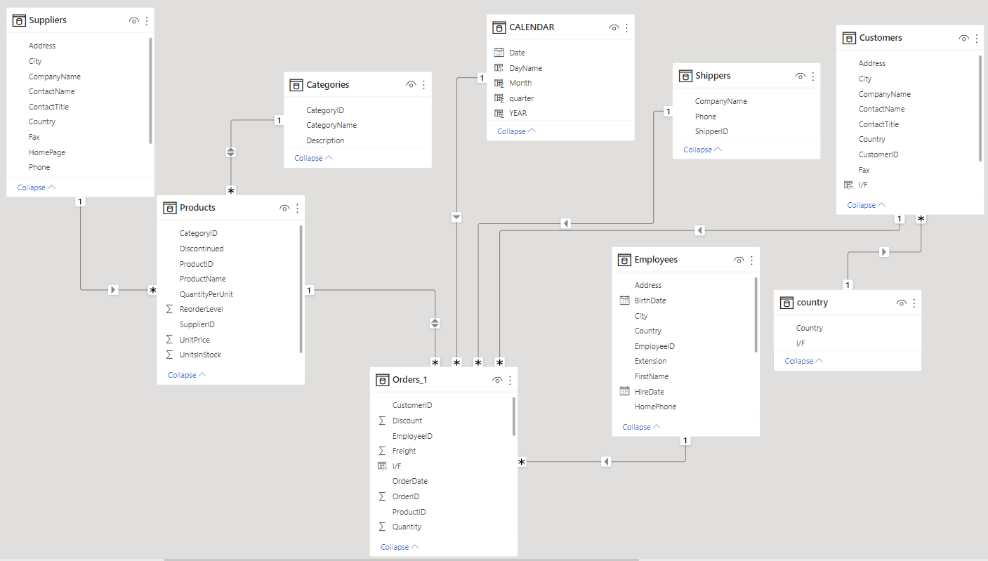
APPENDIX: OUR ORGANIZATIONS

Slide 4
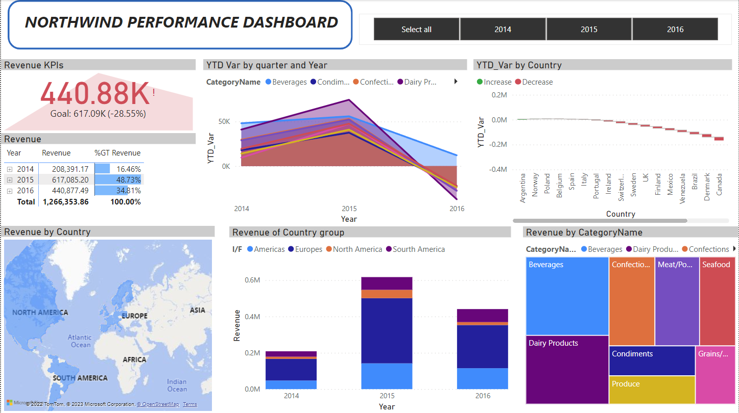
A. Overview Dashboard

Slide 5
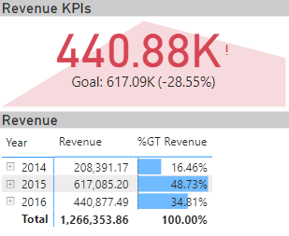
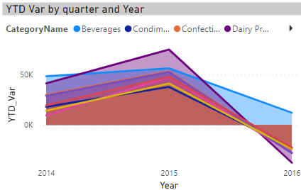
1. Overview dashboard
Overview Revenue:
Total: ~ $1.3 million
2016: ~ $441K, less than 2015 - $617K
Revenue of almost product’s categories went down
Pic.1. Overview Revenue (KPIs, YTD…)

Slide 6
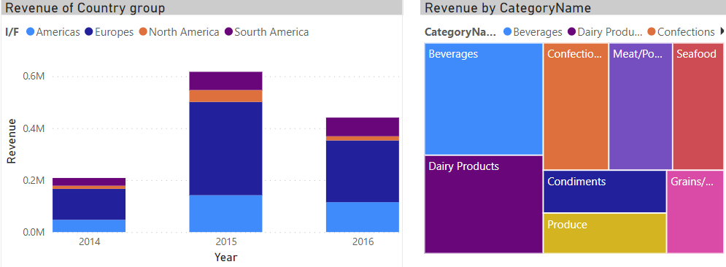
1. Overview dashboard
By Categories: The most revenue gather in Beverages and Dairy Products.
By Country:
We can see the significant drop of revenue in Europe in 2016
Let’s see:
1. % revenue of each country in Europe
2. The factors could be there to low down revenue (the revenue different between 2015 – 206 in categories, country…)
Pic.2. Overview Revenue (by Country, categories..)

Slide 7
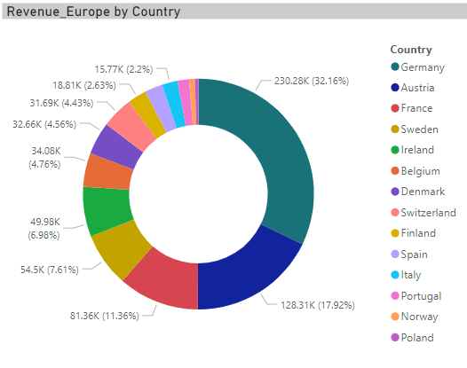
2. Europe’s Revenue attribution
Comment:
Austria & Germany is the top 2 countries in Europe’s overview revenue
=> If we can find some special pattern in these two countries, it could give us the answer
Pic.2.1. Europe’s revenue attribute by Country

Slide 8
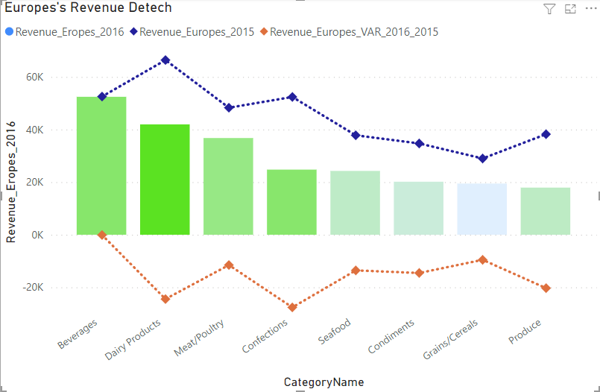
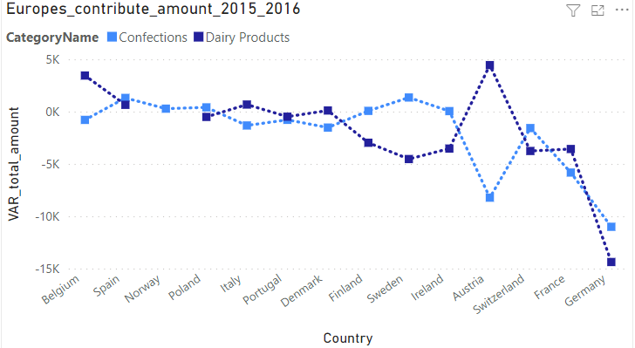
3. Europe’s revenue drop
Why Europe’s revenue have been dropped in 2016?
Pic.3. Europe’s revenue in 2015 - 2016
We can see some specifical trend in Austria and Germany, we will talk about it next..
Pic.4. Europe’s revenue attribution by Country - categories
There’s are negative growth in Dairy Products and Confections

Slide 9
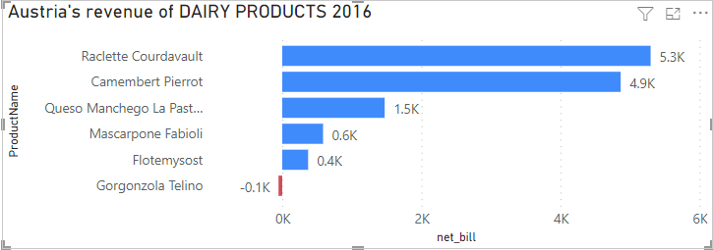
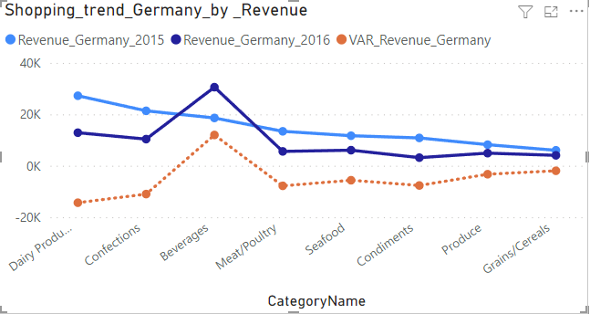
2. Europe’s revenue drop
Why Europe’s revenue have been dropped in 2016?
In Austria, customer’s bill almost in some products of DAIRY PRODUCTS category => Customer’s shopping trend is on DAIRY PRODUCTS, but the amount is less than 2015
Pic.5. Austria’s revenue distribution by Dairy Product’s line
Pic.4. Europe’s revenue attribution by Country -categories
Customer’s shopping trend in Germany strongly increased on Beverages on 2016 => Beverages' growth line is up higher than other
Pic.6. Germany’s revenue trend over 2015 - 2016

Slide 10
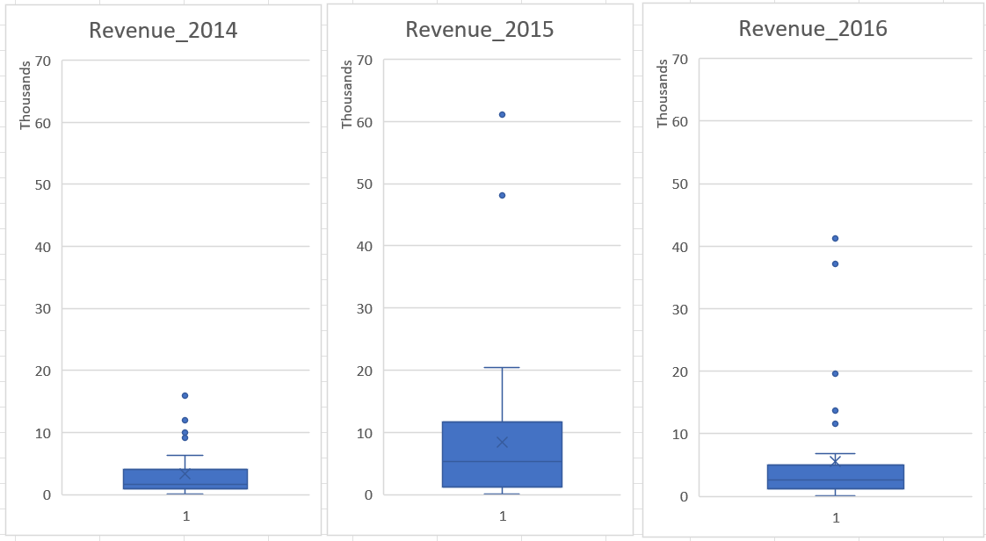
Revenue categories by overview statistic result
In 2016, 75% order’s booking rev is $4900, but still less than the average is $5200
In 2015, 50% the order’s booking revenue is $5200
In 2014, 75% the order’s booking revenue is $4015
=> Overall, the revenue gather the most in range of about $5000
Pic.10. Revenue attribution over years

Slide 11
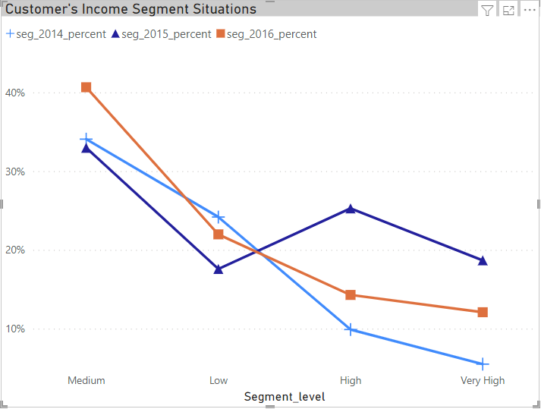
3. Segment level by Customer’s Income situation
Overall, our customers mainly spent less than $5000 (final price contain discount)
Segment in High and Very high group in 2015 is much better than 2016, and the distribution is pretty
In 2016, almost order’s bill in Medium rank
*Note: Total of customers number is unchanged over time (91 person)
Pic.7. Overview segment situation by Customer’s Income
Segment level by Income’s Situation :
Low: $0-$1000 Medium: $1000 - $5000 High : $5000 - $10000 Very high: Above $10000

Slide 12
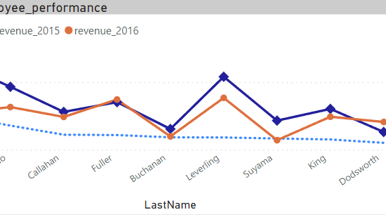
B. Overview Employee’s Performance

Slide 13
1. Employee’s organization tree
Andrew Fuller
Steven Buchanan
Michael Suyama
Robert King
Nancy Davolio
Janet Leverling
Margaret Peacock
Anne Dodsworth

Slide 14
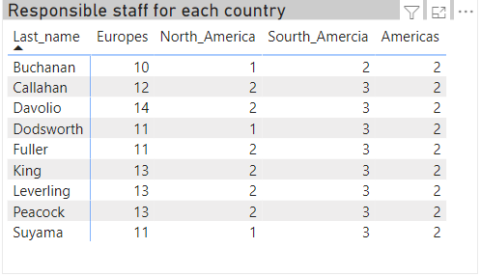
Responsible staff for each country
Almost staff seller across area

Slide 15
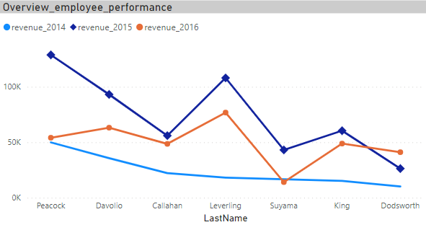
2. Employee’s overview performance
Overview Employee’s Performance:
Overall, 2015s’ is the great year for sale => almost have KPIs revenue strongly higher than 2014
In 2016, due to consumer decreased => overall KPIs revenue decreased.
Pic.8. Overview Employee’s performance

Slide 16
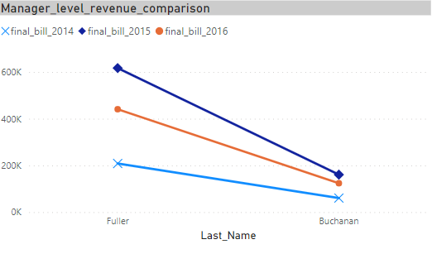
2. Manager line performance
Overview Manager Line Performance:
Overall, due to the common trend in 2016, the total revenue is decreased accordingly
Because Andrew Fuller is the boss of Steven Buchanan => of course, the revenue result is more than Buchanan
Buchanan’s team seem not working in the affect way , the max revenue in 2015 of all team is less than $200000, in the contrary, only Peacock’s staff revenue is ~$128000 in the same period
Pic.8. Overview Employee’s performance

Slide 17
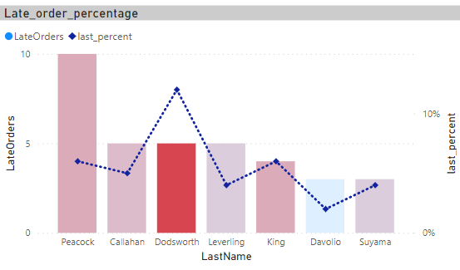
2. Delivering late - overview
His late percent is the highest one
We have some problem:
According to the delivering late percent (per total delivered orders) => Dodsworth seems to be struggling in the delivering step
Pic.9. Employee’s late delivering overview

Slide 18
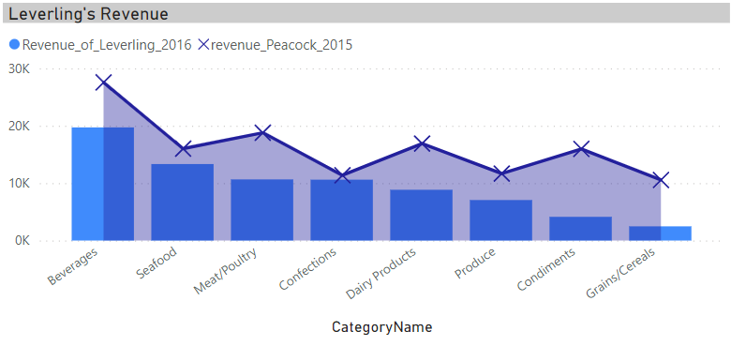
We’re so thankful for this seller….
Leverling is the staff that keep steadily KPI’s revenue most
Pic.9. Overview Employee’s performance
His performance is steadily even in 2015 and 2016 (in 2016 his revenue be downed but the deviant is not that bad).
The most source of his revenue come from Beverage's products.
Pic.8. Overview Employee’s performance

