Slide 1
Arrays
By
Sana Mateen

Slide 2
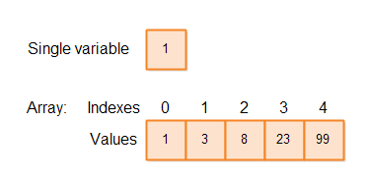
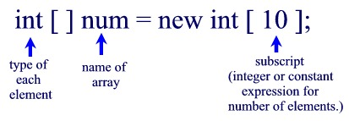
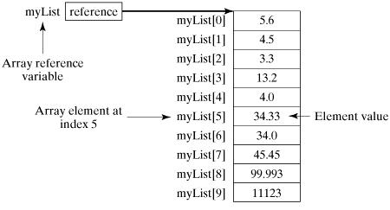
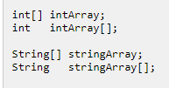
An Array is a group of similar type of variables referred to by common name.
Declaring an Array Variable in Java
A Java array variable is declared just like you would declare a variable of the desired type, except you add [] after the type.
int[] intArray;

Slide 3
Instantiating an Array in Java
When you declare a Java array variable you only declare the variable (reference) to the array itself. The declaration does not actually create an array. You create an array like this:
int[] intArray;
intArray = new int[10];
Once an array has been created its size cannot be changed. In some languages arrays can change their size after creation, but in Java an array cannot change its size once it is created. If you need an array-like data structure that can change its size, you should use a List.

Slide 4
Java Array Literals
The Java programming language contains a shortcut for instantiating arrays of primitive types and strings. If you already know what values to insert into the array, you can use an array literal. Here is how how an array literal looks in Java code:
int[] ints2 = { 1,2,3,4,5,6,7,8,9,10 };
String[] strings = {"one", "two", "three"};

Slide 5
Accessing Java Array Elements
Each variable in an Java array is also called an "element". Thus, the example shown earlier created an array with space for 10 elements, and each element is a variable of type int.
Each element in the array has an index (a number). You can access each element in the array via its index. Here is an example:
intArray[0] = 0;
int firstInt = intArray[0];
Array Length
You can access the length of an array via its length field.
int[] intArray = new int[10]; int arrayLength = intArray.length;

Slide 6
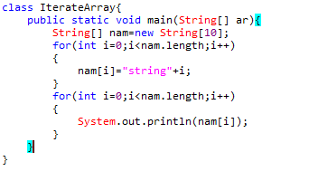
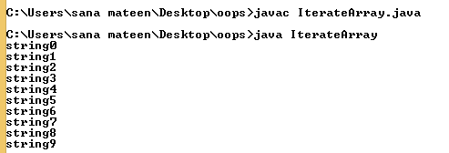
Iterating Arrays
You can loop through all the elements of an array using the Java for loop. Here is an example of iterating an array with a for loop in Java:

Slide 7
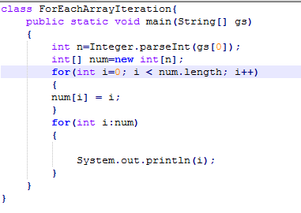
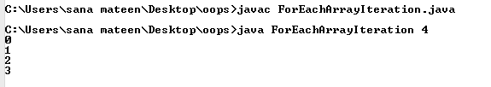

Slide 8
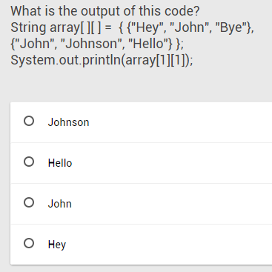
Multidimensional Arrays
Multidimensional arrays are array that contain other arrays. The two-dimensional array is the most basic multidimensional array. To create multidimensional arrays, place each array within its own set of square brackets. Example of a two-dimensional array:
int[ ][ ] sample = { {1, 2, 3}, {4, 5, 6} };
To access an element in the two-dimensional array, provide two indexes, one for the array, and another for the element inside that array.
The array's two indexes are called row index and column index.

Slide 9
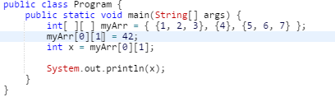
You can get and set a multidimensional array's elements using the same pair of square brackets.
The above two-dimensional array contains three arrays. The first array has three elements, the second has a single element and the last of these has three elements.
Remember, that all array members must be of the same type.

Slide 10
