Slide 1
MOBILE PHONE PRICE
PREDICTION
Exploratory Data Analysis • Feature Engineering • Feature Selection
A Python-based data science project using a mobile phone specifications dataset

Slide 2
Project Overview
• Load and inspect the mobile phone dataset with pandas.
• Check structure, data types, descriptive statistics, missing values and duplicate records.
• Clean inconsistent formats, especially comma-separated prices and camera megapixel strings.
• Perform univariate and multivariate EDA to explore distributions and relationships.
• Create useful derived features and encode categorical variables.
• Use a Random Forest regressor to rank features and select a reduced feature set.
01
02
Load
Inspect
03
04
Clean
EDA
05
06
Engineer
Select
MOBILE PHONE PRICE PREDICTION | PYTHON + MACHINE LEARNING
2

Slide 3
Dataset Description
541 rows × 12 columns in the original file
Categorical
Numeric
• 541 mobile phone records and 12 columns, including an index column.
• Features include model, colour, memory, RAM, battery, cameras, AI Lens, height and processor.
• Target variable: Prize (mobile phone price).
• After dropping the non-informative index column, 11 meaningful columns remain.
Model, Colour, Processor_
Memory, RAM, Battery_
Camera
Target
Rear Camera, Front Camera
Prize
MOBILE PHONE PRICE PREDICTION | PYTHON + MACHINE LEARNING
3

Slide 4
Loading & Exploring the Dataset
import pandas as pd
df = pd.read_csv("Processed_Flipdata - Processed_Flipdata.csv")
print(df.head()) # first 5 rows
print(df.shape) # rows and columns
print(df.info()) # data types and non-null counts
print(df.describe()) # numeric descriptive statistics
print(df.isnull().sum())
print(df.duplicated().sum())
• head() previews the first records.
• shape confirms dataset dimensions.
• info() reveals object columns that may need conversion.
• describe() summarizes count, mean, standard deviation and quartiles.
• isnull() and duplicated() check data quality.
MOBILE PHONE PRICE PREDICTION | PYTHON + MACHINE LEARNING
4

Slide 5
Preprocessing & Inconsistency Checks
• Original file: 541 rows and 12 columns.
• Missing values detected in raw file: 0.
• Exact duplicate rows including index: 0.
• Duplicate rows after excluding the index column: 10.
• Prize is stored as text with comma separators (for example, 7,299).
• Rear Camera and Front Camera values contain text suffixes such as MP.
• Unnamed: 0 is an index-like column and should not be used as a predictor.
df = df.drop(columns=['Unnamed: 0'], errors='ignore')
df['Prize'] = pd.to_numeric(
df['Prize'].astype(str).str.replace(',', '', regex=False),
errors='coerce'
)
for col in ['Rear Camera', 'Front Camera']:
df[col] = pd.to_numeric(
df[col].astype(str).str.extract(r'(\d+\.?\d*)')[0],
errors='coerce'
)
df = df.drop_duplicates()
MOBILE PHONE PRICE PREDICTION | PYTHON + MACHINE LEARNING
5

Slide 6
Preprocessing Steps
• Remove the index-like Unnamed: 0 column.
• Convert Prize from comma-separated text to numeric values.
• Extract numeric megapixel values from camera specifications.
• Convert RAM, Memory, Battery_, AI Lens and Mobile Height to numeric types.
• Remove duplicate records after reviewing whether they are genuine duplicates.
• Handle missing values with median imputation for numeric columns and most-frequent imputation for categorical columns.
Cleaned price summary
Minimum
₹920
Median
₹13,499
Mean
₹16,228
Maximum
₹80,999
MOBILE PHONE PRICE PREDICTION | PYTHON + MACHINE LEARNING
6

Slide 7
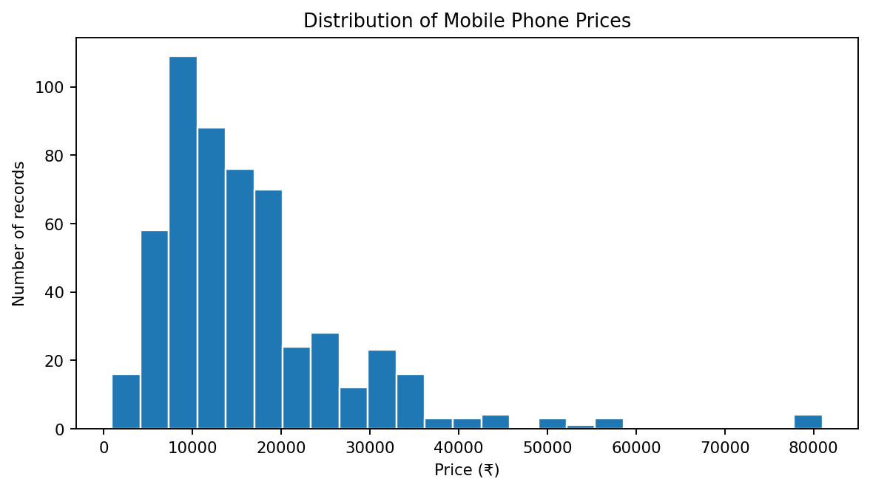
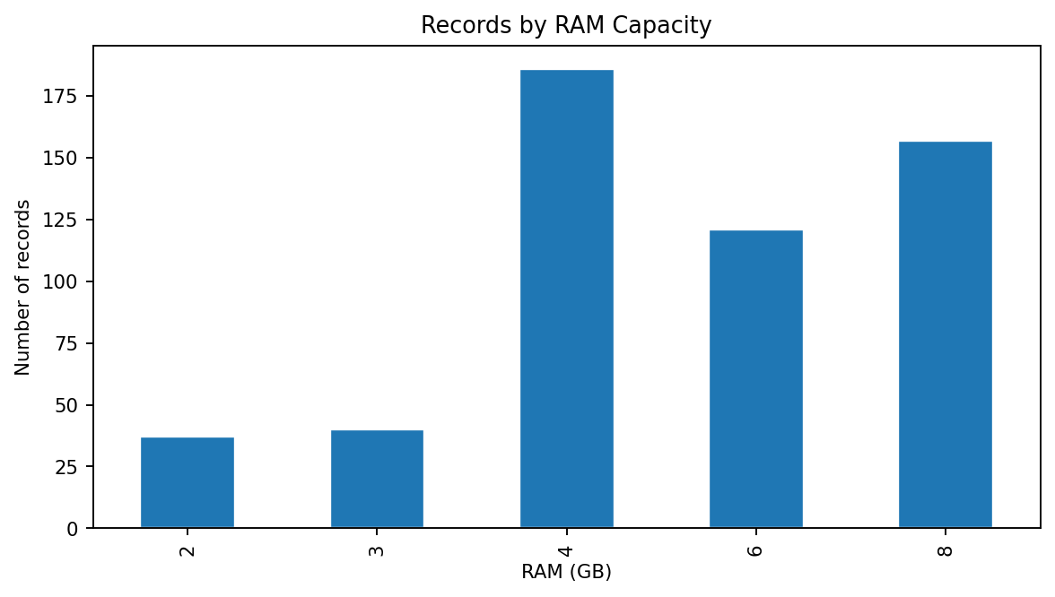
EDA: Univariate Analysis
Study the distribution of one variable at a time
Price range: ₹920–₹80,999; median price: ₹13,499.
RAM configurations in the dataset: 2, 3, 4, 6 and 8 GB.
MOBILE PHONE PRICE PREDICTION | PYTHON + MACHINE LEARNING
7

Slide 8
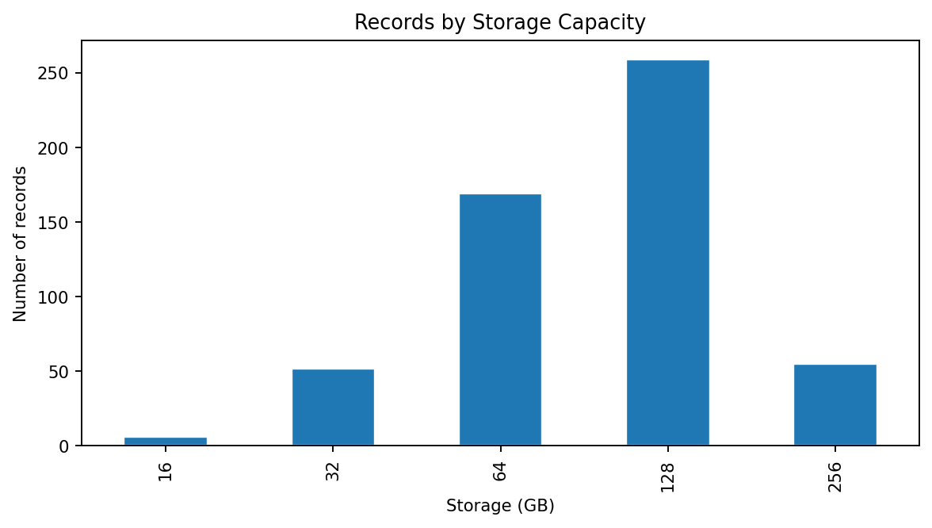
EDA: Storage Distribution
Frequency of memory/storage configurations
Storage counts
• 16 GB: 6 records
• 32 GB: 52 records
• 64 GB: 169 records
• 128 GB: 259 records
• 256 GB: 55 records
Univariate EDA helps identify common configurations and possible skew or unusual values.
MOBILE PHONE PRICE PREDICTION | PYTHON + MACHINE LEARNING
8

Slide 9
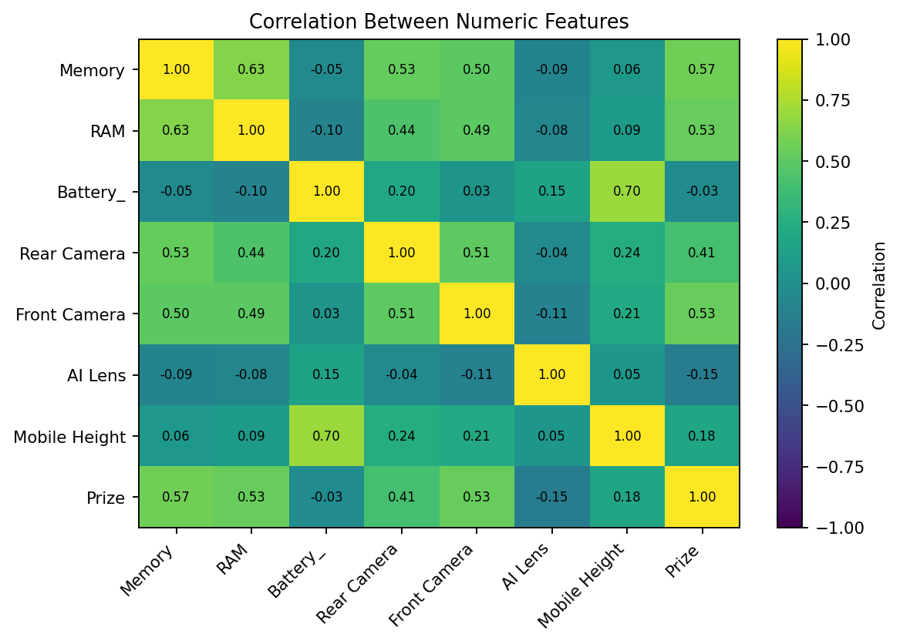
EDA: Multivariate Correlation
Explore how numeric variables move together
Highest positive correlations with Prize
• Memory: 0.57
• Front Camera: 0.53
• RAM: 0.53
• Rear Camera: 0.41
• Mobile Height: 0.18
Correlation indicates association, not causation.
MOBILE PHONE PRICE PREDICTION | PYTHON + MACHINE LEARNING
9

Slide 10
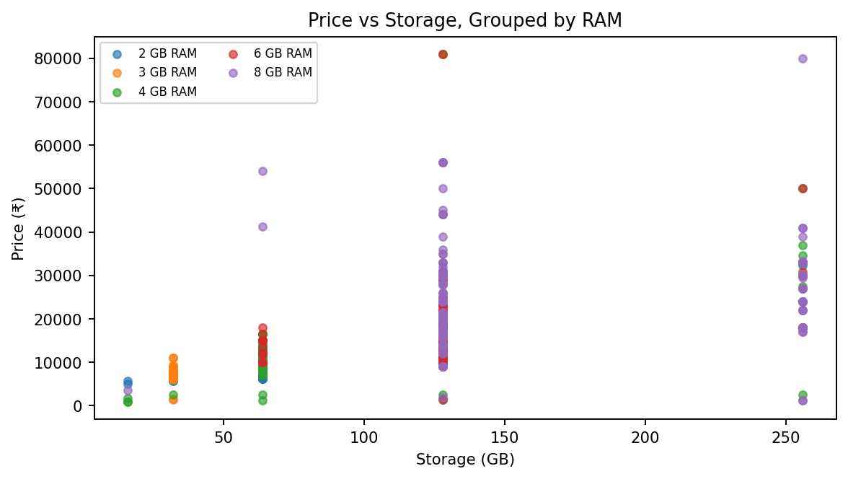
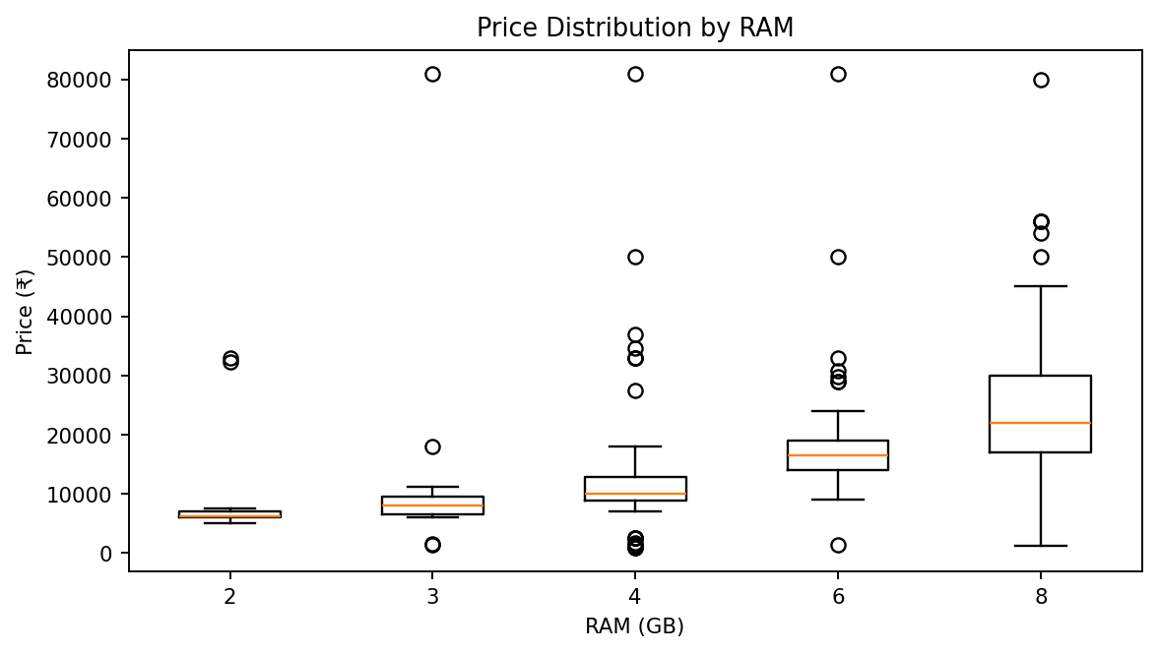
EDA: RAM, Storage & Price
Three variables compared in one visualization
Use hue/grouping and boxplots to compare price patterns across RAM and storage configurations.
MOBILE PHONE PRICE PREDICTION | PYTHON + MACHINE LEARNING
10

Slide 11
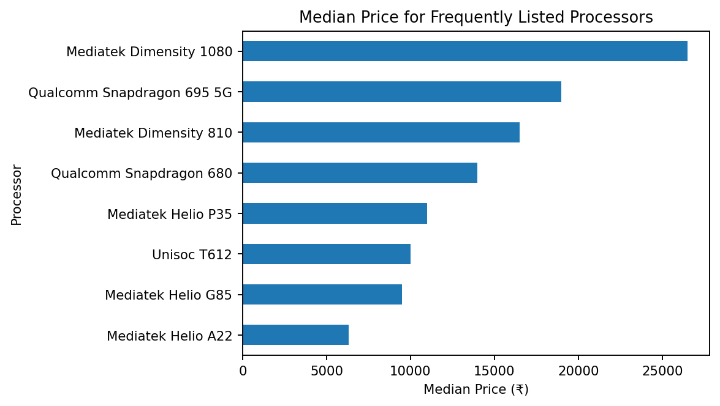
EDA: Processor and Price
Compare median price across frequently occurring processor types
• Processor_ is categorical and should be encoded before modelling.
• The chart uses the eight most frequent processor types.
• Median price offers a robust comparison when distributions contain outliers.
• Processor labels can have many unique categories, so model validation is important.
MOBILE PHONE PRICE PREDICTION | PYTHON + MACHINE LEARNING
11

Slide 12
Feature Extraction / Engineering
# Target
y = df['Prize']
# Example engineered features
df['Total_Camera_MP'] = (
df['Rear Camera'].fillna(0) +
df['Front Camera'].fillna(0)
)
df['Storage_RAM_Ratio'] = (
df['Memory'] / df['RAM'].replace(0, np.nan)
)
df['Battery_RAM_Ratio'] = (
df['Battery_'] / df['RAM'].replace(0, np.nan)
)
• Total_Camera_MP combines rear and front camera megapixel values.
• Storage_RAM_Ratio describes storage relative to RAM.
• Battery_RAM_Ratio describes battery capacity relative to RAM.
• Derived features are hypotheses: validate them with model performance.
• Feature extraction here means feature engineering; dimensionality reduction is a separate technique.
MOBILE PHONE PRICE PREDICTION | PYTHON + MACHINE LEARNING
12

Slide 13
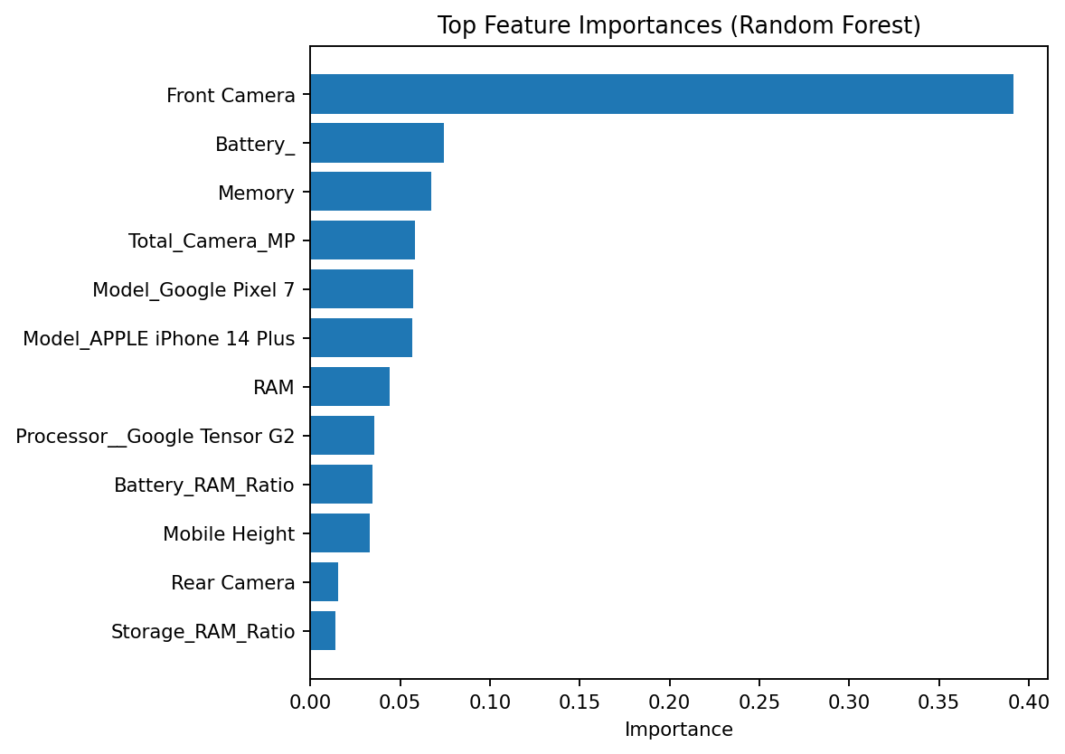
Feature Selection with Random Forest
Rank encoded features by their contribution to predictive performance
• Split the dataset into training (80%) and testing (20%) sets.
• Impute missing numeric values and one-hot encode categorical columns.
• Fit a RandomForestRegressor on training data.
• Use feature_importances_ to rank encoded features.
• Select features above the median importance threshold with SelectFromModel.
MOBILE PHONE PRICE PREDICTION | PYTHON + MACHINE LEARNING
13

Slide 14
Selected-Feature Model Evaluation
Random Forest regression
• R² summarizes how well the model explains price variation on the test split.
• MAE is the average absolute difference between predicted and actual prices.
• These results are a baseline, not a guarantee of future performance.
• Random Forest importance can be biased toward some feature types; consider permutation importance and cross-validation for stronger validation.
R² score: 0.845
Mean Absolute Error: ₹1,767
Selected 272 of 543 encoded features using a median importance threshold.
MOBILE PHONE PRICE PREDICTION | PYTHON + MACHINE LEARNING
14

Slide 15
Conclusion & Next Steps
• The dataset contains 541 mobile phone records and a mix of numerical and categorical fields.
• Preprocessing is required for comma-separated prices and camera specifications stored as text.
• Univariate EDA summarizes distributions; multivariate EDA reveals relationships among features.
• Feature engineering creates useful derived variables, while feature selection reduces the encoded input space.
• Random Forest provides a baseline model for price prediction.
Recommended next steps
• Tune model hyperparameters.
• Use cross-validation.
• Compare Random Forest with Gradient Boosting.
• Check outliers and unusual phone-height values.
• Document assumptions and limitations.
Thank you
MOBILE PHONE PRICE PREDICTION | PYTHON + MACHINE LEARNING
15

