Slide 1
Objective
Use blockledger to illustrate how insurance companies can share information to tackle problems of unpaid amounts and duplicate claims.
Implement system using toolset Hyperledger Composer.
Build in checks and balances to prevent collusion and fraud

Slide 2
Domain definition
Proof-of-concept implemented in a consortium of Life Insurance Companies, as unclaimed amounts is a big problem in Life Insurance.
Policy type used is Term Life , where Nominee is paid death benefits if Customer dies during Term of policy.
One rider, Long Term Care – Reimbursement used to model duplicate and overlapping claims.

Slide 3
System set-up
Life insurance companies are members of consortium.
Data sharing agreement made between pairs of companies.
Every company has two levels of employees, agents and managers.
System supervisor gets reports on all transactions.

Slide 4
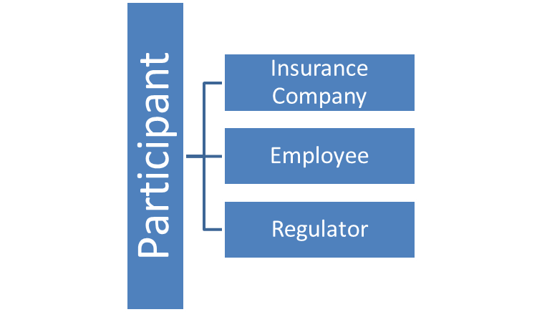
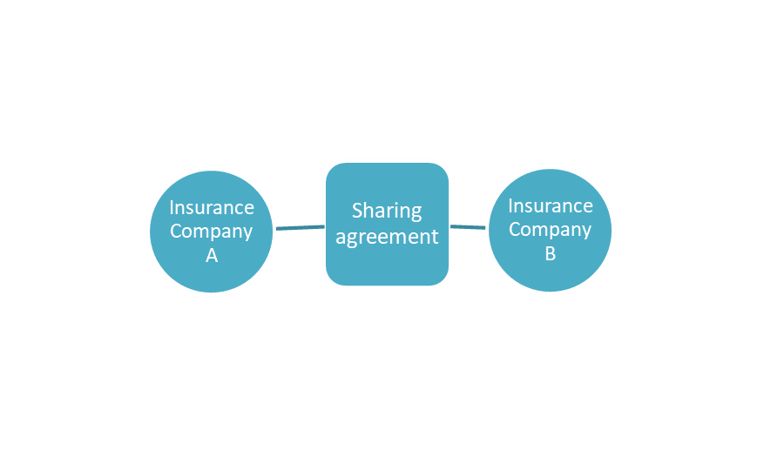
How this is modelled- 1

Slide 5
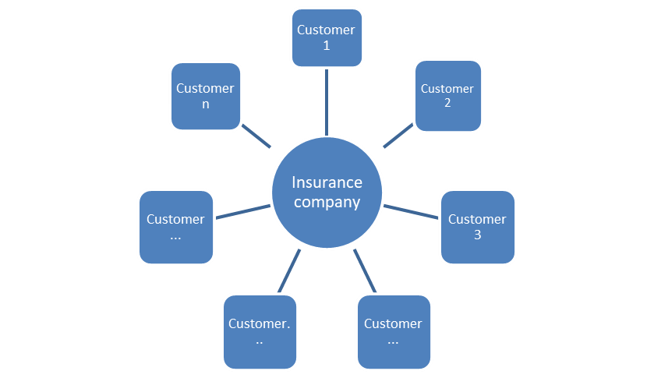
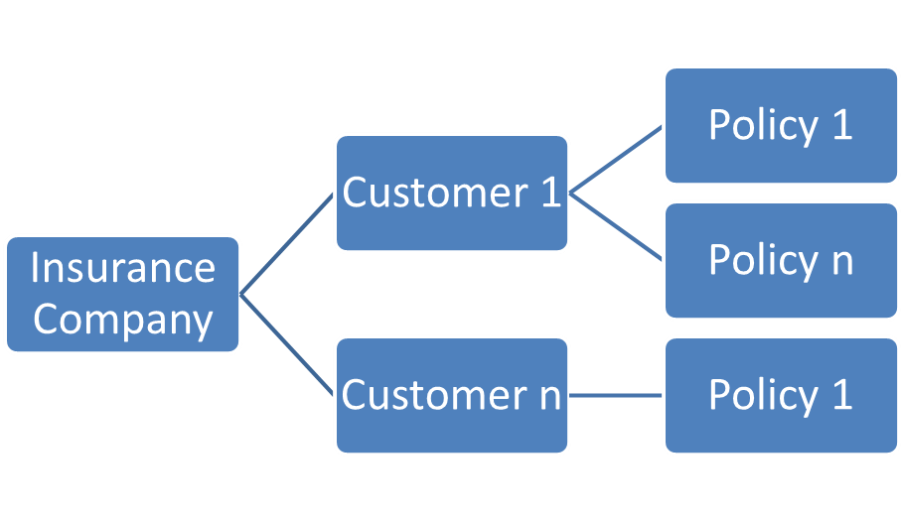
How this is modelled- 2

Slide 6
Customers and Nominees
Name, Date of Birth (DOB) and Social Security Number (SSN) mandatory for Customers.
Name and DOB mandatory for Nominees; SSN to be provided if Nominee has SSN.
If Customer activates confidentiality clause, then all records of this Customer not available for search.
Confidentiality clause does not apply for policies with LTC-R riders, in relation to LTC-R claims.

Slide 7
Unclaimed Amounts
Scope of prototype limited to unclaimed amounts lying with insurance companies after death of Customer, because Nominee unaware of policy.
Deaths marked in customer record through link with Death Master File of Social Security Administration and after ascertaining insurable death.
Search into shared database initiated after Nominee is not traceable.

Slide 8
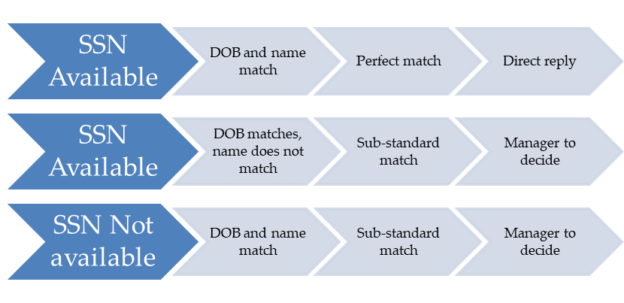
Unclaimed Amounts- Nominee address search
Action required in second company based on type of match and no customer confidentiality clause.

Slide 9
UNCLAIMED AMOUNT- SCENARIO 1
Napolean Malaparte, customer of Maple Life dies on March 24, 2017.
He has two policies, nominees are his daughter Katie and son Napolean, both of whom are estranged from him, so they are unaware of the policies.
S Capoor, agent of Maple enters a request to trace Katie.
M Wingis, manager at Maple approves request.
System discovers Katie is a customer of Bear Assurance- Perfect match, so address details shared with Maple.
K. Narx, manager at Bear informed of the match.

Slide 10
UNCLAIMED AMOUNT- SCENARIO 2
What happens when Maple Insurance tries to locate Napolean Malaparte 2, son of Napolean Malaparte?
S Capoor, agent of Maple enters a request to trace Napolean, Jr.
M Wingis, manager at Maple approves request.
System discovers Napolean, Jr is a customer of Kingfisher Mutual Life. But the customer has a privacy agreement with Kingfisher. System sends denial to Maple.
P. Ritz, manager at Kingfisher informed of the denial.

Slide 11
UNCLAIMED AMOUNT- SCENARIO 3
Bill Wryson, customer of Maple Life dies on March 3, 2017.
Indu Wryson, his wife is the nominee of his policy. They had divorced; Maple is unable to trace Indu Wryson.
S Capoor, agent of Maple enters a request to trace Indu.
M Wingis, manager at Maple approves request.
System discovers Bear Assurance has a customer with same SSN and DOB, but customer name is Indira Bandhi. Sub-standard match.
K. Narx manager at Bear to decide whether to supply address or deny request.

Slide 12
UNCLAIMED AMOUNT- SCENARIO 4
Margaret Bead, customer of Maple Life dies on March 15, 2017.
She has made a policy favoring her sister Alicia Bead who lives in the UK and has no SSN. Margaret misplaced the policy, so Alicia was unaware of it.
S Capoor, agent of Maple enters a request to trace Katie.
M Wingis, manager at Maple approves request.
System discovers Margaret Bead had another policy with Kingfisher Mutual Assurance, which Alicia Bead had claimed on April 15 2017. However it is a sub-standard match as nominee does not have an SSN.
P. Ritz, manager at Kingfisher to decide whether to supply address or deny it.

Slide 13
Duplicate Claims- Explaining LTC-R
Prototype looks at Long Term Care-Reimbursement rider attached to a Life Insurance where Policy reimburses professional care expenses to policy-holder subject to a daily limit.
Assumption: Each person has only one billing agency. Agency can give multiple copies of same bill .
For example, customer’s LTC-R daily limit as per policy with Company A is 300$; he submits bill of 4000$ for 10 days.
Amount payable by Company A = Min(4000$,300$*10)= 3000$.
If same customer has policy with Company B with LTC-R daily limit of 200$ and submits same bill to company B.
In the absence of shared data, Company B could use same formula and pay customer Min (4000$,200$*10)=2000$.
Customer pockets 1000$ extra.

Slide 14
Duplicate Claims- How system works
Agent enters LTC-R claim bill number, amount, start date and end date.
System checks if bill not already claimed in this company.
System then checks if same person (based on SSN) has submitted same bill to other insurance companies.
System calculates actual amount due and puts it up to manager for approval.

Slide 15
DUPLICATE CLAIMS SCENARIO 1
Samuel Doleridge, a customer of Bear Assurance submits an LTC-R claim for 1500$ for a 10 day period. His daily limit is $100.
A Herkel, agent of Bear enters bill details.
System shows bill has not been submitted earlier to Bear.
System finds that Doleridge has already submitted same bill to Kingfisher Mutual Assurance, who paid him 1000$.
System calculates amount payable by Bear as Min (1500$-1000$,100*10)= 500$.
Bill sent to K. Narx manager at Bear for approval.

Slide 16
DUPLICATE CLAIMS SCENARIO 2
Jean Paul Cartre, a customer of Bear Assurance submits an LTC-R claim for 3000$ for a 10 day period. His daily limit is $100.
A Herkel, agent of Bear enters bill details.
System shows bill has not been submitted earlier to Bear.
System finds that Cartre has already submitted same bill to Kingfisher Mutual Assurance, who paid him 1000$. He also has submitted same bill to Maple Life who paid him 2000$
System calculates amount payable by Bear as Min (3000$-(1000$+2000),100*10)= 0$.
Bill sent to K. Narx manager at Bear for approval.

