Slide 1
FlexPoints Using RL to Create a Betting Product
N. Ahmed, S. Siegel, and J. Fuest

Slide 2
Background
Sports Betting
FlexPoints
Data

Slide 3


Sports-betting is one of the hottest new markets in the country, and we can expand on it with RL
Environ.
(Sports)
Agent
(Bettor)
The sports-betting market has undergone explosive growth since legalization in 2018
Reinforcement learning allows for complex derivative products to be accurately priced
Source: Gabelli Securities as cited by Variety, March 3, 2021

Slide 4
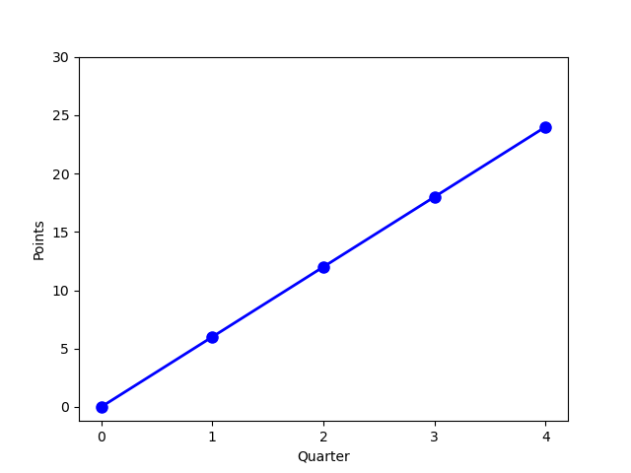
Traditional sports-betting calculates a pay-out at the end the game
S
Bet on Line at Fixed Price
(“Vig” or “Juice”)
Lamer version of
European Option
How can we make the
in-game emotions of the
betting experience actionable?

Slide 5
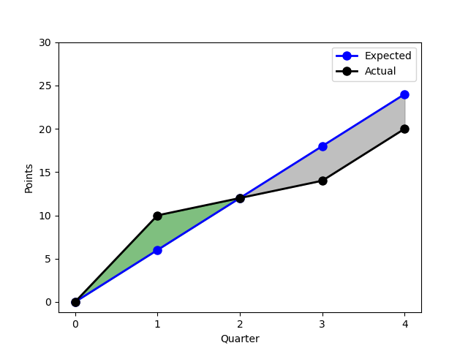
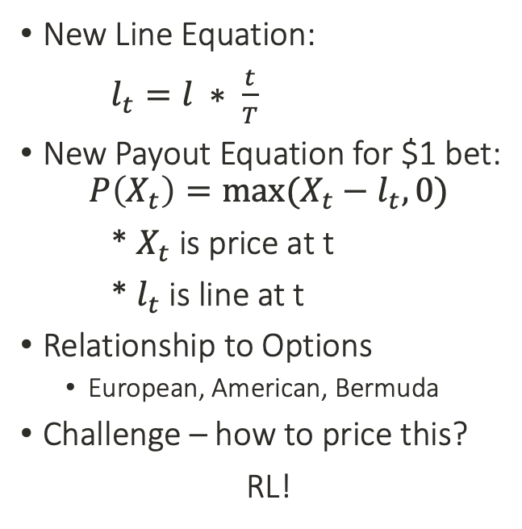
With FlexPoints, players can cash-out after every quarter, providing more opportunities to win!
New Line Equation:
$l_{t}=l ∗ \frac{t}{T}$
New Payout Equation for $1 bet:
$$P\left(X_{t}\right)=max⁡(X_{t}−l_{t}, 0)$$
* $X_{t}$ is price at t
* $l_{t}$ is line at t
Relationship to Options
European, American, Bermuda
Challenge – how to price this?
RL!

Slide 6
We utilize open-source NBA data and sports analytics expertise to engineer our product
S
Quarter | Player | Points | Avg. Points | Avg. Team Points | Opp. Avg. Points | …
3 | L. James | 21 | 27.2 | 103.3 | 107.4 | …
4 | L. James | 29 | 27.2 | 103.3 | 107.4 | …
0 | S. Curry | 0 | 25.8 | 108.1 | 103.2 | …
1 | S. Curry | 7 | 25.8 | 108.1 | 103.2 | …
2 | S. Curry | 15 | 25.8 | 108.1 | 103.2 | …
3 | S. Curry | 18 | 25.8 | 108.1 | 103.2 | …
4 | S. Curry | 26 | 25.8 | 108.1 | 103.2 | …
Source: Basketball Reference
Samples: 5.336 player games
13 numeric features

Slide 7
Pricing Algorithms
Least Squares Policy Iteration (LSPI)
Deep Q-Learning (DQL)

Slide 8
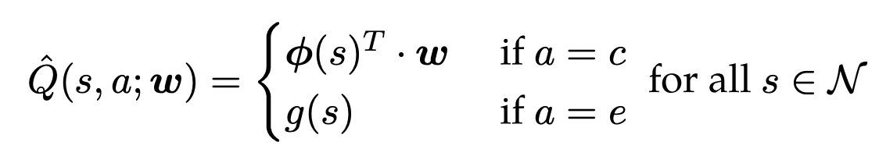
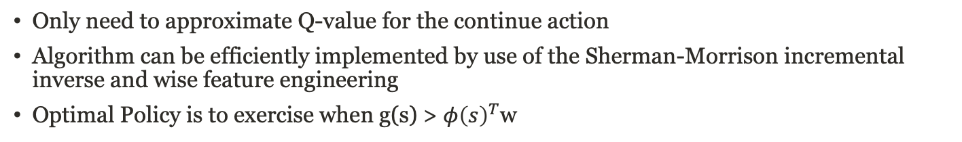

LSPI is a standard approach for pricing via a linear relationship with our engineered features
$$φ{\left(s\right)}^{T}=[{t, pts}_{t}, l_{0}, avg team points, …]$$
g(s) $=max⁡(pts_{t}−l_{0}(\frac{t}{T}), 0)$
Only need to approximate Q-value for the continue action
Algorithm can be efficiently implemented by use of the Sherman-Morrison incremental inverse and wise feature engineering
Optimal Policy is to exercise when g(s) > $φ{\left(s\right)}^{T}$w
Source: RL-Book

Slide 9
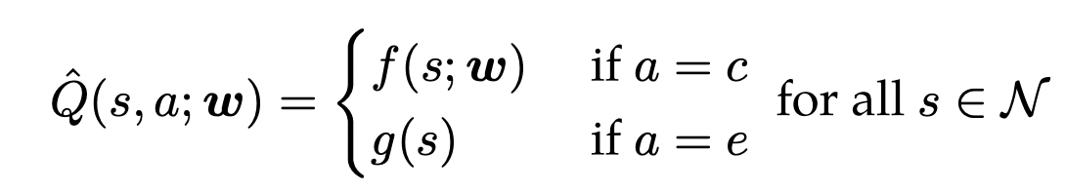

Deep Q-Learning allows for even greater modelling flexibility, but convergence can be a challenge
g(s) $=max⁡(pts_{t}−l_{0}(\frac{t}{T}), 0)$
DQL utilizes the semi-gradient for model weight updates
Standardization of features, learning rate decay, and random sampling of atomic experiences aids model convergence
Philosophy: price against sophisticated bettors to avoid being exploited, so sell this option at Q-value function plus a margin
Source: RL-Book

Slide 10
Pricing Examples
In-Sample Example
Out-of-Sample Example (Audience Participation!)

Slide 11
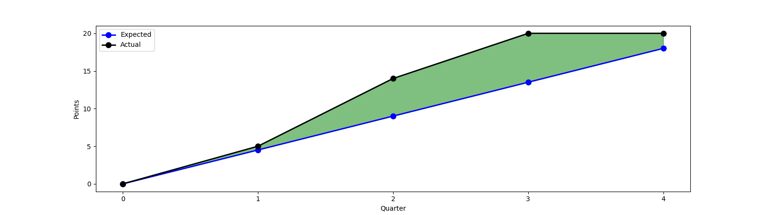
Anthony Davis vs Dallas Mar 19th 2019
Exercise Value | $ 0.0 | $ 0.50 | $ 5.00 | $ 6.50 | $ 2.00
Q-Value (LSPI) | $4.18 | $ 3.83 | $ 5.38 | $ 5.05 | -
Optimal Action | Continue | Continue | Continue | Stop | -

Slide 12
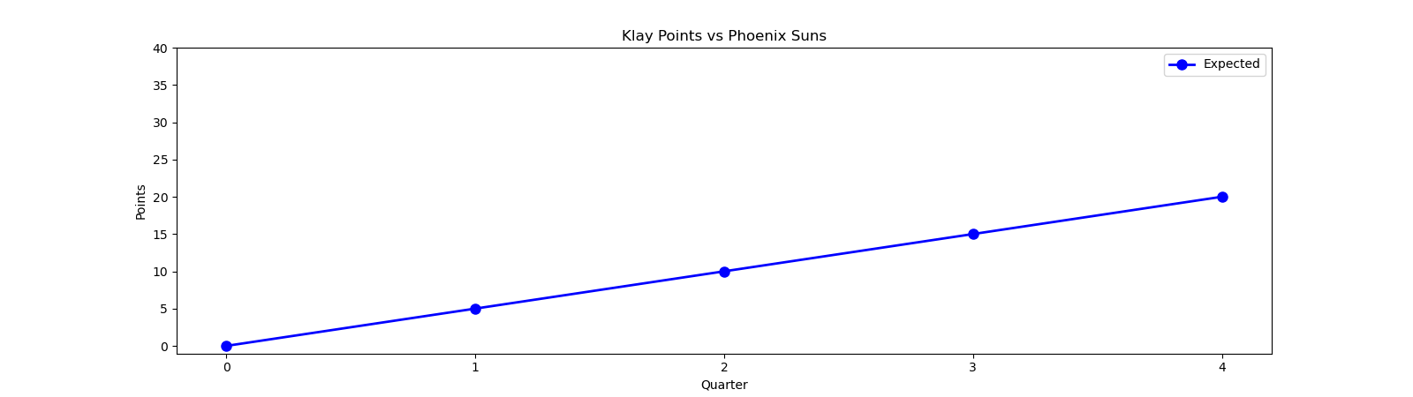
Klay Thompson vs Phoenix Suns Mar 13th 2023
Exercise Value | $ 0 | ? | ? | ? | ?
Q-Value (DQL) | $ 3.56 | ? | ? | ? | -
Optimal Action | Continue | ? | ? | ? | -

Slide 13
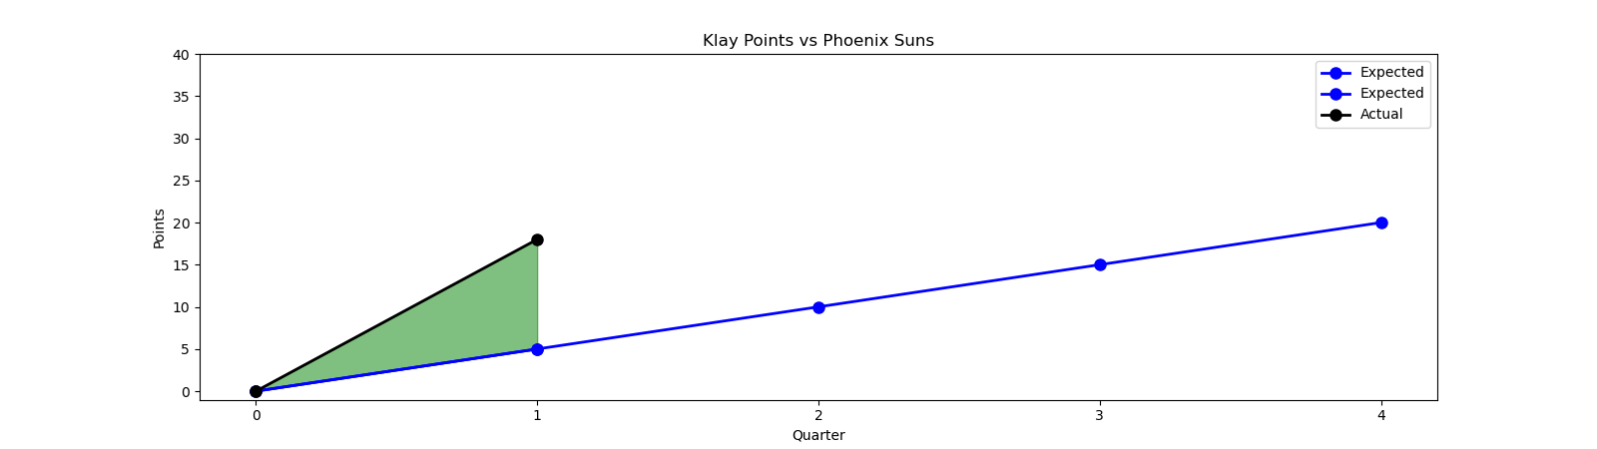
Klay Thompson vs Phoenix Suns Mar 13th 2023
Exercise Value | $ 0 | $ 13.00 | ? | ? | ?
Q-Value (DQL) | $ 3.56 | ? | ? | ? | -
Optimal Action | Continue | ? | ? | ? | -

Slide 14
Klay Thompson vs Phoenix Suns Mar 13th 2023
Exercise Value | $ 0 | $ 13.00 | ? | ? | ?
Q-Value (DQL) | $ 3.56 | $ 27.45 | ? | ? | -
Optimal Action | Continue | Continue | ? | ? | -

Slide 15
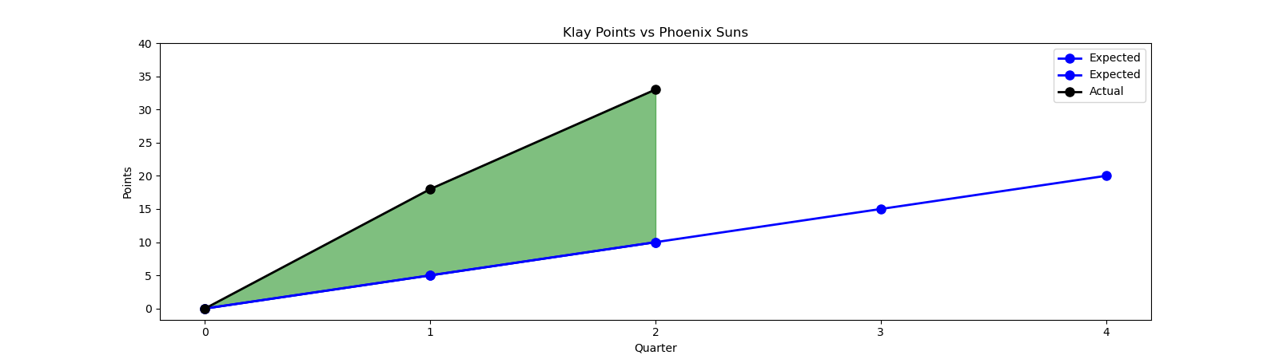
Klay Thompson vs Phoenix Suns Mar 13th 2023
Exercise Value | $ 0 | $ 13.00 | $ 23.00 | ? | ?
Q-Value (DQL) | $ 3.56 | $ 27.45 | ? | ? | -
Optimal Action | Continue | Continue | ? | ? | -

Slide 16
Klay Thompson vs Phoenix Suns Mar 13th 2023
Exercise Value | $ 0 | $ 13.00 | $ 23.00 | ? | ?
Q-Value (DQL) | $ 3.56 | $ 27.45 | $ 20.69 | ? | -
Optimal Action | Continue | Continue | Stop | ? | -

Slide 17
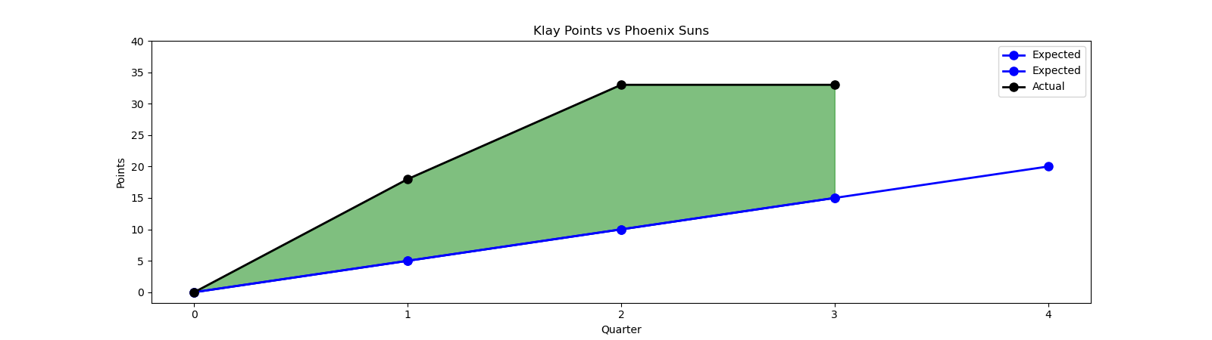
Klay Thompson vs Phoenix Suns Mar 13th 2023
Exercise Value | $ 0 | $ 13.00 | $ 23.00 | $ 18.00 | ?
Q-Value (DQL) | $ 3.56 | $ 27.45 | $ 20.69 | ? | -
Optimal Action | Continue | Continue | Stop | ? | -

Slide 18
Klay Thompson vs Phoenix Suns Mar 13th 2023
Exercise Value | $ 0 | $ 13.00 | $ 23.00 | $ 18.00 | ?
Q-Value (DQL) | $ 3.56 | $ 27.45 | $ 20.69 | $ 21.18 | -
Optimal Action | Continue | Continue | Stop | Continue | -

Slide 19
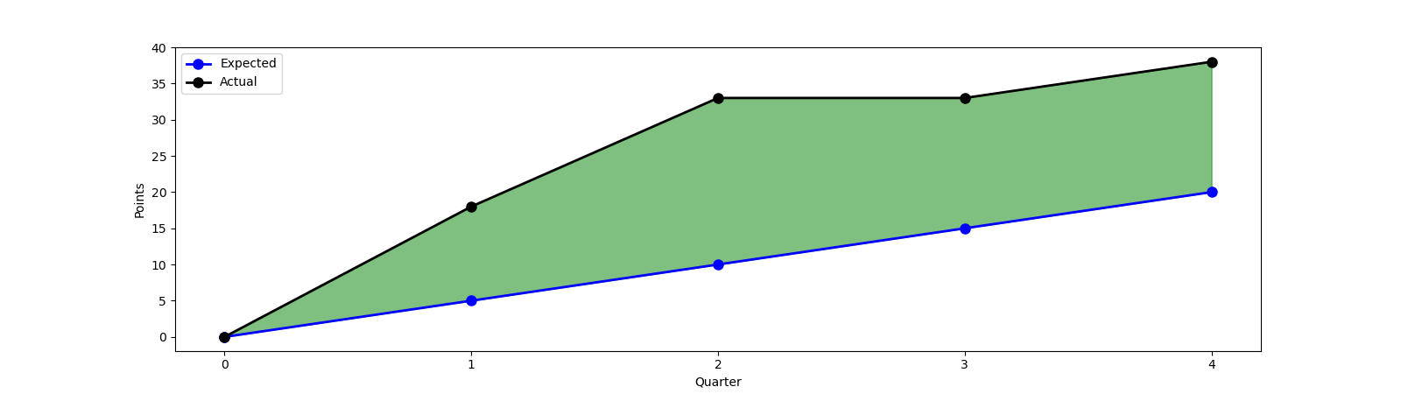
Klay Thompson vs Phoenix Suns Mar 13th 2023
Exercise Value | $ 0 | $ 13.00 | $ 23.00 | $ 18.00 | $ 18.00
Q-Value (DQL) | $ 3.56 | $ 27.45 | $ 20.69 | $ 21.18 | -
Optimal Action | Continue | Continue | Stop | Continue | -

Slide 20
Thank You

Slide 21
Possible Improvements
Buy-in mid-game using Q-value plus a mark-up
Extension to more granular time intervals
Cash-out at any stoppage in play
Offer cash-out below Q-value when exercise value is zero

