Slide 1
PET图像处理
PET Image Processing
上海大学PET创新创业小组
PET Innovation and Entrepreneurship Group, Shanghai University

Slide 2
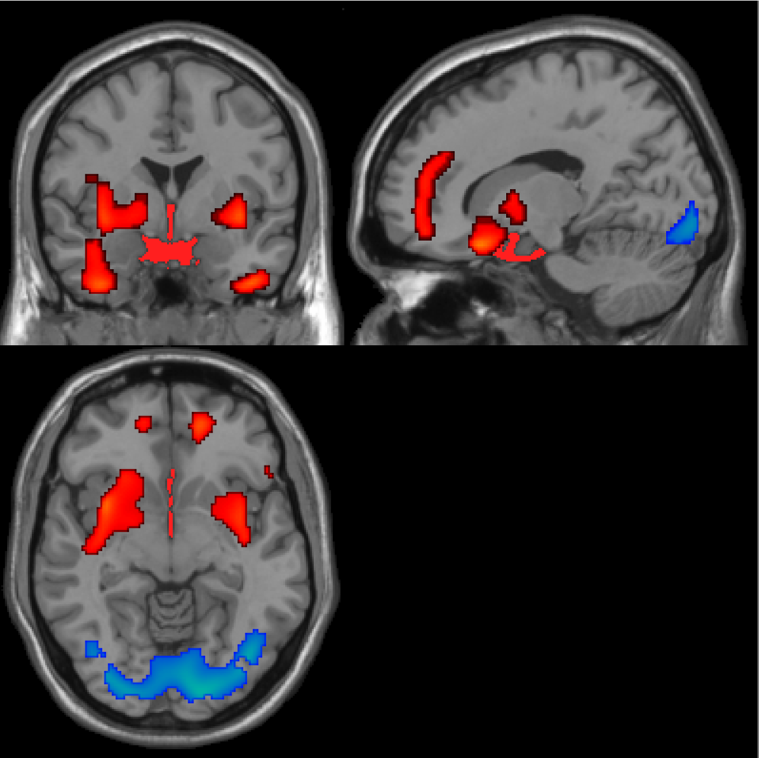

Slide 3
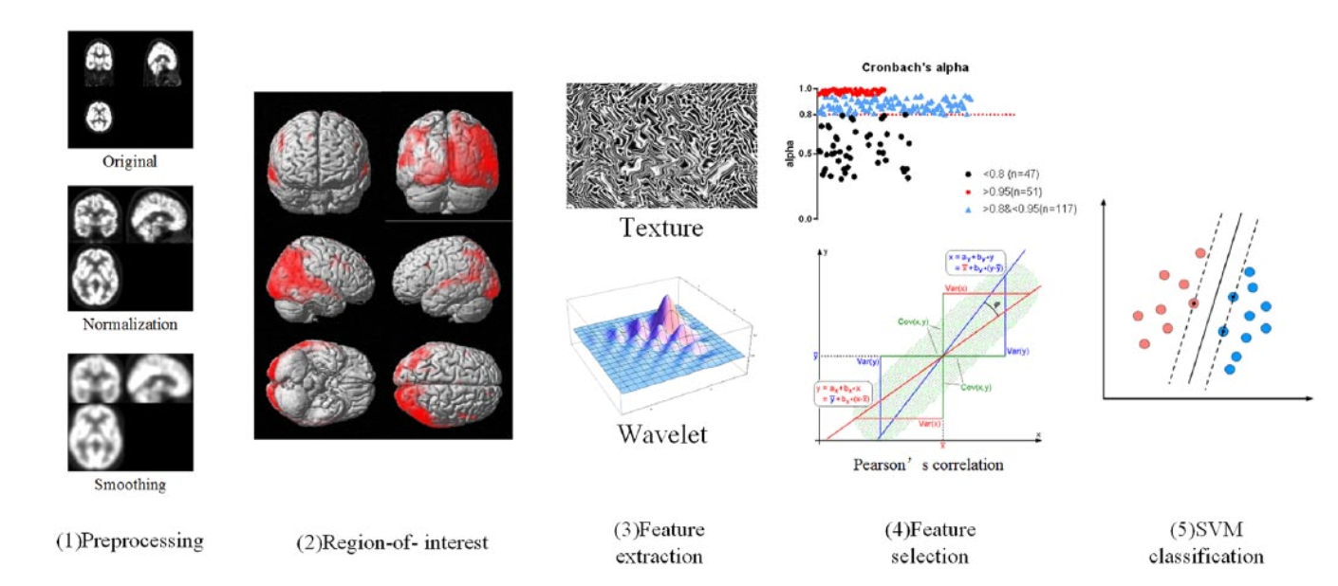

Slide 4
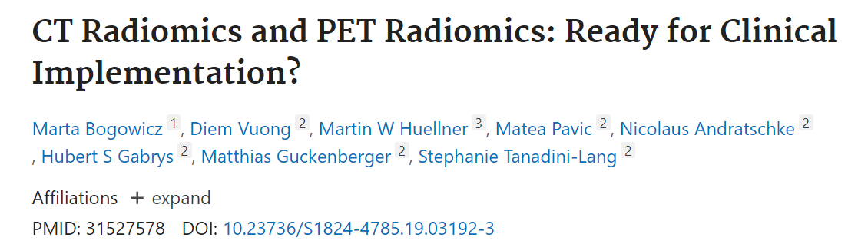
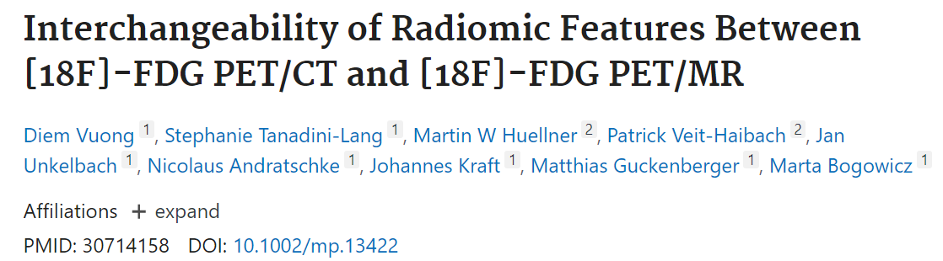
PET radiomics are promising pre-treatment and intra-treatment biomarkers for outcome prediction.
shape and intensity features were robust when comparing two types of [18F]-FDG PET scans (PET/CT and PET/MR).

Slide 5
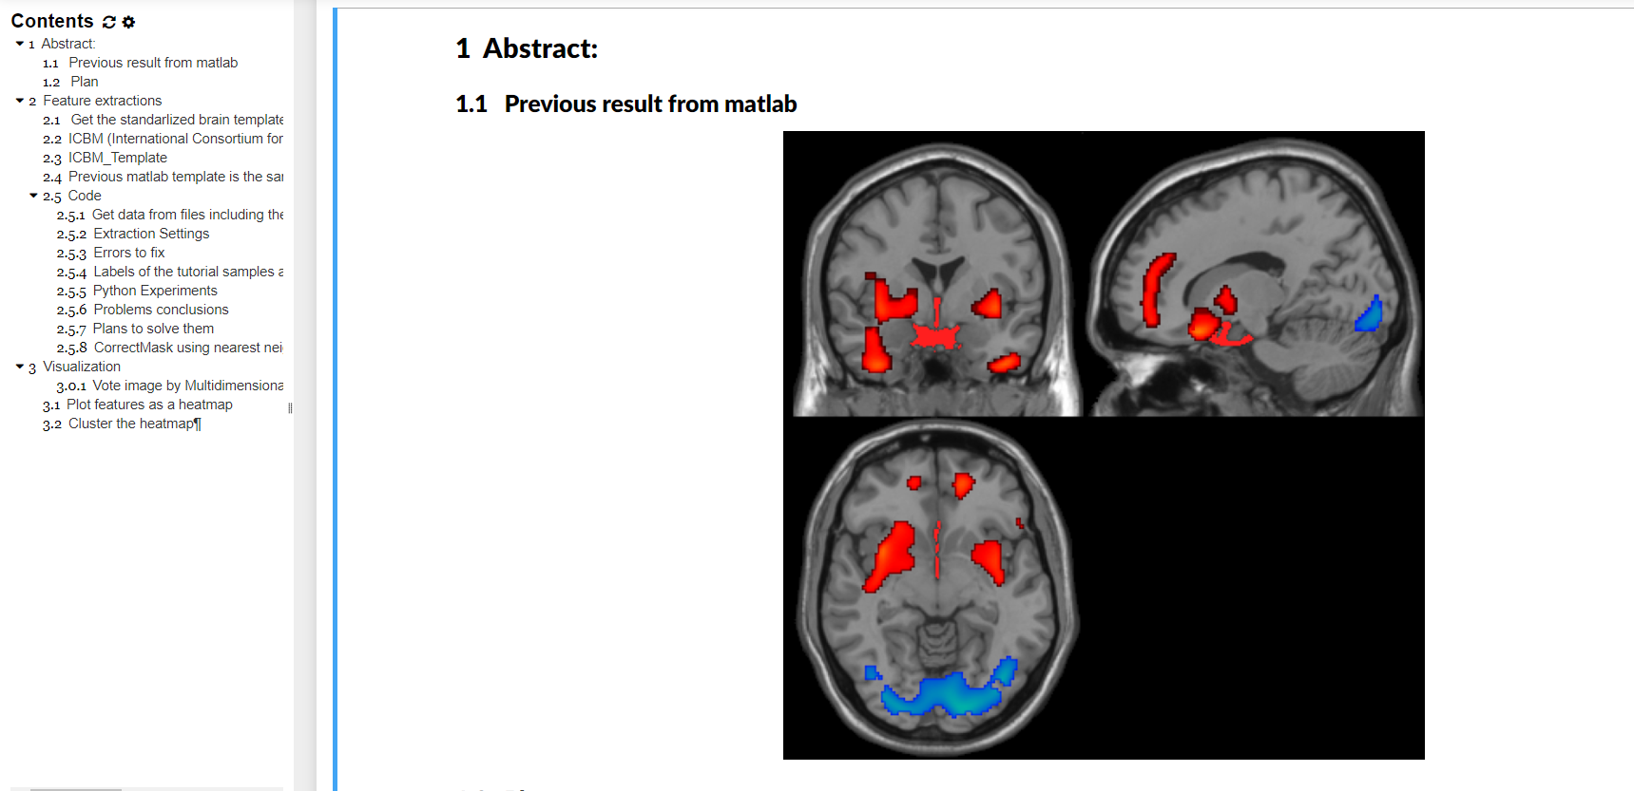
experiment

Slide 6
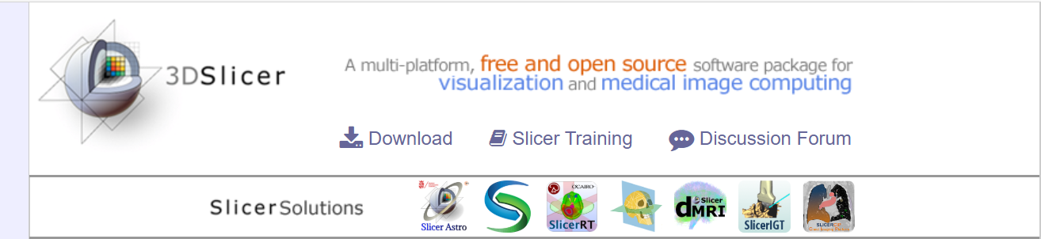
Open source

Slide 7
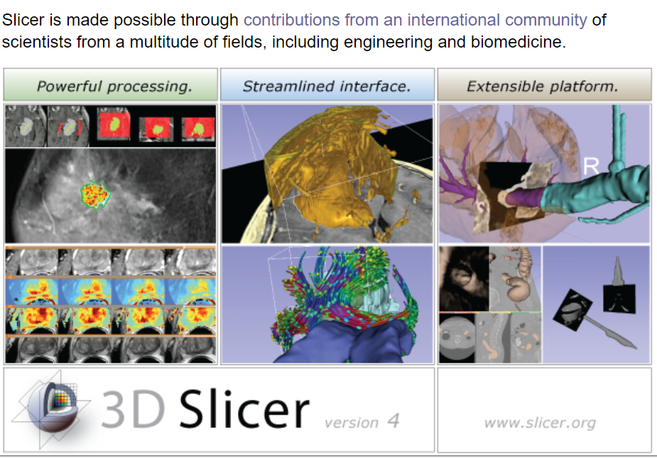

Slide 8
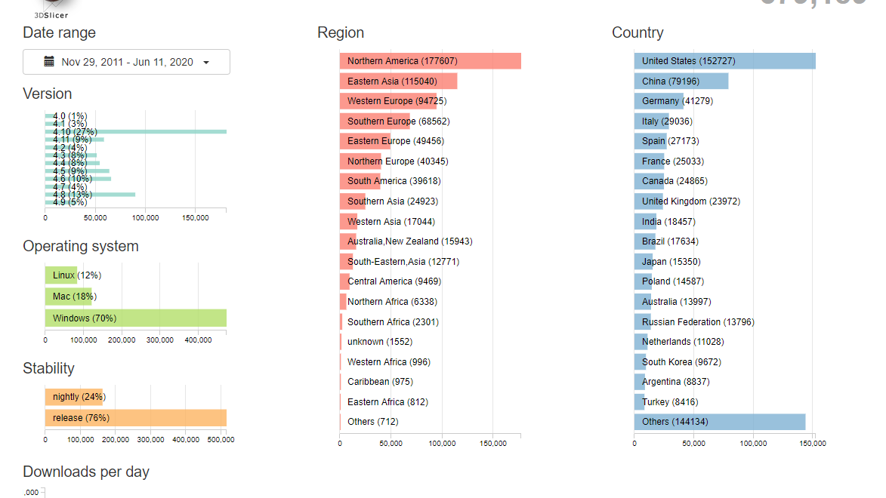

Slide 9
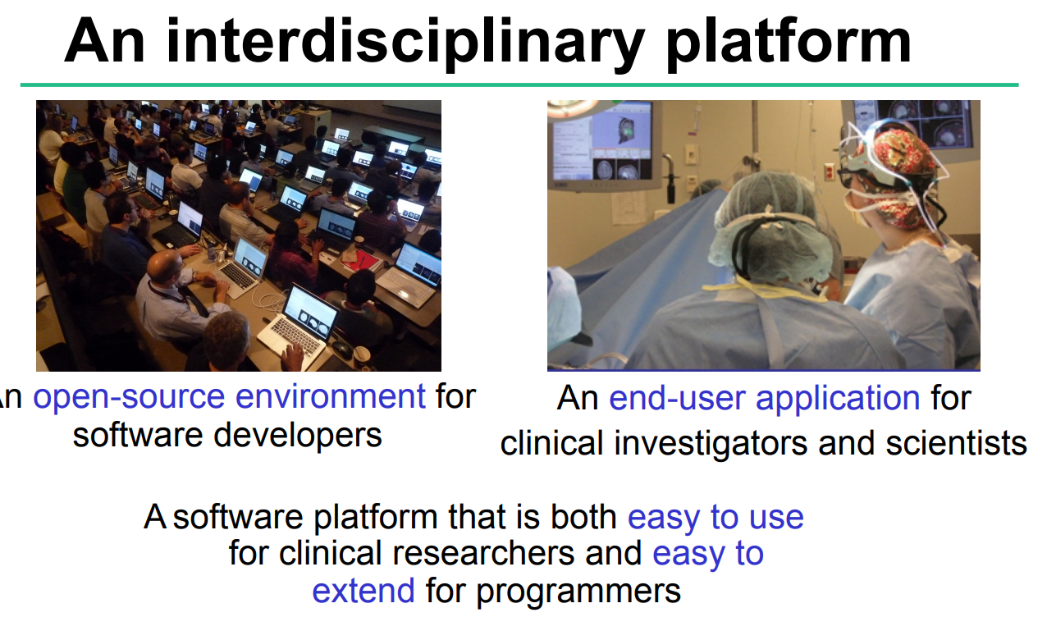

Slide 10
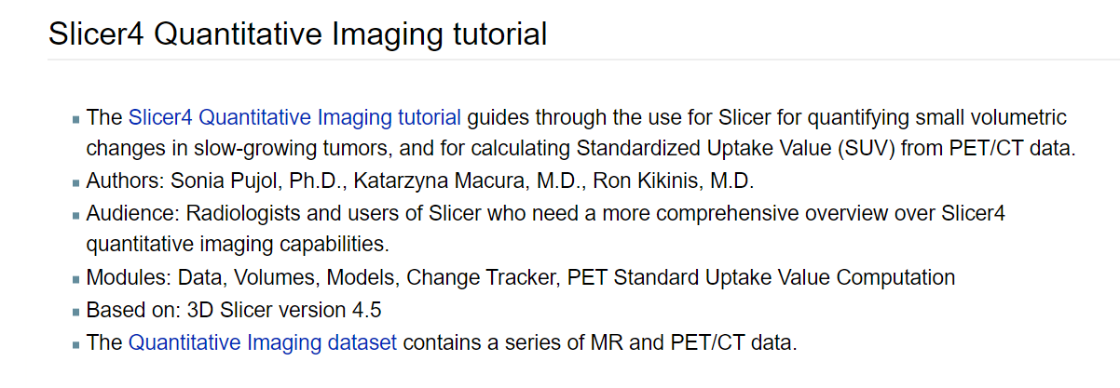

Slide 11
Our solution
Build a software based on 3D slicer to dig out more radiomics features from PET images
But we need some help from target customers
What problems are in urgent need to solve based on radiomics features from PET?
What features or functions do you want?
Other questions for us?

Slide 12

Thank you

