Slide 1
Kubernetes Knowledge Sharing and Learning
A part of DevOps knowledge sharing and learning courses

Slide 2
Definition of Scope
Inclusions
Exclusions
Aimed at providing readers “main features of Kubernetes used in real projects”.
K8s cluster setup (including RBAC authorization)
K8s utilities setup ( CLI, user interaction tools)

Slide 3
Kubernetes Overview
Benefits of Kubernetes
What is Kubernetes
Kubernetes Architecture
Primary Kubernetes Objects
Deployment
StatefulSet
CronJob
Network
Configuration data
Persistent Storage
Kubernetes User Interaction
K8s CLI
External tool

Slide 4
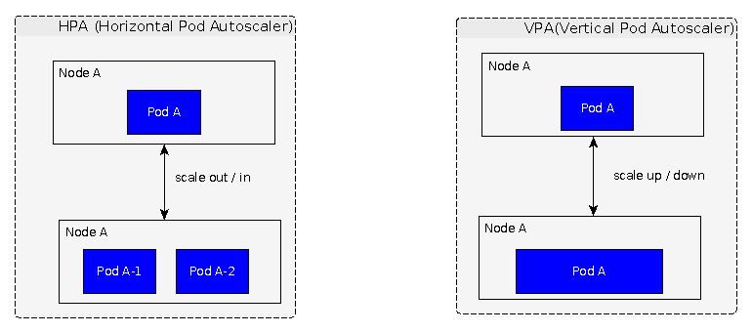
1- Kubernetes Overview Benefits of Kubernetes – High Availability
Docker
NOT able to manage auto-scaling itself
Kubernetes – auto scaling
Provide HPA, VPA, CA (not recommended)
<number>

Slide 5
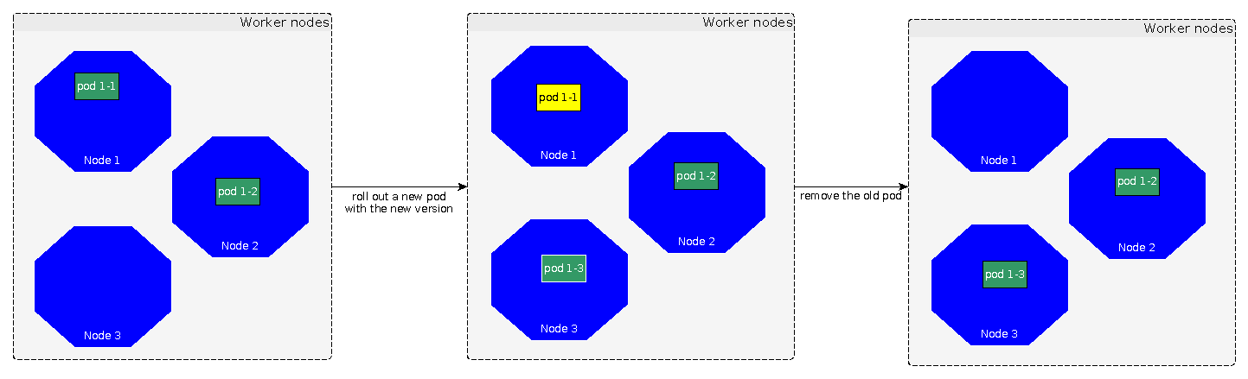
1- Kubernetes Overview Benefits of Kubernetes – High Availability
Docker
Introduce a downtime where there is an update
Kubernetes – zero downtime deployment
Deployment strategies: rolling update, blue / green, ...
<number>

Slide 6
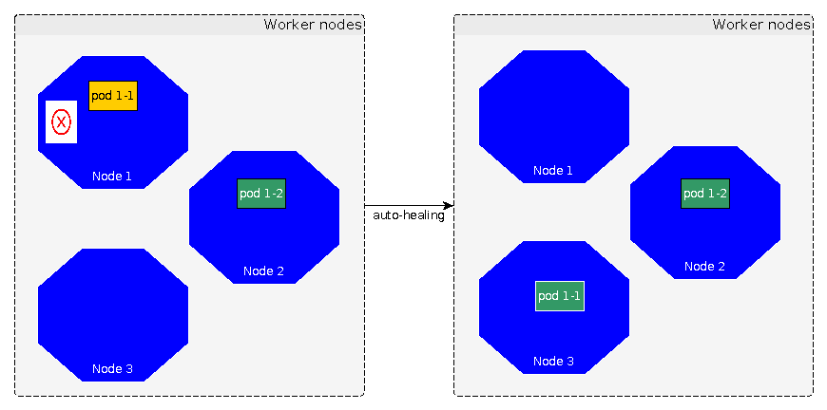
1- Kubernetes Overview Benefits of Kubernetes – High Availability
Docker
NOT able to get failed applications back
Kubernetes – auto healing capability
Probes: detect failure and recover applications
<number>

Slide 7
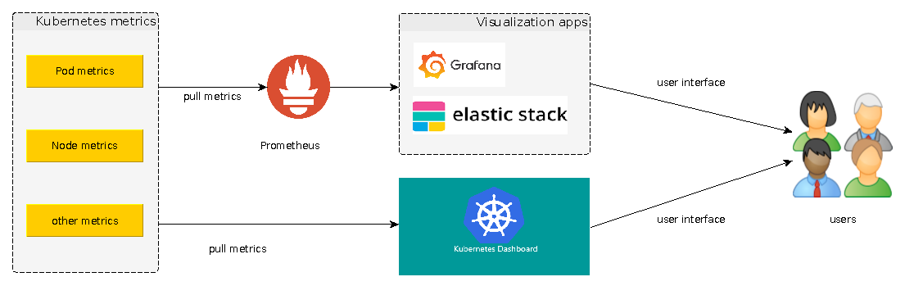
1- Kubernetes Overview Benefits of Kubernetes – Monitoring
Docker
Challenges of setting up monitoring tools
Kubernetes – Kubernetes APIs
Provide metrics and built in functions to integrate with 3rd tools
<number>

Slide 8
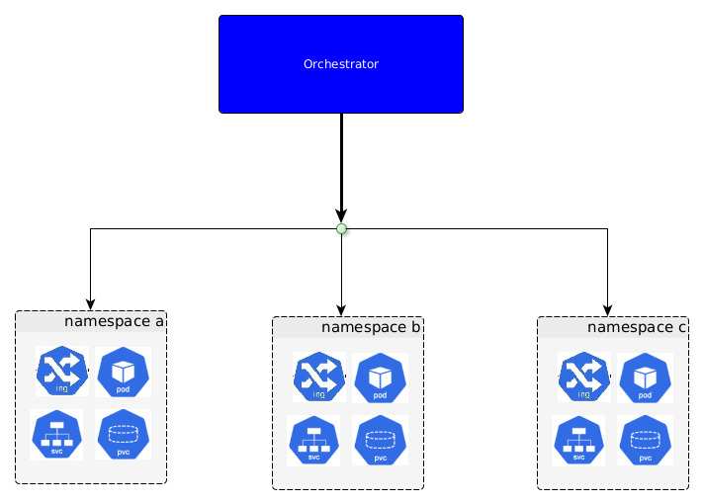
1- Kubernetes Overview What is Kubernetes
Found by Google
Open source
Container orchestrator
Automate manual processes (deployment, scaling, management of containerized applications
<number>

Slide 9
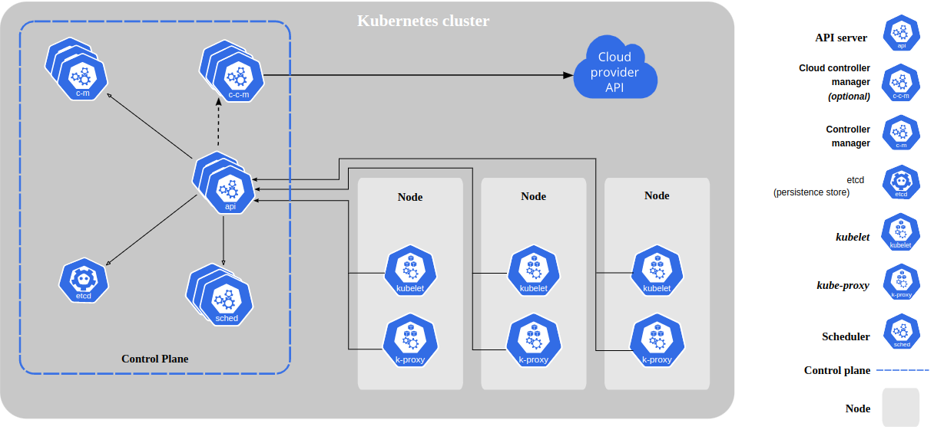
2 - Kubernetes Architecture
Control plane (master)
Nodes (worker)
<number>

Slide 10
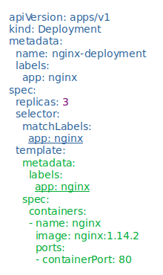
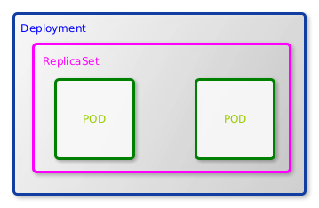
3 - Primary Kubernetes Objects Deployment
A declarative template for pods and replicaSet
Used for stateless application
<number>

Slide 11
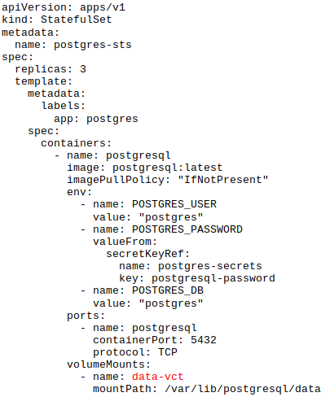
3 - Primary Kubernetes Objects StatefulSet
Similar to “deployment” but:
Used for stateful application
There are 3 sections that can be updated on the fly:
replicas
template
updateStrategy
Ordered pod creation/deletion
Pod can be accessed by it’s own service.
<number>

Slide 12
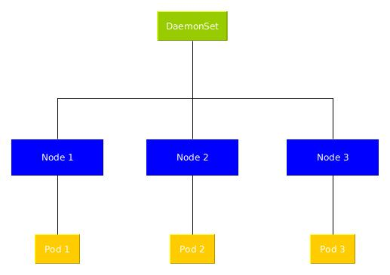
3 - Primary Kubernetes Objects DeamonSet
Similar to “deployment” but:
Every node has one pod (master & worker)
Each Pod lifetime depends on it’s node.
Use cases:
Install a monitoring agent per node
Install a log connector on each node.
<number>

Slide 13
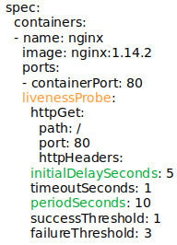
3 - Primary Kubernetes Objects Probes
Probes are health checks that can monitor a container's status and act on it.
- StartupProbes: Indicate when the pod is started.
- ReadinessProbes: indicate when to start serving
- LivenessProbes: indicate when to restart the pod
<number>

Slide 14
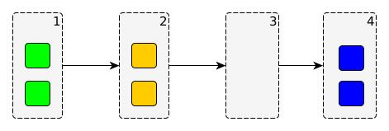
3 - Primary Kubernetes Objects Deployment Strategies - Recreate
Terminate all current pods, create new ones
Use case:
Not able to have 2 different versions of app at installed the same time (big update)
Cons:
Introduce a downtime period.
Pros:
Quick update
<number>

Slide 15
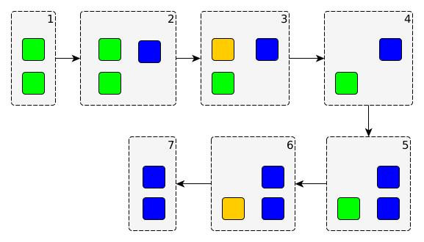
3 - Primary Kubernetes Objects Deployment Strategies - RollingUpdate
Create a few of new pods, then terminate old ones correspondingly
Use case:
There is no conflict between old and new versions
Cons:
There is a period when the old and new application versions serve users at the same time
Pros:
No downtime
<number>

Slide 16
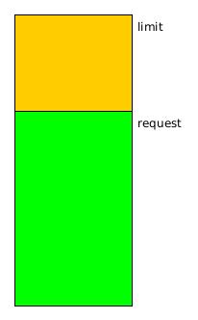
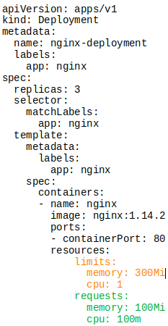
3 - Primary Kubernetes Objects Resource Request & Limit
There are 2 main types of resources: CPU & memory
Request: Ensure the minimum amount of resources required for the container
Limit: Is the maximum amount of resources that Kubernetes will allow the container to use
<number>

Slide 17
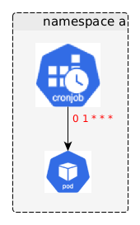
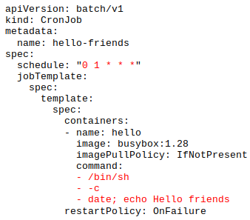
3 - Primary Kubernetes Objects Cronjob
Automatic action triggered in every scheduled time
<number>

Slide 18
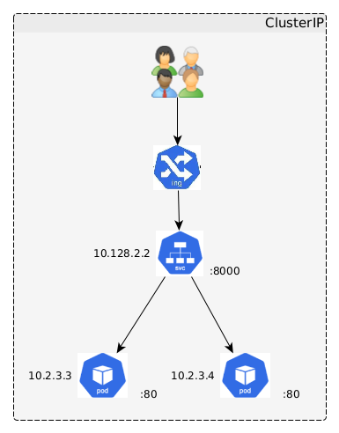
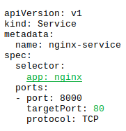
3 - Primary Kubernetes Objects Network - Service
A logical collection of pods
Roles:
Enable network access to pods
Load balancing
Types:
ClusterIP: provide internal access inside cluster only
NodePort:
Provide an unique fixed cluster node port for external access
Not recommended due to security (expose access to cluster)
LoadBalacer: Integrate with cloud providers for external access
<number>

Slide 19
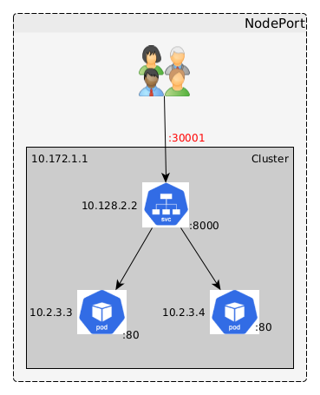
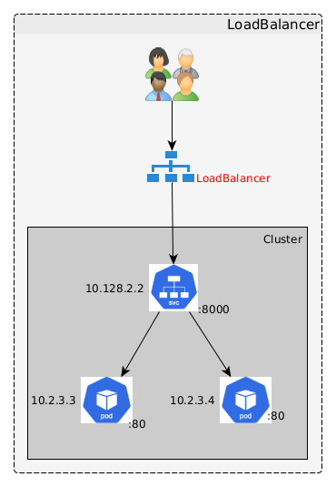
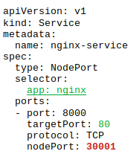
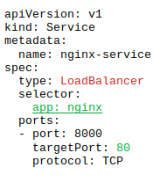
3 - Primary Kubernetes Objects Network - Service
<number>

Slide 20
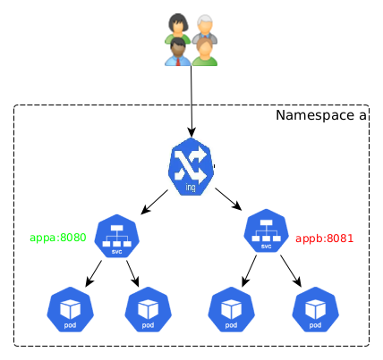
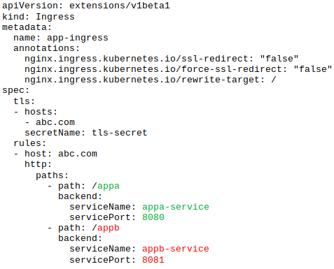
3 - Primary Kubernetes Objects Network - Ingress
Provide access to application by providing readable human URL with http/https protocols and routing rules.
<number>

Slide 21
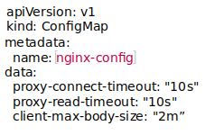
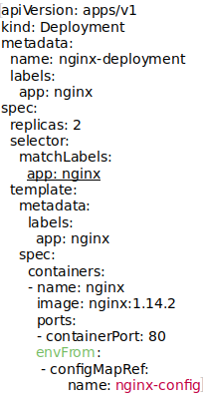
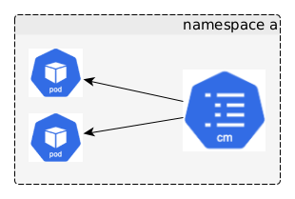
3 - Primary Kubernetes Objects Configuration data - ConfigMap
Key-value pairs of data
Manage pods configuration data
Environment variables
Configuration files
Used for non-sensitive data (plain text)
<number>

Slide 22
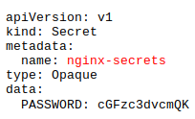
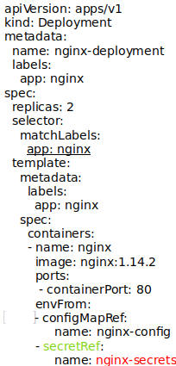
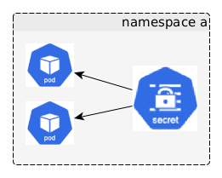
3 - Primary Kubernetes Objects Configuration data - Secret
Key-value pairs of data
Manage pods configuration data
Environment variables
Secret files
Used for sensitive data (base64–encoded)
<number>

Slide 23
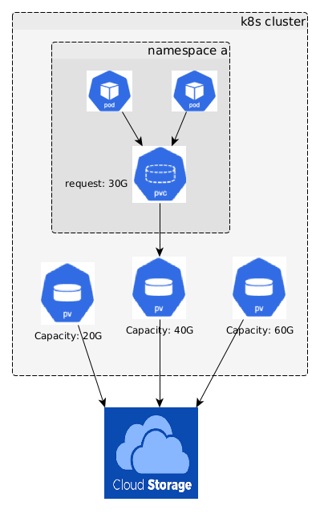
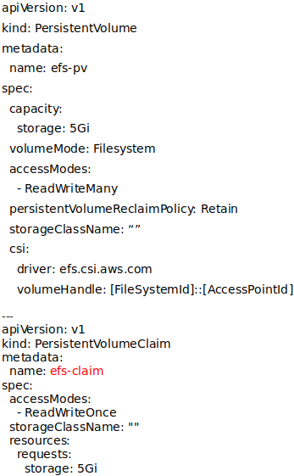
3 - Primary Kubernetes Objects Persistent Storage – Persistent Volume, Persistent Volume Claim
Persistent volume:
Static storage allocated in a cluster
Independent from pod’s lifecycle
Provisioned by cluster admin
Persistent volume claim:
Dynamic storage request
Depending on pod’s lifecycle
Asked by pods
<number>

Slide 24
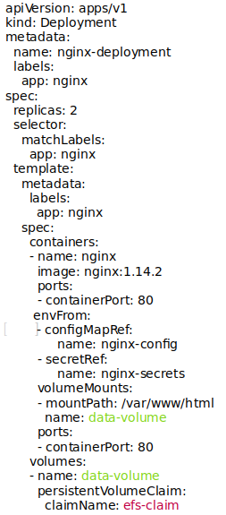
3 - Primary Kubernetes Objects Persistent Storage – Persistent Volume, Persistent Volume Claim
<number>

Slide 25
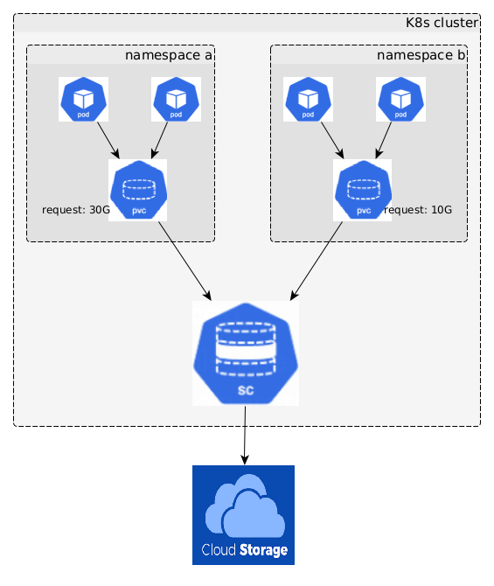
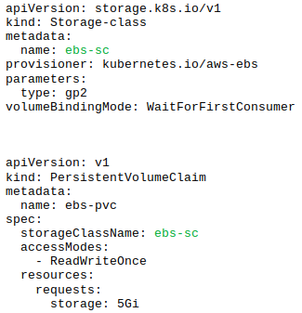
3 - Primary Kubernetes Objects Persistent Storage – Storage Class
Similar to PV, but providing a way to dynamically provision PV in a cluster
<number>

Slide 26
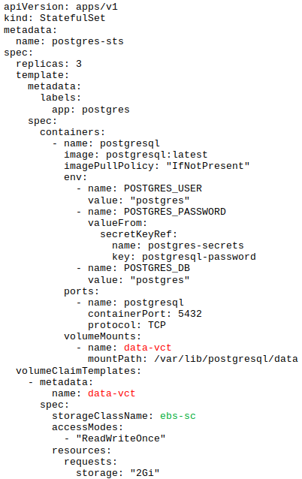
3 - Primary Kubernetes Objects Persistent Storage – Volume Claim Templates
Similar to PVC but:
Used for stateful app (DB)
Each pod can have it’s own allocated pvc
<number>

Slide 27
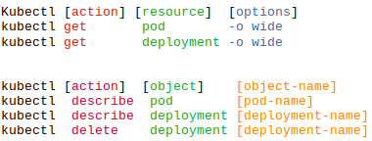
4 - Kubernetes User Interaction Command line - kubectl
Command line tool
Communicate with K8s resources
<number>

Slide 28
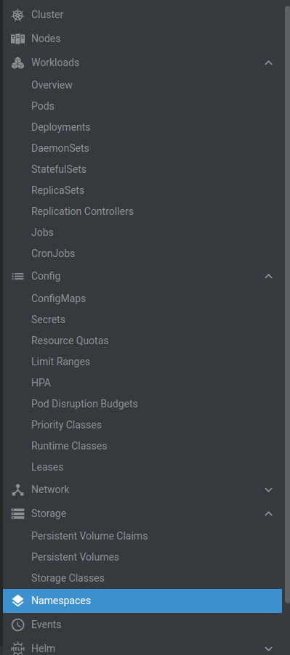
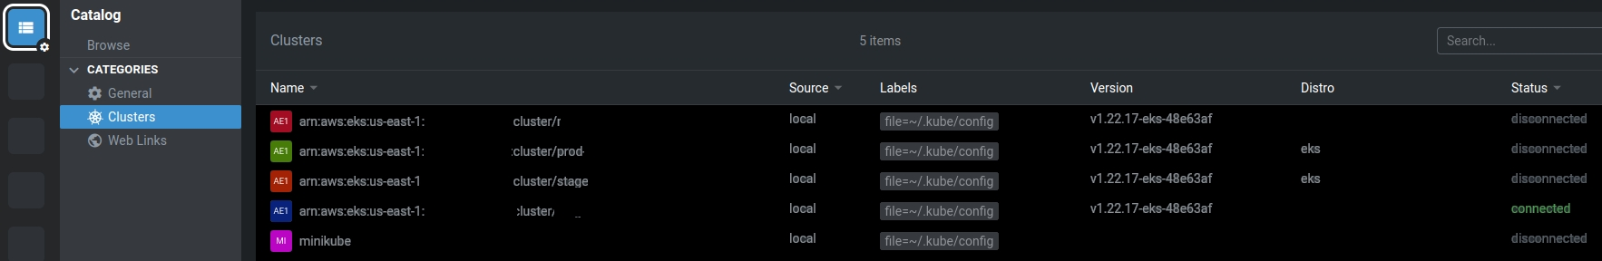
4 - Kubernetes User Interaction User interface - Lens
User interface tool
Communicate with K8s resources
<number>

Slide 29

Question and Answer
<number>

