Slide 1
Kubernetes Knowledge Sharing and Learning
A part of DevOps knowledge sharing and learning courses
Compiled and presented by Nguyen Canh Hat

Slide 2
Definition of Scope
Inclusions
Exclusions
Aimed at providing readers with some “main objects of Kubernetes used in real projects”
K8s cluster setup
K8s utilities setup ( CLI, user interaction tools)

Slide 3
Kubernetes Overview
Benefits of Kubernetes
What is Kubernetes?
Kubernetes Architecture
Primary Kubernetes Objects
Deployment, StatefulSet, DaemonSet
Probes, Deployment Strategies
Resource Request and Limit
CronJob
Network
Configuration data
Persistent Storage
Kubernetes User Interaction
K8s CLI
External tool

Slide 4
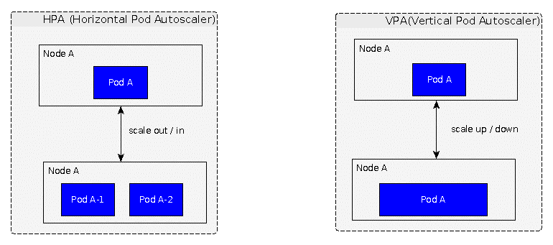
1- Kubernetes Overview Benefits of Kubernetes – High Availability
Docker
NOT able to manage auto-scaling itself
Kubernetes – auto scaling
Provide HPA, VPA, CA (not recommended)
<number>

Slide 5
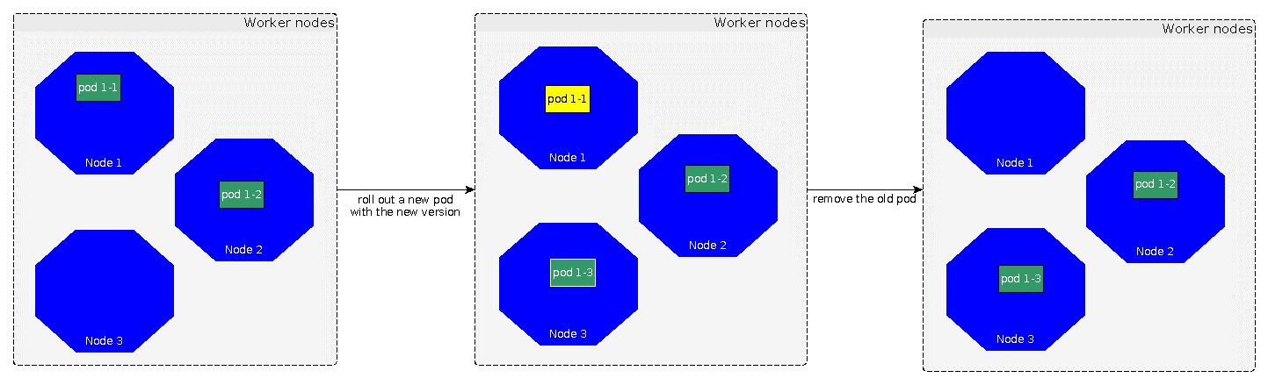
1- Kubernetes Overview Benefits of Kubernetes – High Availability
Docker
Introduce a downtime where there is an update
Kubernetes – zero downtime deployment
Deployment strategies: rolling update, recreate
<number>

Slide 6
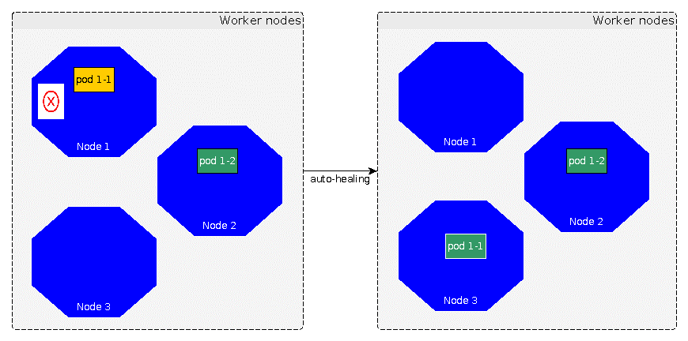
1- Kubernetes Overview Benefits of Kubernetes – High Availability
Docker
NOT able to get failed applications back
Kubernetes – auto healing capability
Probes: detect failure and recover applications
<number>

Slide 7
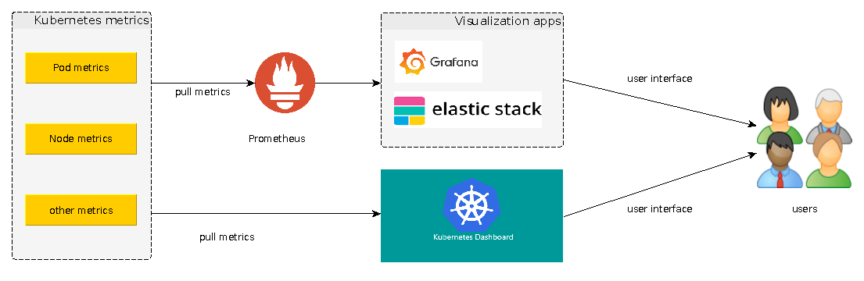
1- Kubernetes Overview Benefits of Kubernetes – Monitoring
Docker
Challenges of setting up monitoring tools
Kubernetes – Kubernetes APIs
Provide metrics and built in functions to integrate with 3rd tools
<number>

Slide 8
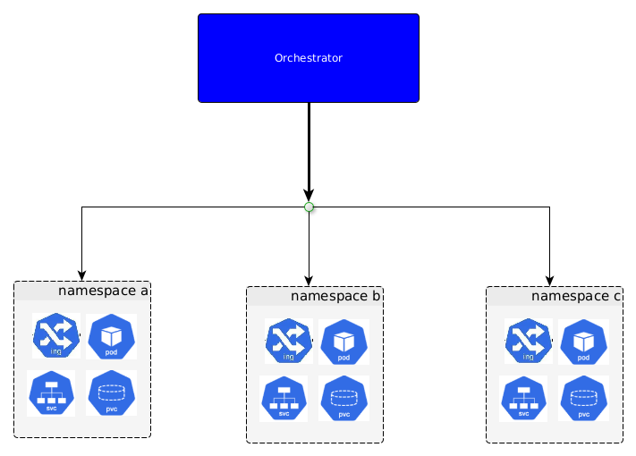
1- Kubernetes Overview What is Kubernetes?
Found by Google
Open source
Container orchestrator
Automate manual processes (deployment, scaling, management of containerized applications
<number>

Slide 9
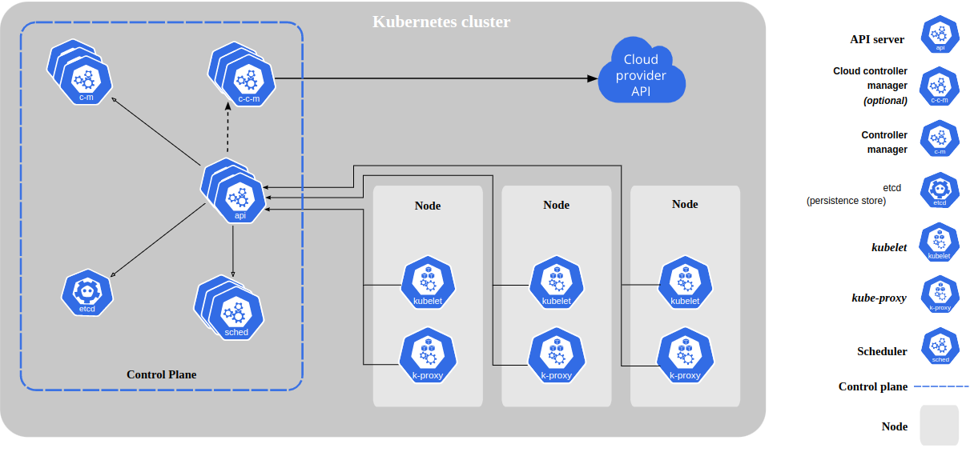
2 - Kubernetes Architecture
Control plane (master)
Nodes (worker)
<number>

Slide 10
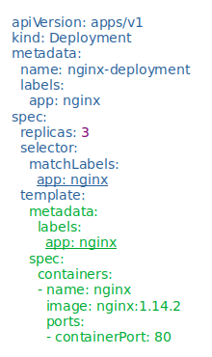
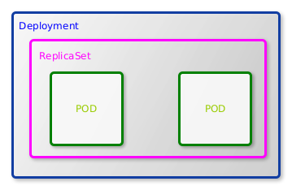
3 - Primary Kubernetes Objects Deployment
A declarative template for pods and replicaSet
Used for stateless application
<number>

Slide 11
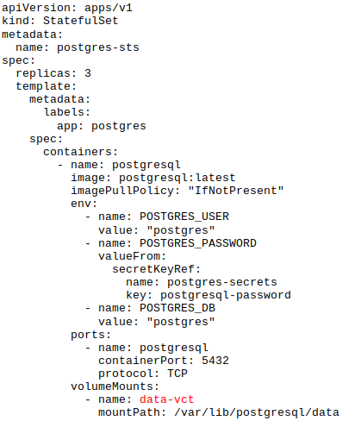
3 - Primary Kubernetes Objects StatefulSet
Similar to “deployment” but:
Used for stateful application
There are 3 sections that can be updated on the fly:
replicas
template
updateStrategy
Ordered pod creation/deletion
Pod can be accessed by its own service
<number>

Slide 12
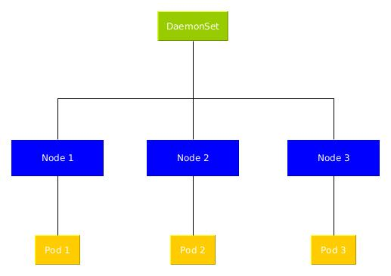
3 - Primary Kubernetes Objects DeamonSet
Similar to “deployment” but:
Every node has one pod (master & worker)
Each Pod lifetime depends on its node
Use cases:
Install a monitoring agent per node
Install a log connector on each node
<number>

Slide 13
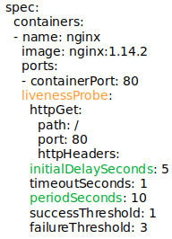
3 - Primary Kubernetes Objects Probes
Probes are health checks that can monitor a container's status and act on it.
- StartupProbes: Indicate when the pod is started.
- ReadinessProbes: indicate when to start serving
- LivenessProbes: indicate when to restart the pod
<number>

Slide 14
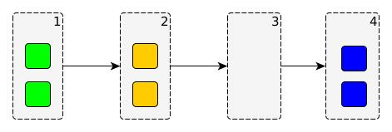
3 - Primary Kubernetes Objects Deployment Strategies - Recreate
Terminate all current pods, create new ones
Use case:
Not able to have 2 different versions of app at installed the same time (big update)
Cons:
Introduce a downtime period.
Pros:
Quick update
<number>

Slide 15
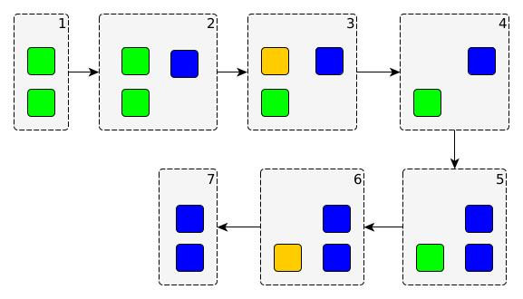
3 - Primary Kubernetes Objects Deployment Strategies - RollingUpdate
Create a few of new pods, then terminate old ones correspondingly
Use case:
There is no conflict between old and new versions
Cons:
There is a period when the old and new application versions serve users at the same time
Pros:
No downtime
<number>

Slide 16
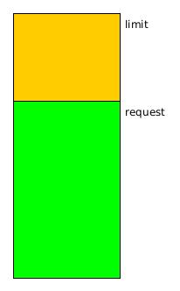
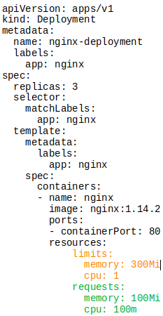
3 - Primary Kubernetes Objects Resource Request & Limit
There are 2 main types of resources: CPU & memory
Request: Ensure the minimum number of resources required for the container
Limit: Is the maximum number of resources that Kubernetes will allow the container to use
<number>

Slide 17
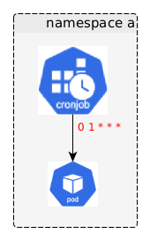
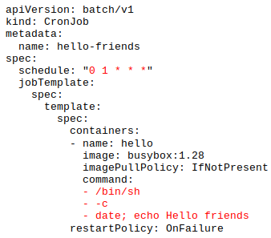
3 - Primary Kubernetes Objects Cronjob
Automatic action triggered in every scheduled time
<number>

Slide 18
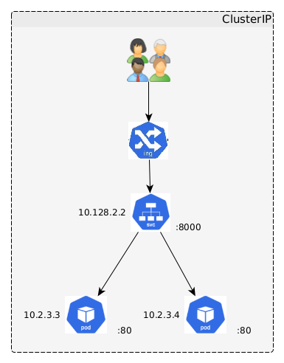
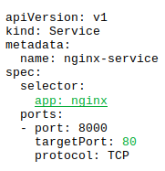
3 - Primary Kubernetes Objects Network - Service
A logical collection of pods
Roles:
Enable network access to pods
Load balancing
Types:
ClusterIP: provide internal access inside cluster only
NodePort:
Provide a unique fixed cluster node port for external access
Not recommended due to security (expose access to cluster)
LoadBalacer: Integrate with cloud providers for external access
<number>

Slide 19
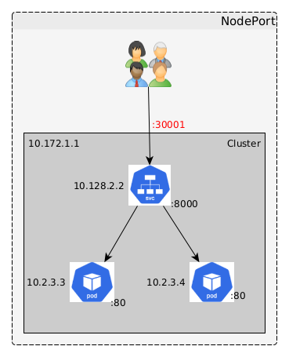
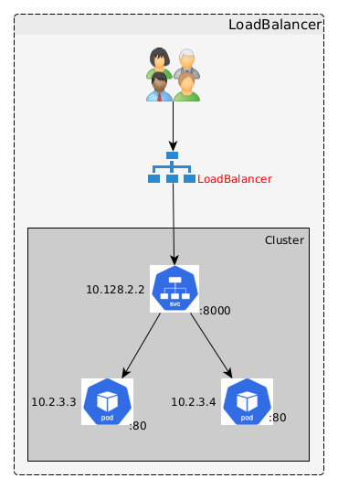
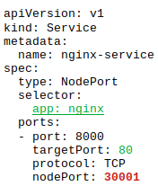
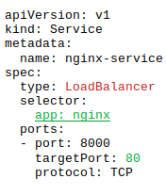
3 - Primary Kubernetes Objects Network - Service
<number>

Slide 20
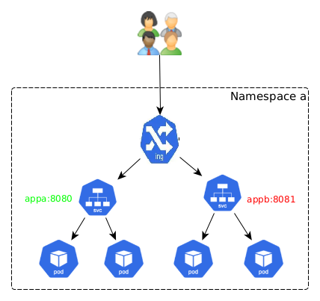
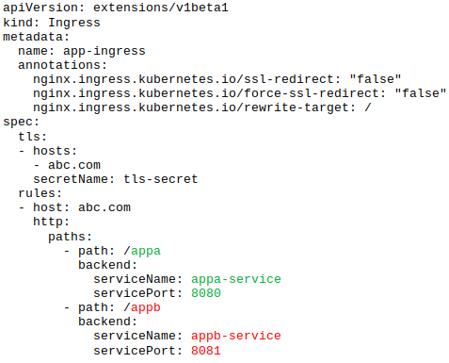
3 - Primary Kubernetes Objects Network - Ingress
Provide access to application by providing readable human URL with http/https protocols and routing rules.
<number>

Slide 21
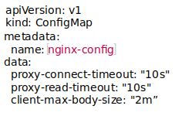
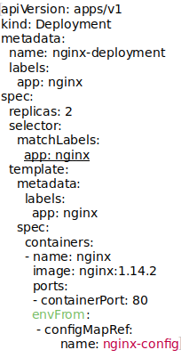
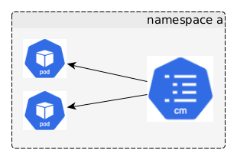
3 - Primary Kubernetes Objects Configuration data - ConfigMap
Key-value pairs of data
Manage pods configuration data
Environment variables
Configuration files
Used for non-sensitive data (plain text)
<number>

Slide 22
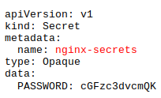
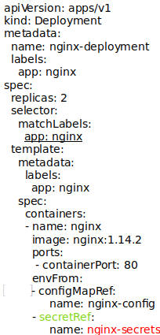
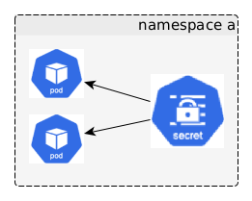
3 - Primary Kubernetes Objects Configuration data - Secret
Key-value pairs of data
Manage pods configuration data
Environment variables
Secret files
Used for sensitive data (base64–encoded)
<number>

Slide 23
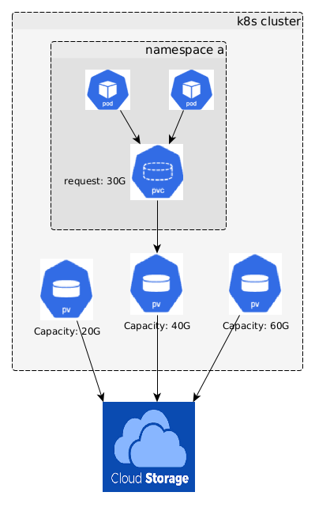
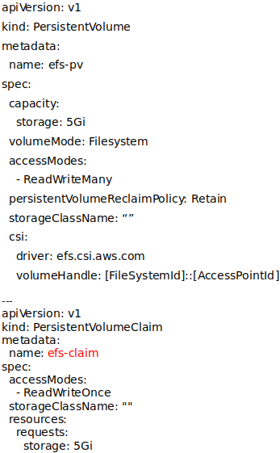
3 - Primary Kubernetes Objects Persistent Storage – Persistent Volume, Persistent Volume Claim
Persistent volume:
Static storage allocated in a cluster
Independent from pod’s lifecycle
Provisioned by cluster admin
Persistent volume claim:
Dynamic storage request
Depending on pod’s lifecycle
Asked by pods
<number>

Slide 24
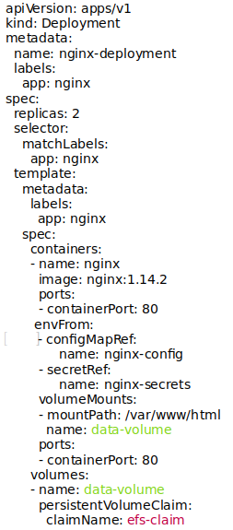
3 - Primary Kubernetes Objects Persistent Storage – Persistent Volume, Persistent Volume Claim
<number>

Slide 25
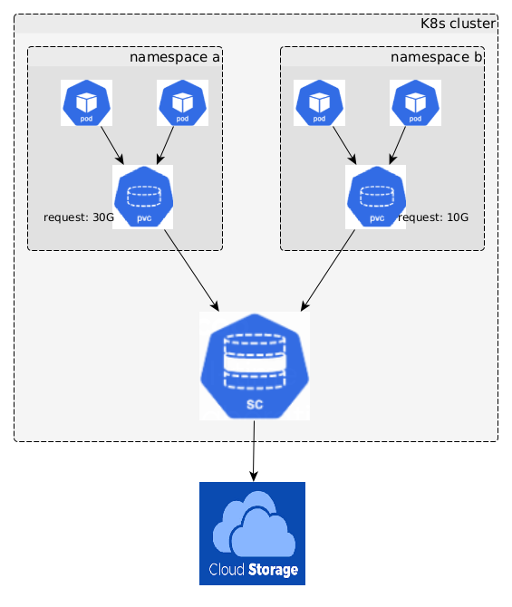
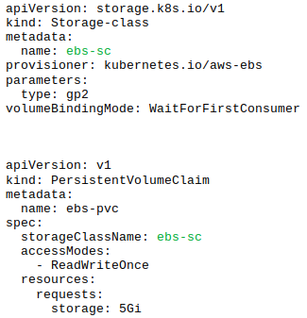
3 - Primary Kubernetes Objects Persistent Storage – Storage Class
Similar to PV, but providing a way to dynamically provision PV in a cluster
<number>

Slide 26
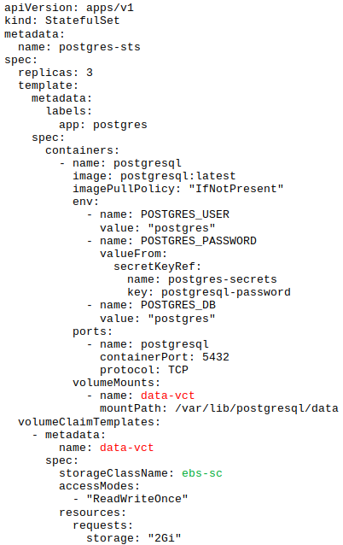
3 - Primary Kubernetes Objects Persistent Storage – Volume Claim Templates
Similar to PVC but:
Used for stateful app (DB)
Each pod can have its own allocated PVC
<number>

Slide 27
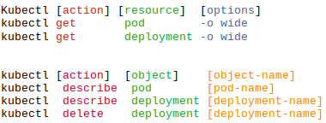
4 - Kubernetes User Interaction Command line - kubectl
Communicate with K8s resource
Command line tool (refer to “install kubectl” for the installation”
<number>

Slide 28
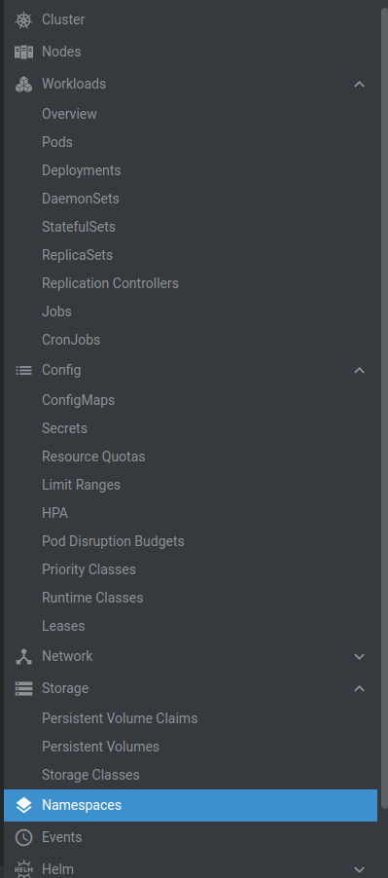
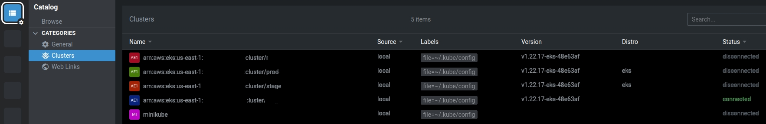
4 - Kubernetes User Interaction User interface - Lens
Communicate with K8s resource
User interface tool (refer to “install lens” for the installation)
<number>

Slide 29

Questions and Answers
<number>

