Slide 1
Project Proposal
Valerio Longo, Alessio Papi

Slide 2
Data Sources
Notes:
Raccolto dati - Public dataset collections - Kaggle, Metacritic, CORGIS, VGChartz

Slide 3
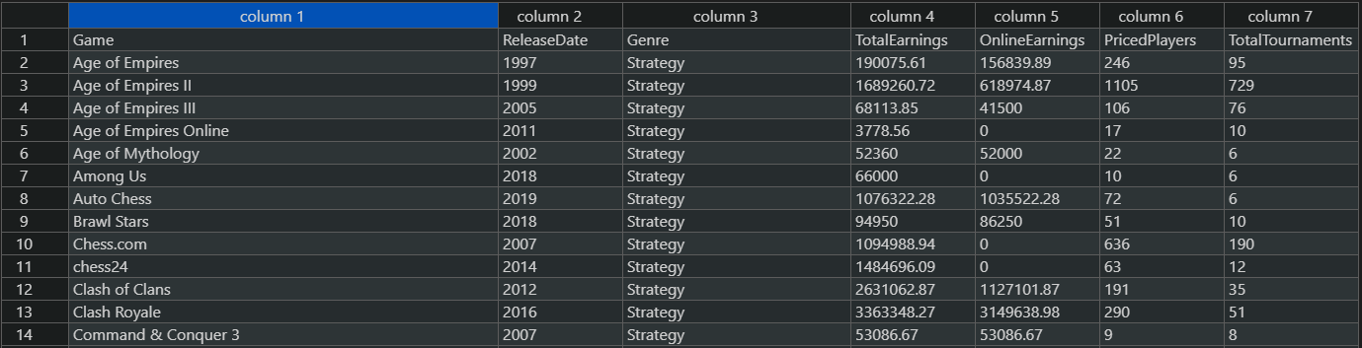
Kaggle
The following datasets were taken from Kaggle:
GeneralEsportData (csv)
Provides general information about games and related earnings and tournaments.
Game | ReleaseDate | Genre | TotalEarnings | OnlineEarnings | PricedPlayers | TotalTournaments

Slide 4
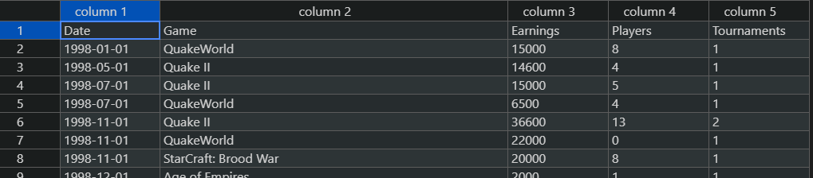
Kaggle
The following datasets were taken from Kaggle:
HistoricalEsportData (csv)
Provides general information about games form an historical perspective. (Tuples are sorted by Date).
Date | Game | Earnings | Players | Tournaments

Slide 5
Metacritic
Metacritic is a website that aggregates reviews and averaged scores for films, TV shows, music albums, video games and formerly, books.
metacritic (json)
This dataset stresses out the averaged user score and the metacritic score for each game of the dataset.
id | title | us | ms | platform | release
datagenreX (json)
id | genre
Moreover, in order to retrieve the genres of videogames, metacritic offered 16 different json files (based on 16 different genres)
datagenreX (json)
Note: the table representation is a normalized abstraction of the json dataset.

Slide 6
Metacritic
{
"1.":{
"title":"The Legend of Zelda: Ocarina of Time",
"us":"9.1",
"ms":"99",
"platform":"Nintendo 64",
"release":"November 23, 1998"
},
"2.":{
"title":"Tony Hawk's Pro Skater 2",
"us":"7.4",
"ms":"98",
"platform":"PlayStation",
"release":"September 20, 2000"
},
"3.":{
"title":"Grand Theft Auto IV",
"us":"7.7",
"ms":"98",
"platform":"PlayStation 3",
"release":"April 29, 2008"
},
"4.":{
"title":"SoulCalibur",
"us":"8.5",
"ms":"98",
"platform":"Dreamcast",
"release":"September 8, 1999"
},
"5.":{
"title":"Grand Theft Auto IV",
"us":"7.9",
"ms":"98",
"platform":"Xbox 360",
"release":"April 29, 2008"

Slide 7
Metacritic - genres
{
"0":{
"title":"Gran Turismo",
"genre":"racing"
},
"1":{
"title":"Gran Turismo 3: A-Spec",
"genre":"racing"
},
"2":{
"title":"Need for Speed Shift",
"genre":"racing"
},
"3":{
"title":"Jet Car Stunts",
"genre":"racing"
},
"4":{
"title":"Burnout 3: Takedown",
"genre":"racing"
},
"5":{
"title":"Real Racing 2",
"genre":"racing"
}
}

Slide 8
CORGIS
CORGIS is a “collection of Real-time, Giant, Interesting, Situated Datasets”.
sales_playtime_video_games (csv)
This dataset holds very specialized Metadata about each videogame.
title | ... | genre | ... | Publishers | score | price | console | year | Metadata

Slide 9
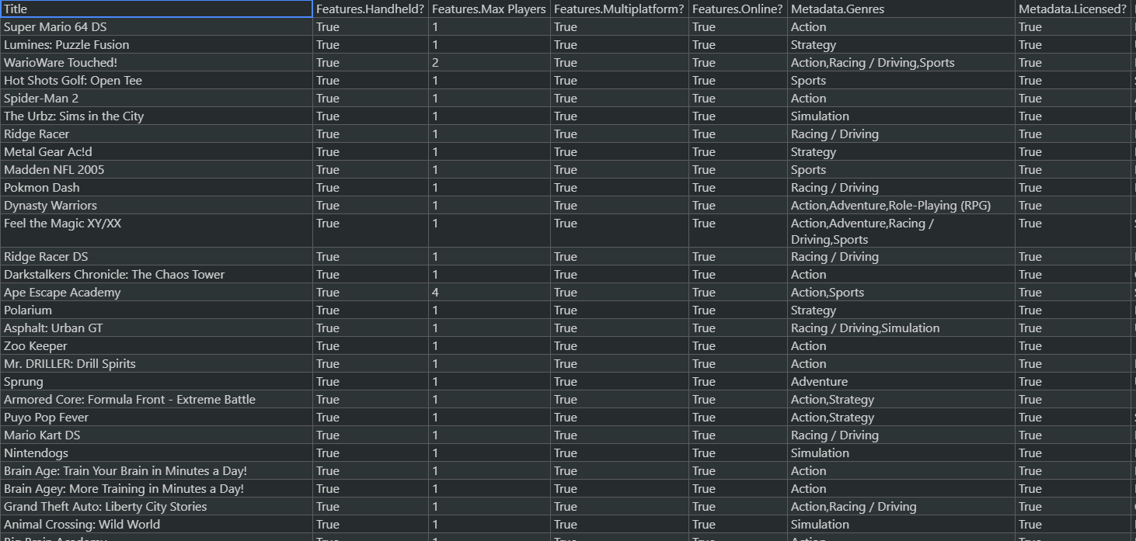
CORGIS

Slide 10
VGCHARTZ
VGChartz delivers comprehensive game chart coverage, including sales data, news, reviews, & game database for PS4, PS5, Xbox One, Series X, Nintendo…
vgsales-2021-04-09_16_51_31 (csv)
Sales-related information about videogames.
sales-by-console Collection of 27 csv files, holding vgsales information specific to every console supported by VGChartz.
id | game | console | publisher | developer | ..scores.. | total_shipped | ..sales.. | releaseDate

Slide 11
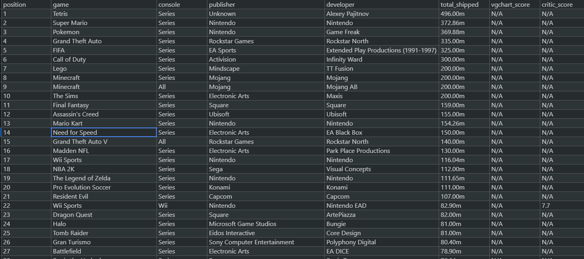
VGCHARTZ

Slide 12
Gamedev
Gamedev (csv)
Contains geographic-related information about videogame developing and publishing companies.
This dataset will be a crucial utility in the design of geographic and market related tasks.
Token from https://www.gamedevmap.com/
X coord | Y coord | name | type | City | Country | website

Slide 13
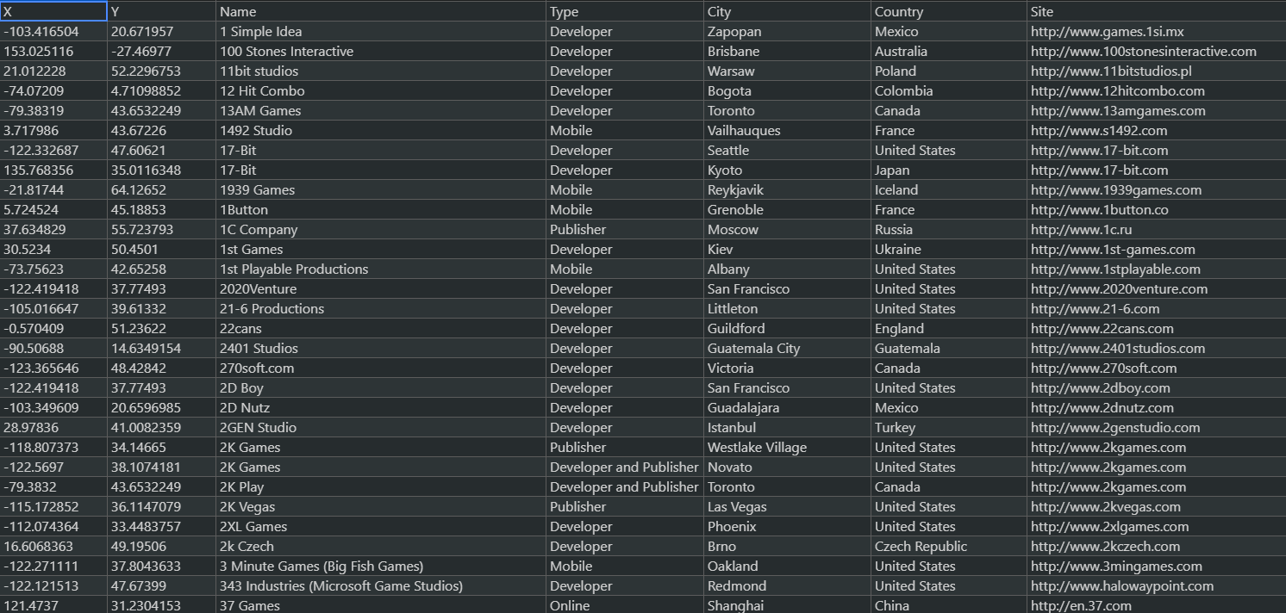
Gamedev

Slide 14
Global Schema

Slide 15
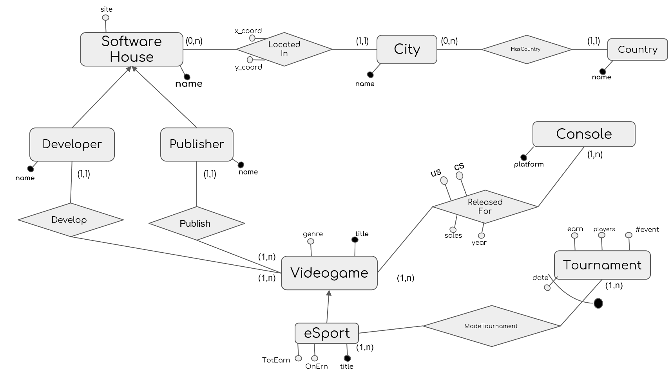

Slide 16
SoftwareHouse(name,site)
City(name)
LocatedIn(softwarehouse, city, x_coord, y_coord)
LocatedIn(softwarehouse) → SoftwareHouse(name)
LocatedIn(city) → City(name)
Country (name)
HasCountry(city, country)
HasCountry(country) → Country(name)
HasCountry(city) → City(name)
Videogame(title, genre)
Console(platform)
ReleasedFor(game, console,us,cs,sales,year)
ReleasedFor(game) → Videogame(title)
ReleasedFor(console) → Console(platform)
Relational Schema
Developer(name)
Developer(name) → SoftwareHouse(name)
Publisher(name)
Publisher(name) → SoftwareHouse(name)
Publish(publisher,game)
Publish(publisher) → Publisher(name)
Publish(game) → Videogame(title)
Develop(developer,game)
Develop(developer) → Developer(name)
Develop(game) → Videogame(title)
eSport(title,TotalEarnings,OnlineEarnings)
eSport(title) → Videogame(title)
Tournament(date,game,earnings,#pricedplayers,#event)
Tournament(game) → eSport(title)

Slide 17
(Tentative) Tasks

Slide 18
Tasks
We think it would be interesting investigating about the following queries:
Which nation (or city or publisher) has…
Produced more games?
Earned the most in tournaments?
Earned the most in sales?
Been producing the longest?
Which console has…
Seen more developed (or remunerative) games?
Which were the most remunerative years for videogaming business?

Slide 19
FOL Mappings

Slide 20
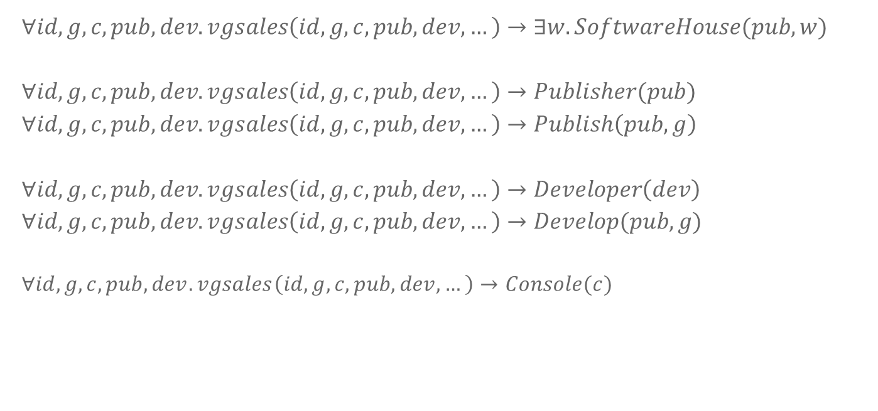
VGCHARTZ
vgsales(id, game, console, publisher, developer, sales, year )
$$∀id,g,c,pub,dev.vgsales\left(id,g,c,pub,dev,…\right)→∃w.SoftwareHouse(pub,w)$$
$$∀id,g,c,pub,dev.vgsales\left(id,g,c,pub,dev,…\right)→Publisher(pub)$$
$$∀id,g,c,pub,dev.vgsales\left(id,g,c,pub,dev,…\right)→Publish\left(pub, g\right)$$
$$∀id,g,c,pub,dev.vgsales\left(id,g,c,pub,dev,…\right)→Developer\left(dev\right)$$
$$∀id,g,c,pub,dev.vgsales\left(id,g,c,pub,dev,…\right)→Develop(pub,g)$$
$$∀id,g,c,pub,dev.vgsales\left(id,g,c,pub,dev,…\right)→Console(c)$$

Slide 21

VIDEOGAME
$$∀id,g,c,pub,dev.vgsales\left(id,g,c,pub,dev,…\right)→∃ge.Videogame\left(g,ge\right)$$
$∀id,g,c,pub,dev.vgsales\left(id,g,c,pub,dev,…\right)\text{∧}$ $\text{ㄱ}$ $\left(∃ge.datagenreX\left(g,ge\right)\right)$ $\text{∧}$
$\text{ㄱ} \left(∃r,te,ge,oe,pp,tt.generalED\left(g, r,te,ge,oe,pp,tt\right)\right)\text{∧}$ $\text{ㄱ}(∃ge,p.spvg\left(g,ge,…,p,…\right))→$
$$→Videogame\left(g,"NULL"\right)$$

Slide 22
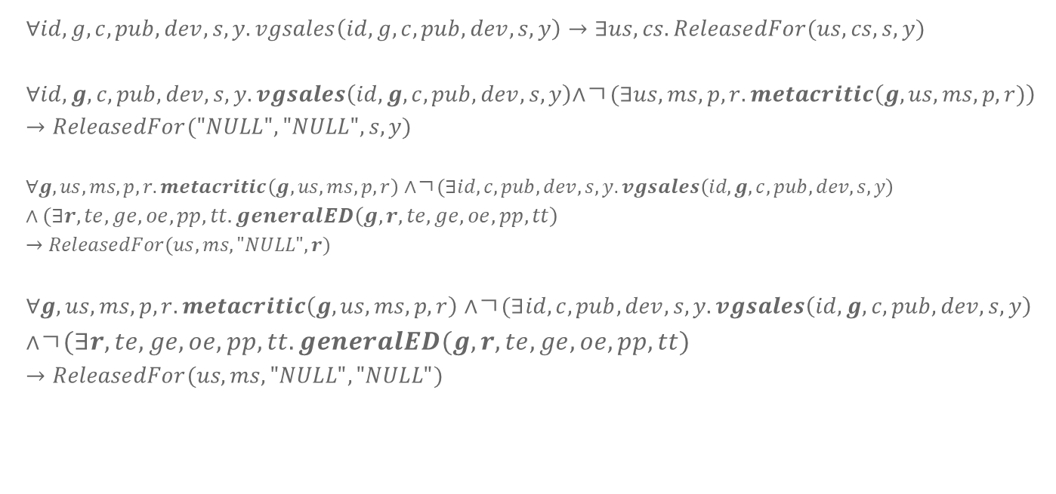
RELEASED FOR
$$∀id,g,c,pub,dev,s,y.vgsales\left(id,g,c,pub,dev,s,y\right)→∃us,cs.ReleasedFor(us,cs,s,y)$$
$$∀id,g,c,pub,dev,s,y.vgsales\left(id,g,c,pub,dev,s,y\right)\text{∧}\text{ㄱ}(∃us,ms,p,r.metacritic\left(g,us,ms,p,r)\right)$$
$$→ReleasedFor("NULL","NULL",s,y)$$
$∀g,us,ms,p,r.metacritic\left(g,us,ms,p,r\right)$ $\text{∧}\text{ㄱ}(∃id,c,pub,dev,s,y.vgsales\left(id,g,c,pub,dev,s,y\right)$ $\text{∧} (∃r,te,ge,oe,pp,tt.generalED\left(g, r,te,ge,oe,pp,tt\right)$
$$→ReleasedFor(us,ms,"NULL",r)$$
$∀g,us,ms,p,r.metacritic\left(g,us,ms,p,r\right)$ $\text{∧}\text{ㄱ}(∃id,c,pub,dev,s,y.vgsales\left(id,g,c,pub,dev,s,y\right)$ $\text{∧}\text{ㄱ}(∃r,te,ge,oe,pp,tt.generalED\left(g, r,te,ge,oe,pp,tt\right)$
$$→ReleasedFor(us,ms,"NULL","NULL")$$

Slide 23
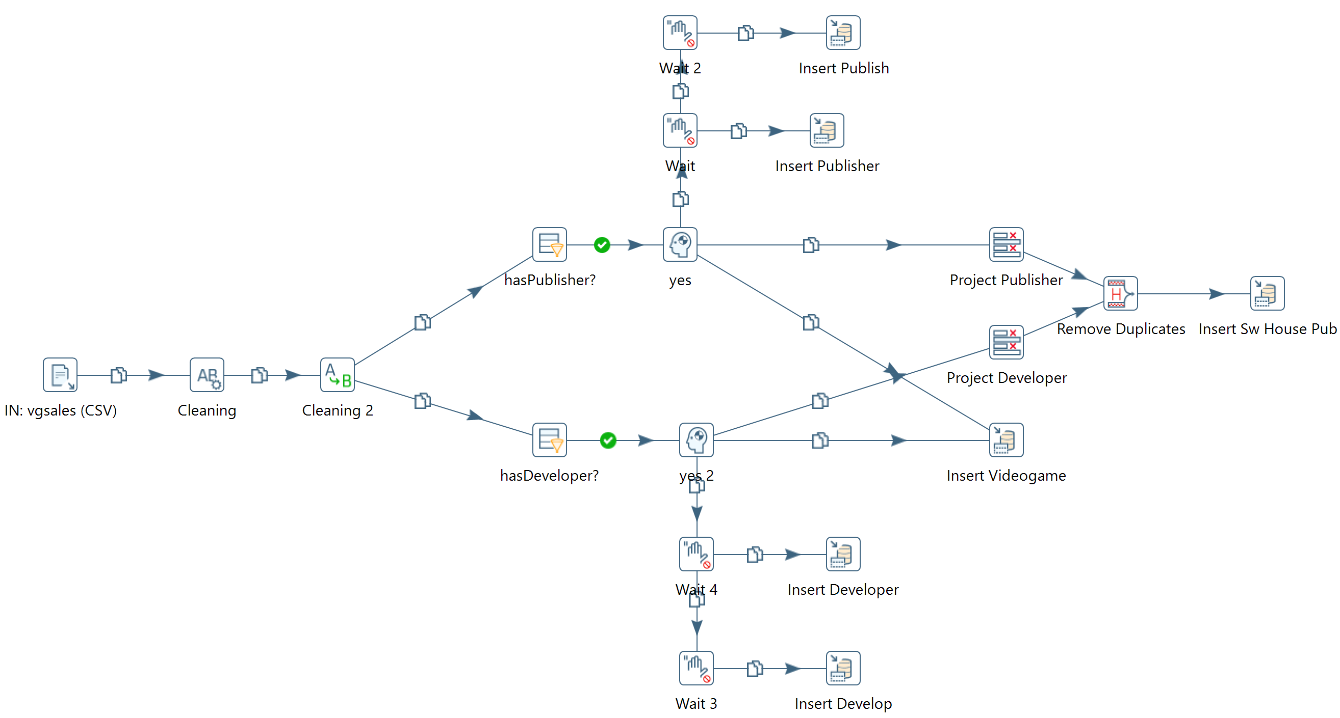
Pentaho Transformation
vgsales

Slide 24
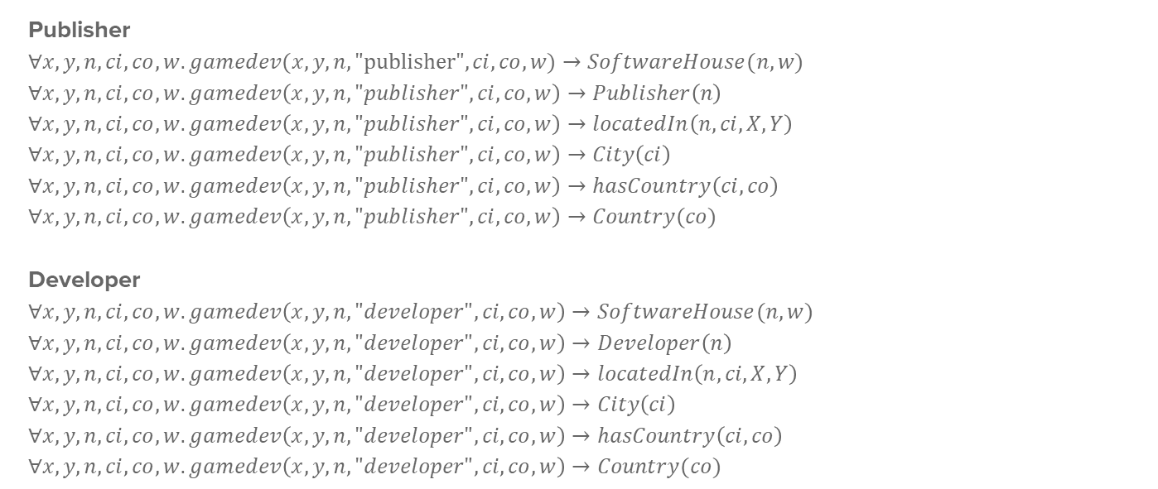
Gamedev
gamedev(x, y, name, type, city, country, website)
Publisher
$$∀x,y,n,ci,co,w.gamedev(x, y, n, "publisher", ci, co, w)→SoftwareHouse(n,w)$$
$$∀x,y,n,ci,co,w.gamedev\left(x, y, n, "publisher", ci, co, w\right)→Publisher\left(n\right)$$
$$∀x,y,n,ci,co,w.gamedev\left(x, y, n, "publisher", ci, co, w\right)→locatedIn\left(n,ci,X,Y\right)$$
$$∀x,y,n,ci,co,w.gamedev\left(x, y, n, "publisher", ci, co, w\right)→City\left(ci\right)$$
$$∀x,y,n,ci,co,w.gamedev\left(x, y, n, "publisher", ci, co, w\right)→hasCountry\left(ci,co\right)$$
$$∀x,y,n,ci,co,w.gamedev\left(x, y, n, "publisher", ci, co, w\right)→Country(co)$$
Developer
$$∀x,y,n,ci,co,w.gamedev\left(x, y, n, "developer", ci, co, w\right)→SoftwareHouse(n,w)$$
$$∀x,y,n,ci,co,w.gamedev\left(x, y, n, "developer", ci, co, w\right)→Developer\left(n\right)$$
$$∀x,y,n,ci,co,w.gamedev\left(x, y, n, "developer", ci, co, w\right)→locatedIn\left(n,ci,X,Y\right)$$
$$∀x,y,n,ci,co,w.gamedev\left(x, y, n, "developer", ci, co, w\right)→City\left(ci\right)$$
$$∀x,y,n,ci,co,w.gamedev\left(x, y, n, "developer", ci, co, w\right)→hasCountry\left(ci,co\right)$$
$$∀x,y,n,ci,co,w.gamedev\left(x, y, n, "developer", ci, co, w\right)→Country(co)$$

Slide 25
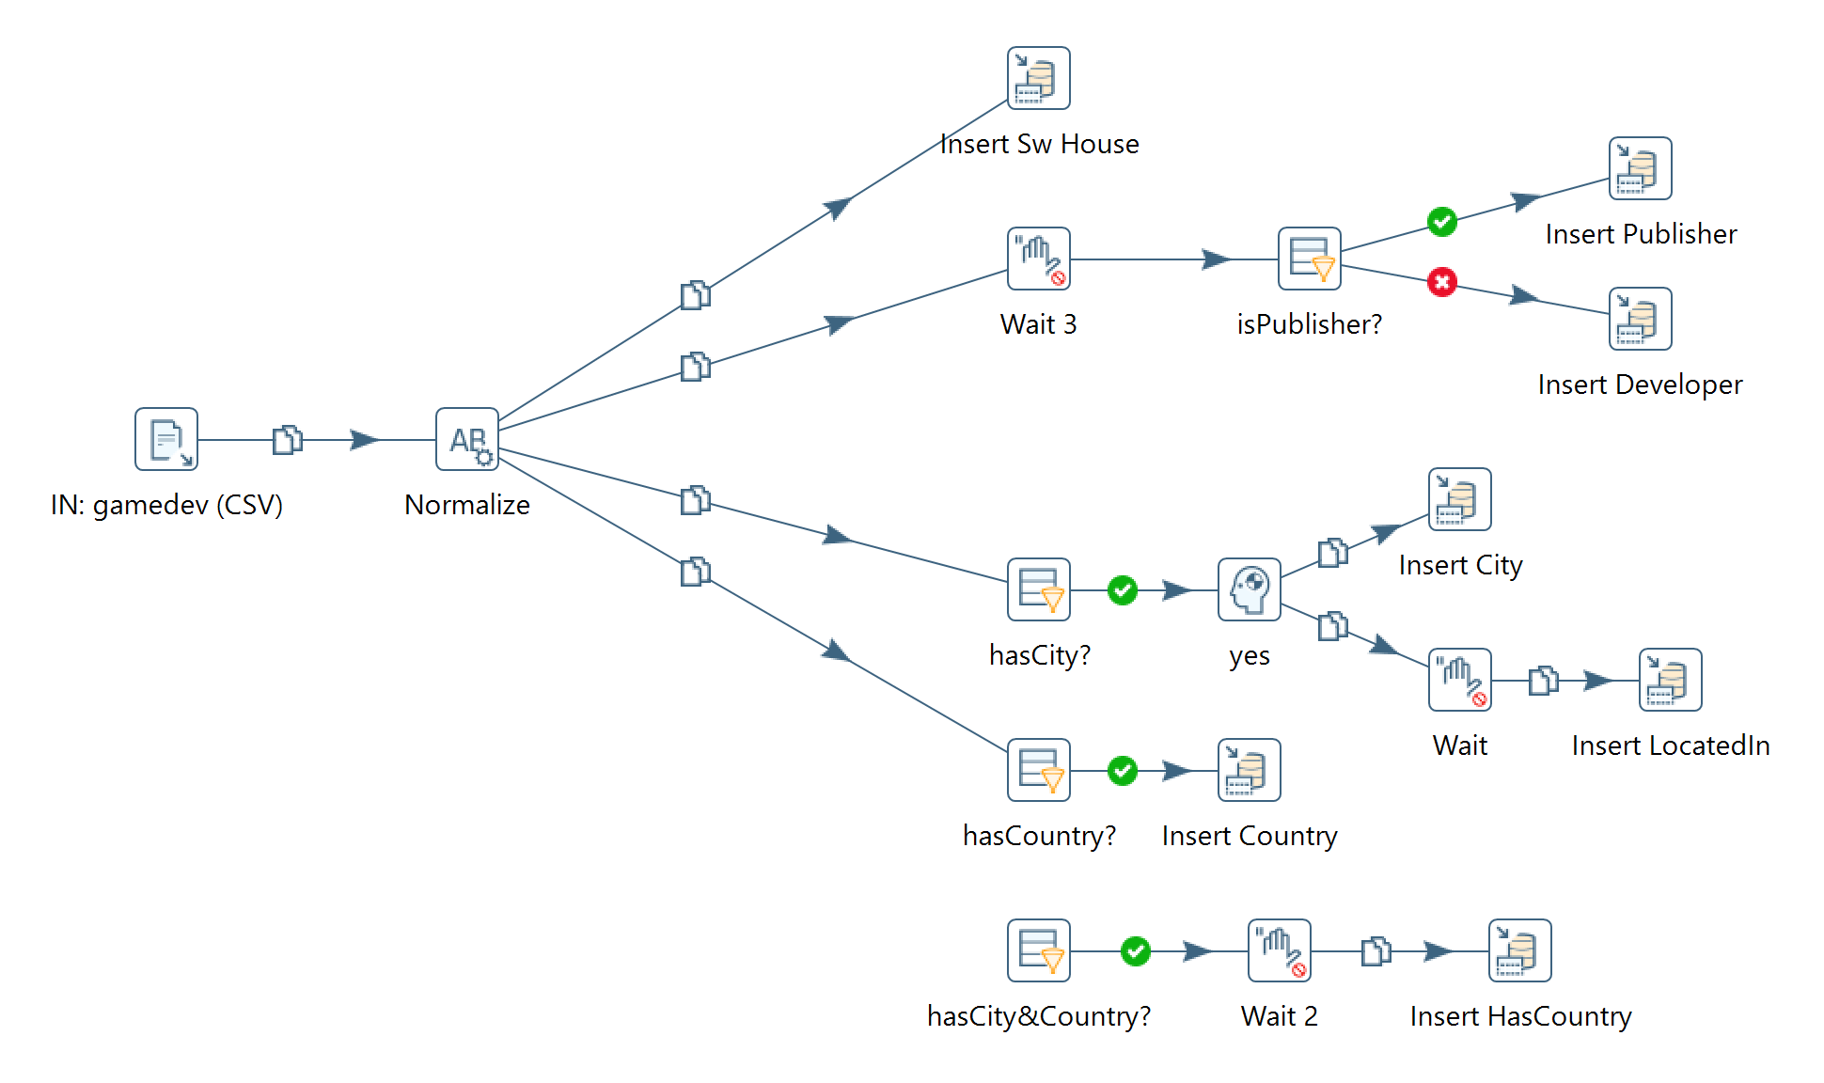
Pentaho Transformation
City and Country

Slide 26

CORGIS
spvg(title, genre, …, publisher, … )
$$∀t,g,p.spvg(t,g,…,p,…)→SoftwareHouse(p)$$
$$∀t,g,p.spvg\left(t,g,…,p,…\right)→Publisher(p)$$
$$∀t,g,p.spvg\left(t,g,…,p,…\right)→Publish(p, t)$$
$$∀t,g,p.spvg\left(t,g,…,p,…\right)→Videogame(t,g)$$

Slide 27
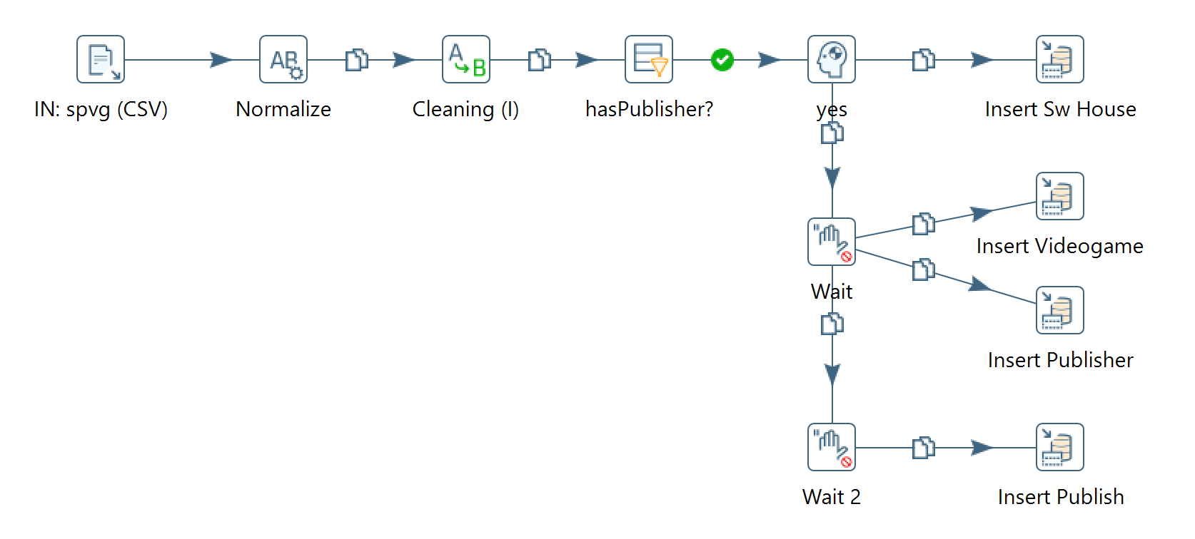
Pentaho Transformation
corgis

Slide 28

METACRITIC
datagenreX(title, genre)
metacritic(title, us, ms, platform,release)
$$∀t,g.datagenreX\left(t,g\right)→Videogame(t,g)$$
$$∀t,us,ms,p,r.metacritic\left(t,us,ms,p,r\right)→∃ge.Videogame(t,ge)$$
$$∀t,us,ms,p,r.metacritic\left(t,us,ms,p,r\right)→∃y,s.ReleasedFor(us,cs,y,s)$$
$$∀t,us,ms,p,r.metacritic\left(t,us,ms,p,r\right)→Console(p)$$

Slide 29
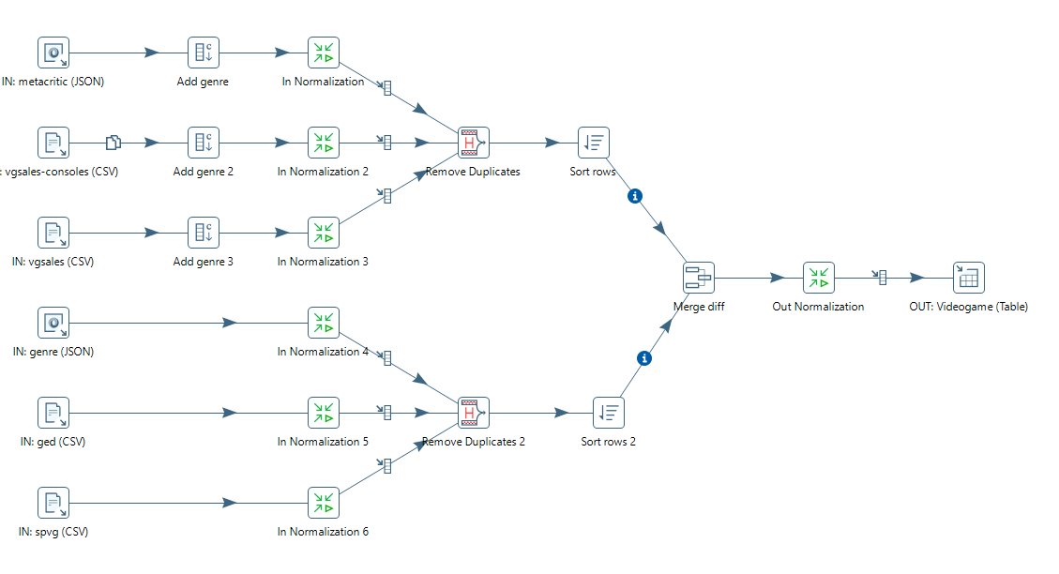
Pentaho Transformation
Videogame

Slide 30
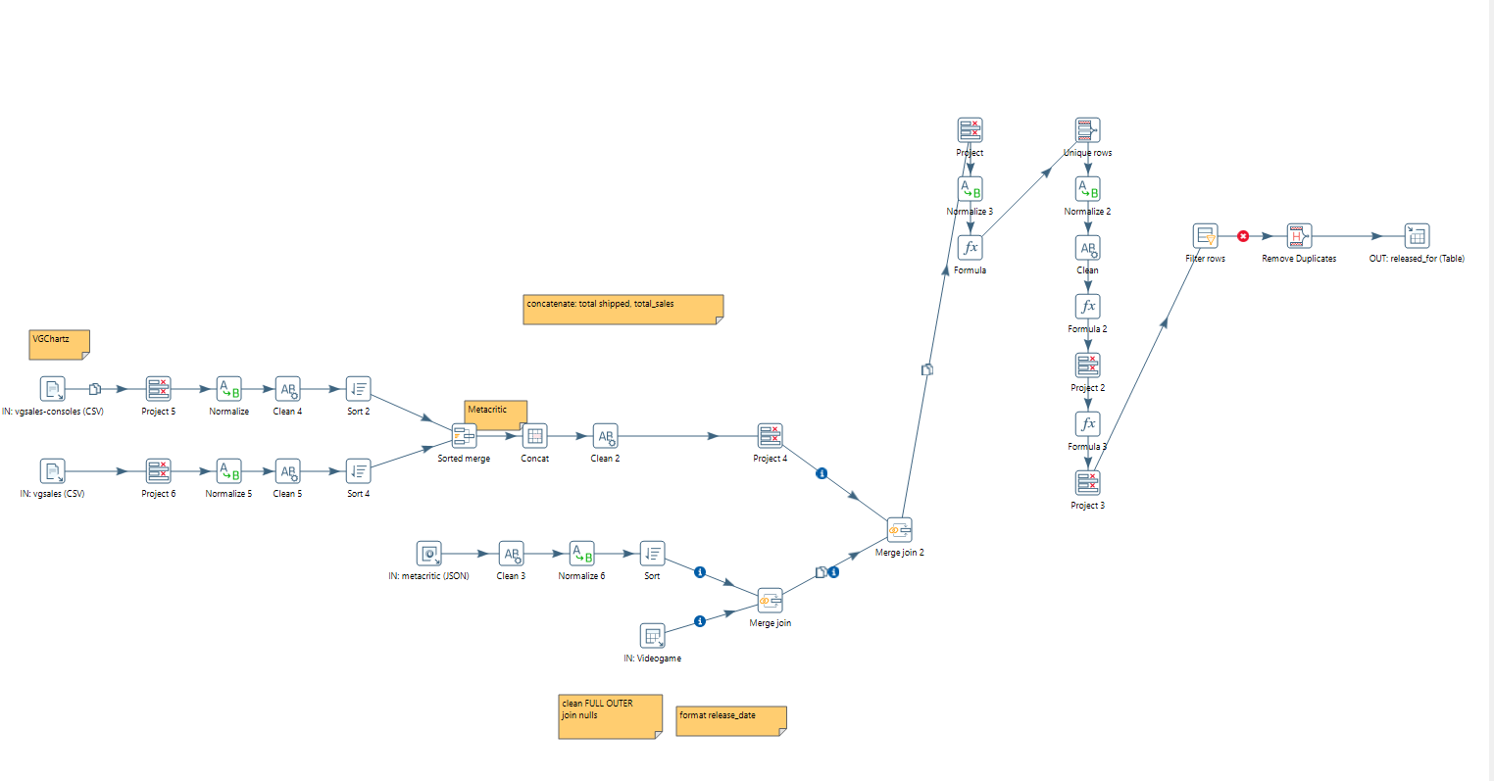
Pentaho Transformation
ReleasedFor

Slide 31

Esportdata
generalED(game, release,genre,TotEarn,OnEarn,PricedP,totTour)
historicalED(date,game,earning,PricedP,nEvents)
$$∀ g, r,te,ge,oe,pp,tt.generalED(g, r,te,ge,oe,pp,tt)→Videogame(g,ge)$$
$$∀ g, r,te,ge,oe,pp,tt.generalED(g, r,te,ge,oe,pp,tt)→Esport(g,te,oe)$$
$$∀d,g,e,pp,ne.historicalED(d,g,e,pp,ne)→Tournament(d,e,pp,ne)$$

