Slide 1
Project Proposal
Valerio Longo, Alessio Papi

Slide 2
Data Sources
Notes:
Raccolto dati - Public dataset collections - Kaggle, Metacritic, CORGIS, VGChartz

Slide 3
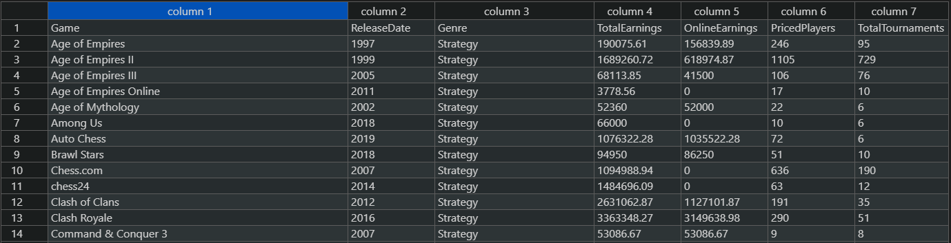
Kaggle
The following datasets were taken from Kaggle:
GeneralEsportData (csv)
Provides general information about games and related earnings and tournaments.
Game | ReleaseDate | Genre | TotalEarnings | OnlineEarnings | PricedPlayers | TotalTournaments

Slide 4
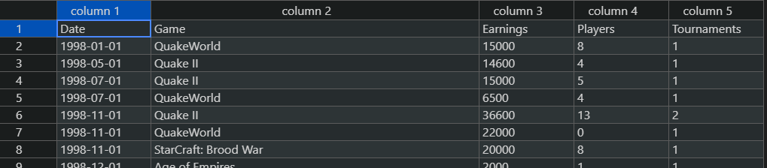
Kaggle
The following datasets were taken from Kaggle:
HistoricalEsportData (csv)
Provides general information about games form an historical perspective. (Tuples are sorted by Date).
Date | Game | Earnings | Players | Tournaments

Slide 5
Metacritic
Metacritic is a website that aggregates reviews and averaged scores for films, TV shows, music albums, video games and formerly, books.
metacritic (json)
This dataset stresses out the averaged user score and the metacritic score for each game of the dataset.
id | title | us | ms | platform | release
Note: the table representation is a normalized abstraction of the json dataset.

Slide 6
Metacritic
{
"1.":{
"title":"The Legend of Zelda: Ocarina of Time",
"us":"9.1",
"ms":"99",
"platform":"Nintendo 64",
"release":"November 23, 1998"
},
"2.":{
"title":"Tony Hawk's Pro Skater 2",
"us":"7.4",
"ms":"98",
"platform":"PlayStation",
"release":"September 20, 2000"
},
"3.":{
"title":"Grand Theft Auto IV",
"us":"7.7",
"ms":"98",
"platform":"PlayStation 3",
"release":"April 29, 2008"
},
"4.":{
"title":"SoulCalibur",
"us":"8.5",
"ms":"98",
"platform":"Dreamcast",
"release":"September 8, 1999"
},
"5.":{
"title":"Grand Theft Auto IV",
"us":"7.9",
"ms":"98",
"platform":"Xbox 360",
"release":"April 29, 2008"

Slide 7
CORGIS
CORGIS is a “collection of Real-time, Giant, Interesting, Situated Datasets”.
sales_playtime_video_games (csv)
This dataset holds very specialized Metadata about each videogame.
Multiplayer mode supported? If yes, which is the maximum amount of players?
Online mode supported?
There is / there will be any sequel?
Metadata about the gaming experience itself: main campaign average completion time, extra missions average completion time, average playing timebyb user...
title | ... | genre | ... | Publishers | score | price | console | year | Metadata

Slide 8
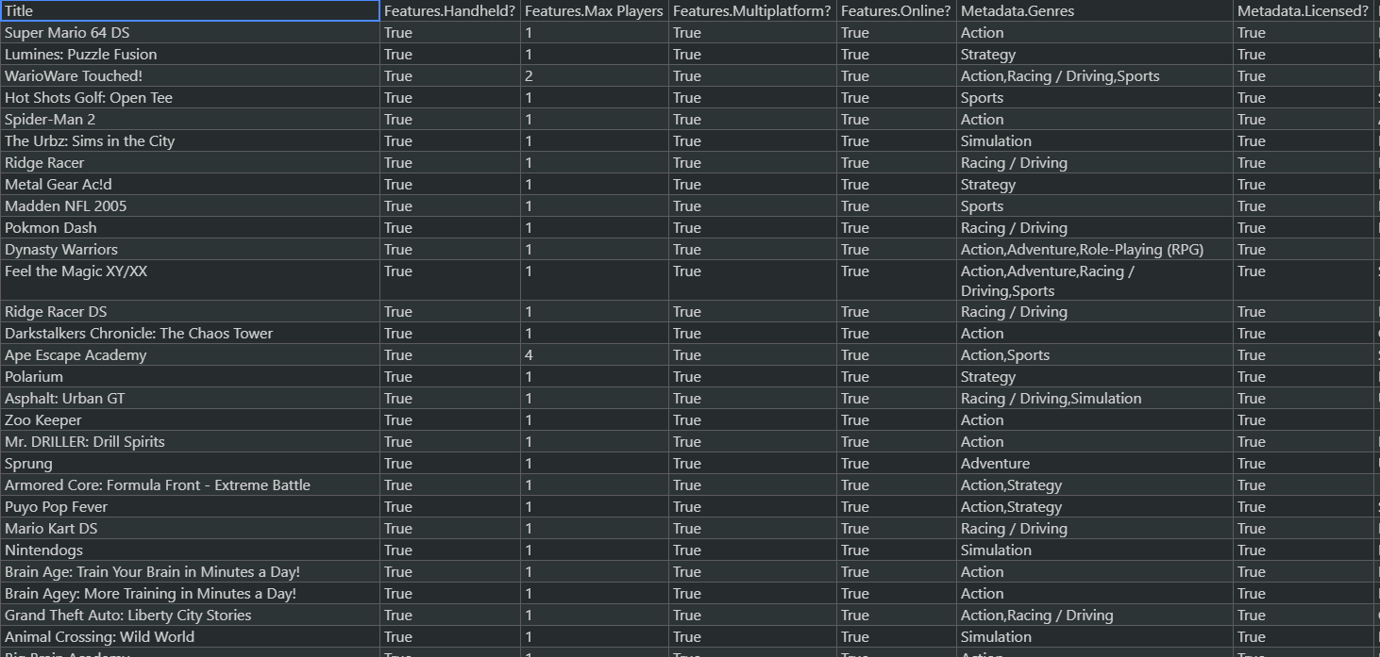
CORGIS

Slide 9
VGCHARTZ
VGChartz delivers comprehensive game chart coverage, including sales data, news, reviews, & game database for PS4, PS5, Xbox One, Series X, Nintendo…
vgsales-2021-04-09_16_51_31 (csv)
Sales-related information about videogames.
sales-by-console Collection of 27 csv files, holding vgsales information specific to every console supported by VGChartz.
id | game | console | publisher | developer | ..scores.. | total_shipped | ..sales.. | releaseDate

Slide 10
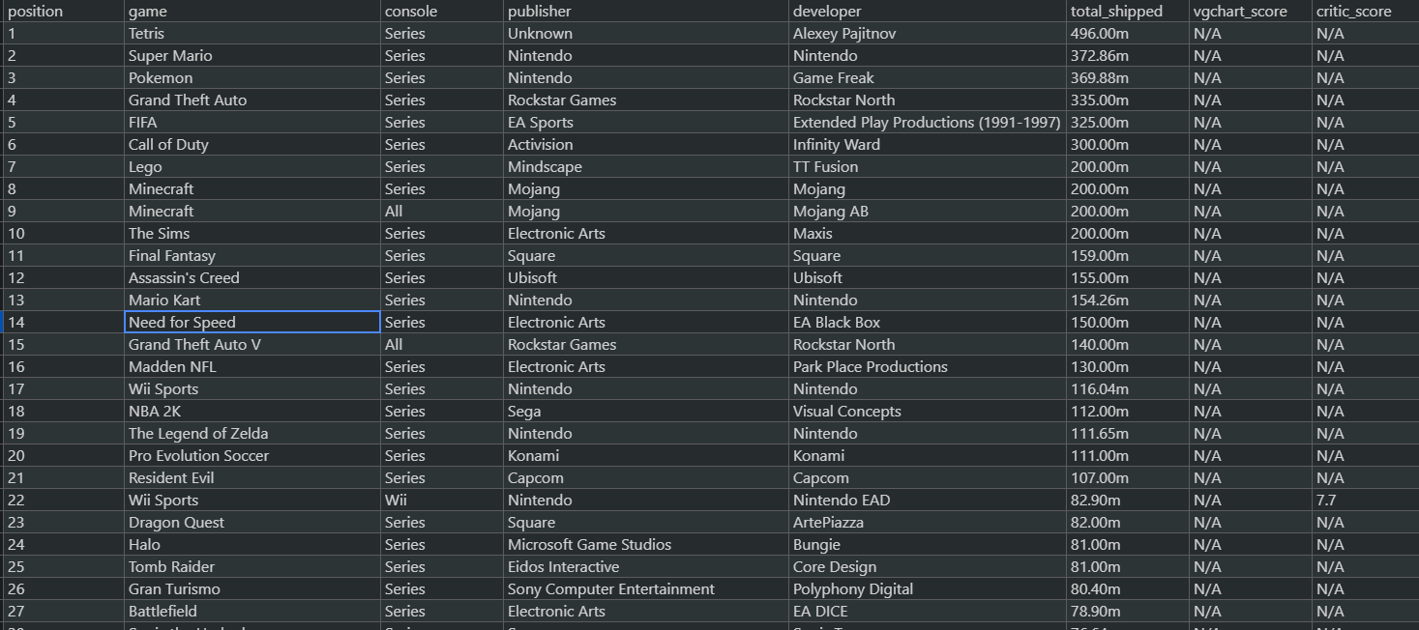
VGCHARTZ

Slide 11
Gamedev
Gamedev (csv)
Contains geographic-related information about videogame developing and publishing companies.
This dataset will be a crucial utility in the design of geographic and market related tasks.
Token from https://www.gamedevmap.com/
X coord | Y coord | name | type | City | Country | website

Slide 12
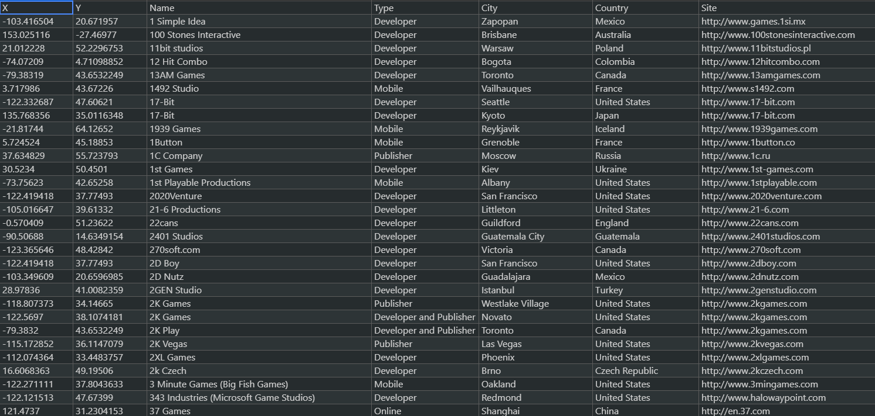
Gamedev

Slide 13
(Tentative) Global Schema

Slide 14
Entities and Relationships
Software House
Located In
City
Has Country
Country
Developer
Publisher
DevelopedBy
PublishedBy
Released for
Console
Videogame
Made Tournament
Tournament
eSport

Slide 15
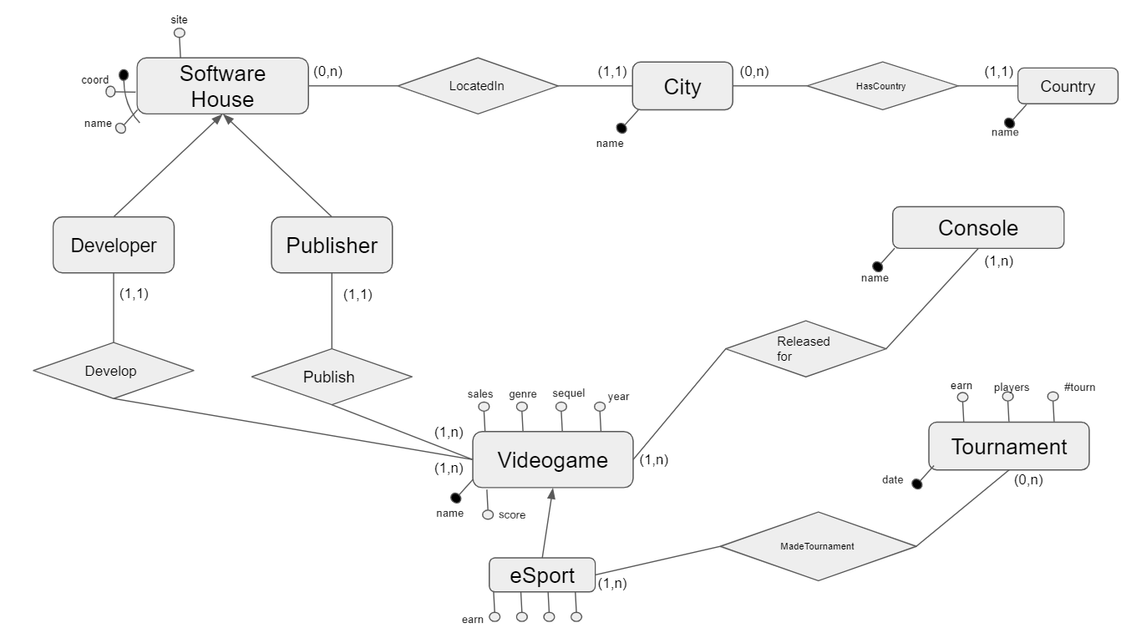
Attributes and Cardinalities

Slide 16
(Tentative) Tasks

Slide 17
Tasks
We think it would be interesting investigating about the following queries:
Which nation (or city or publisher) has…
Produced more games?
Earned the most in tournaments?
Earned the most in sales?
Been producing the longest?
Which console has…
Seen more developed (or remunerative) games?
Which were the most remunerative years for videogaming business?

Slide 18
FOL Mappings

Slide 19
Software Houses

Slide 20
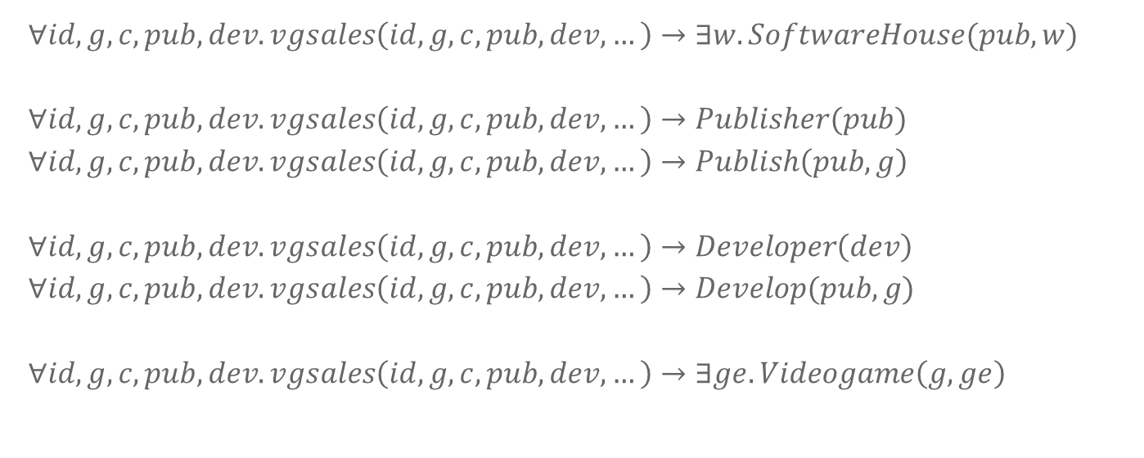
VGCHARTZ
vgsales(id, game, console, publisher, developer, … )
$$∀id,g,c,pub,dev.vgsales\left(id,g,c,pub,dev,…\right)→∃w.SoftwareHouse(pub,w)$$
$$∀id,g,c,pub,dev.vgsales\left(id,g,c,pub,dev,…\right)→Publisher(pub)$$
$$∀id,g,c,pub,dev.vgsales\left(id,g,c,pub,dev,…\right)→Publish\left(pub, g\right)$$
$$∀id,g,c,pub,dev.vgsales\left(id,g,c,pub,dev,…\right)→Developer\left(dev\right)$$
$$∀id,g,c,pub,dev.vgsales\left(id,g,c,pub,dev,…\right)→Develop(pub,g)$$
$$∀id,g,c,pub,dev.vgsales\left(id,g,c,pub,dev,…\right)→∃ge.Videogame\left(g,ge\right)$$

Slide 21
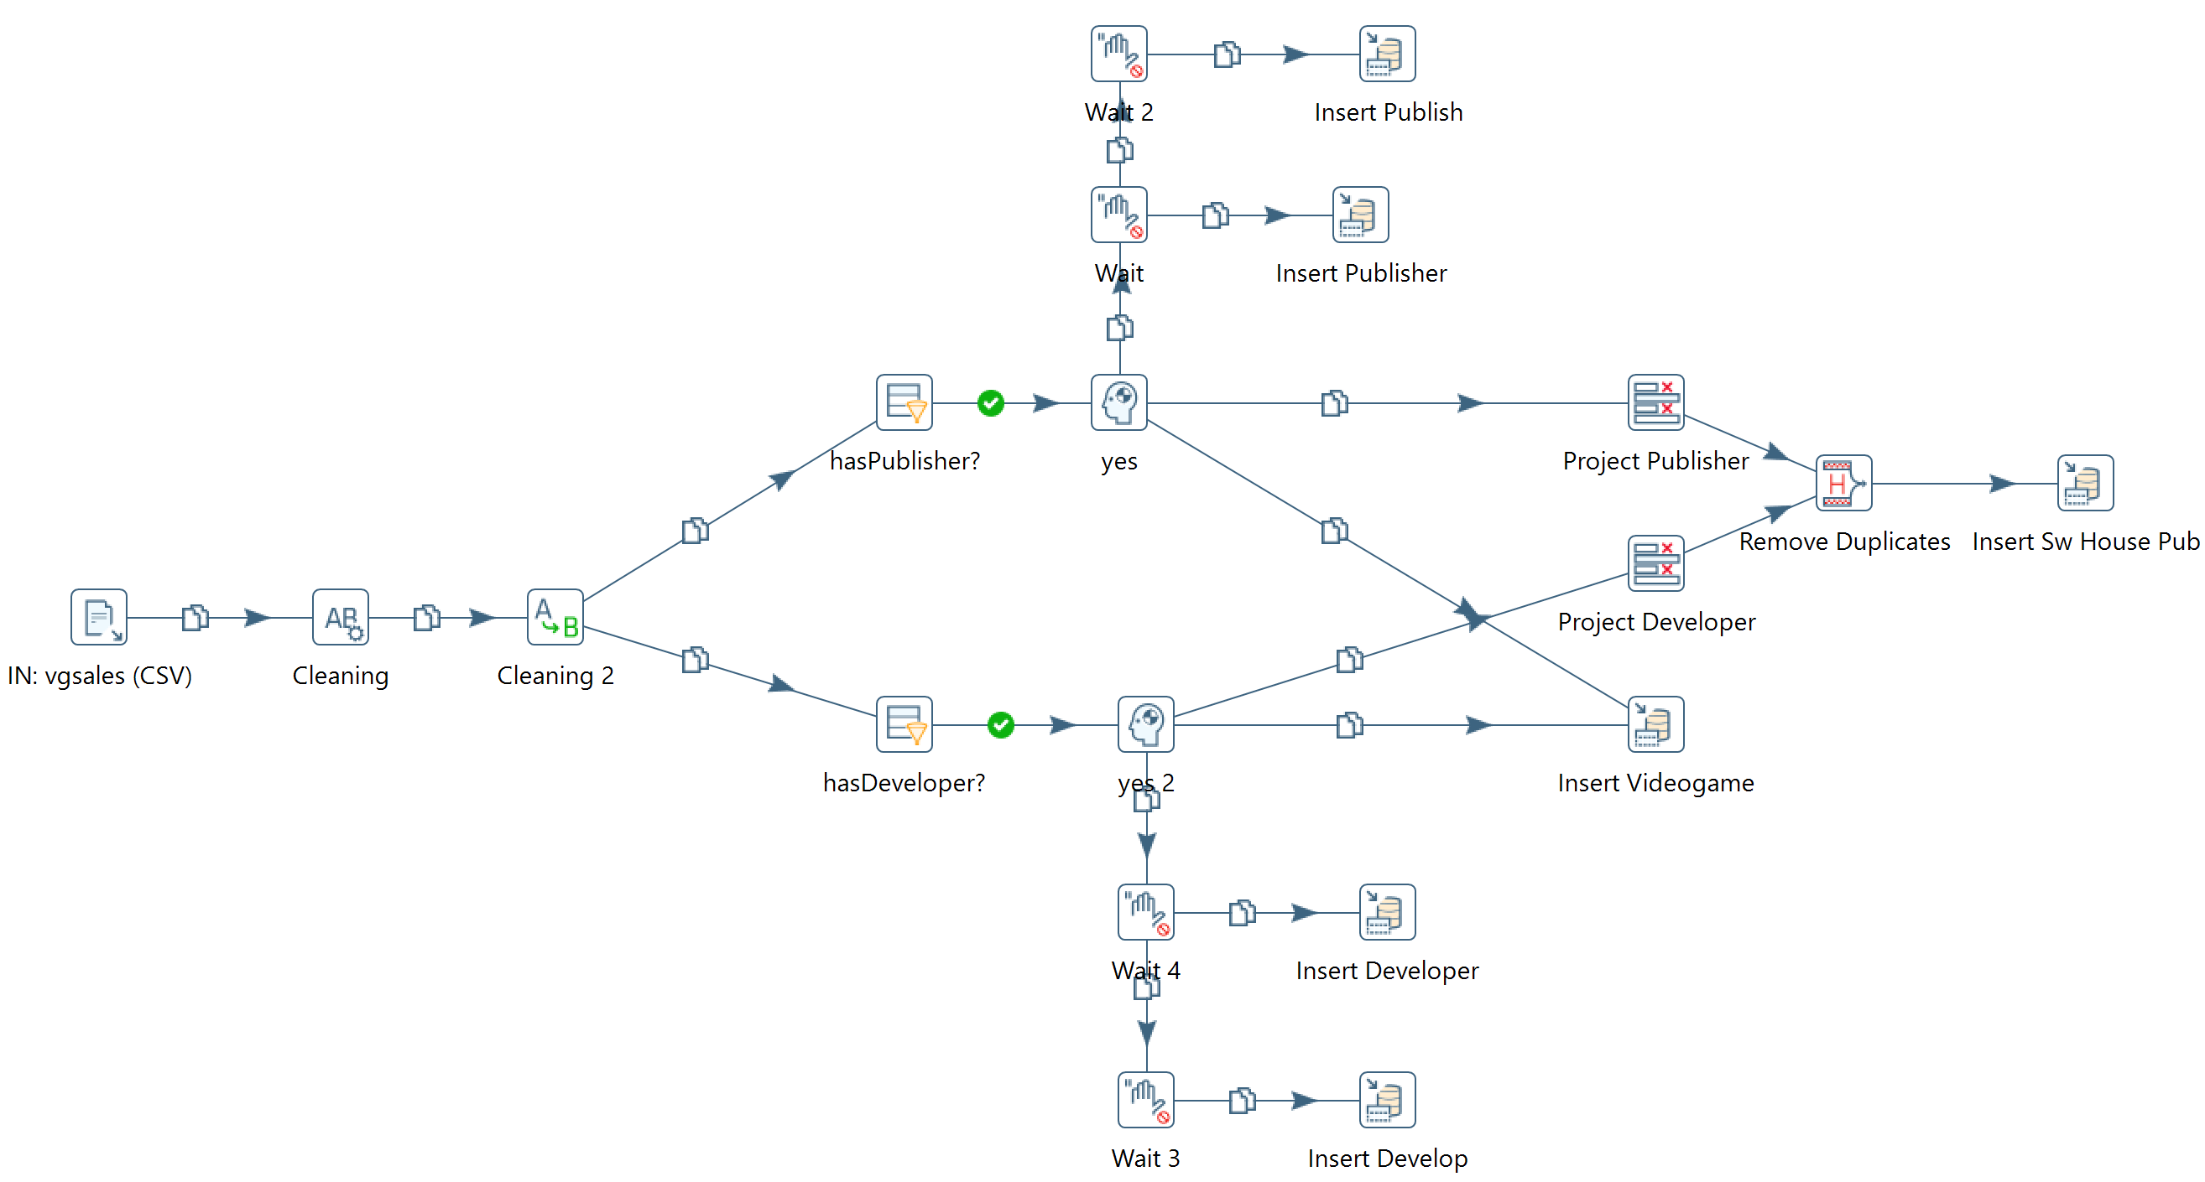
Pentaho Transformation

Slide 22
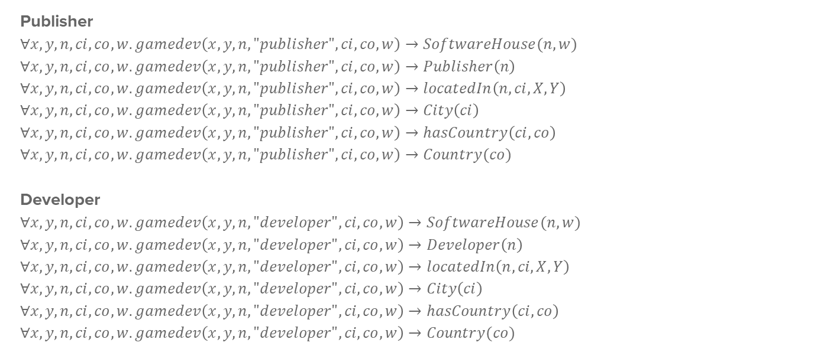
Gamedev
gamedev(x, y, name, type, city, country, website)
Publisher
$$∀x,y,n,ci,co,w.gamedev\left(x, y, n, "publisher", ci, co, w\right)→SoftwareHouse(n,w)$$
$$∀x,y,n,ci,co,w.gamedev\left(x, y, n, "publisher", ci, co, w\right)→Publisher\left(n\right)$$
$$∀x,y,n,ci,co,w.gamedev\left(x, y, n, "publisher", ci, co, w\right)→locatedIn\left(n,ci,X,Y\right)$$
$$∀x,y,n,ci,co,w.gamedev\left(x, y, n, "publisher", ci, co, w\right)→City\left(ci\right)$$
$$∀x,y,n,ci,co,w.gamedev\left(x, y, n, "publisher", ci, co, w\right)→hasCountry\left(ci,co\right)$$
$$∀x,y,n,ci,co,w.gamedev\left(x, y, n, "publisher", ci, co, w\right)→Country(co)$$
Developer
$$∀x,y,n,ci,co,w.gamedev\left(x, y, n, "developer", ci, co, w\right)→SoftwareHouse(n,w)$$
$$∀x,y,n,ci,co,w.gamedev\left(x, y, n, "developer", ci, co, w\right)→Developer\left(n\right)$$
$$∀x,y,n,ci,co,w.gamedev\left(x, y, n, "developer", ci, co, w\right)→locatedIn\left(n,ci,X,Y\right)$$
$$∀x,y,n,ci,co,w.gamedev\left(x, y, n, "developer", ci, co, w\right)→City\left(ci\right)$$
$$∀x,y,n,ci,co,w.gamedev\left(x, y, n, "developer", ci, co, w\right)→hasCountry\left(ci,co\right)$$
$$∀x,y,n,ci,co,w.gamedev\left(x, y, n, "developer", ci, co, w\right)→Country(co)$$

Slide 23
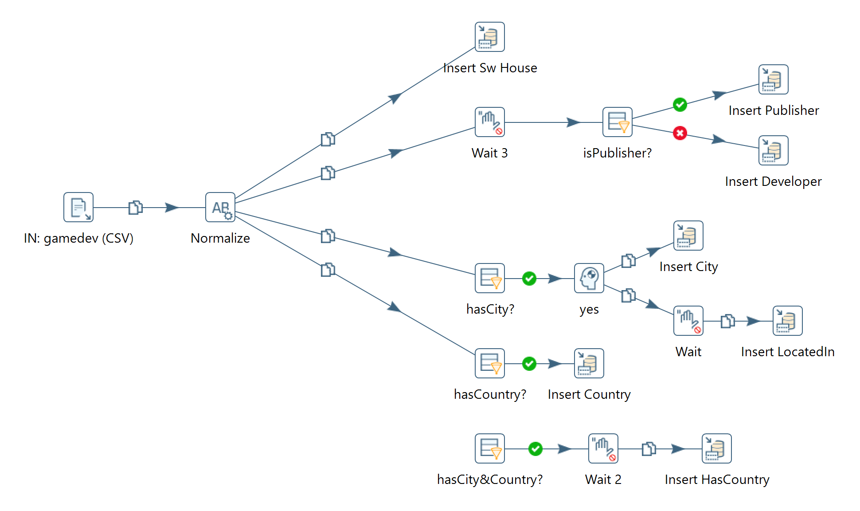
Pentaho Transformation

Slide 24

CORGIS
spvg(title, …, publisher, … )
$$∀t,p.spvg\left(t,…,p,…\right)→SoftwareHouse(p)$$
$$∀t,p.spvg\left(t,…,p,…\right)→Publisher(p)$$
$$∀t,p.spvg\left(t,…,p,…\right)→Publish(p, t)$$
$$∀t,p.spvg\left(t,…,p,…\right)→∃ge.Videogame(t,ge)$$

Slide 25
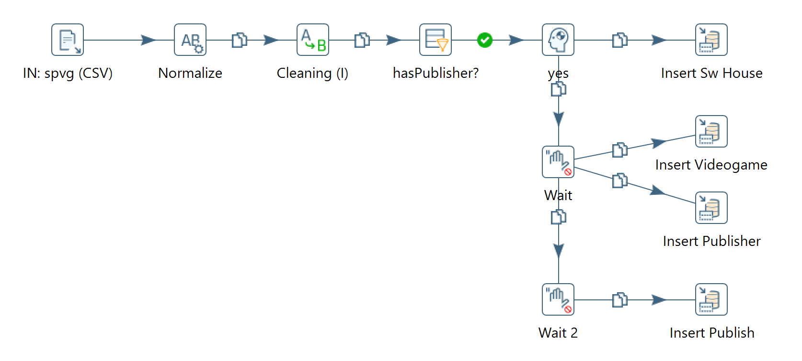
Pentaho Transformation

