Slide 1
国防科技大学
Beyond Code Generation: An Observational Study
of ChatGPT Usage in Software Engineering Practice
The Powerpoint template is a clean and simple template that can be used for personal and business use. Its clean approach makes it easy for the user to print. It comes in both standard and wide versions in ppt and pptx formats.
计算机学院/软件工程
指导老师：周斌
汇报人：陈思迈

Slide 2
Contents
01
Background information
02
Related work
03
Methods and findings
04
Conclusion
05
Personal Opinions

Slide 3
PART 01
Background information
c

Slide 4

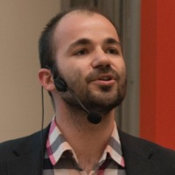

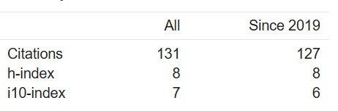
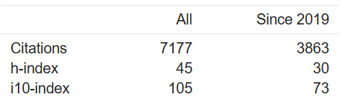
Authors and Institutes
Institute
Ranim Khojah
Mazen Mohamad
Philipp Leitner
Chalmers University of Technology——University of Gothenburg
RISE Research Institutes of Sweden
Gothenburg
PhD student at Chalmers University of Technology,
Major:Chatbots, Large Language models, Software Engineering
Associate Professor at Chalmers University of Technology and the University of Gothenburg
Major:Cloud Computing, Software Engineering, Mining Software Repositories, Software Performance
Researcher at Research Institutes of Sweden (RISE)
Major: Security assurance, Software architecture,
Autonomous systems

Slide 5
Problems and goal
Limititions of Recent Research
Practical Concern
Goal
Can LLM truly be helpful for creative tasks such as essay writing or coding ?—hallucinating
What kind of tasks do software engineers use an
LLM-powered chatbot such as ChatGPT in their work?
What factors influence the personal experience of soft-
ware engineering practitioners when using ChatGPT?
Mainly focuses on specific application scenarios such as code generation, and lacks a comprehensive understanding of the application of LLM throughout the software development lifecycle

Slide 6
PART 02
Related work

Slide 7
Certain Works
How LLM influence productivity
Storey and Zagalsky provide a cognitive support framework, in this text to measure the productivity
02
01
03
Recent Research
Code Generation
code generation, requirements analysis, test generation in specific context
How developer interacting with Copilot:
acceleration mode(write things faster)
exploration mode(explore solutions)

Slide 8
PART 03
METHODOLOGY

Slide 9
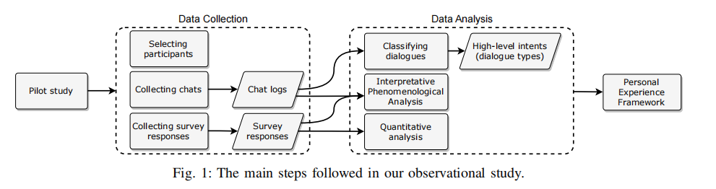
Procedure of the observation study

Slide 10
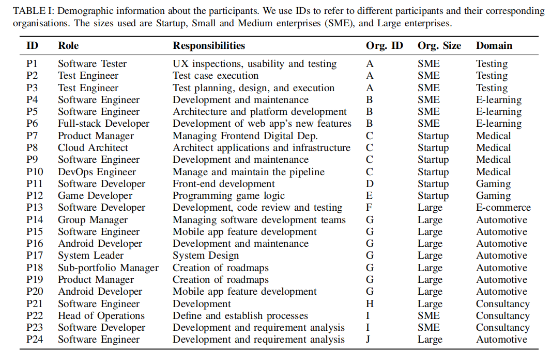
Data Collection
Select participantes
24 specialized software engineers from 10 European companies
Chat protocols
Collecting 130 chats from ChatGPT’s web interface and filtered them to 180 dialogues related to software engineering
Exit Survey
A survey to explore the overall experience and thoughts of the participants after completing the study. The survey includes (i) The overall experience; (ii) specific scenarios where participants thought that their interaction went well (or not well); (iii) feeling of trust in ChatGPT’s answers; (iv) perceived effectiveness and efficiency of ChatGPT;(v) learned lessons from their interactions and future usage of ChatGPT.

Slide 11
Data Analysis
Quantitative analysis
Descriptive statistics and visual analysis of the survey closed questions. focuses on the flow of the dialogues and the overall user experience
Dialogue classification
Artifact Manipulation:Generate a concrete solution or codes
Training:Acquire wider ranges of theories and practical knowledge, not solve certain problem
Expert Consultation:Ask for guidance of certain question and no need to solve certain problem
Interpretative phenomenological analysis
Examine personal lived experiences in-depth, emphasising understanding of the individual’s own terms and seeking patterns across cases through interpretative processes

Slide 12
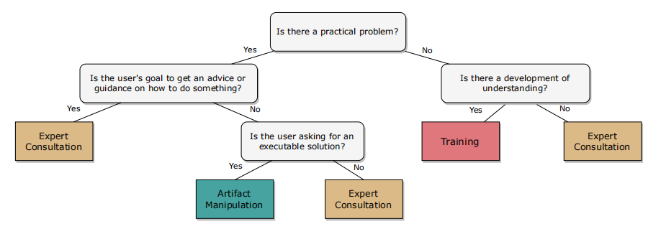
Data Analysis

Slide 13
研究成果与展示
输入小标题
输入小标题
本模板内所有图片及字体仅供参考，请根据您的实际情况进行替换或更改，并根据实际情况编辑文字内容。
本模板内所有图片及字体仅供参考，请根据您的实际情况进行替换或更改，并根据实际情况编辑文字内容。
输入小标题
本模板内所有图片及字体仅供参考，请根据您的实际情况进行替换或更改，并根据实际情况编辑文字内容。
输入小标题
输入小标题
输入小标题
本模板内所有图片及字体仅供参考，请根据您的实际情况进行替换或更改，并根据实际情况编辑文字内容。
本模板内所有图片及字体仅供参考，请根据您的实际情况进行替换或更改，并根据实际情况编辑文字内容。
本模板内所有图片及字体仅供参考，请根据您的实际情况进行替换或更改，并根据实际情况编辑文字内容。

Slide 14
PART 04
Research Findings

Slide 15
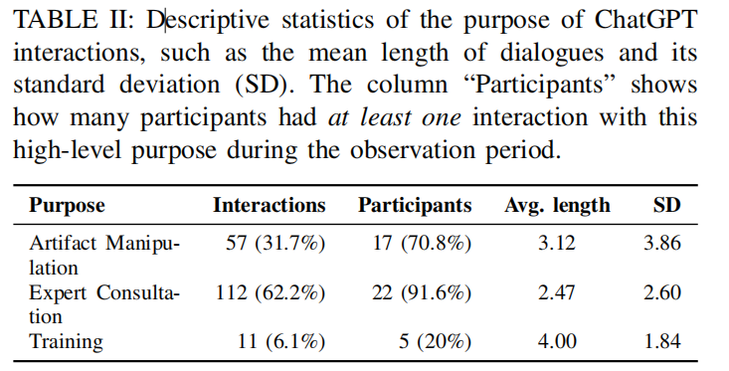
Purpose to using GPT
Expert consultation was the most common scenario for ChatGPT use, accounting for 62% of all conversations.And 22 participants have done expert consultation among 24 participants.

Slide 16
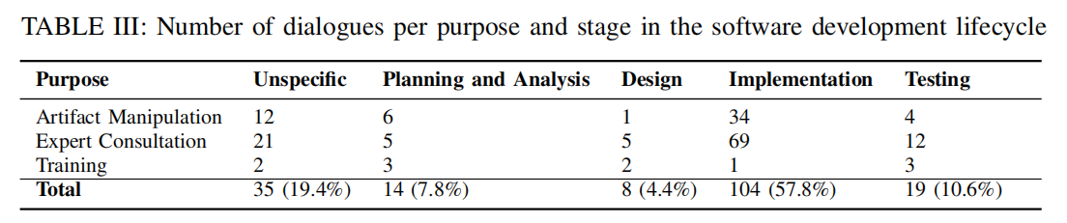
Purpose to using GPT
ChatGPT is used in all phases of software development, and most use occurs during the implementation phase of software development

Slide 17
Internal and External Factors
Prompt
Legal questions and concerns regarding company policies
The way Participants structure these prompts affects ChatGPT’s responses. There’s no evident disparsity of lingustic structures.Providing project-specific information(product requirements, code snippets, domain-specific
constraints, and process structure) could significantly enhance the participants’ overall experiences. Purpose behind a dialogue strongly influences the amount and type of context participants provide.
Uncertainty whether they are allowed to use the tool for a specific use case. Some participants are
concerned about a stale knowledge base of the tool.
Personal factors
How much they know about generative AI, and their tolerance to inaccuracies in responses. Sceptical participants are often confirmed in their believe that ChatGPT is not useful for their work, and stop using it quickly. Participants that use ChatGPT for training are often more happy with the results they receive.

Slide 18
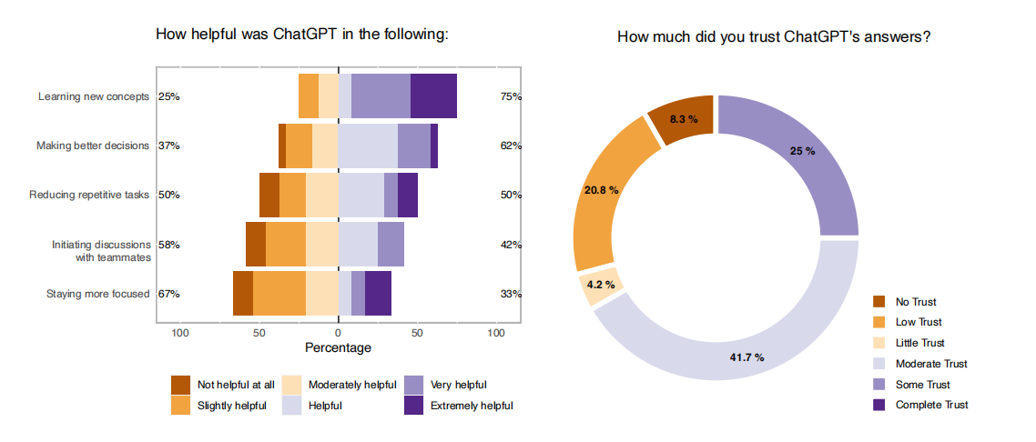
Personal Experience
Plots showing how the 23 participants reported ChatGPT’s usefulness (left) and trust in its answer (right)

Slide 19
PART 05
Conclusion

Slide 20
Conclusion
01
03
02
ChatGPT can, in some ways, hurt developer productivity
04
Usage
ChatGPT is more frequently used for receiving guidance and training than for directly generating code
ChatGPT can be useful even for creative tasks, not just to solve clearly-specified problems.
ChatGPT can be helpful in all phases of the software
development lifecycle, not just for implementation.

Slide 21
PART 06
Personal opinion

Slide 22
Advantage
Comprehensiveness
Meaningful
Rigor
Explainable
This framework covers every step of software engineering.
It inspires us how to use chatGPT effectively and dicover that chatGPT could also perform creativity tasks.
Each step is based numerous of experience and discussion.
The data visualization is great. Each table and figure is straightforward.

Slide 23
Limitation
The amount of data is very small. It only select 24 participants. Paricipants are only from 3 European countries.
The classification of Dialogue is subjective and lacks an effective way to quantify
Only concentrate on the usage of ChatGPT and ignore other LLMs
Lacks research on Software Engineering Development Model (SEDM)

Slide 24
Questions

Slide 25
(1) Have you ever use ChatGPT or other LLMs to program? Please share your experience and what influence your personal experience while using it.
(2) According to this paper and your personal understanding, how to improve the accuracy of LLM answers?

