Slide 1
LINUX COMMANDS
NAME : SREEHARI KARICHERY ,166589
DEVOPS TRAINING
TRAINER : VENKAT
DAY 3,4 ,FEB 11,12

Slide 2
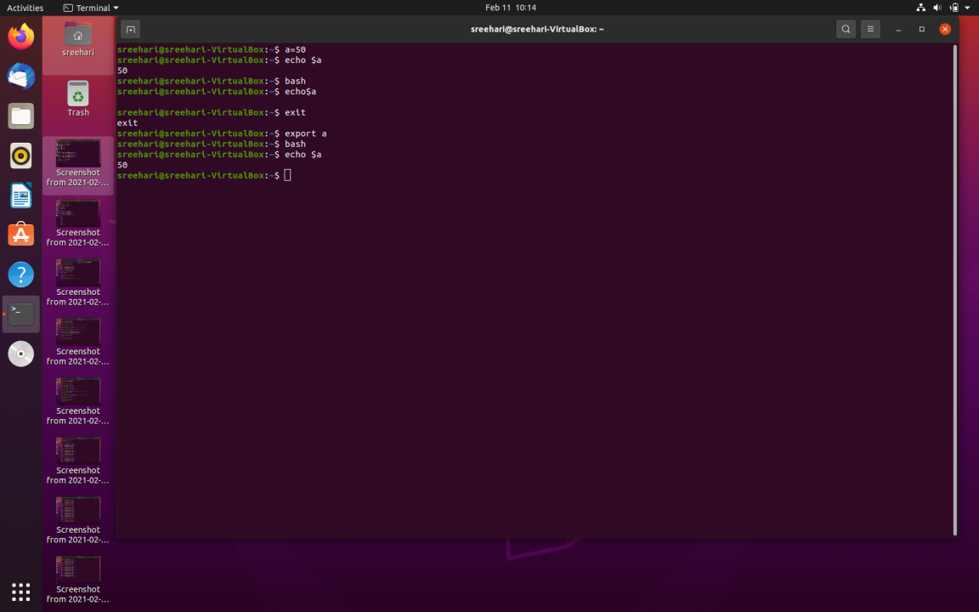
COMMANDS
echo - used to display line of text or string or number that are passed as argument
exit – to terminate the shell script
bash – it is a shell that read and execute shell script

Slide 3
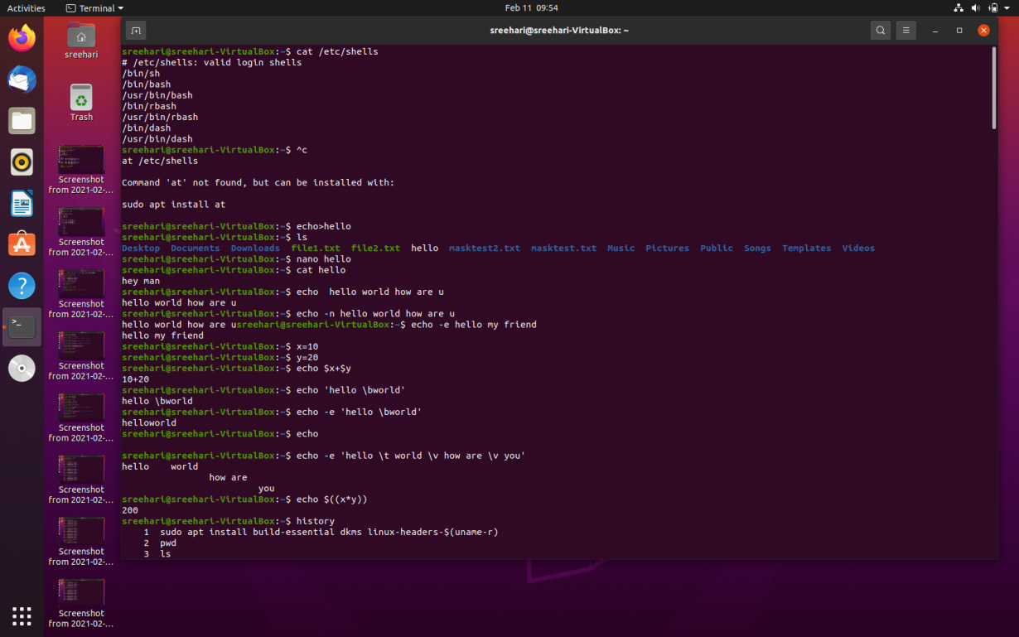
COMMANDS
echo>file name – create a file
nano hello – input to the file
cat hello – display the file structure
OPTIONS
-n -output without a new line
-e -allow use of backslash escapes
\b -removes the space btwn the text
\n -prints the text in new line
\t -gives a horizontal tab
\v -gives a vertical tab

Slide 4
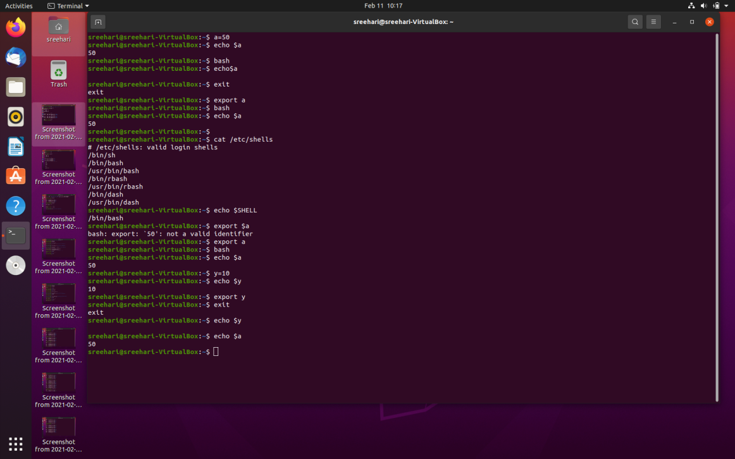
COMMANDS
export - used to create environment variable
unset - removes the variable previously set
-b - notify the job termination immedietly
-e - exit immedietly if a command exists with a non zero status
-m - job control is enabled

Slide 5
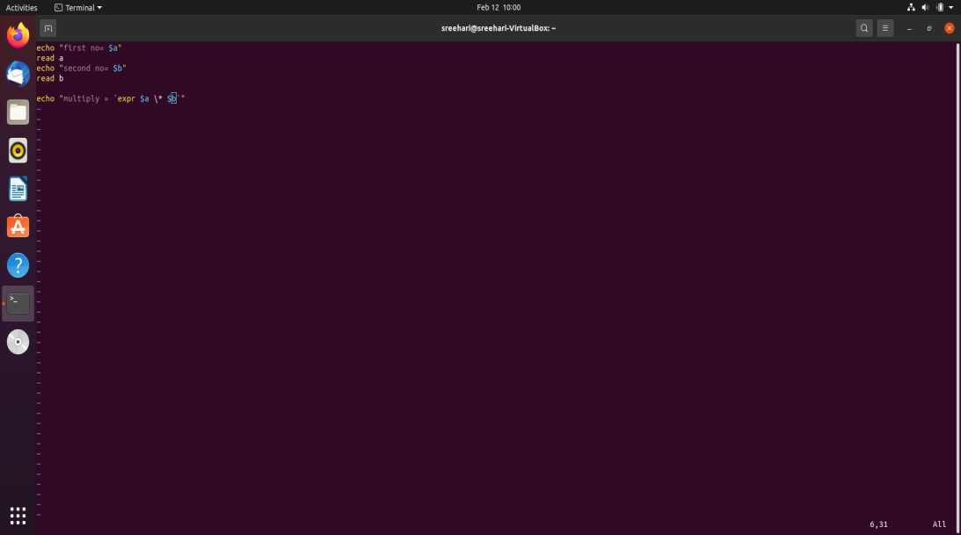
COMMANDS
I - insert mode enabled
:wq! - save and quit
:q! - quit
vi filename
k - to move cursor up
j - move cursor down

Slide 6
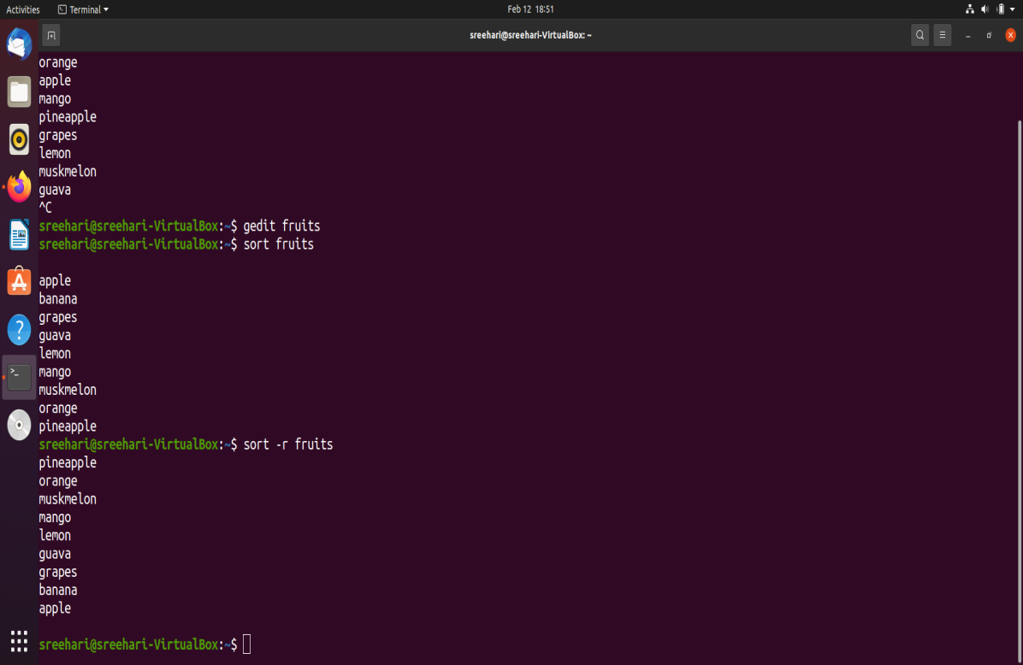
COMMANDS
yy -copy a single line
4yy - copy 4 lines
p - paste
dd - delete or remove single line
3dd -delete 3 lines
cc - cut a single line
2cc - cut two lines
sort file name – ort the content in the file
sort -r file name -sort in reverse order
sort -nr file name -sorted according to reverse number order

Slide 7
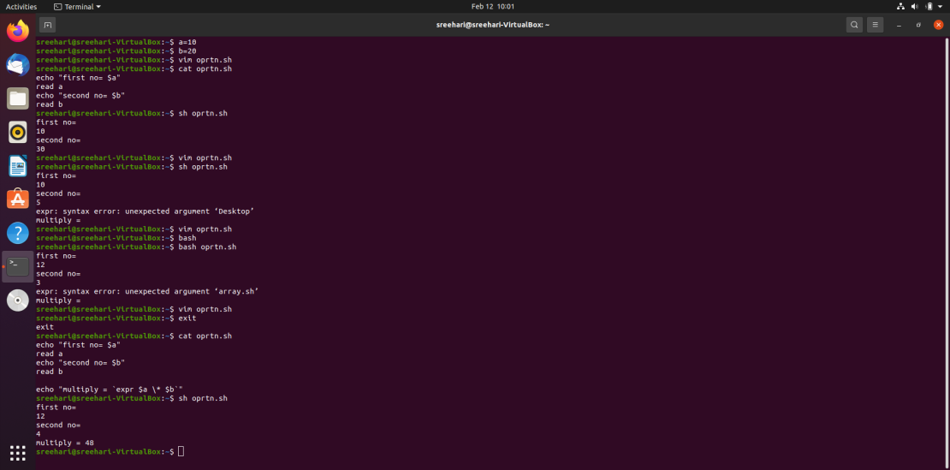
COMMANDS
vim filename.sh - creates a new file if it doesn’t exist,otherwise opens the existing file with the given file name
vi -r filename.sh - opens the existing file in read only mode
sh filename.sh - executes the file

Slide 8
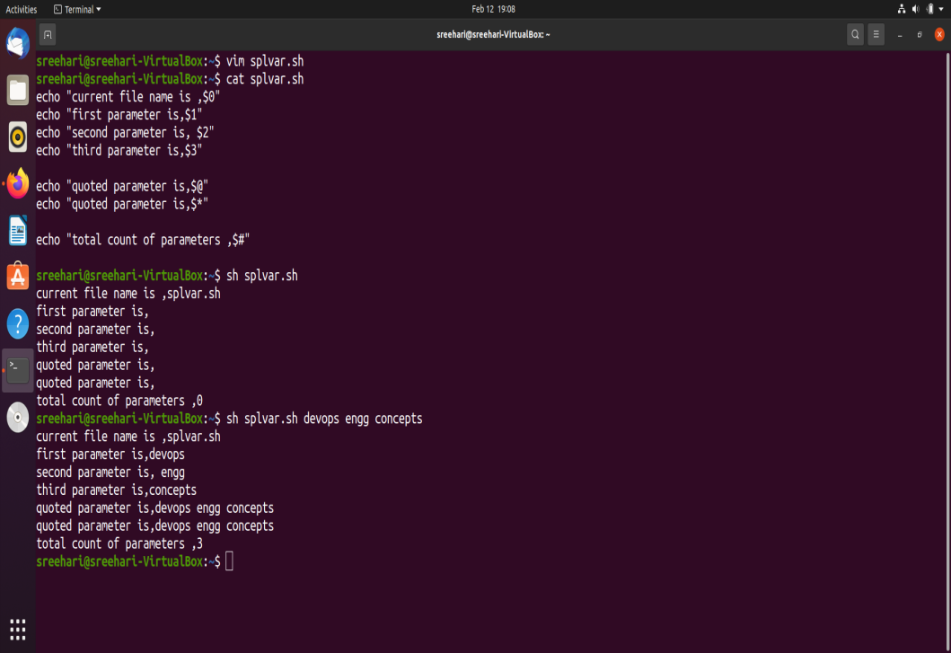
COMMANDS
$0 - the file name of current script
$n -position of a argument
$# - the no.of arguments supplied to the script
$* -all the arguments are double quoted
$@ - all the arguments are indivdualy double quoted
$? -the exit status of the last command is executed
$$ -process id of the curret shell is shown
$! -process no.of last background file

Slide 9
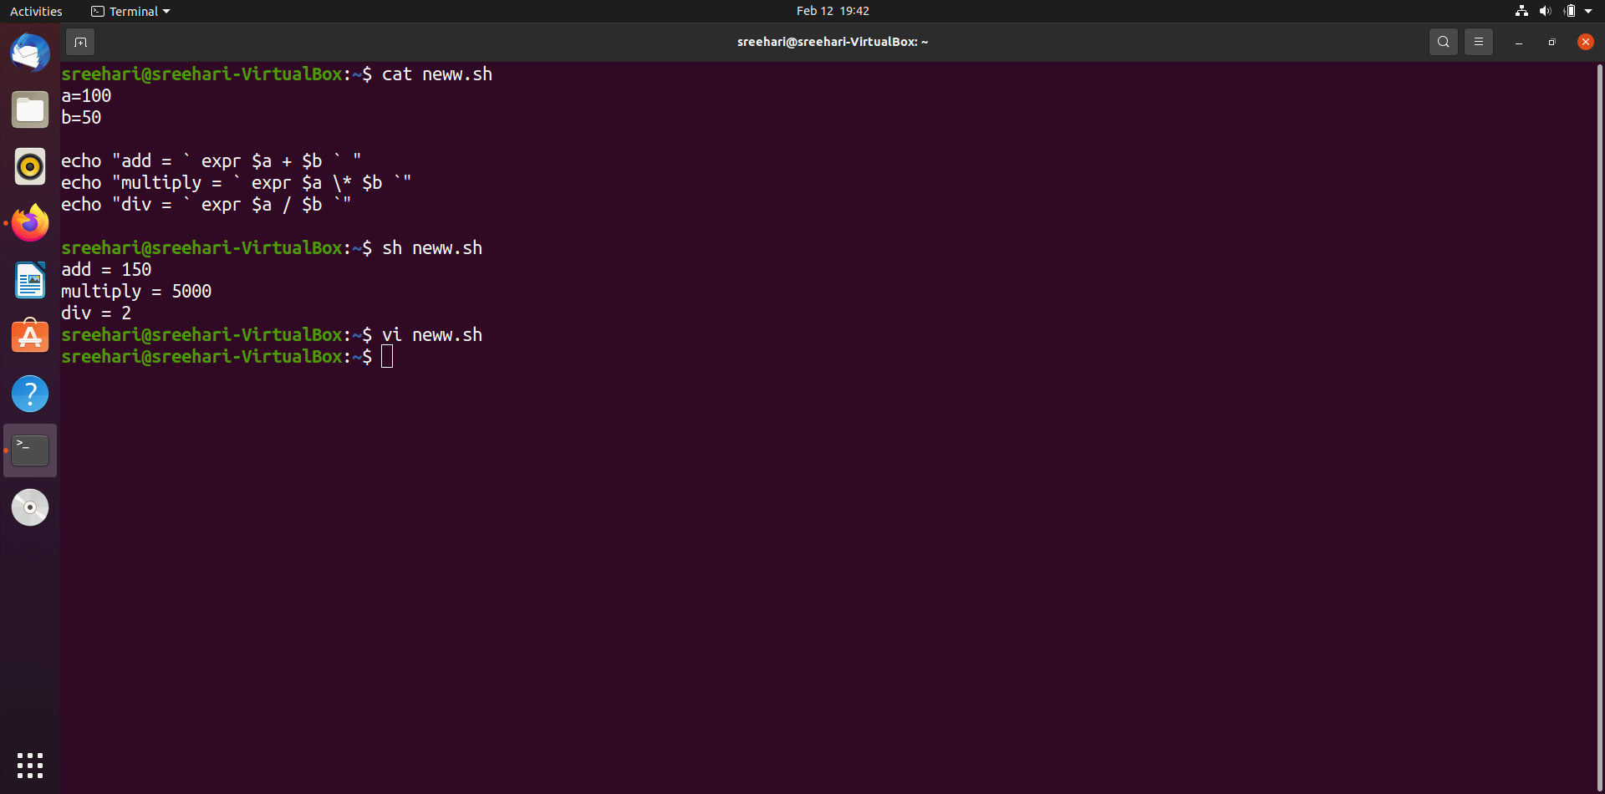
COMMANDS
OPERATORS
ARITHMETIC -, +, / ,* ,%,= ,==, !=
BOOLEAN ! (negation inverts yes or no)
-o(or oprtn if one comand is true
then cndtn is true)
-a (AND oprtn)
RELATIONAL -gt ,-lt ,-eq , -ne ,-ge , -le
STRING OPRTN

Slide 10
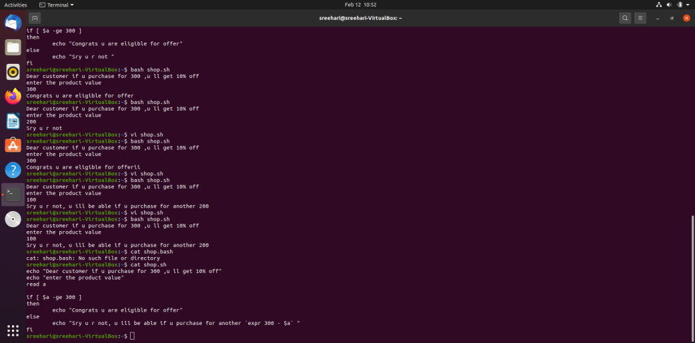
COMMANDS
DECISION MAKING
if
elif - else if

Slide 11
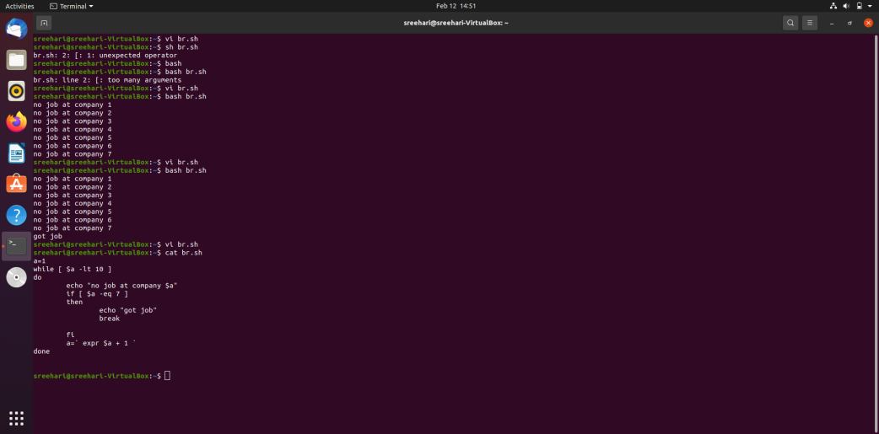
COMMANDS
LOOPS
for
while
do while
until
select
LOOP CONTROLS
break
continue

Slide 12
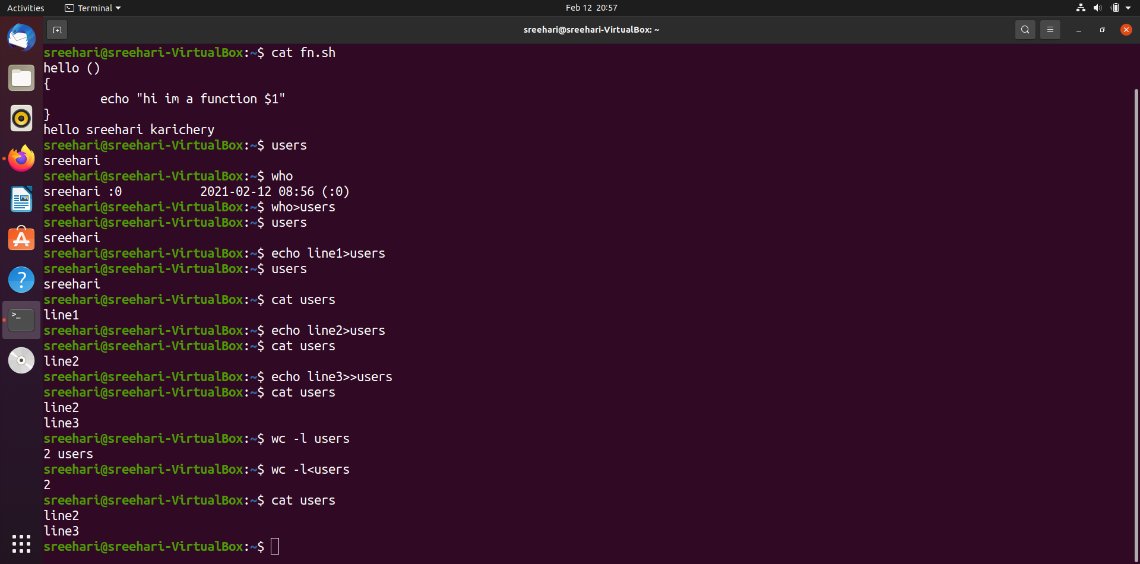
COMMANDS
SHELL FUNCTIONS
functions are used to write reusable code
REDIRECTION
>
>>
<

Slide 13
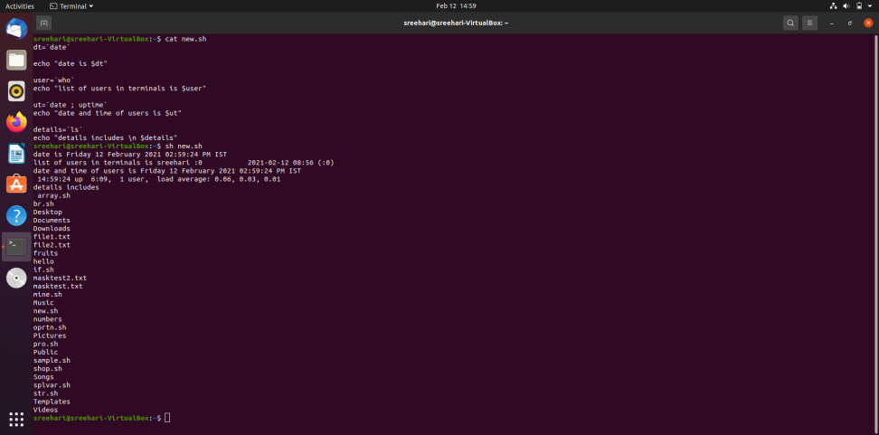
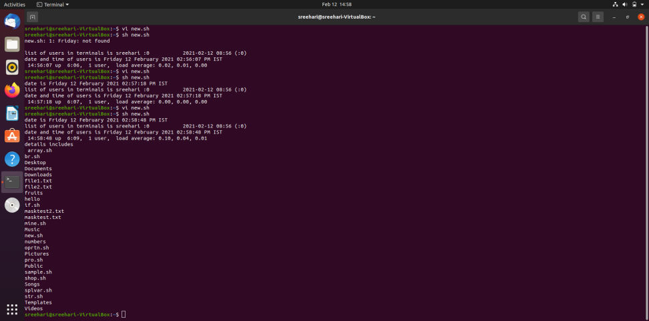

Slide 14
THANK YOU

