Slide 1
Shell Scripting

Slide 2
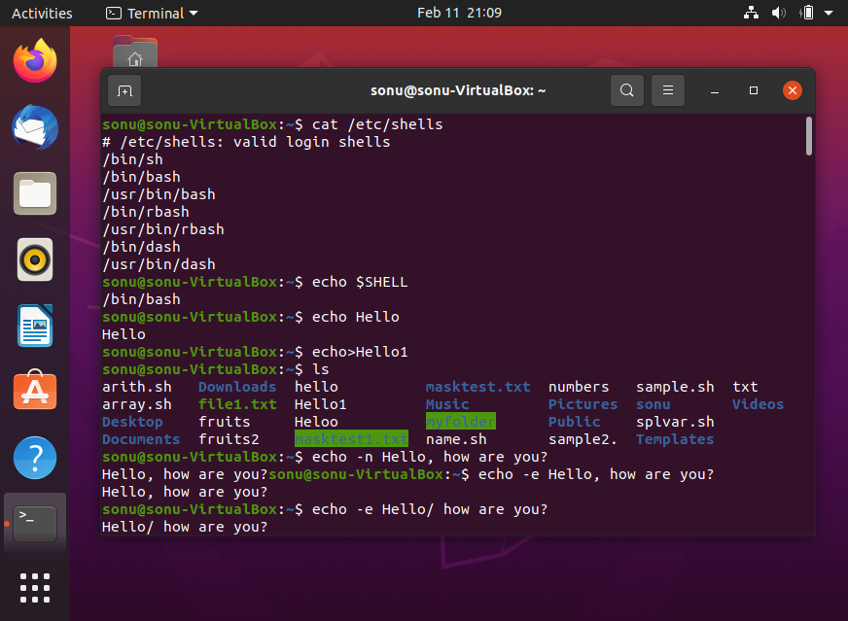
Cat /etc/shells : Used to find the no. of shells available
Echo $Shell: Used to find which shell your using
Echo hello: Prints hello
Echo>hello: Creates a File hello
echo
Option task
-n gives the o/p with new line
-e allows to use backslash escapes
\b Removes space b/w text
\n prints the txt in new line
\t Does a horizontal tab
\v Does a vertical tab

Slide 3
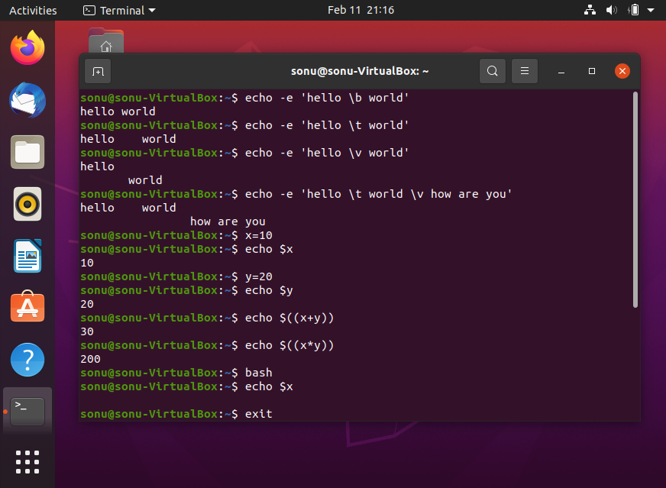
Echo $x : Prints the value of the variable
Operators can be used and the result can be obtained through echo

Slide 4
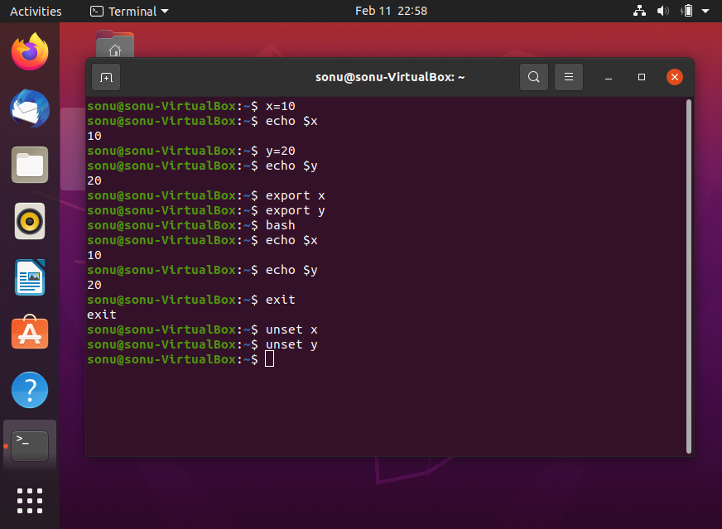
Export : Used for shell to shell access
Set and Unset Variable
Set: Set the variable
Export: Create environment variable
Unset : Remove the variable already set
Set
Option task
-b notify the job termin. immediately
-e exit imm. If the command exist with non zero status
-m Job will be enabled

Slide 5
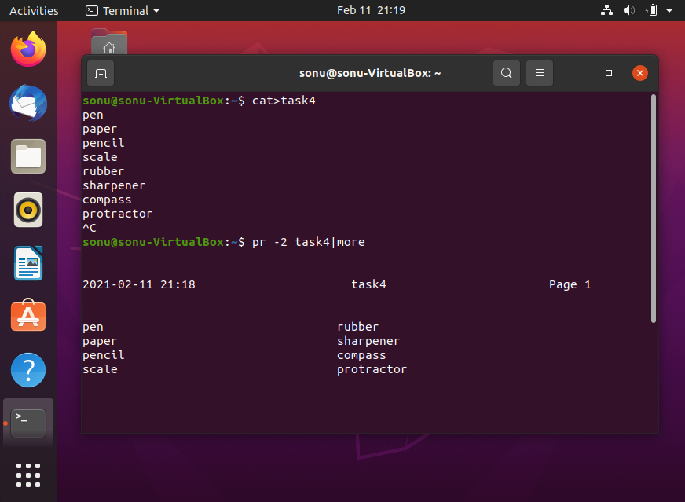
Pr -n filename|more: Used to print in desired columns

Slide 6
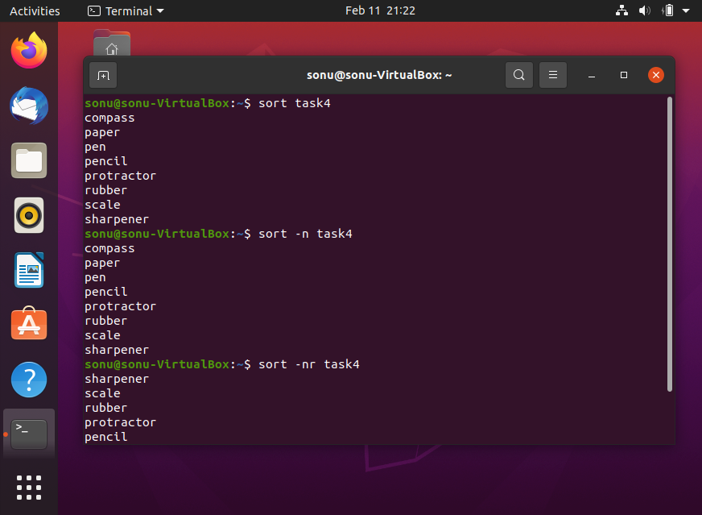
Sort filename:
Sorts the first letter of each word in alphabetic order
Sort –n filename: sorts the words in alphabetic order
Sort –nr filename: sorts the words in reverse alphabetic order

Slide 7
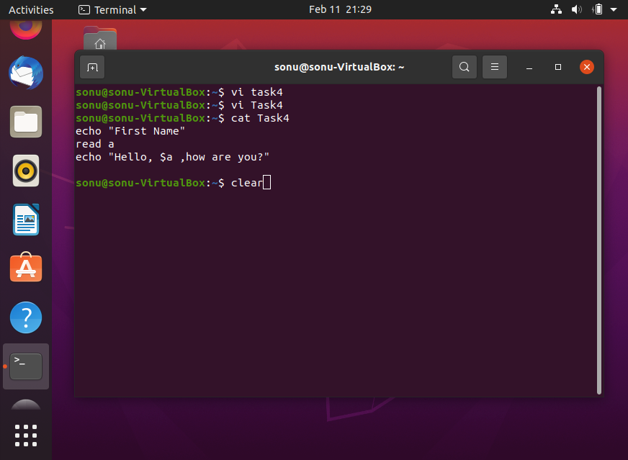
Vi/vim : Editor to edit files
Vi filename: Creates a new file if does not exist otherwise it opens
Vi –R filename: Opens the existing file in read only mode
Vi commands
j- to down the cursor
k- up the cursor
h-to move left the cursor
I –to move right the cursor
:q!– quit
:wq- save nd quit
yy- copy complete line
4yy- copy 4 lines
dd-to delete
p- paste
cc-cut

Slide 8
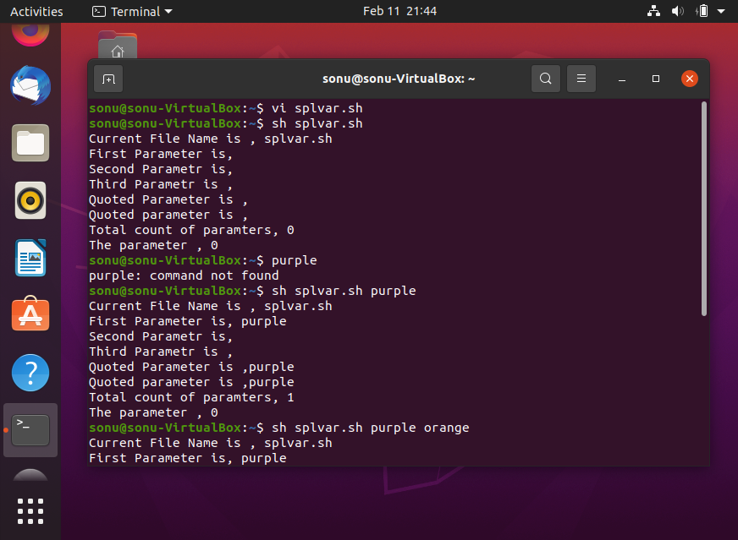
Special variable
$0- filename of the current script
$n- position of an argument
$#- No. of arguments supplied to the script
$*-all the arguments are double quoted
$@-all the arguments are individually quoted
$?- exit status of the last command

Slide 9
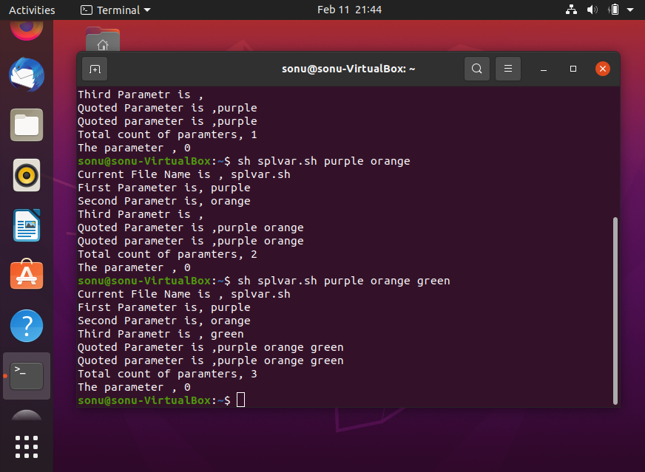

Slide 10
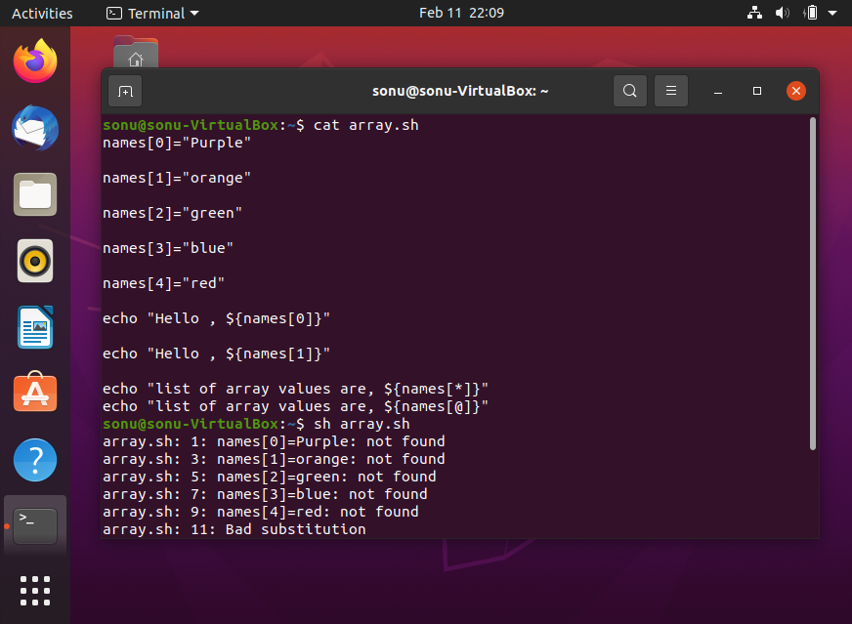
Shell arrays
File= [file1,file2, file3]
1st value stored in 0
Second value stored in 1
Third value stored in 2

Slide 11
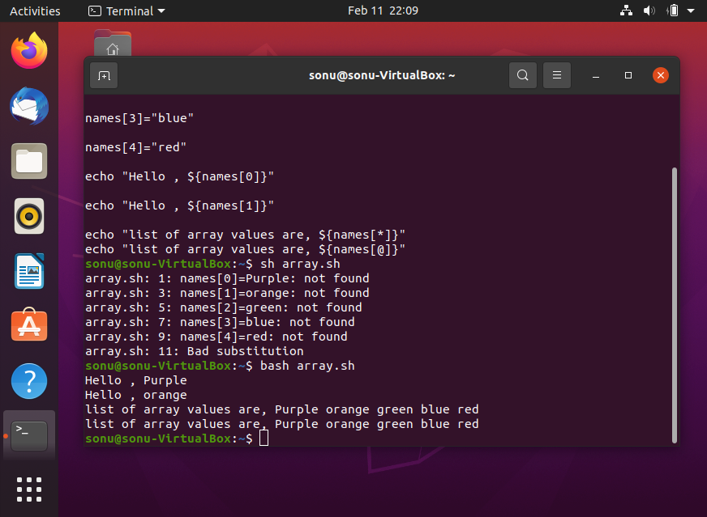

Slide 12
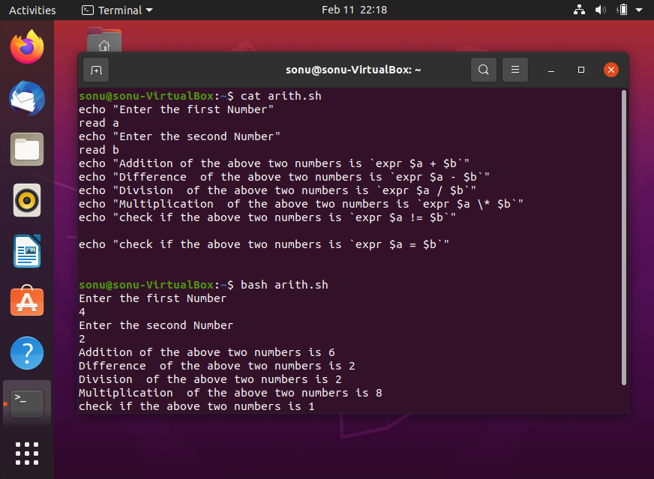
Shell Operators
Arithmetic: + ,- ,* ,/ ,= ,!=
Relational : eq , eq or not
Boolean: True or false
String
File test

Slide 13
