Slide 1
E commerce

Slide 2
Abstract
Online shopping is something that most of us take for granted these days. We enjoy the convenience and other benefits of shopping online.
However it wasn’t that long ago that we couldn’t shop online from home at all. Online shopping didn’t even develop until the mid-1990’s.
When we remember that, we realize that we’re still in the early stages of online shopping.
We’re still learning what works, what doesn’t and how we can improve this great shopping option so that it’s even better in the future than it is today.

Slide 3
Goals
Selling products online.
Making brands to reach more customers.
Maintain admin panel
Maintain vendor panel
Vendor can add or delete his/her advertisements.
Admin can maintain both customers and vendors.

Slide 4
Technology used
Java(spring ,hibernate)
Mysql for database
Html
Css
Java script
jsp

Slide 5
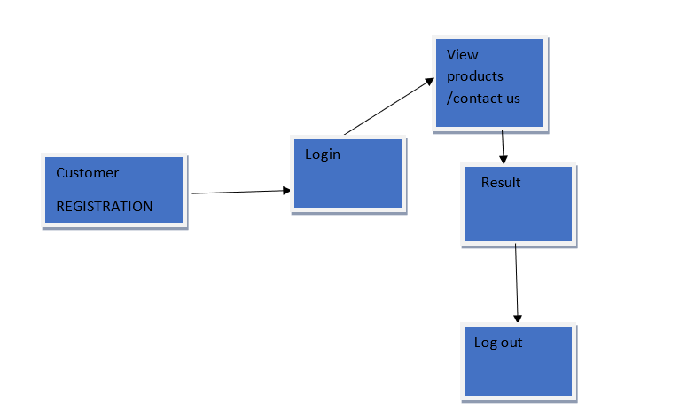
Customer flow diagram

Slide 6
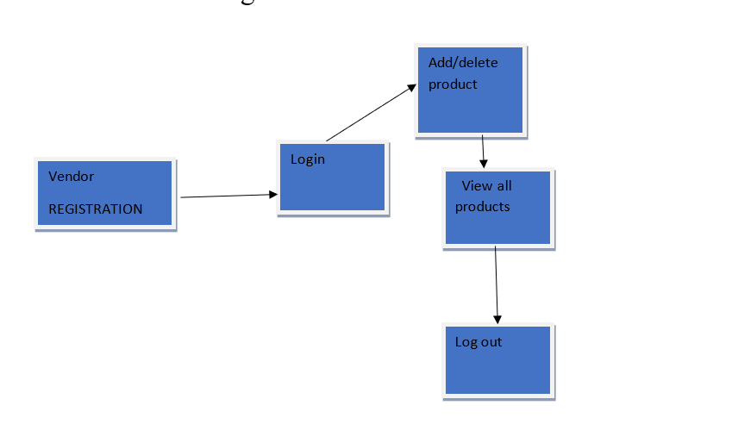
Vendor flow diagram

Slide 7
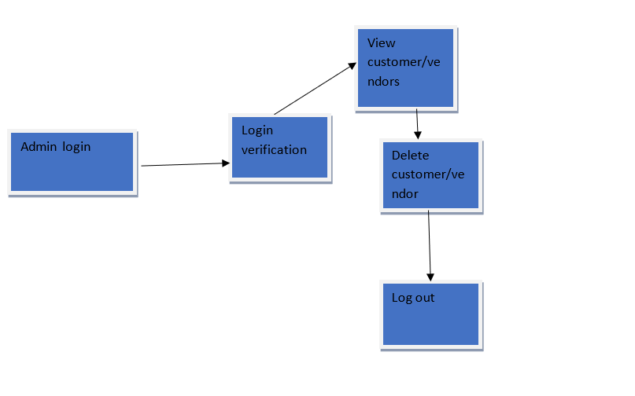
Admin flow diagram

Slide 8
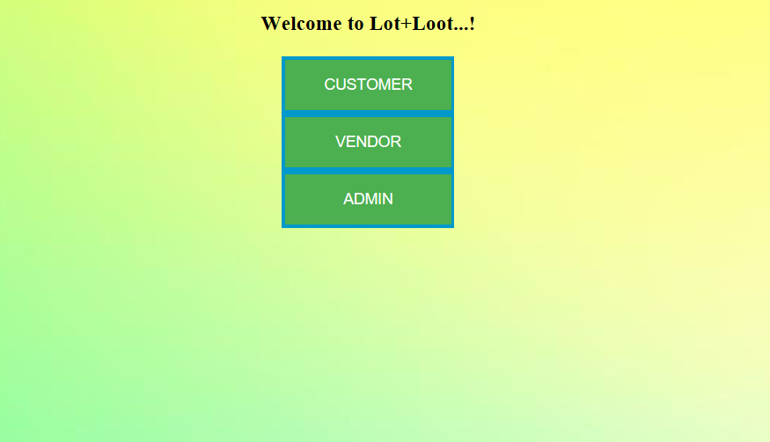
Index page

Slide 9
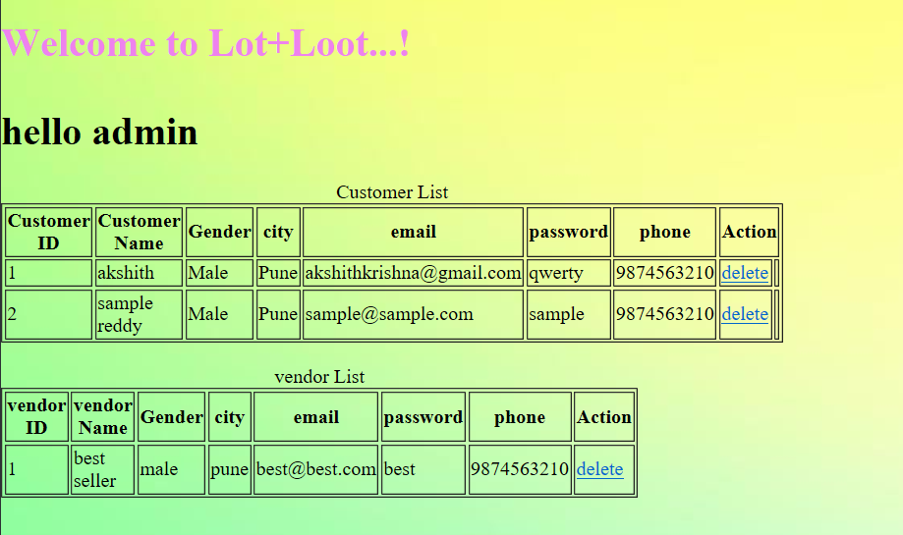
Admin page:

Slide 10
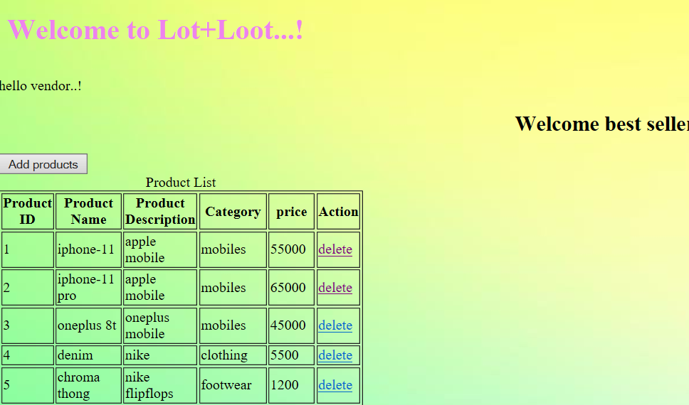
Vendor page:

Slide 11
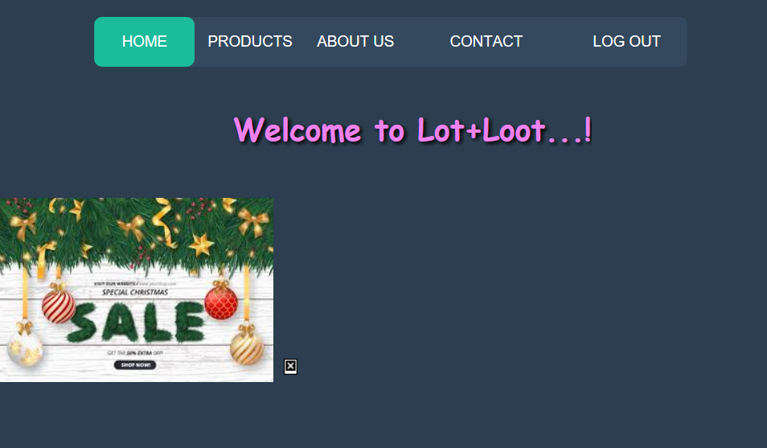
Customer home page

Slide 12
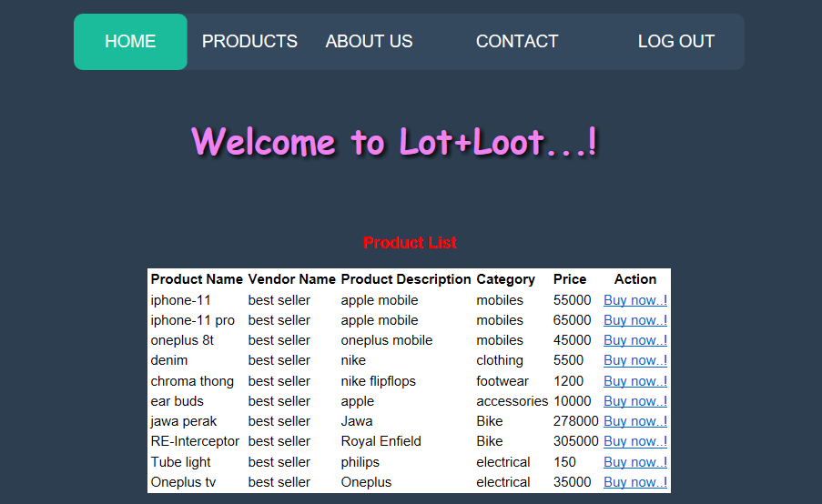
Product page

Slide 13
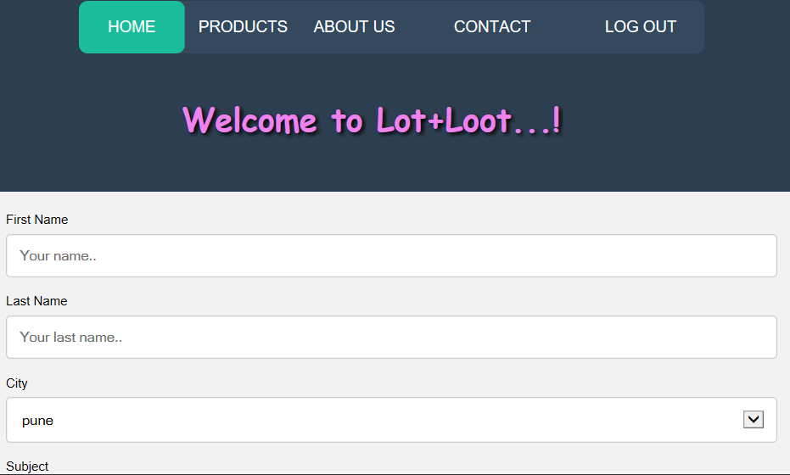
Customer contacting to site:

Slide 14
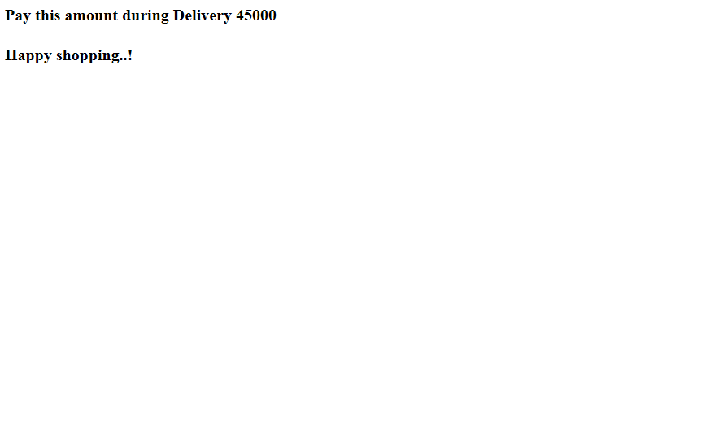

Slide 15


