Slide 1


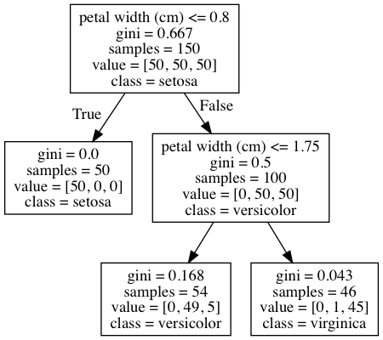
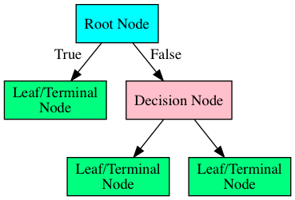
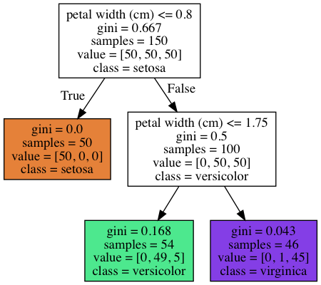

Slide 2

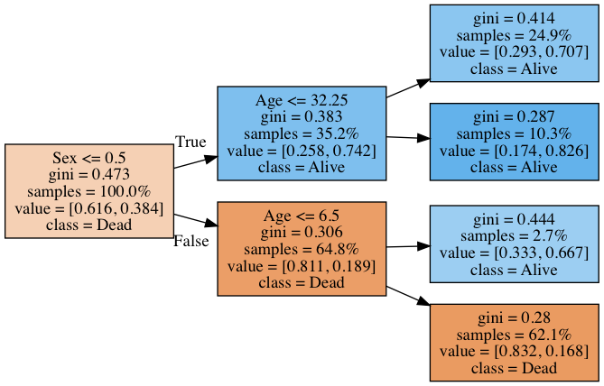
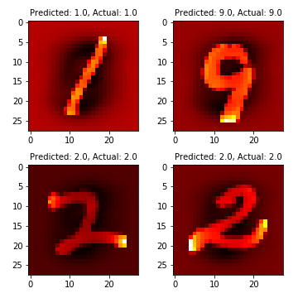
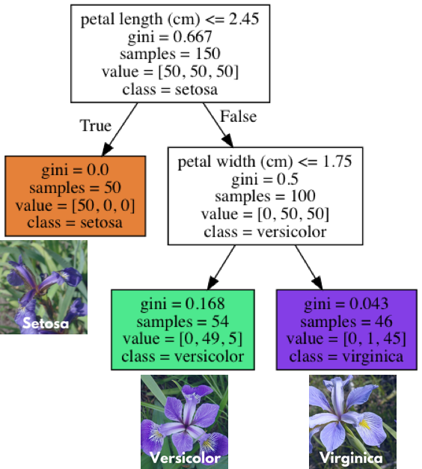

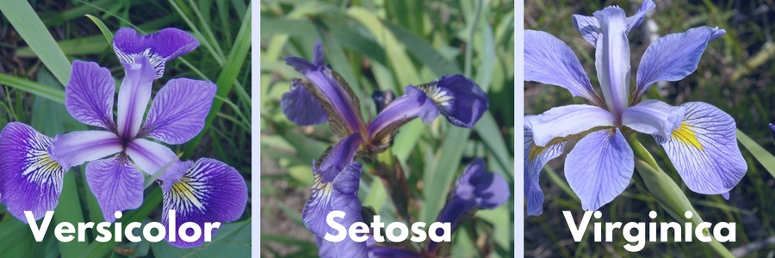

Slide 3
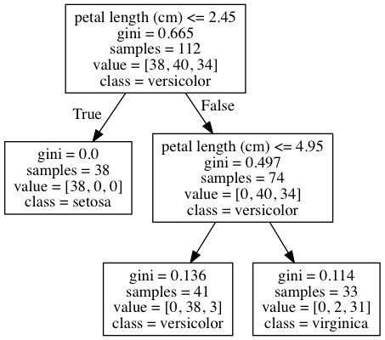

Slide 4
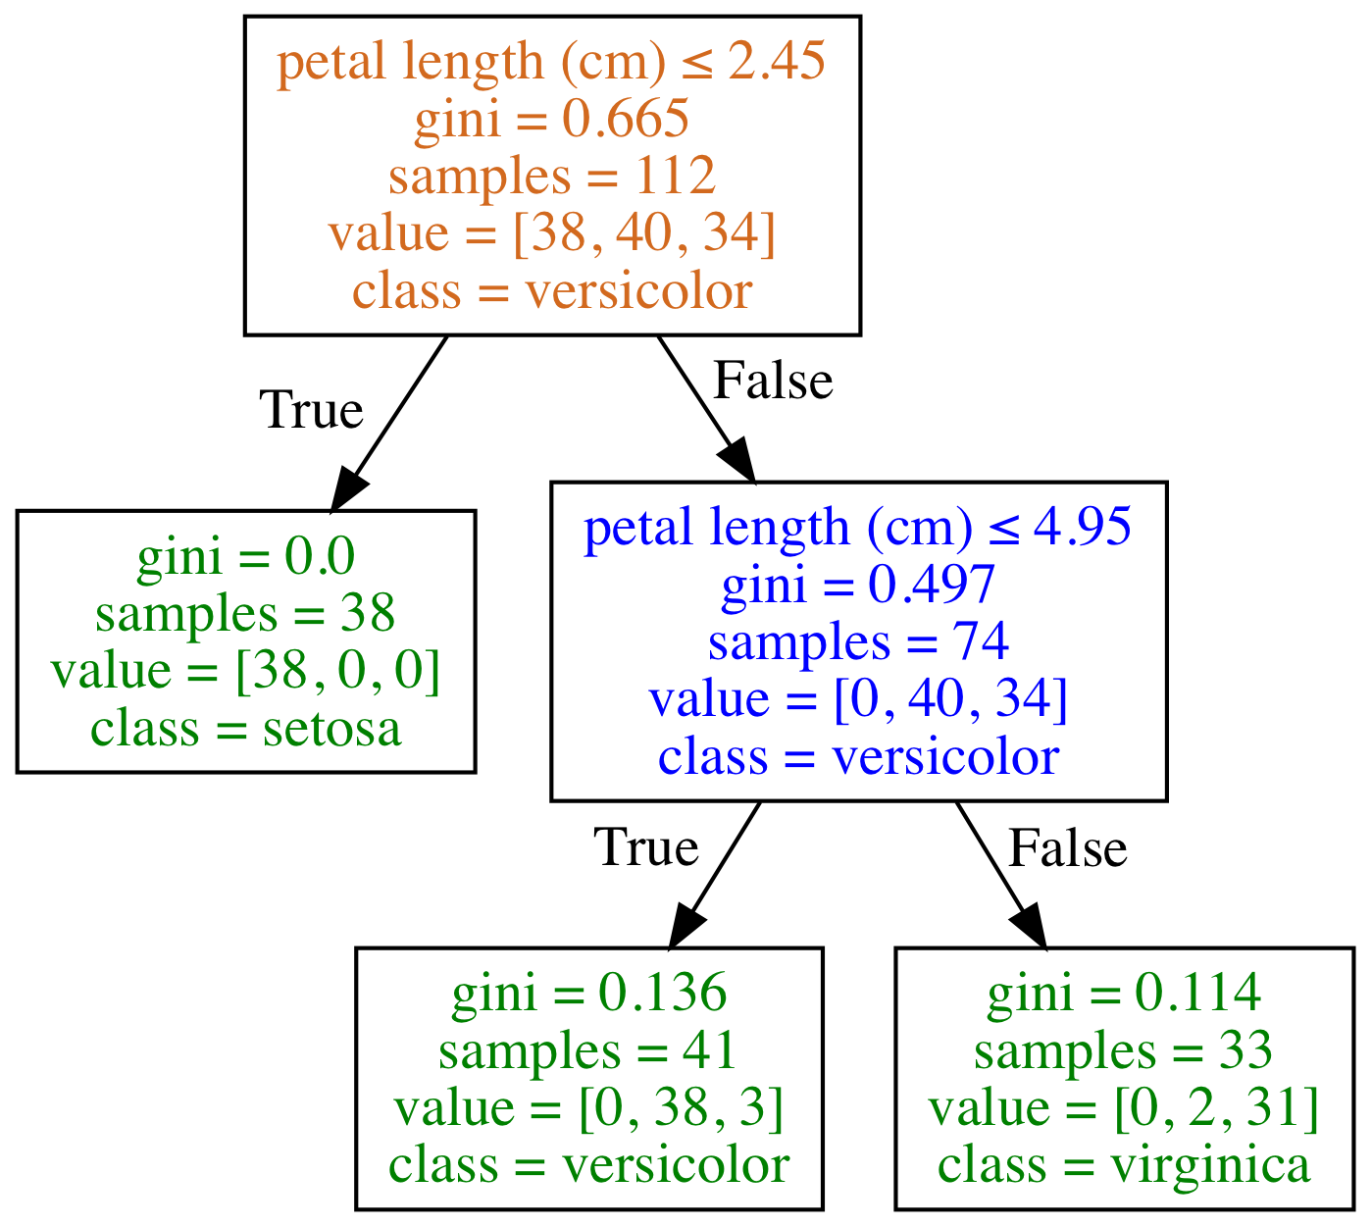
Type of Node
Root Node
Decision Node
Leaf/Terminal Node

Slide 5
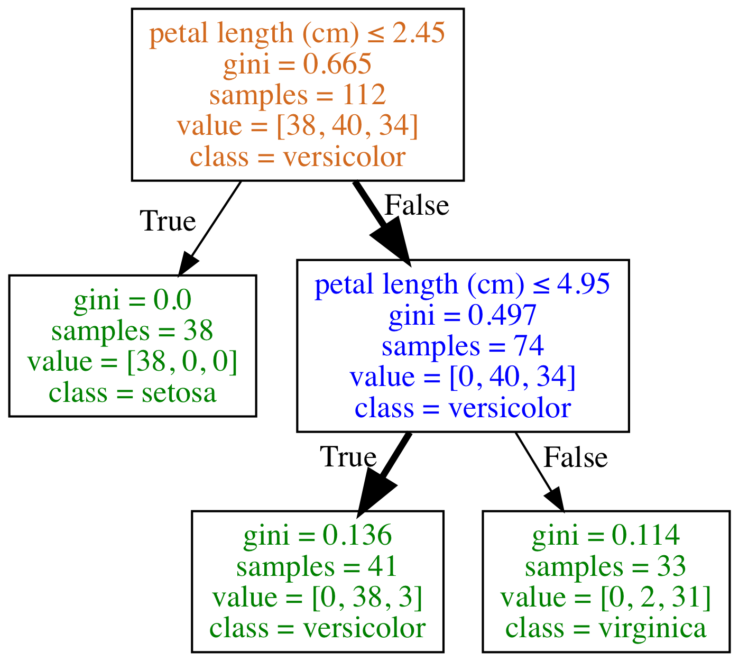
What class (species) is a flower with the following feature?
petal length (cm): 4.5
Type of Node
Root Node
Decision Node
Leaf/Terminal Node
Species counts are: setosa=0, versicolor=38, virginica=3
Prediction is versicolor as it is the majority class

Slide 6
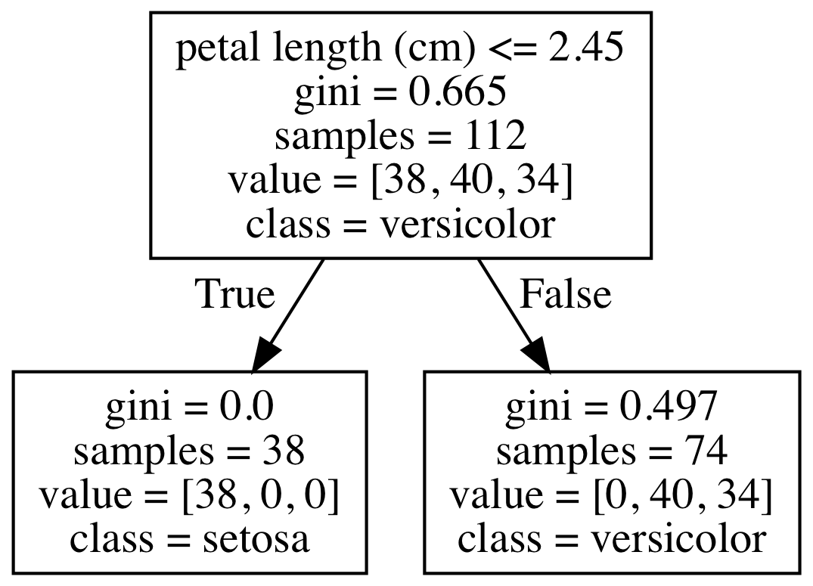
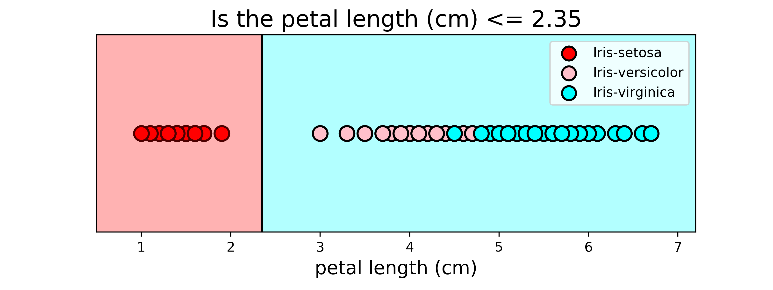
Classified as Setosa
Classified as Virginica
Fix to have split point as 2.45 to be consistent. Put in A and B so it can be labeled

Slide 10
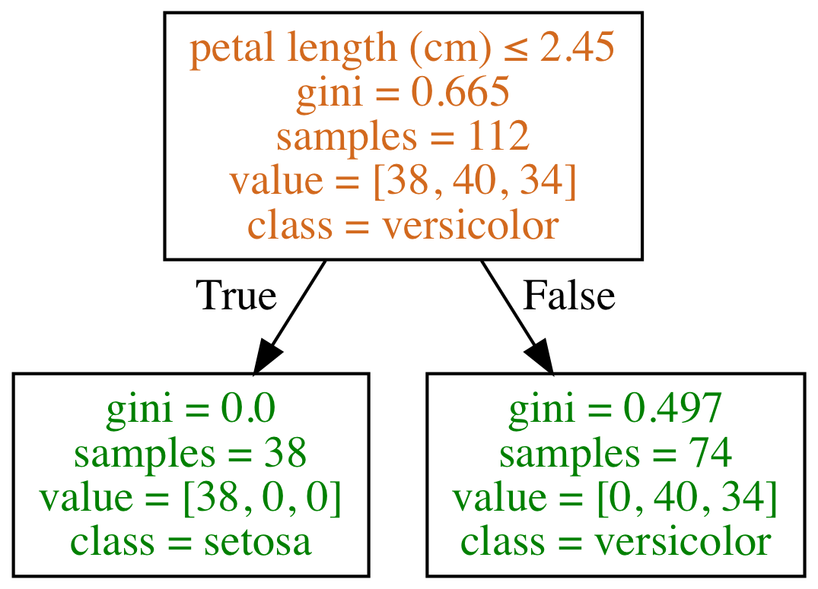
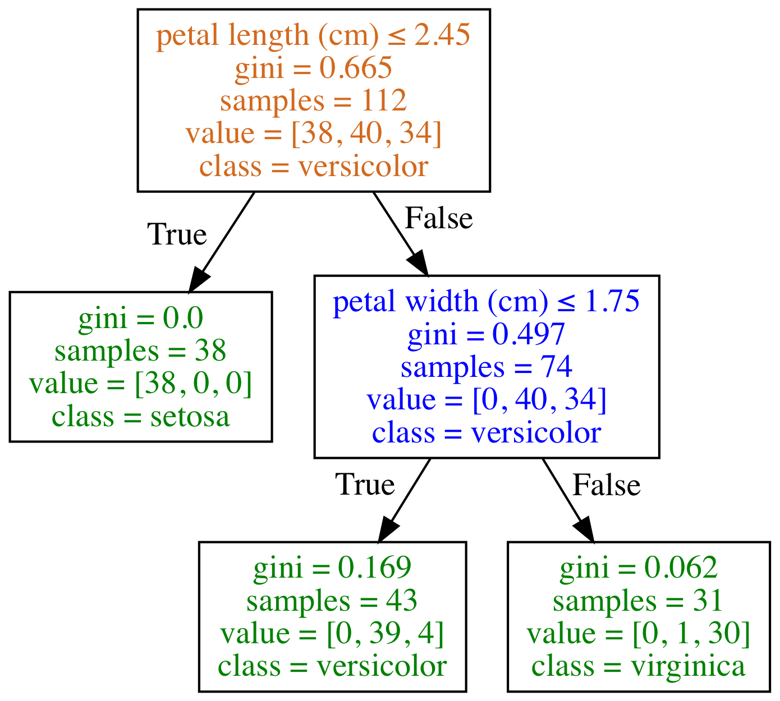
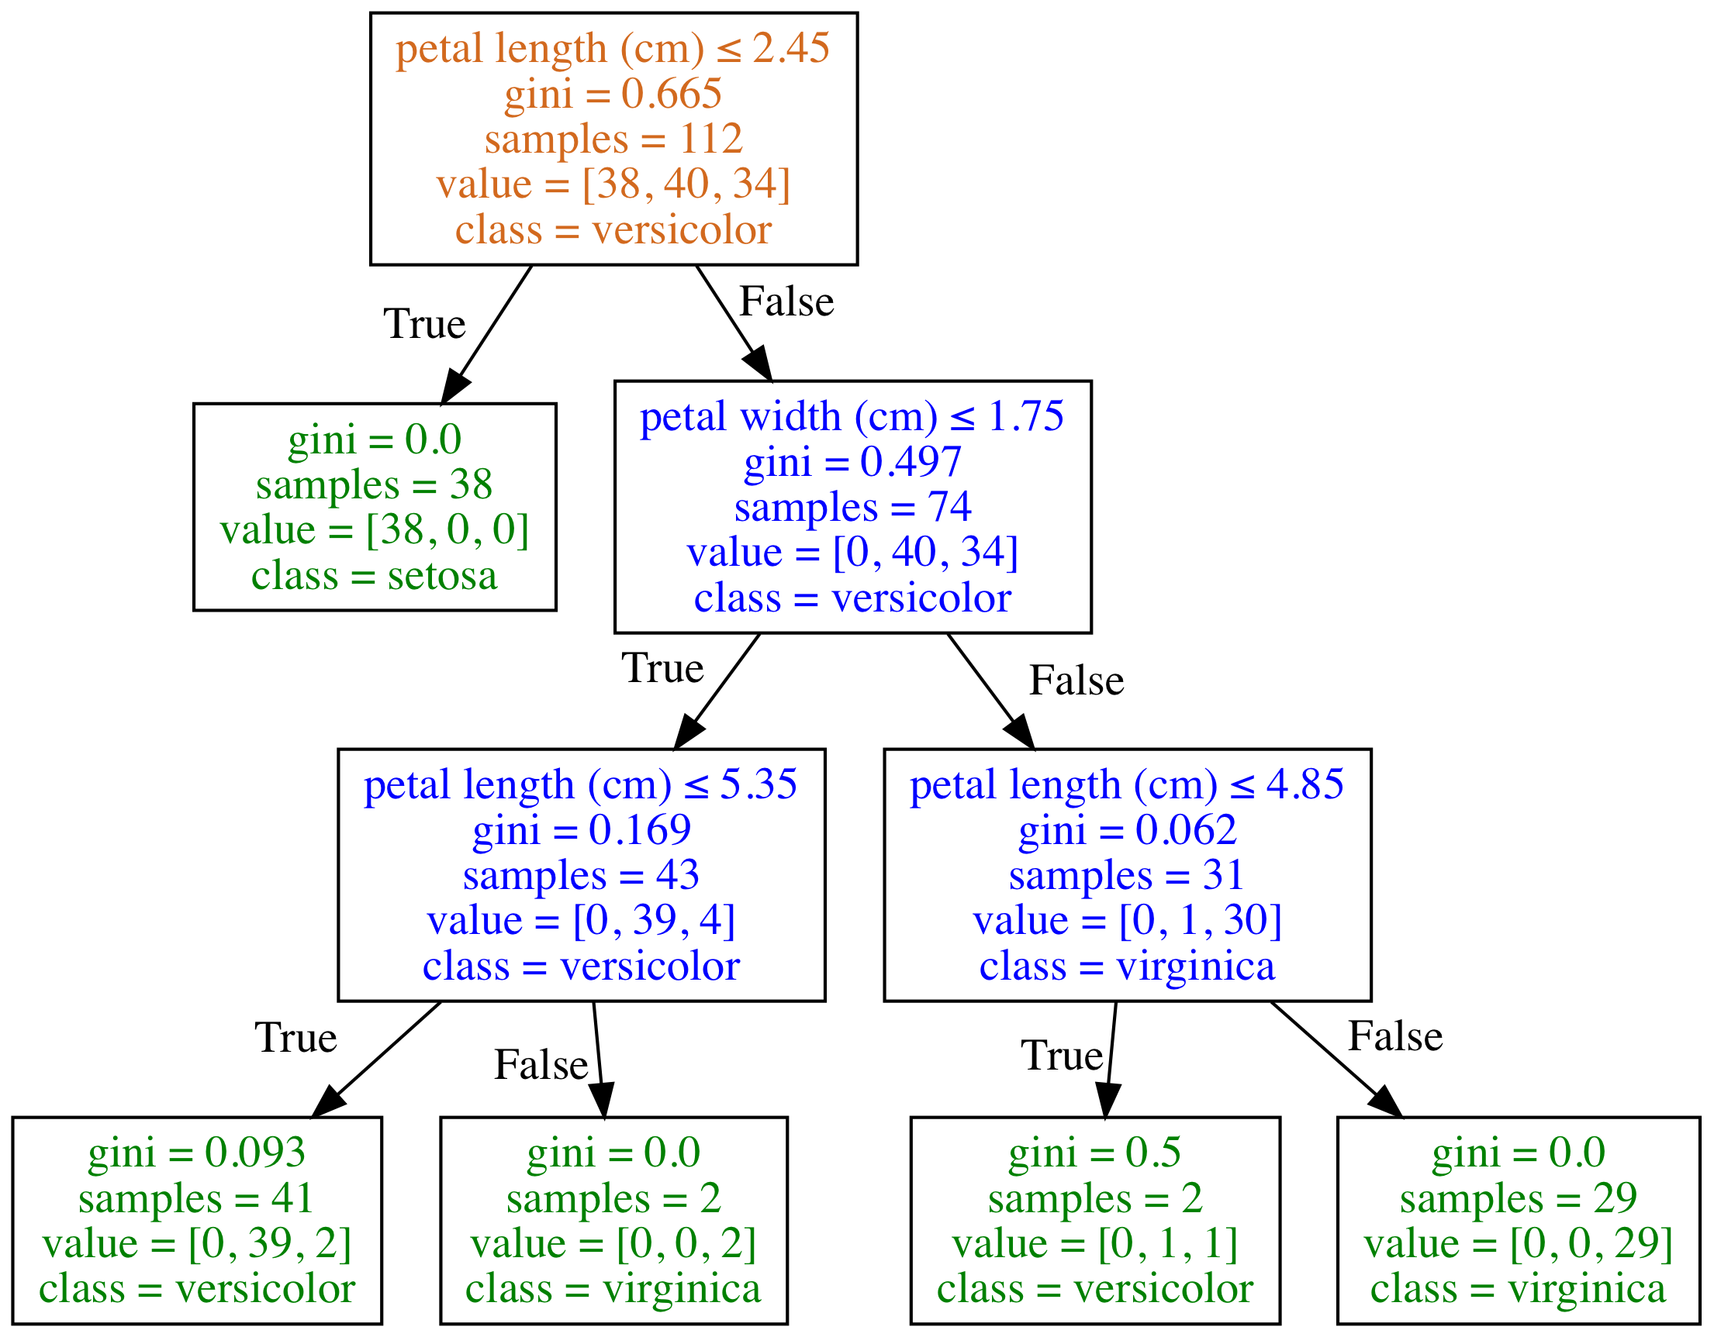
Depth of Classification Trees
Type of Node
Root Node
Decision Node
Leaf/Terminal Node
Depth = 1
Depth = 2
Depth = 3
Species counts are: setosa=0, versicolor=38, virginica=3
Prediction is versicolor as it is the majority class

Slide 19
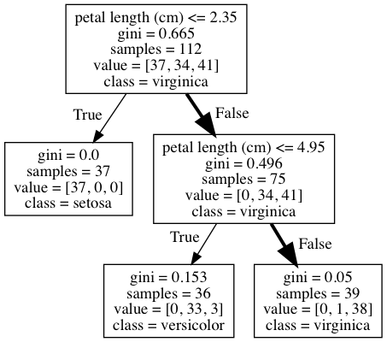
What class (species) is a flower with the following features?
sepal length (cm): 5.8
sepal width (cm): 2.8
petal length (cm): 5.1
petal width (cm): 2.4
The prediction is virginica as it is the majority class.

Slide 20
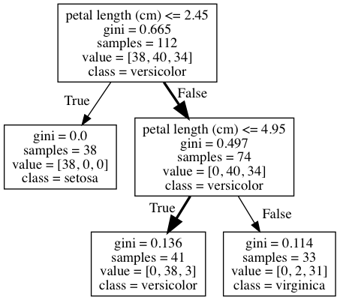


Slide 21
What class (species) is a flower with the following feature?
petal length (cm): 4.5
The prediction is versicolor

Slide 22
What class (species) is a flower with the following features?
sepal length (cm): 5.8
sepal width (cm): 2.8
petal length (cm): 5.1
petal width (cm): 2.4
The prediction is virginica as it is the majority class.

Slide 23
