Slide 1
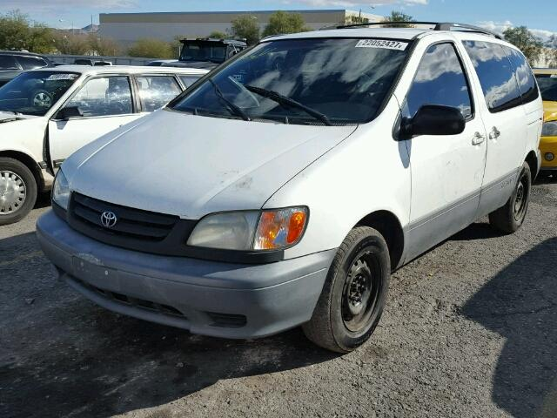

2002 Toyota Sienna
2019 Toyota Sienna

Slide 2
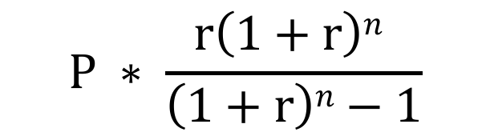
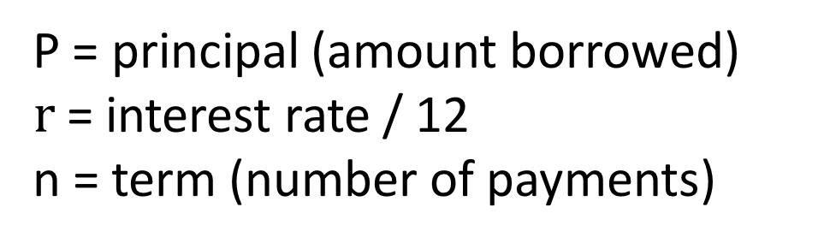
P = principal (amount borrowed)
$r$= interest rate / 12
n = term (number of payments)
$$P ∗ \frac{r\left(1+r\right)n }{\left(1+r\right)n−1}$$

Slide 3
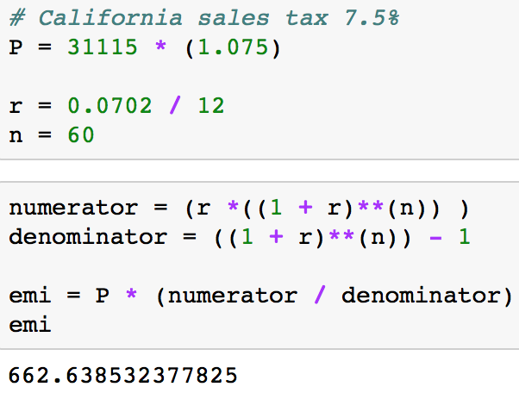
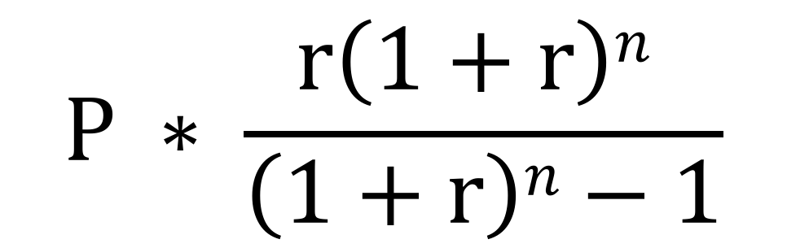
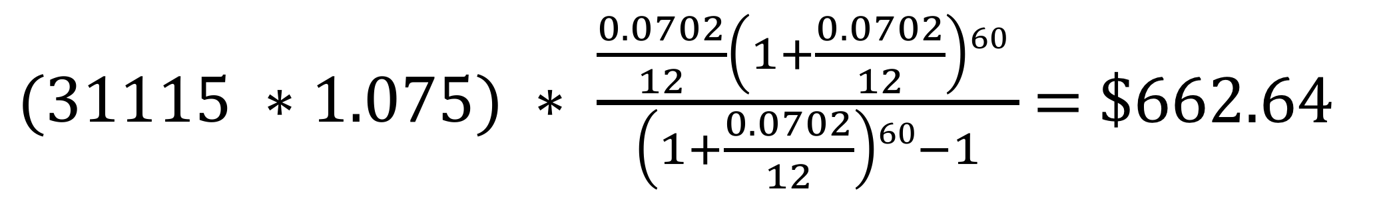
EMI Formula
Python Calculation
$$P ∗ \frac{r\left(1+r\right)n }{\left(1+r\right)n−1}$$
Calculation
$(31115 ∗1.075) ∗ \frac{\frac{0.0702}{12}\left(1+\frac{0.0702}{12}\right)60 }{\left(1+\frac{0.0702}{12}\right)60−1}$ = $662.64

Slide 4
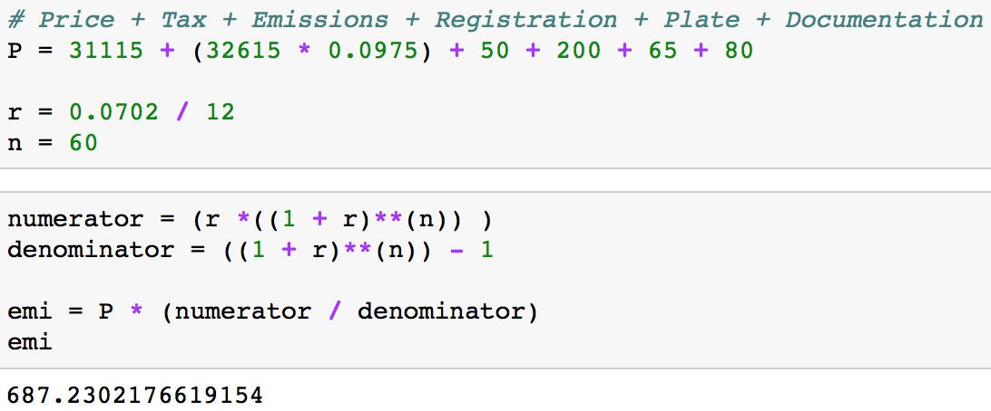
EMI Formula
Python Calculation
$$P ∗ \frac{r\left(1+r\right)n }{\left(1+r\right)n−1}$$
Calculation
$\text{[31115+}\text{(32615∗0.0975 )+(50+200+65+80) }\text{]}$ $∗ \frac{\frac{0.0702}{12}\left(1+\frac{0.0702}{12}\right)60 }{\left(1+\frac{0.0702}{12}\right)60−1}$ = $687.23

Slide 5
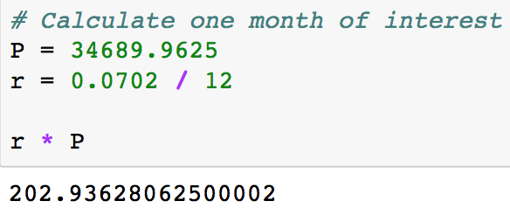

Interest Paid (One Month)
Python Calculation
$$r ∗P$$
Calculation
$\frac{0.0702}{12}∗34689.96$= $202.94

Slide 6
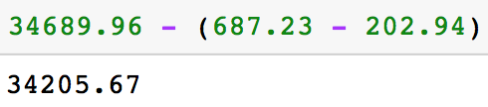
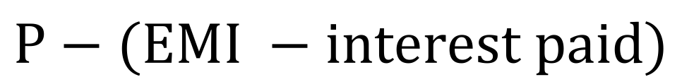
Calculate New Principal
Python Calculation
$$P−(EMI −interest paid)$$
Calculation
$34689.96$ – (687.23 - $202.94) = 34205.67

Slide 7
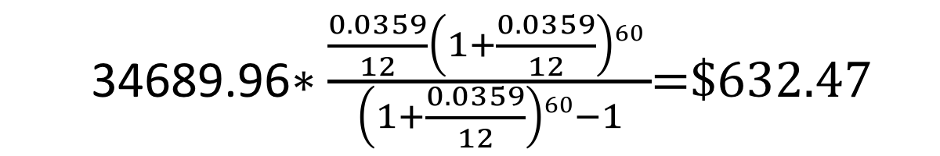
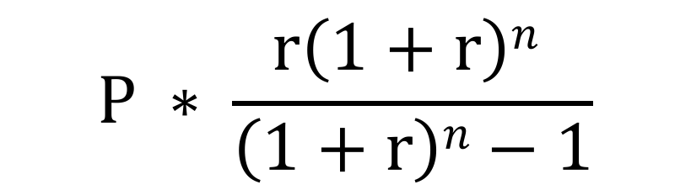
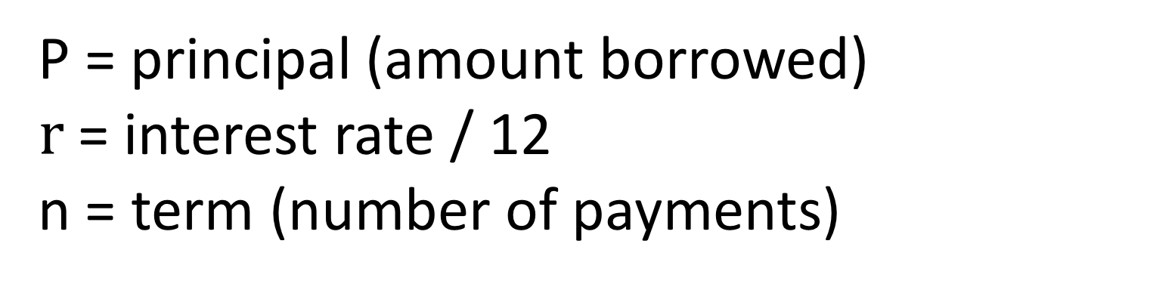
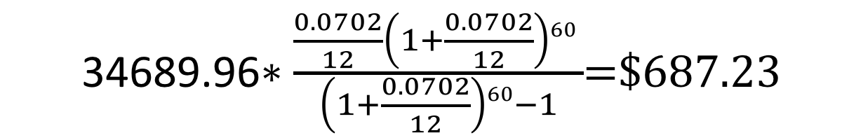
EMI Formula
P = principal (amount borrowed)
$r$= interest rate / 12
n = term (number of payments)
$$P ∗ \frac{r\left(1+r\right)n }{\left(1+r\right)n−1}$$
Calculation (7.02%)
Calculation (3.59%)
34689.96$∗\frac{\frac{0.0702}{12}\left(1+\frac{0.0702}{12}\right)60 }{\left(1+\frac{0.0702}{12}\right)60−1}$=$687.23
34689.96$∗\frac{\frac{0.0359}{12}\left(1+\frac{0.0359}{12}\right)60 }{\left(1+\frac{0.0359}{12}\right)60−1}$=$632.47

