Slide 1


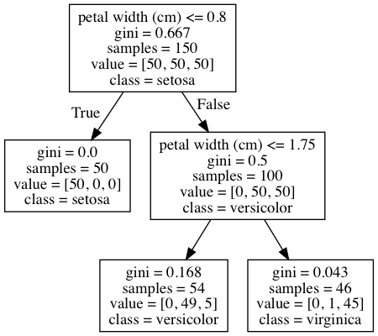
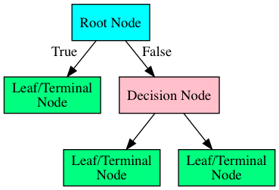
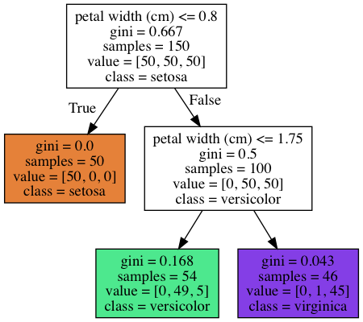

Slide 2

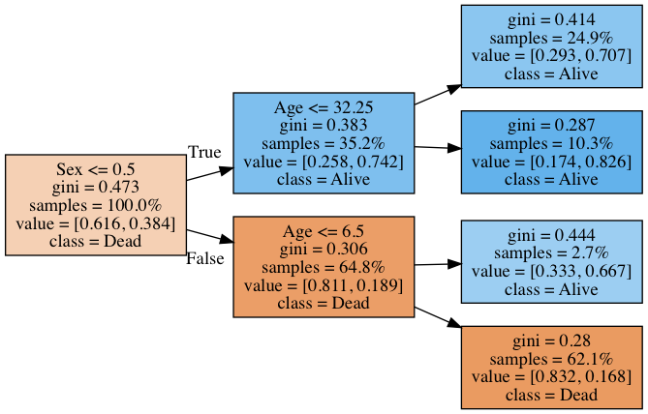
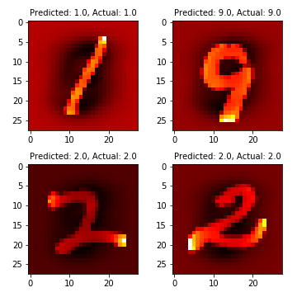
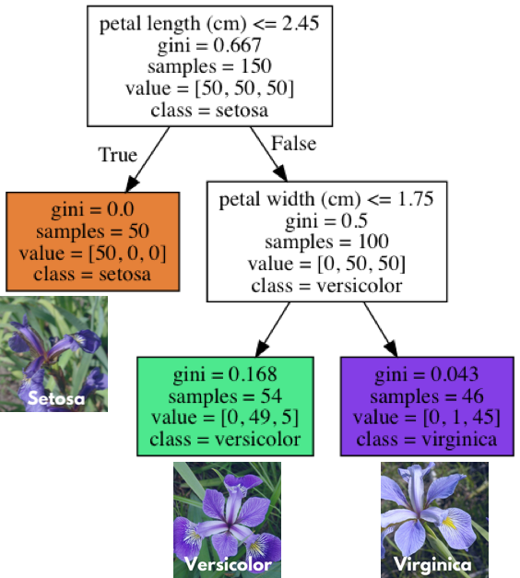

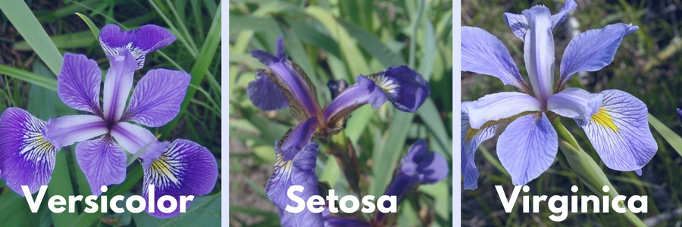

Slide 3
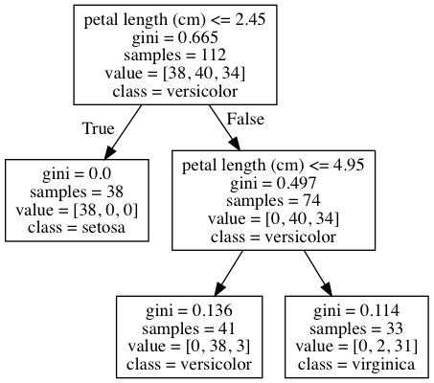

Slide 4
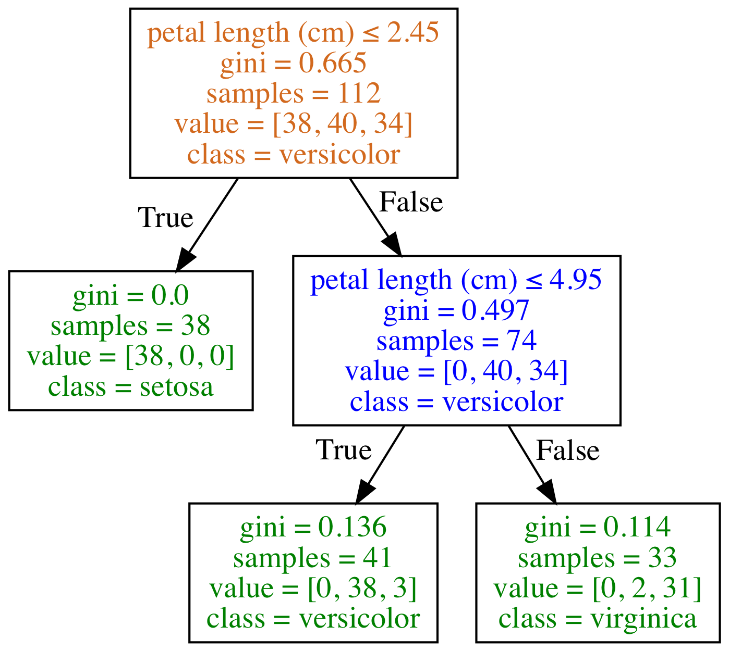
Type of Node
Root Node
Decision Node
Leaf/Terminal Node

Slide 5
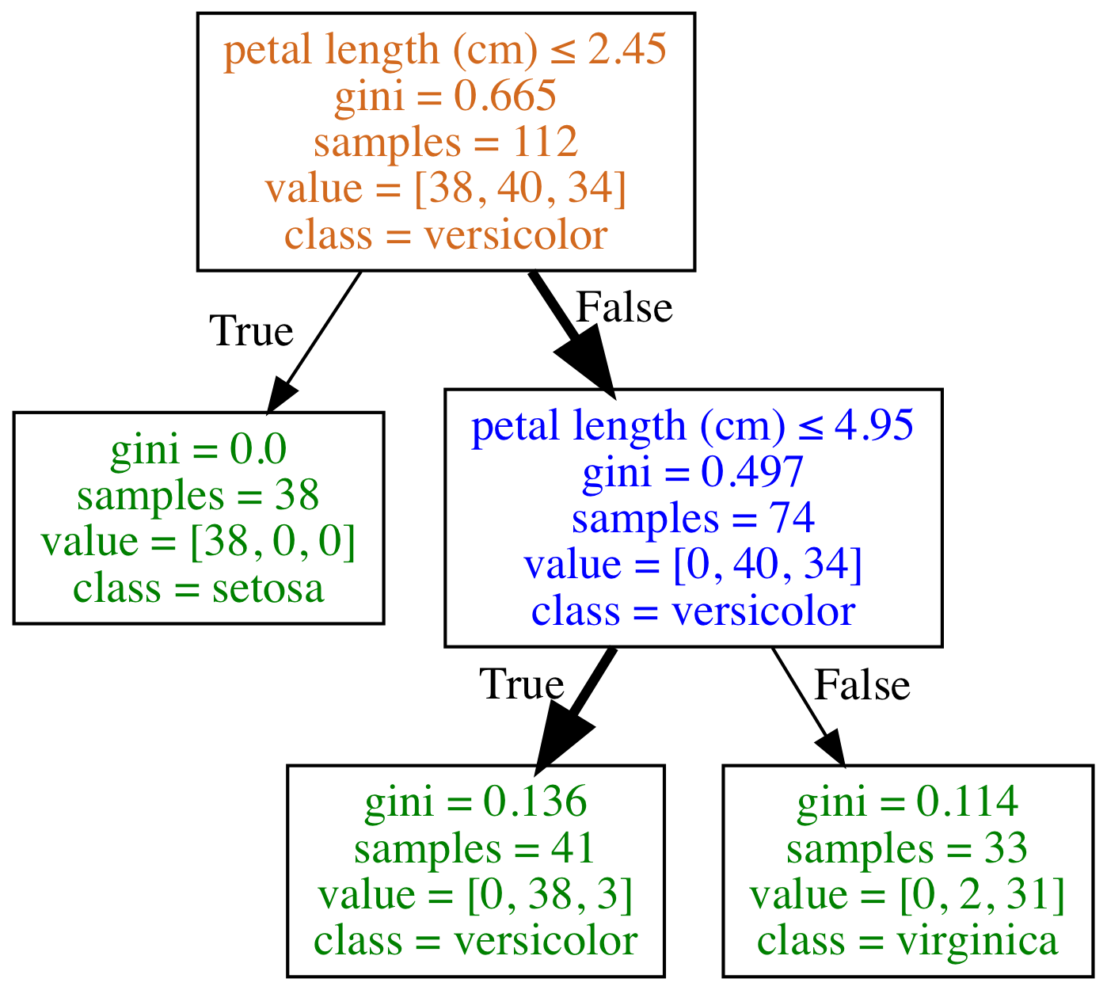
What class (species) is a flower with the following feature?
petal length (cm): 4.5
Type of Node
Root Node
Decision Node
Leaf/Terminal Node
Species counts are: setosa=0, versicolor=38, virginica=3
Prediction is versicolor as it is the majority class

Slide 6
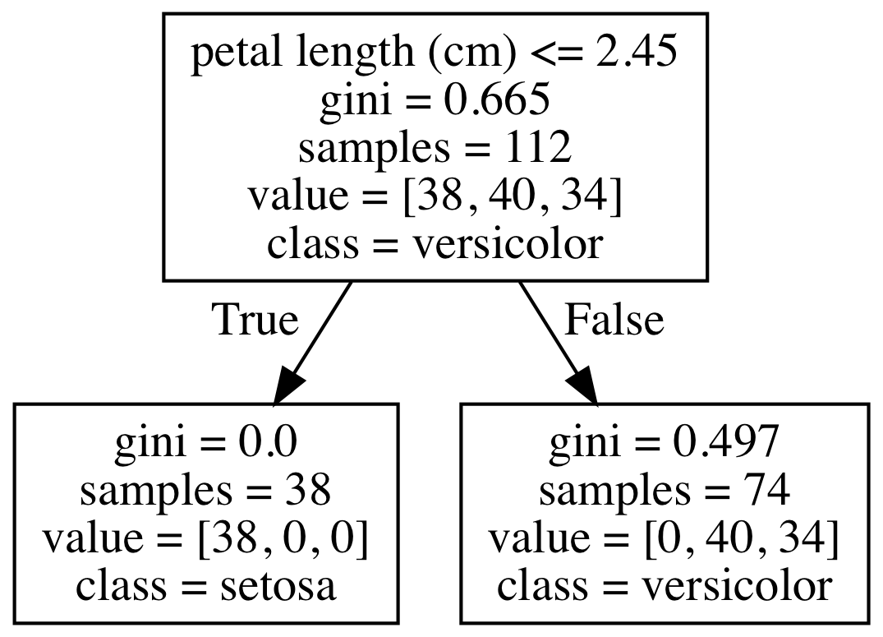
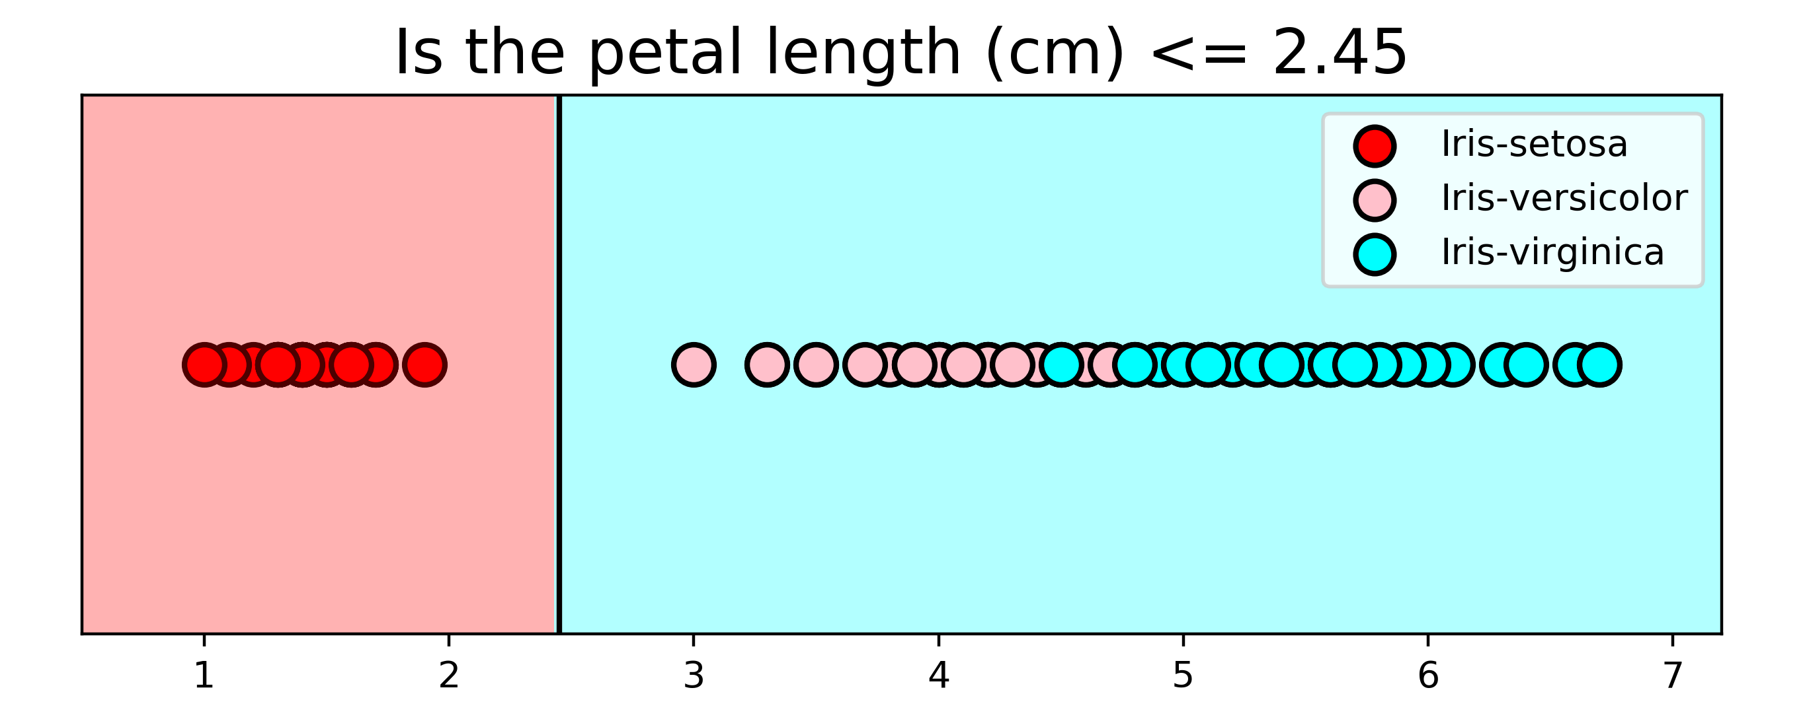
Classified as Setosa
Classified as
Virginica
Split Point = 2.45
Pure Node so no further splitting
Impure Node so can split further

Slide 7

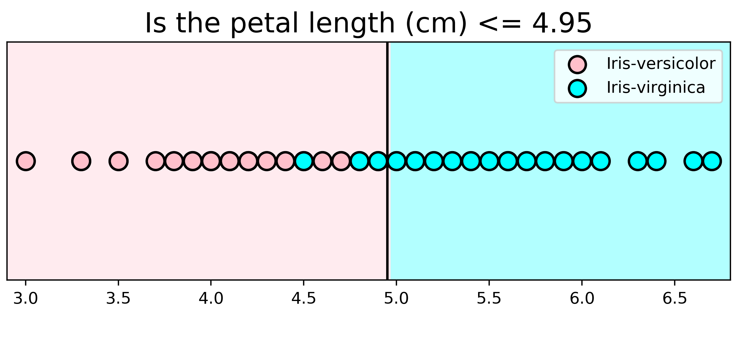
Classified as Versicolor
Classified as
Virginica
Split Point = 4.95
Impure Node so can split further
Impure Node so can split further
Classified as Setosa
Classified as
Virginica
Split Point = 2.45

Slide 8
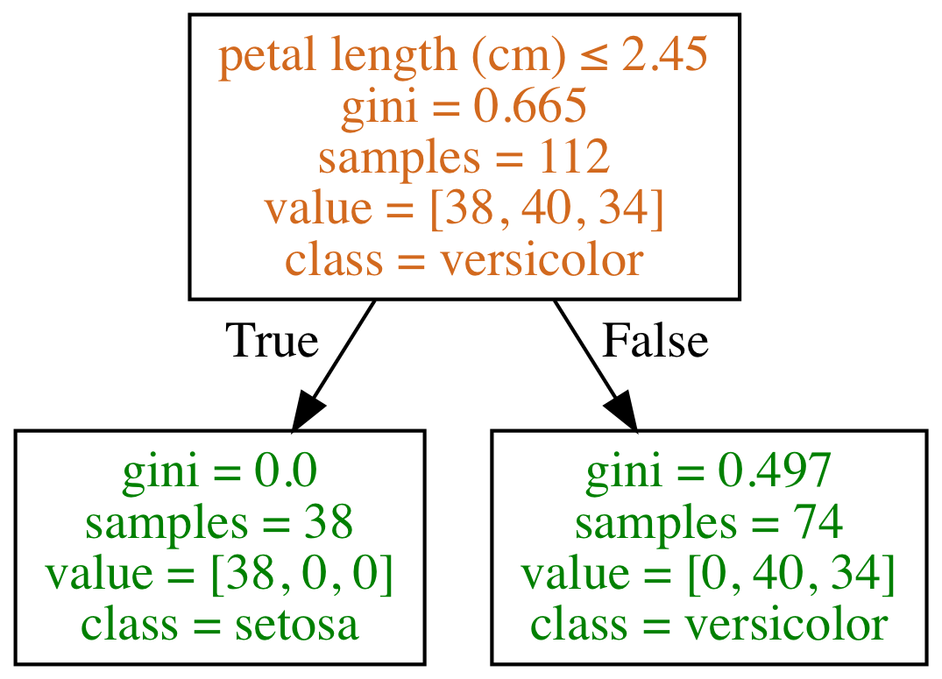
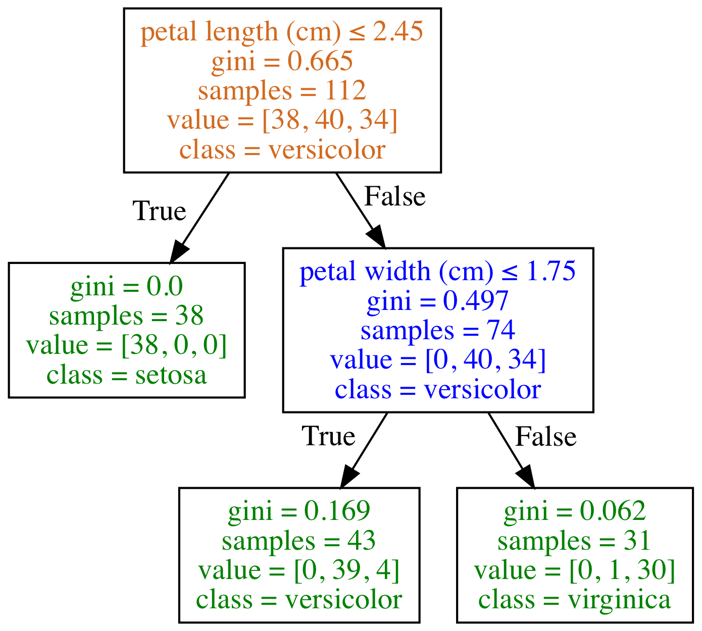
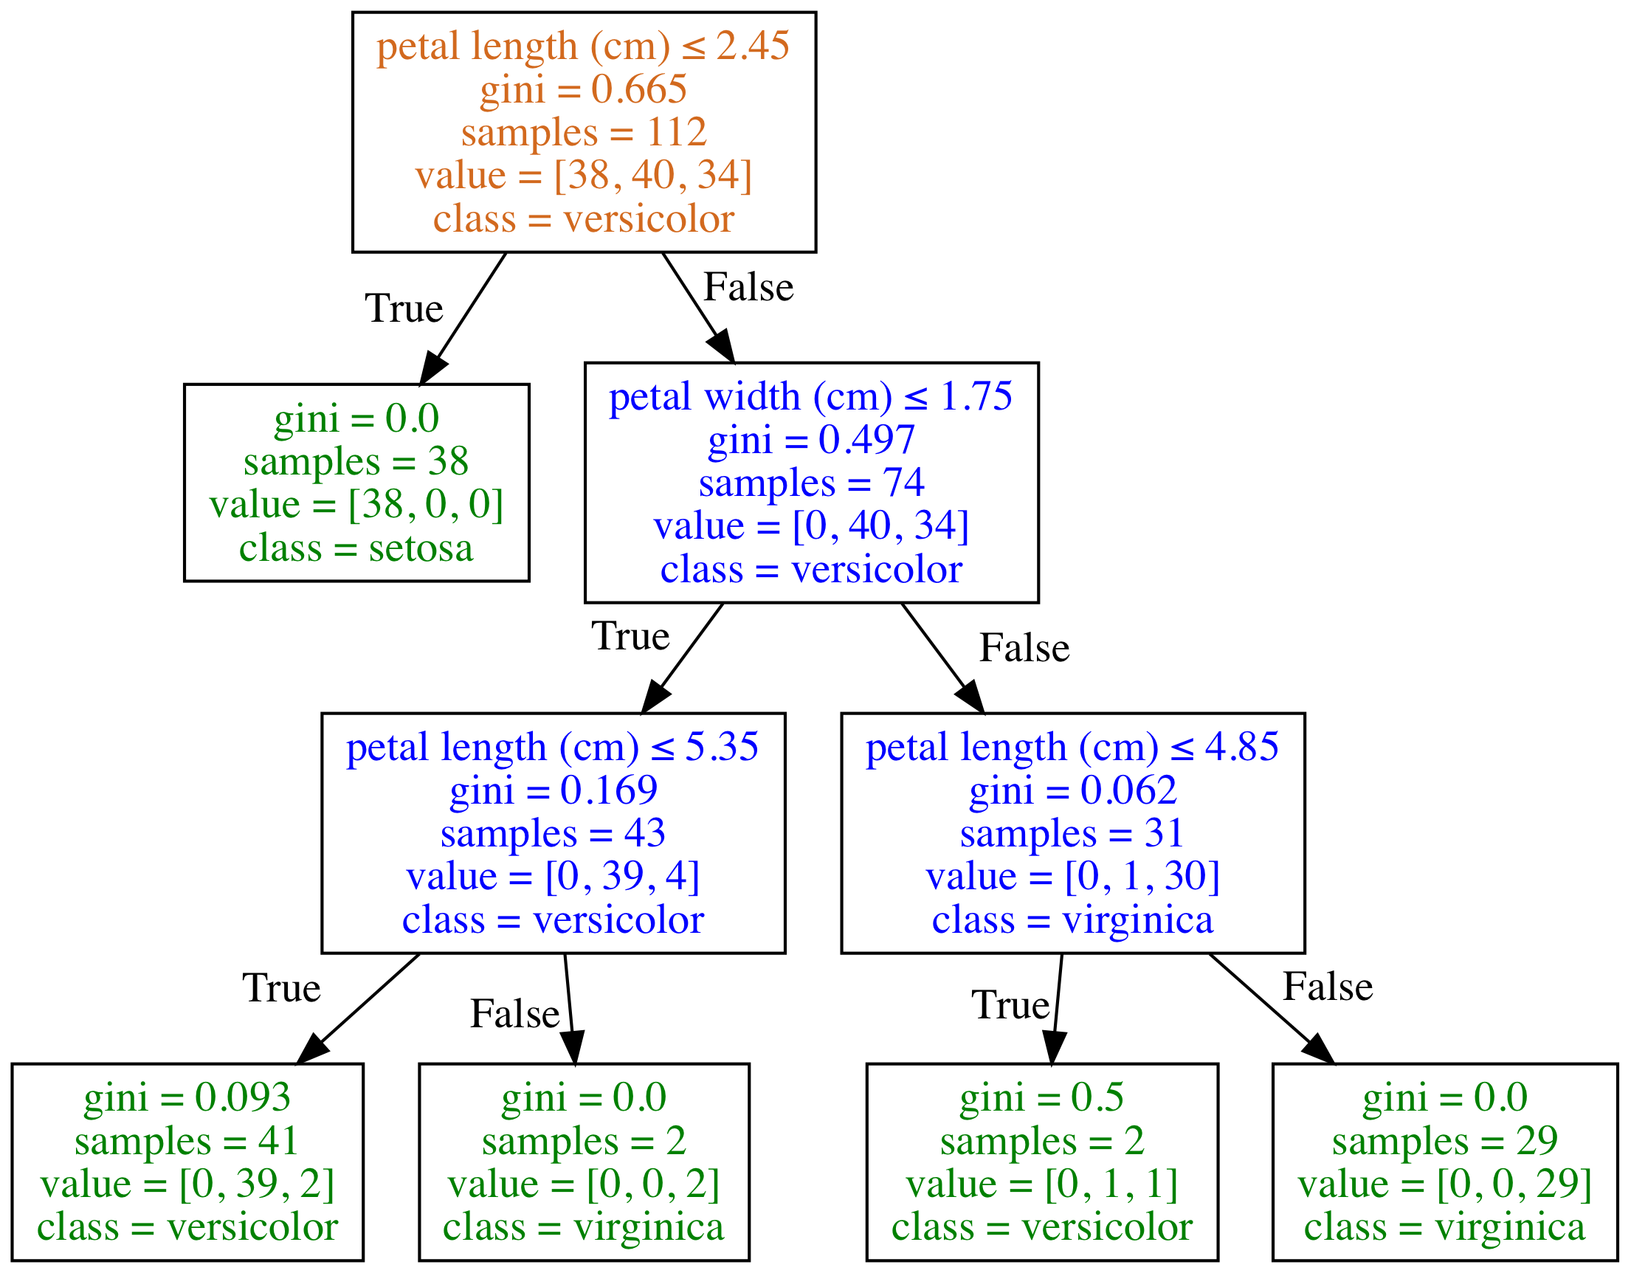
Depth of Classification Trees
Type of Node
Root Node
Decision Node
Leaf/Terminal Node
Depth = 1
Depth = 2
Depth = 3
Depth of Classification Trees
Type of Node
Root Node
Decision Node
Leaf/Terminal Node
Species counts are: setosa=0, versicolor=38, virginica=3
Prediction is versicolor as it is the majority class
Depth = 1
Depth = 2
Depth = 3

Slide 9
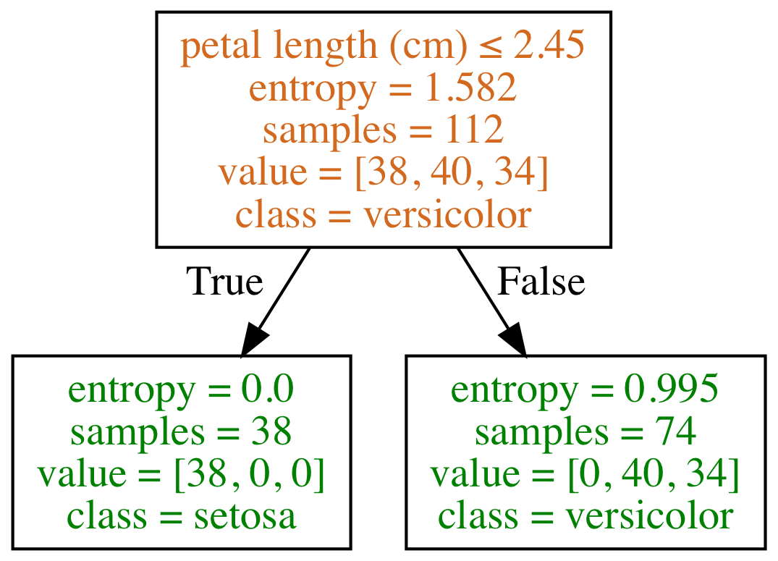
D
Type of Node
Root Node
Decision Node
Leaf/Terminal Node
criterion= 'gini'
criterion= 'entropy'
Depth = 3

Slide 10
a
a is the parent node of the child nodes b and c
b
c

Slide 11
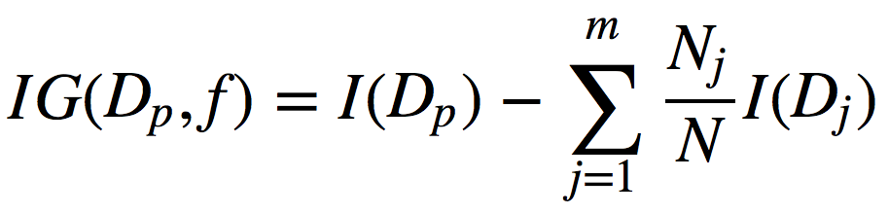
f: feature split on
D_{p}: dataset of the parent node
D_{j}: dataset of the jth child node
I: impurity criterion
N: total number of samples
N_{j}: number of samples at jth child node

Slide 12
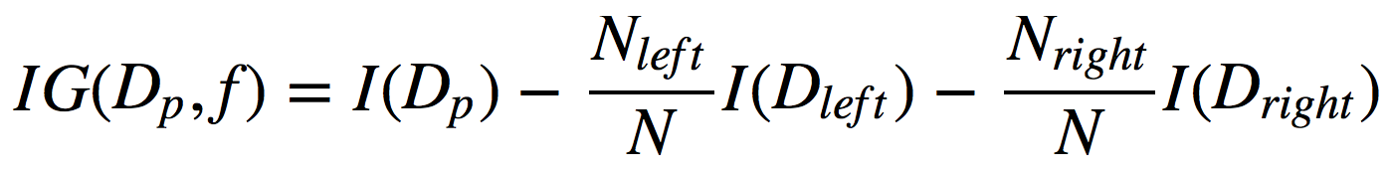
Information Gain
f: feature split on
D_{p}: dataset of the parent node
D_{left}: dataset of the left child node
D_{right}: dataset of the right child node
I: impurity criterion (Gini Index or Entropy)
N: total number of samples
N_{left}: number of samples at left child node
N_{right}: number of samples at right child node

Slide 13
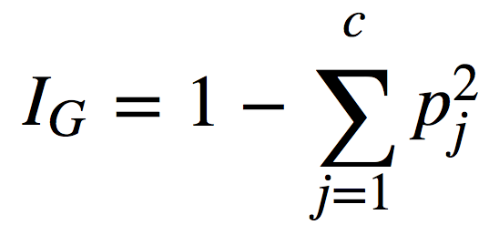
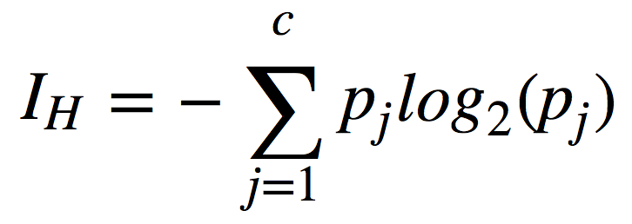
Impurity Criterion
Gini Index
Entropy
p_{j}: proportion of the samples that belongs to class c for a particular node
p_{j}: proportion of the samples that belongs to class c for a particular node.
*This is the the definition of entropy for all non-empty classes (p ≠ 0). The entropy is 0 if all samples at a node belong to the same class.

Slide 14
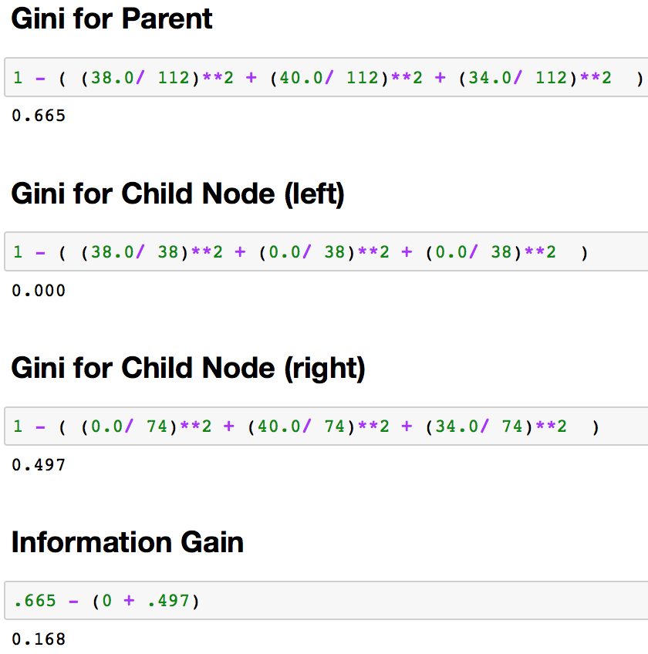
Gini Formula
Information Gain Calculation
Decision Tree
Information Gain
.665 – (0.000 + .497)
Notes:
Make a split at Some Really Wrong Point to show less information gain.
Look up which of them is better for what kind of split.

Slide 15
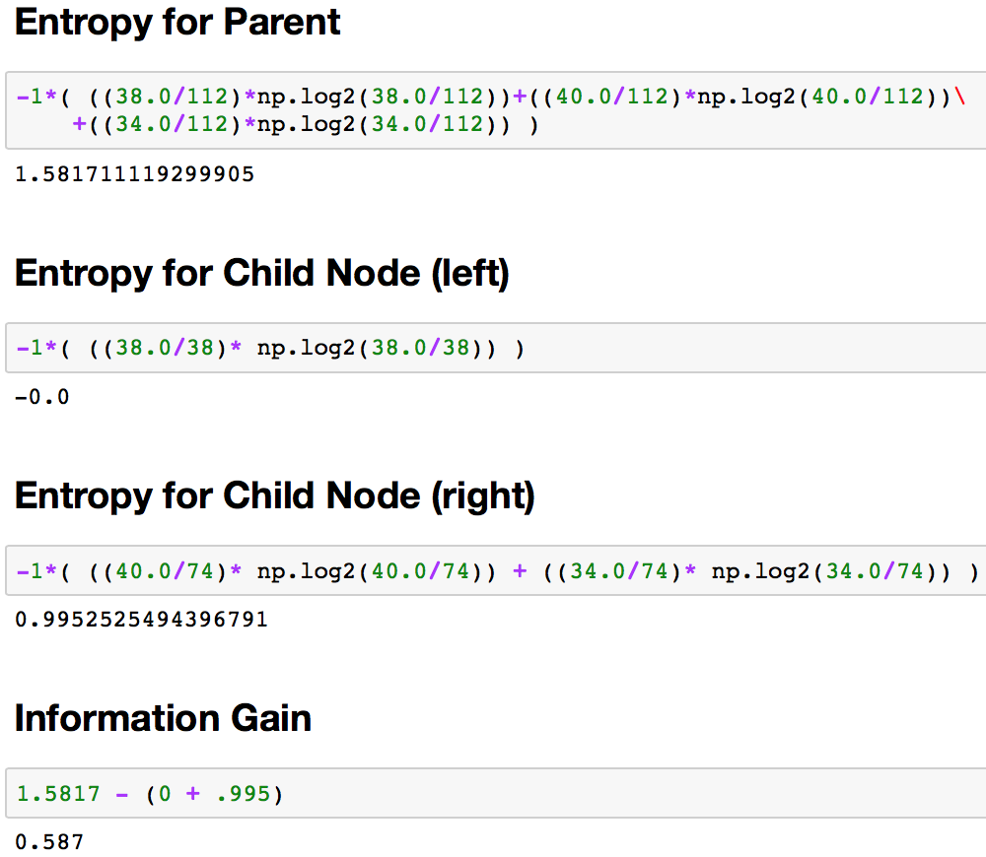
Entropy Formula
Information Gain Calculation
Decision Tree
Information Gain
.665 – (0.000 + .497)
Notes:
Make a split at Some Really Wrong Point to show less information gain.
Look up which of them is better for what kind of split.

Slide 16
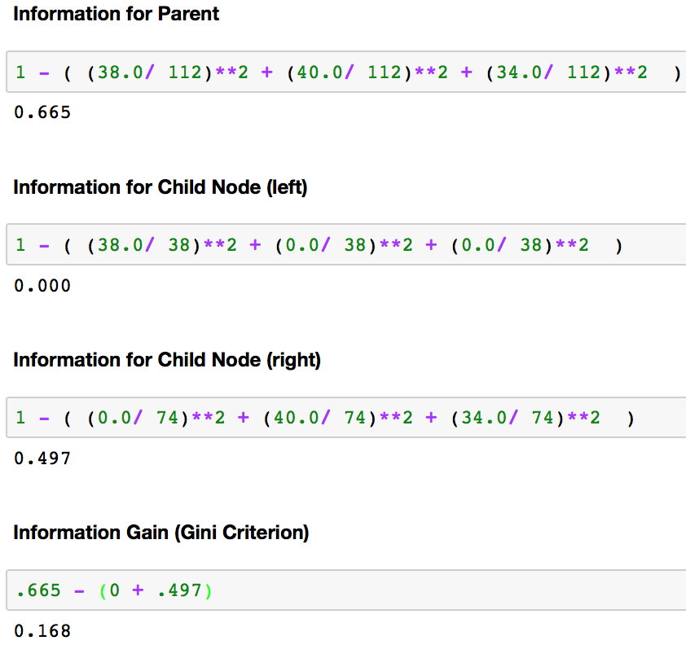

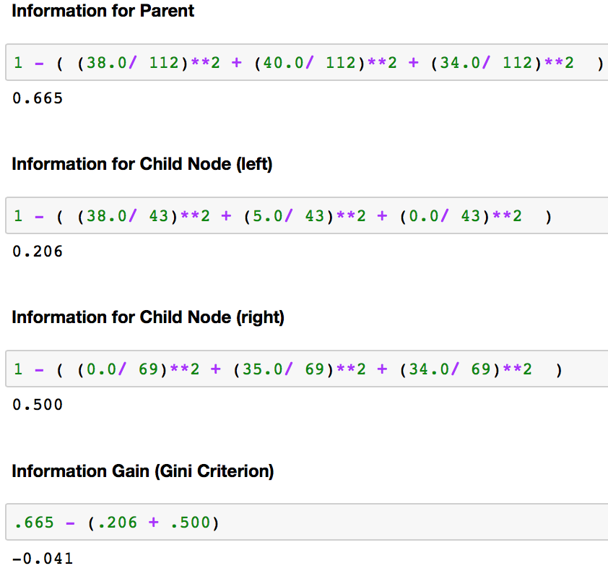
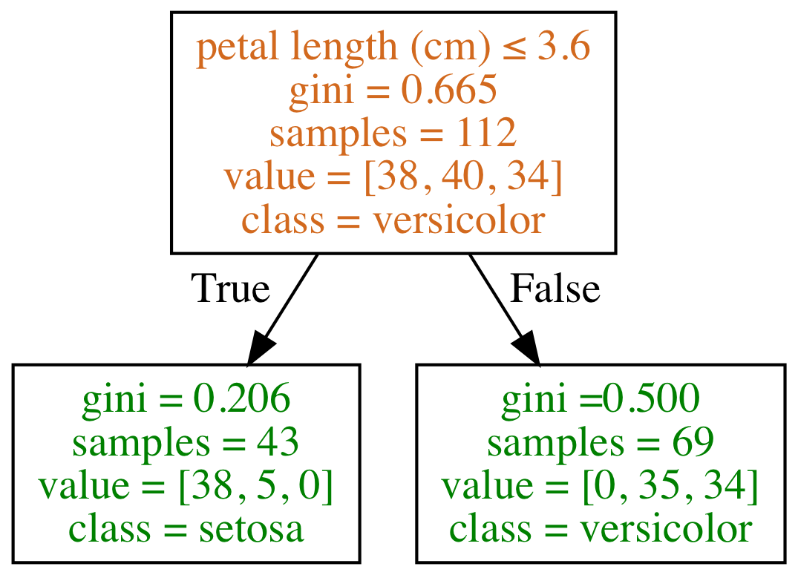
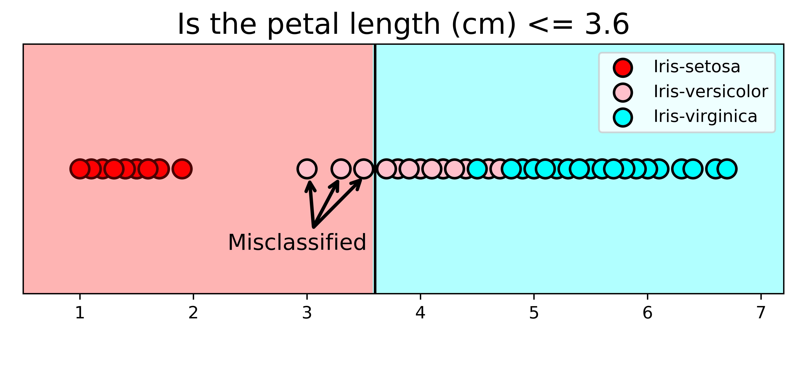
Splitting Scenario 2
(Note impossible with entropy via Kullback-leibler divergence, don’t bother fixing )

Slide 25
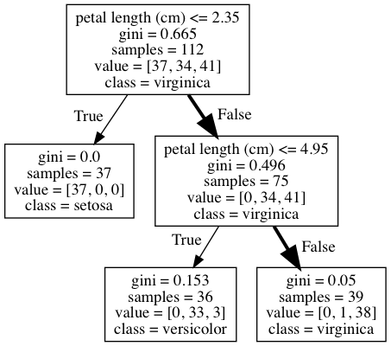
What class (species) is a flower with the following features?
sepal length (cm): 5.8
sepal width (cm): 2.8
petal length (cm): 5.1
petal width (cm): 2.4
The prediction is virginica as it is the majority class.

Slide 26
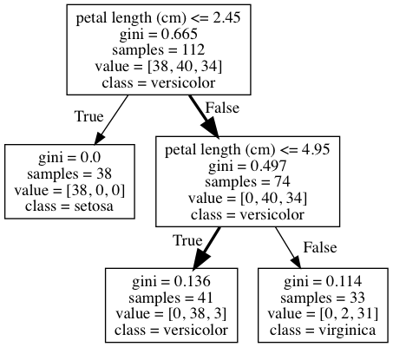
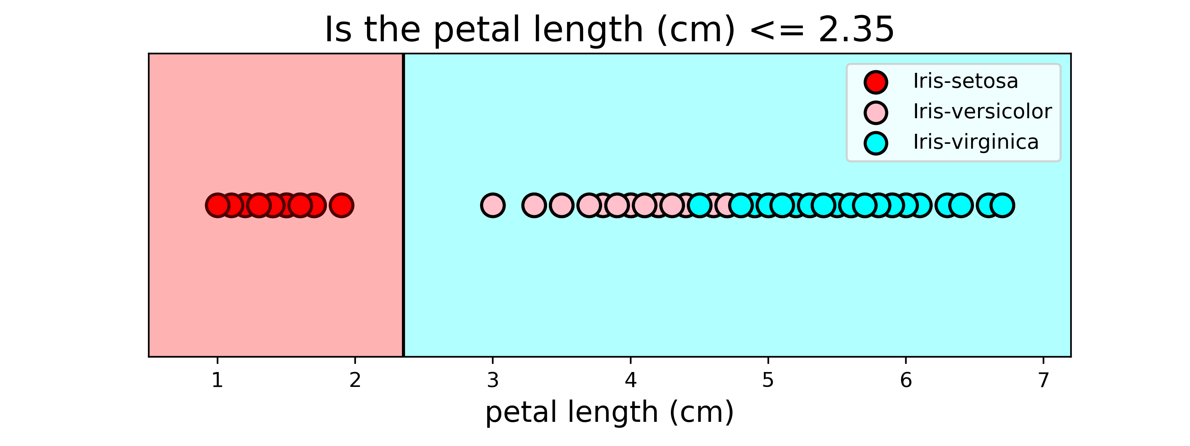

Slide 27
What class (species) is a flower with the following feature?
petal length (cm): 4.5
The prediction is versicolor

Slide 28
What class (species) is a flower with the following features?
sepal length (cm): 5.8
sepal width (cm): 2.8
petal length (cm): 5.1
petal width (cm): 2.4
The prediction is virginica as it is the majority class.

Slide 29
