Slide 1


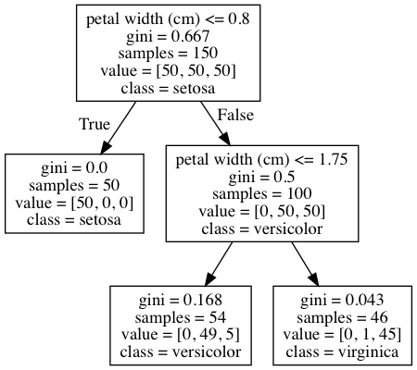
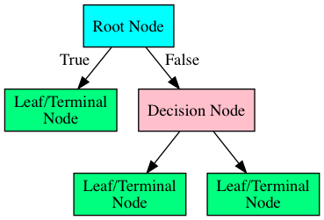
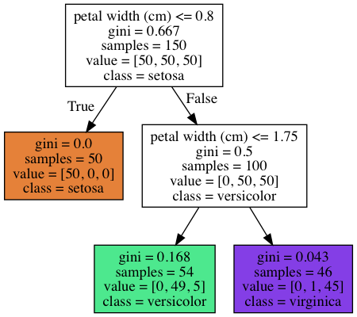

Slide 2

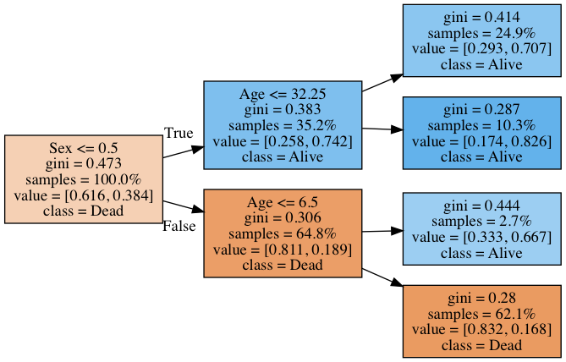
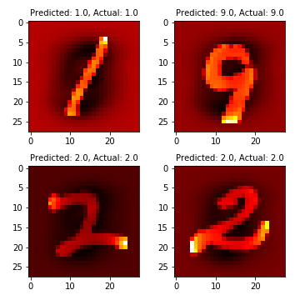
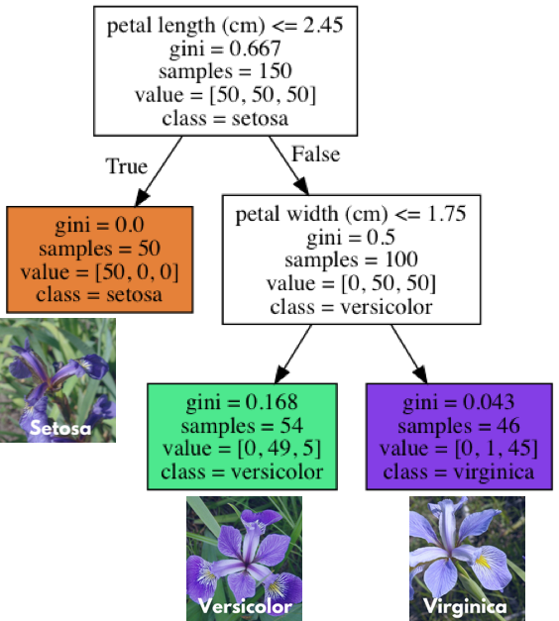

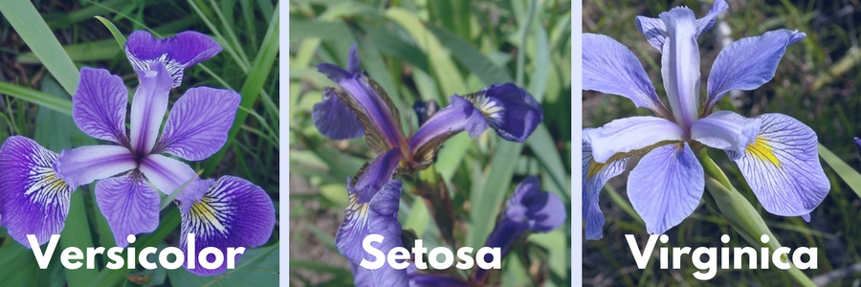

Slide 3
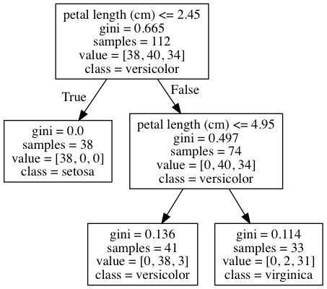

Slide 4
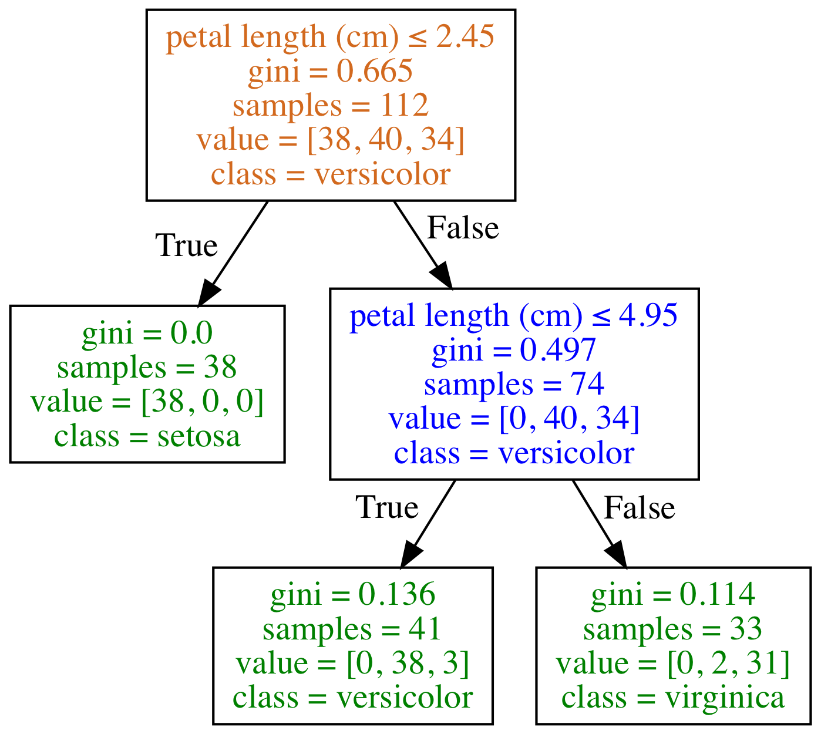
Type of Node
Root Node
Decision Node
Leaf/Terminal Node

Slide 5
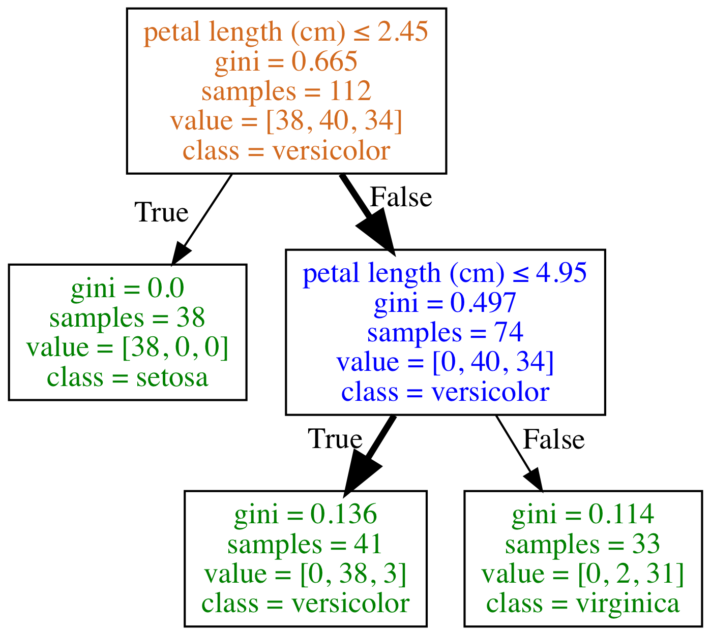
What class (species) is a flower with the following feature?
petal length (cm): 4.5
Type of Node
Root Node
Decision Node
Leaf/Terminal Node
Species counts are: setosa=0, versicolor=38, virginica=3
Prediction is versicolor as it is the majority class

Slide 6
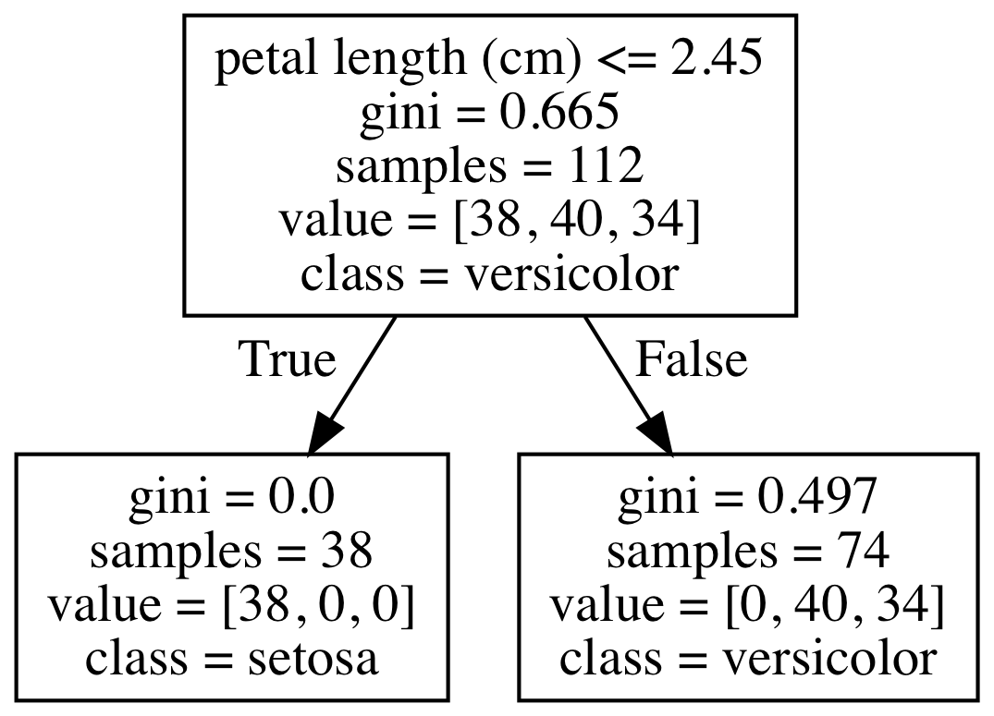
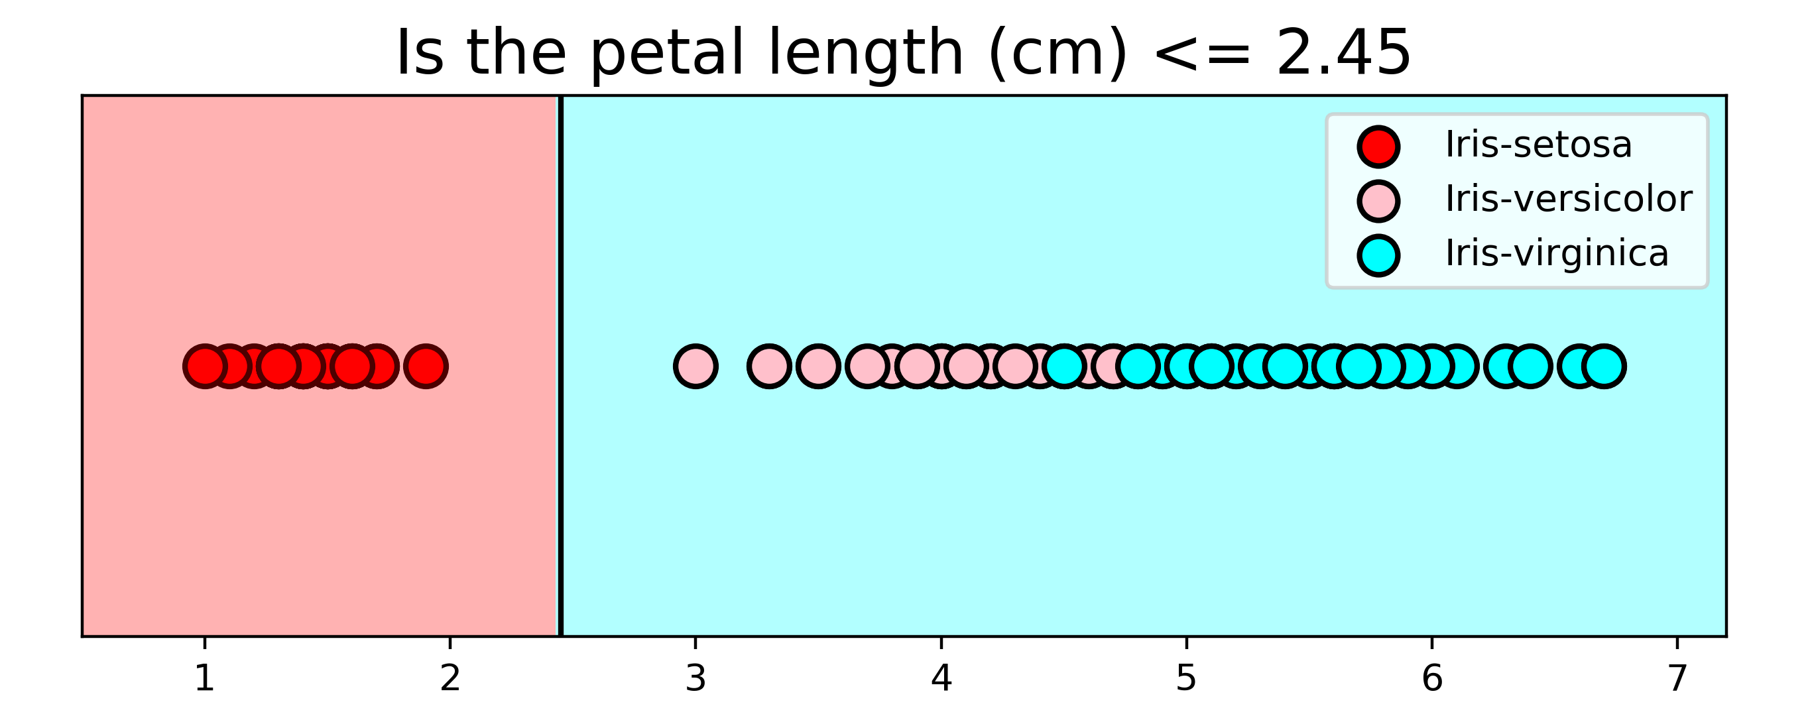
Classified as Setosa
Classified as
Virginica
Split Point = 2.45
Pure Node so no further splitting
Impure Node so can split further

Slide 7

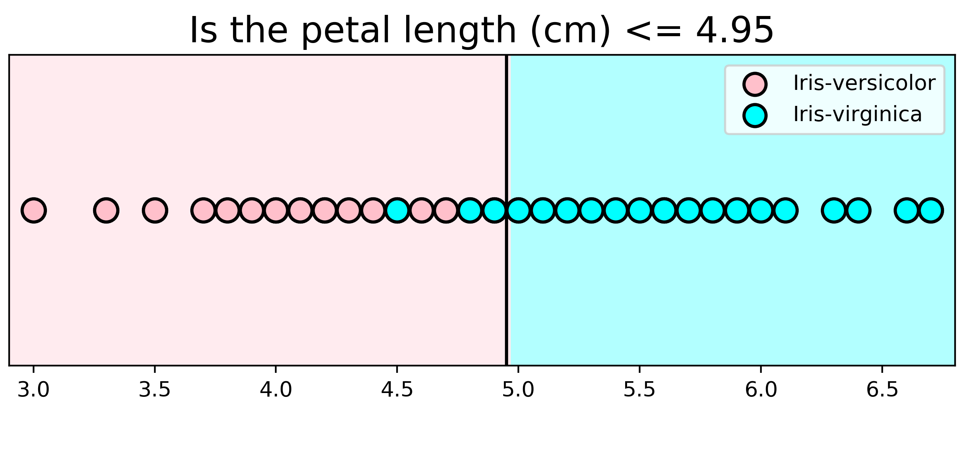
Classified as Versicolor
Classified as
Virginica
Split Point = 4.95
Impure Node so can split further
Impure Node so can split further
Classified as Setosa
Classified as
Virginica
Split Point = 2.45

Slide 8
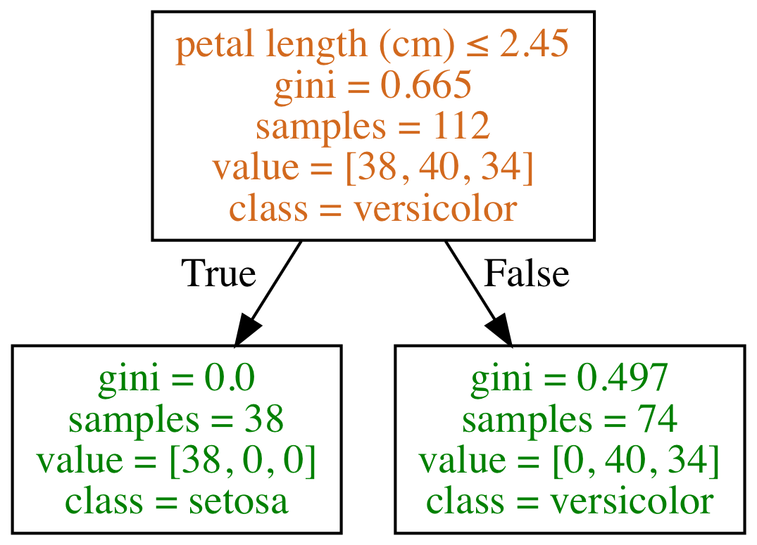
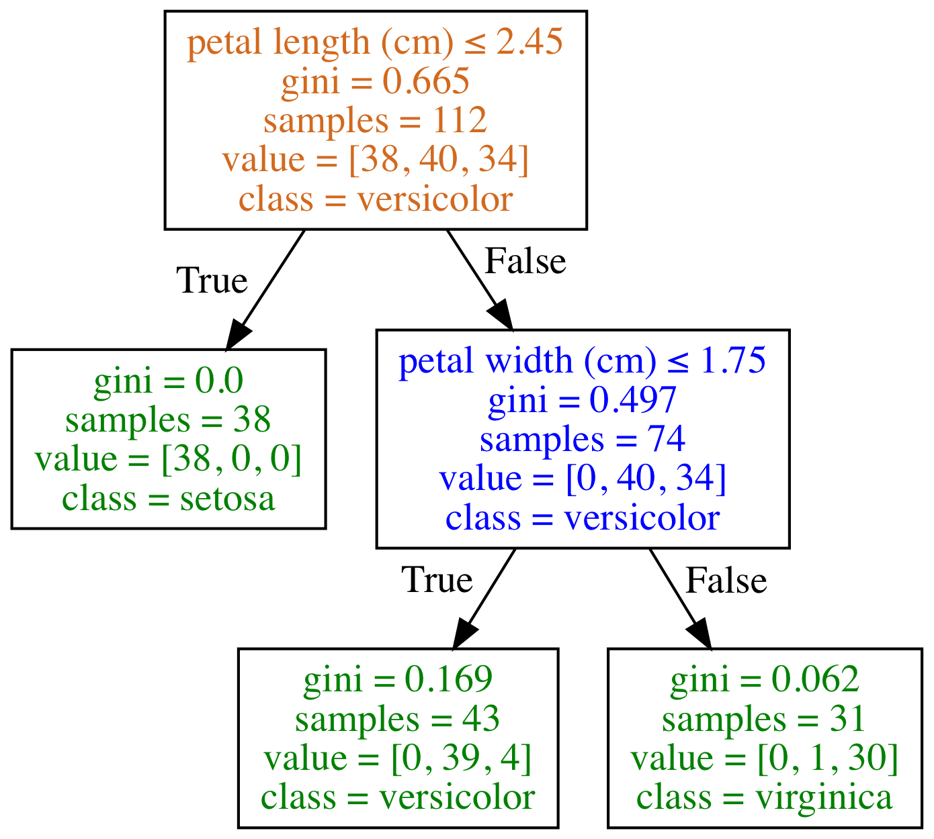
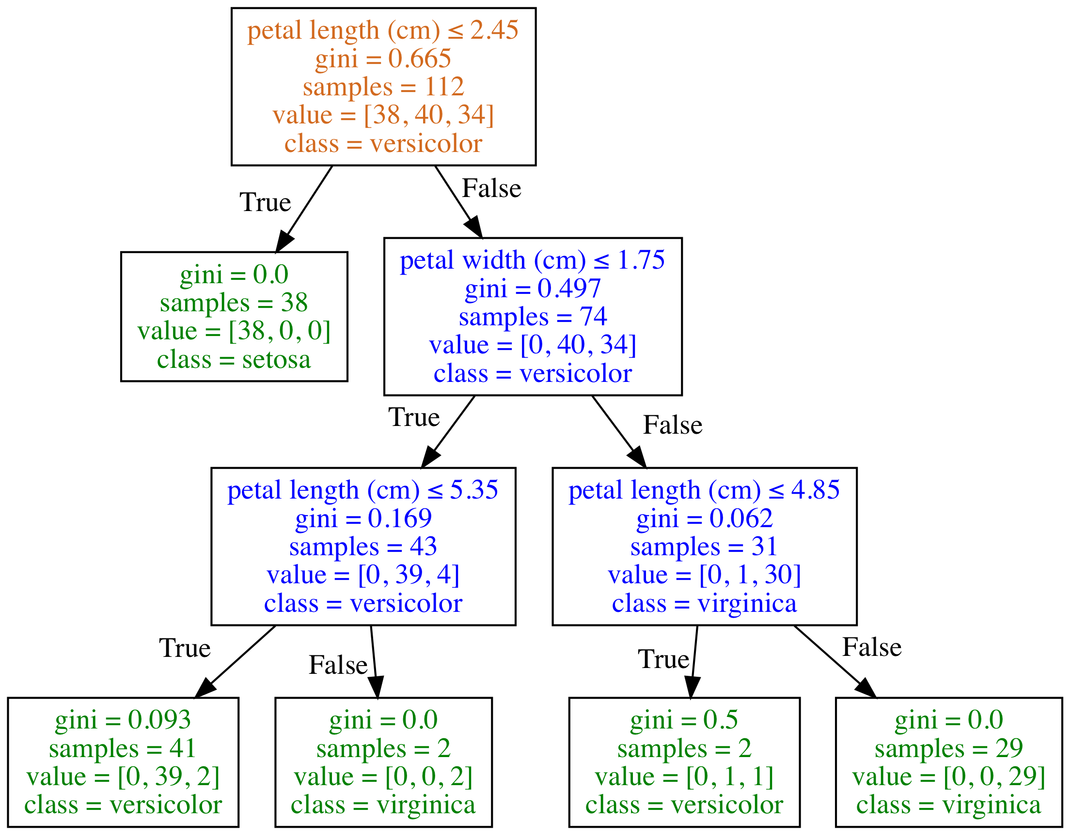
Depth of Classification Trees
Type of Node
Root Node
Decision Node
Leaf/Terminal Node
Depth = 1
Depth = 2
Depth = 3
Depth of Classification Trees
Type of Node
Root Node
Decision Node
Leaf/Terminal Node
Species counts are: setosa=0, versicolor=38, virginica=3
Prediction is versicolor as it is the majority class
Depth = 1
Depth = 2
Depth = 3

Slide 9
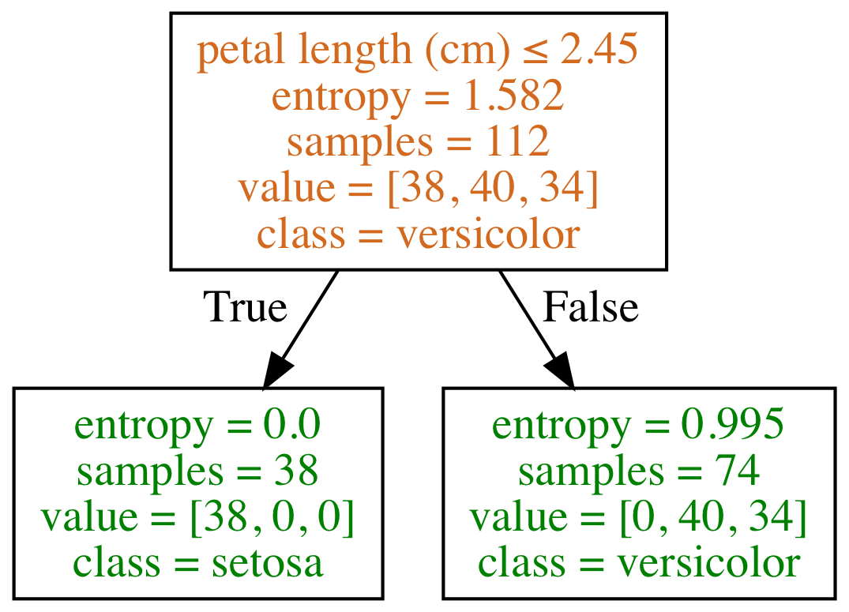
D
Type of Node
Root Node
Decision Node
Leaf/Terminal Node
criterion= 'gini'
criterion= 'entropy'
Depth = 3

Slide 10
a
a is the parent node of the child nodes b and c
b
c

Slide 11
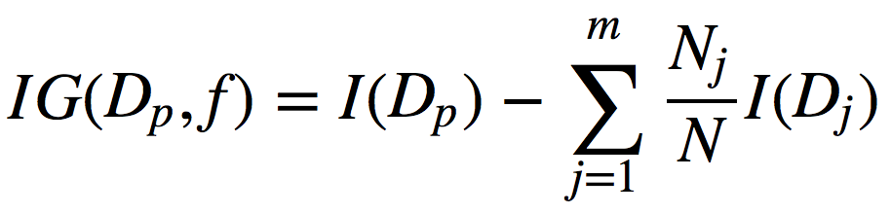
f: feature split on
D_{p}: dataset of the parent node
D_{j}: dataset of the jth child node
I: impurity criterion
N: total number of samples
N_{j}: number of samples at jth child node

Slide 12
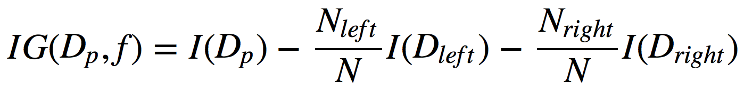
Information Gain
f: feature split on
D_{p}: dataset of the parent node
D_{left}: dataset of the left child node
D_{right}: dataset of the right child node
I: impurity criterion (Gini Index or Entropy)
N: total number of samples
N_{left}: number of samples at left child node
N_{right}: number of samples at right child node

Slide 13
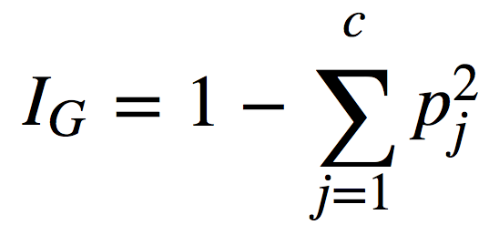
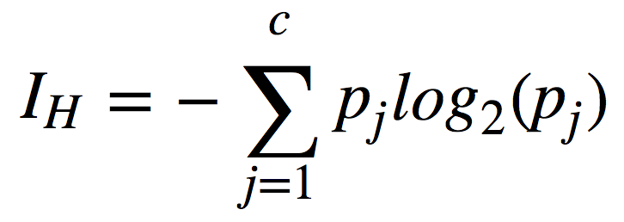
Impurity Criterion
Gini Index
Entropy
p_{j}: proportion of the samples that belongs to class c for a particular node
p_{j}: proportion of the samples that belongs to class c for a particular node.
*This is the the definition of entropy for all non-empty classes (p ≠ 0). The entropy is 0 if all samples at a node belong to the same class.

Slide 14
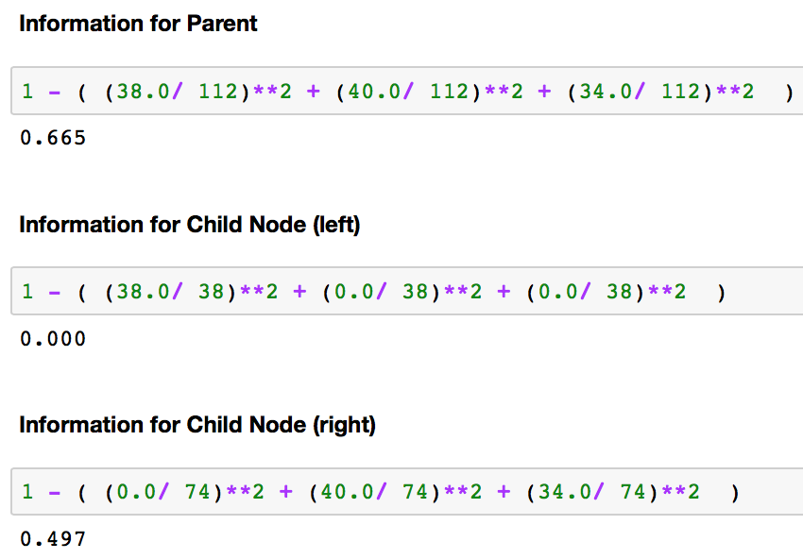
Information Gain
.665 – (0.000 + .497)
Notes:
Make a split at Some Really Wrong Point to show less information gain.
Look up which of them is better for what kind of split.

Slide 15
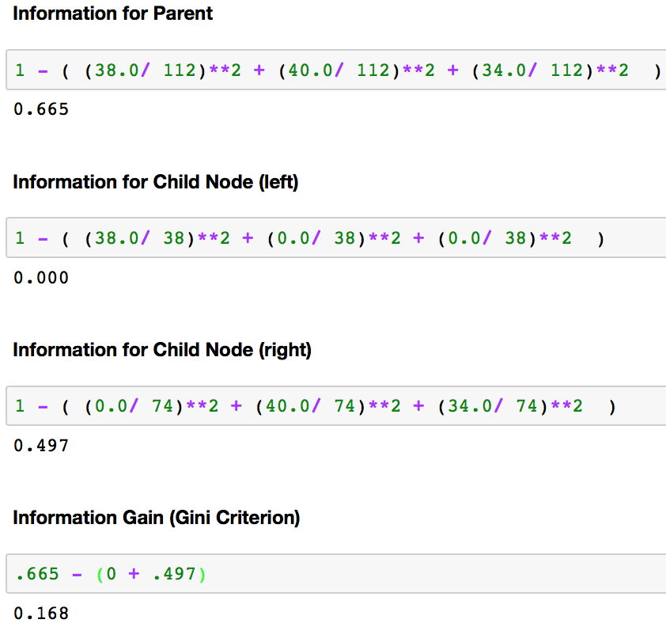

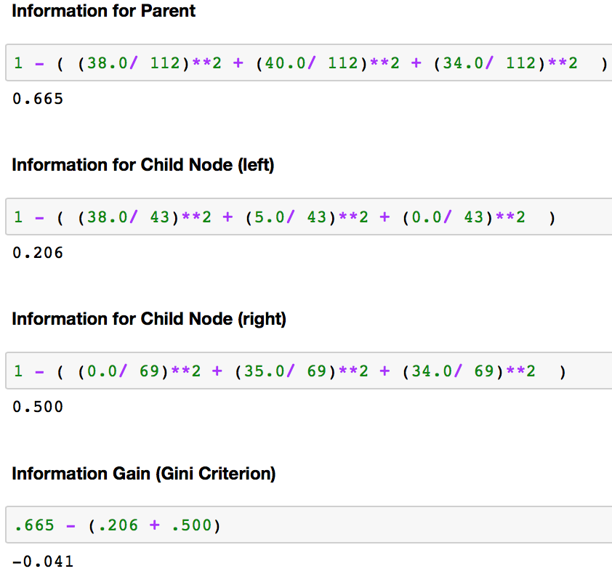
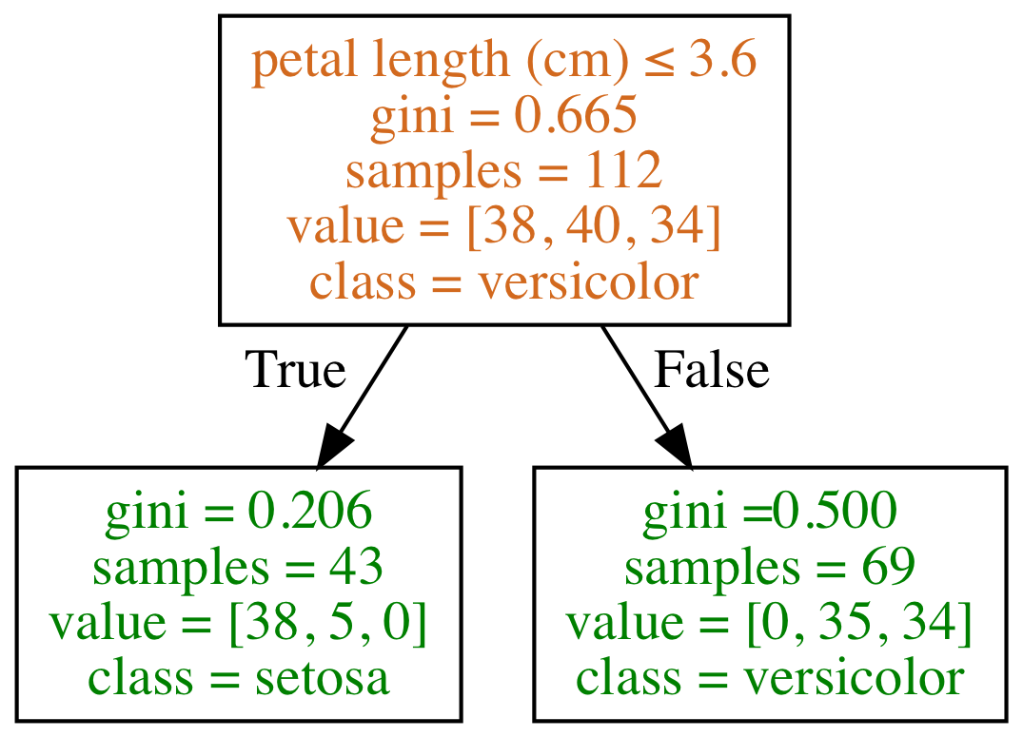
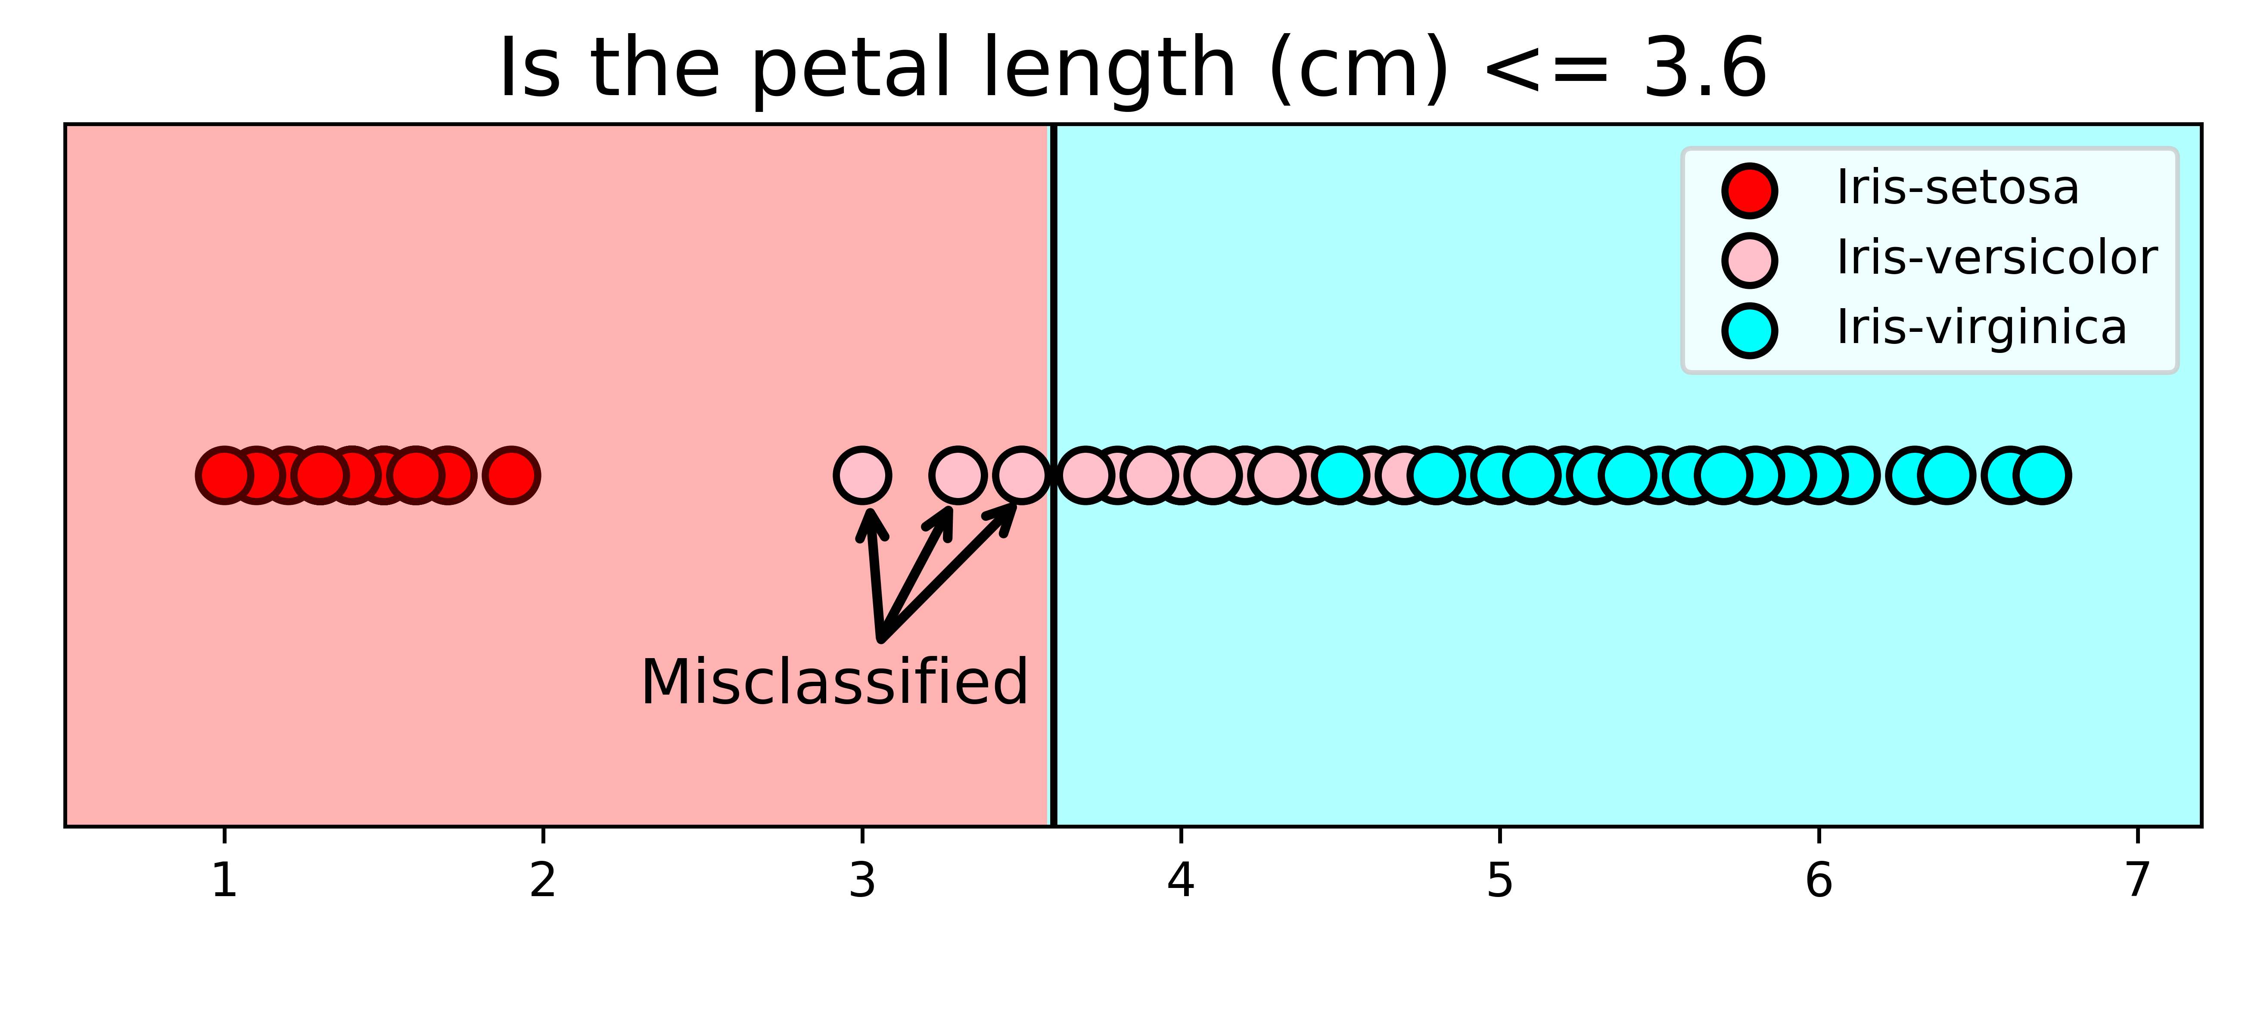
Splitting Scenario 2
(Note impossible with entropy via Kullback-leibler divergence, don’t bother fixing )

Slide 24
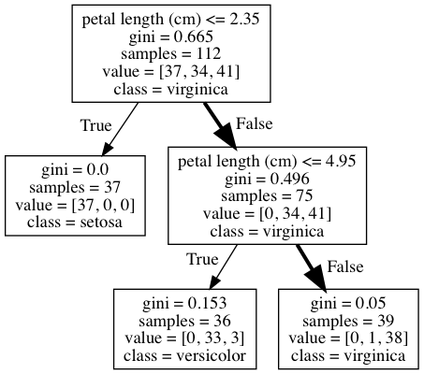
What class (species) is a flower with the following features?
sepal length (cm): 5.8
sepal width (cm): 2.8
petal length (cm): 5.1
petal width (cm): 2.4
The prediction is virginica as it is the majority class.

Slide 25
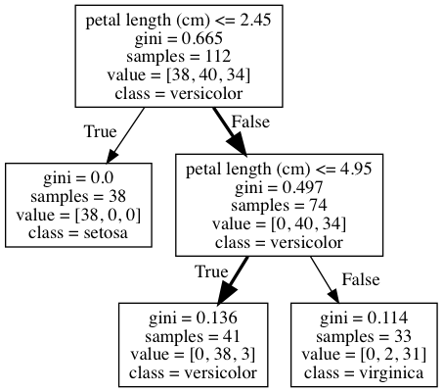
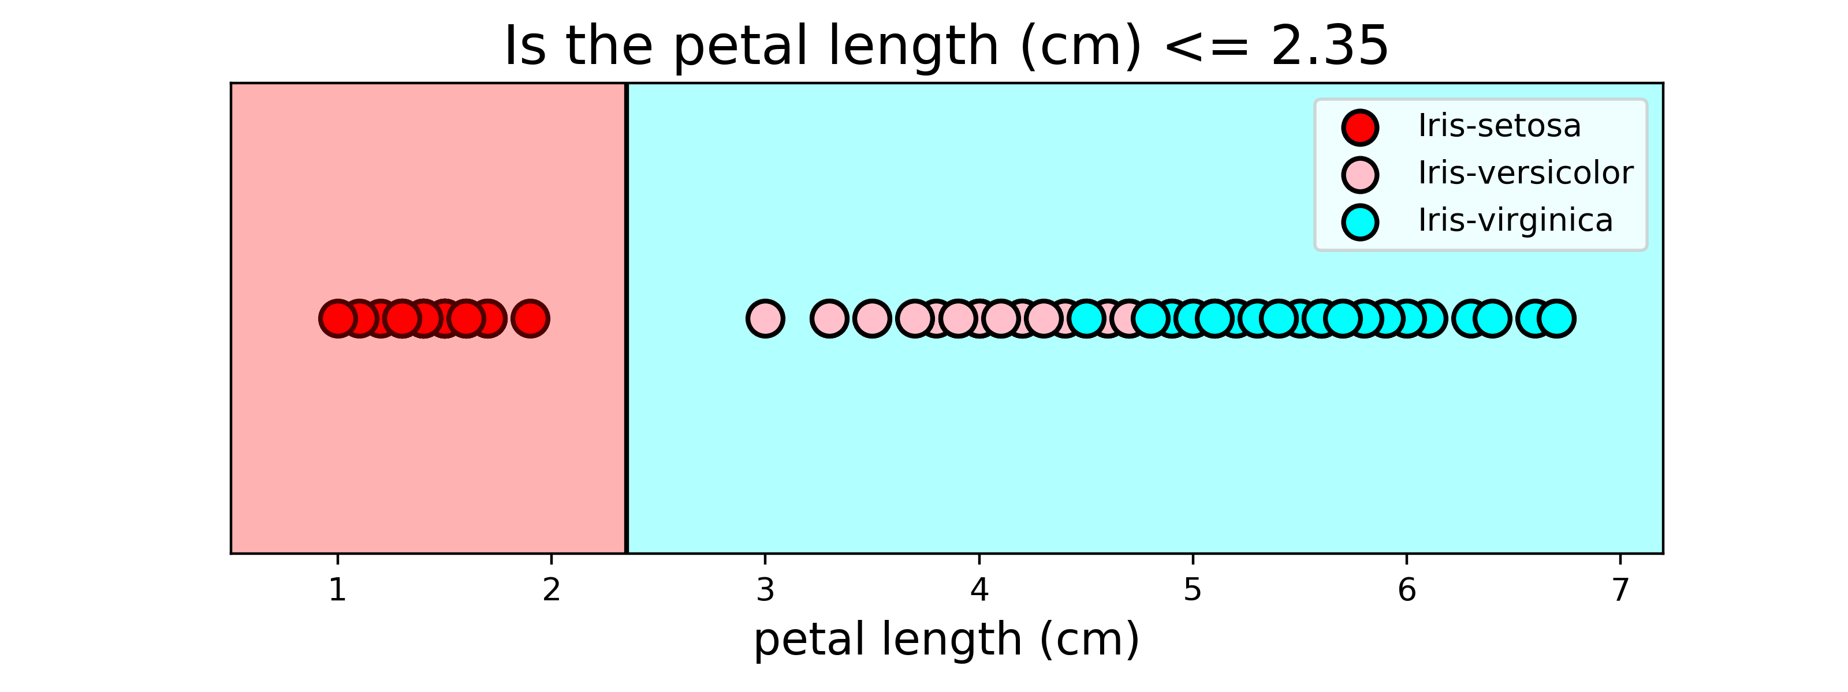

Slide 26
What class (species) is a flower with the following feature?
petal length (cm): 4.5
The prediction is versicolor

Slide 27
What class (species) is a flower with the following features?
sepal length (cm): 5.8
sepal width (cm): 2.8
petal length (cm): 5.1
petal width (cm): 2.4
The prediction is virginica as it is the majority class.

Slide 28
