Slide 1


2002 Toyota Sienna
2019 Toyota Sienna

Slide 2
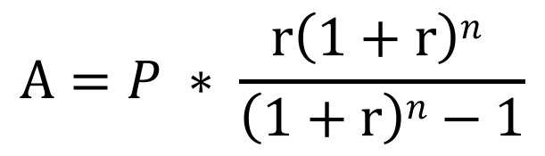
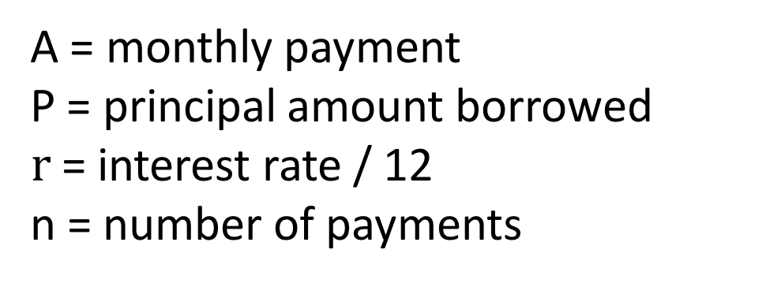
A = monthly payment
P = principal amount borrowed
$r$= interest rate / 12
n = number of payments
$$A=P ∗ \frac{r\left(1+r\right)n }{\left(1+r\right)n−1}$$

