Slide 1
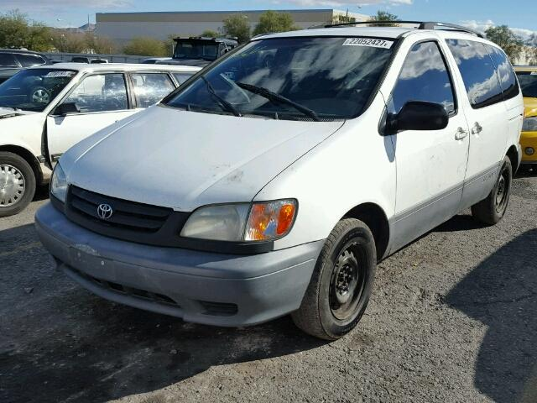

2002 Toyota Sienna
2019 Toyota Sienna

Slide 2
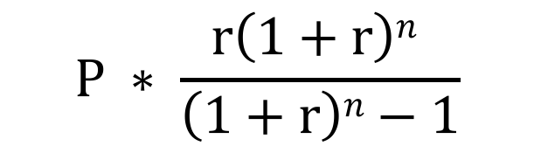
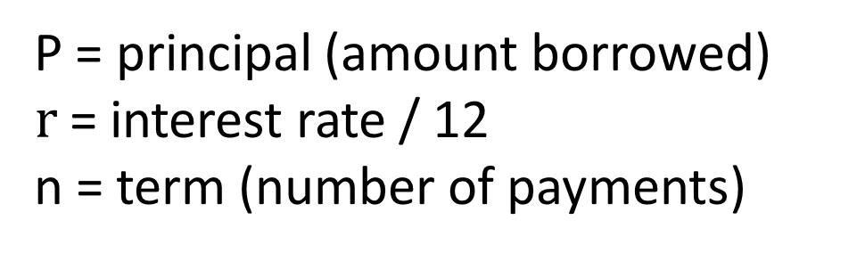
P = principal (amount borrowed)
$r$= interest rate / 12
n = term (number of payments)
$$P ∗ \frac{r\left(1+r\right)n }{\left(1+r\right)n−1}$$

Slide 3
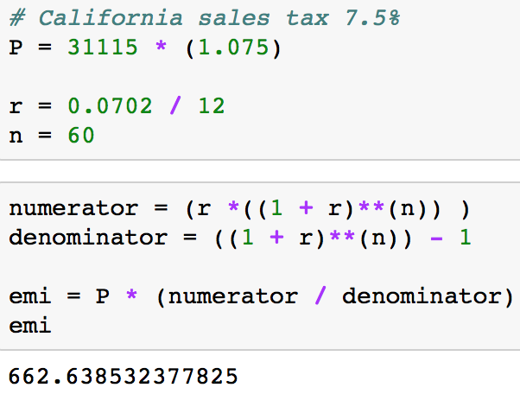
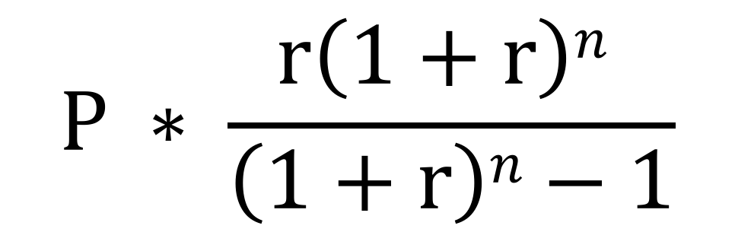
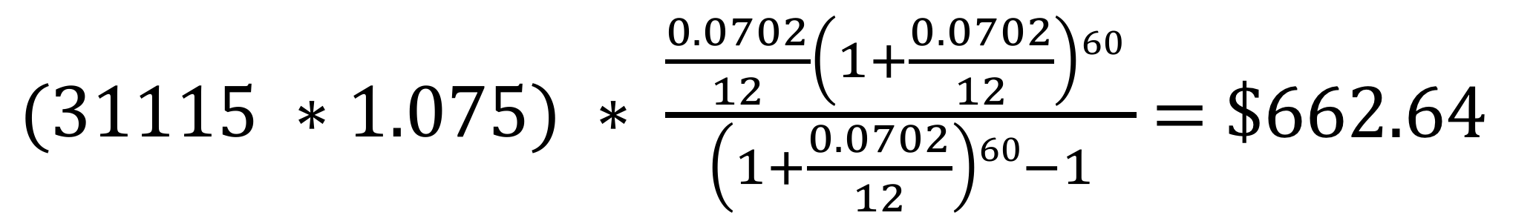
EMI Formula
Python Calculation
$$P ∗ \frac{r\left(1+r\right)n }{\left(1+r\right)n−1}$$
Calculation
$(31115 ∗1.075) ∗ \frac{\frac{0.0702}{12}\left(1+\frac{0.0702}{12}\right)60 }{\left(1+\frac{0.0702}{12}\right)60−1}$ = $662.64

Slide 4
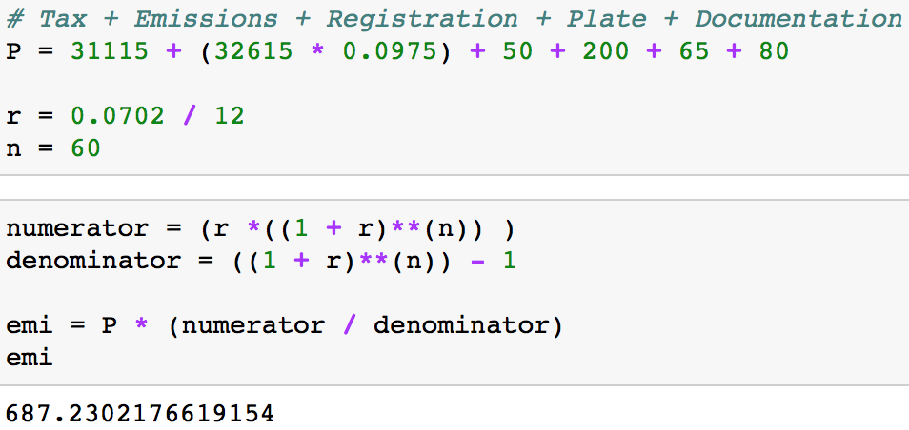

EMI Formula
Python Calculation
$$P ∗ \frac{r\left(1+r\right)n }{\left(1+r\right)n−1}$$
Principal Calculation
$\text{(}\text{31115 + }\text{(32615 * 0.0975 ) + (50 + 200 + 65 + 80) )}$ =
$∗ \frac{\frac{0.0902}{12}\left(1+\frac{0.0702}{12}\right)60 }{\left(1+\frac{0.0702}{12}\right)60−1}$ = $687.64

